Slide 1

Craft Breweries and Beers
Analysis and Recommendations for the Current Market
Notes:
Michel, Thank you for inviting me to perform this analysis and present it to you today. Respecting your 5-minute timeline, please hold your questions to the end and let’s get down to business.

Slide 2
INQUIRY
Introduction & Context
Brewing Technology
Growth of Craft Beers
Corporate Goal : 20% of our global beer volume to zero or near-zero ABV by 2025
Market: Consolidation & Partnerships
Notes:
Our newest process, ZERO, produces an identical-tasting, low-alcohol alternative to the original beer. This new process positions us to surpass our corporate goal of making 20% of our beverages zero or near-zero alcohol by 2025. A-B’s current American portfolio remains heavily weighted in lighter styles that are easy to drink. The question is, what beverages should we bring to market with this new technology?
Among craft beers, the IPA dominates.
The bitter taste profile and the higher alcohol content make the IPA well-suited to the ZERO process. We recommend securing market share through partnership with an large, established craft brewery, as our American competitors, Heineken and Molson-Coors, already have. This partnership will credibly round out our taste portfolio and set us up to introduce low-alcohol versions to market.
Let’s dig into the data.

Slide 3
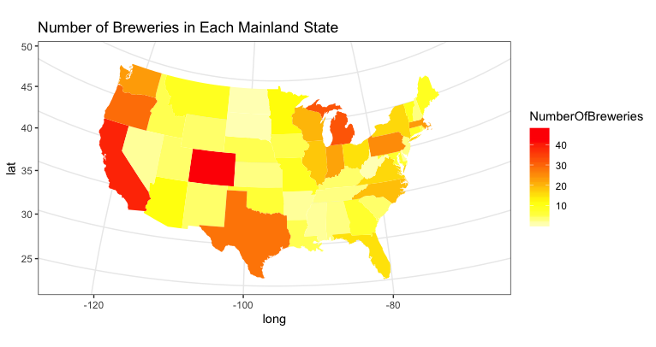
Craft Breweries
Total Breweries 551
Breweries per state
Range: 47 (Colorado) to 1 (DC, Dakotas, West Virginia)
Median: 7 Breweries per state
75% of states have between 3.5 and 16 breweries
Notes:
This heat map reflects the concentration and variability of the 551 craft breweries across the United States. Colorado leads the way with 47 breweries, followed by a solid west coast, and predictably beer-loving states like Michigan, Texas and Pennsylvania following suit. Four states have one brewery apiece, and No state is beer free. The median number of breweries per state is 7.
On the next slide

Slide 4
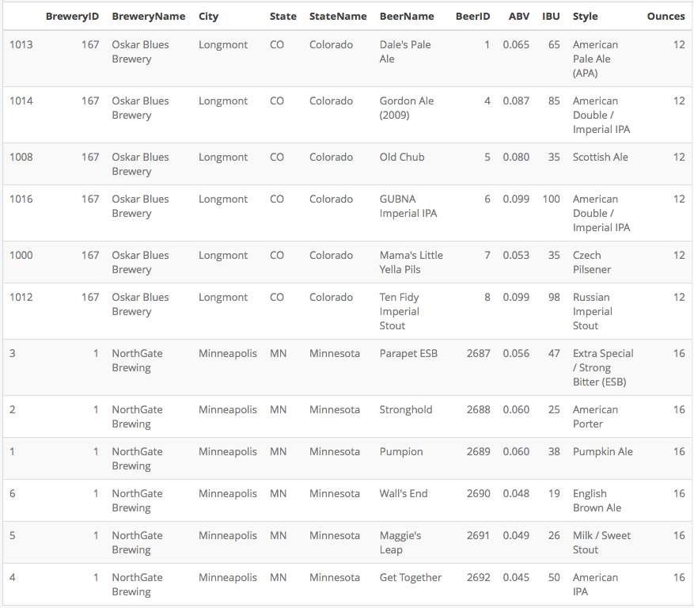
Craft Beers
Total Beers 2410
Ordered by Beer ID, first 6 and last 6 beers each come from the same brewery
Max beers per brewery 62 beers
120 Breweries produce only 1 beer each
Median: 3 beers per brewery
Notes:
we look at the beers these breweries produce. Two thousand four hundred and ten craft beers are produced within the United States. The median number of beers per brewery is 3. But if we take a deeper look, that is also quite variable. One brewery produces 62 of these beers, while 120 breweries produce only 1 beer each.
Some notes about the data

Slide 5
Craft Beers Data - issues
Dataset contains 2410 beers produced by the 551 craft breweries
Some beers have multiple entries marked with different years – possibly due to reformulation
62 beers are missing both ABV and IBU data
943 beers missing IBU data only
Some missing data could be imputed if justified by a further study
Notes:
Some beers have multiple entries marked with different years – possibly due to reformulation.
We did not analyze reformulations for this presentation but feel it is a good idea to vet these before the next steps.
62 beers are missing ABV and IBU data, and another 943 beers are missing IBU data alone. Some missing data could be imputed if justified by a further study
That said, now lets look at the beers.

Slide 6
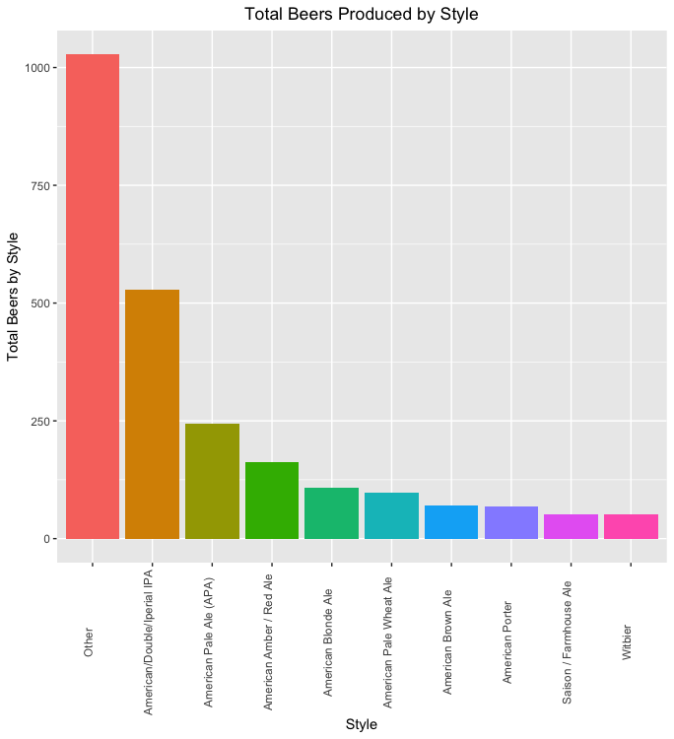
Craft Beer Styles
Ten beer styles account for 50% of the craft beers made in America
“Other” style is comprised of 90 different styles, each with fewer than 50 beers of its type
IPA styles lead the market with 574 beers, 23.8% of craft beers brewed
American Pale Ales with IBU > 40 also fall into IPA category, adding another 90 beers – increasing the share to 27.6%
Of the 120 breweries that produce only one beer each, 50 of those produce an IPA varietal
Opportunity: America loves bitter beer
Notes:
Ten beer styles account for half of the craft beers made in America
This first column of “Other” is comprised of 90 different styles, each with fewer than 50 beers of its type
IPA varietals have a 23.8% market share. American Pale Ales with IBU > 40 could easily be classified as IPAs. Including these increases share to 27.6%
One TELLING Statistic- Of the 120 breweries that produce only one beer each, 50 of those choose to produce an IPA varietal or APA
Americans loves bitter beer
But what is an IPA?

Slide 7
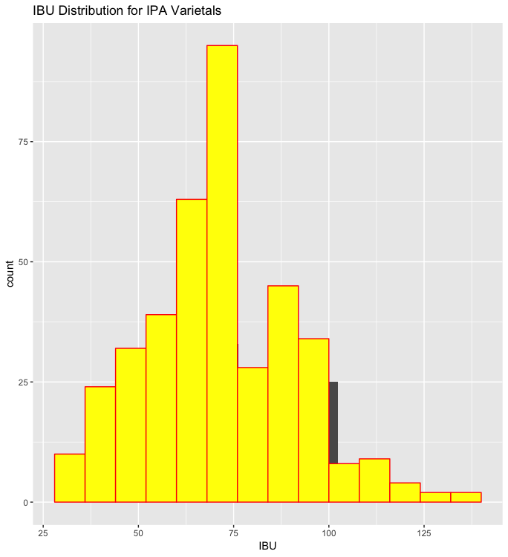
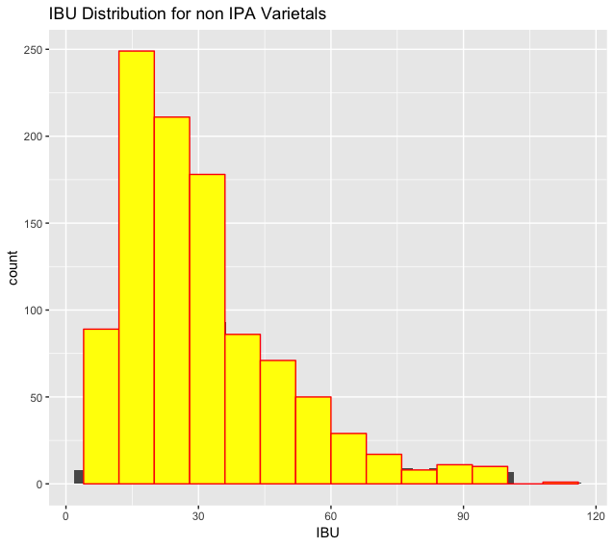
IBU Comparisons
IBU distributions for IPA styles versus non-IPA styles show that
IPA median IBU is 70 units
Other varietal median IBU is 27 units
A-B players: Budweiser registers 12 IBU and Bud Light registers 27 IBU
Opportunity: Current A-B InBev beers fall in the bottom half of the IBU distribution
Notes:
IPA is defined in part by higher IBU and you can see the distribution of IPA IBU ratings versus non-IPA varietals
IPA median IBU is 70 units
Other varietal median IBU is 27 units
By comparison to our best-sellers, Bud Light registers 27 IBU and Budweiser registers only 12

Slide 8
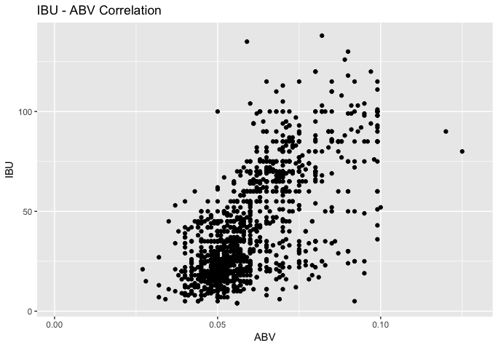
ABV – IBU Relationship
A plot of all beers reveals a positive correlation between IBU and ABV
Correlation between IBU and ABV is
.67
As ABV increases, IBU variability also increases
Opportunity: High IBU beers usually have high ABV
Notes:
Here we see the cloudy, dare I say bitter, relationship between ABV and IBU with a positive correlation of .67.
Also note that the IBU RANGE increases as ABV increases.
High IBU beers usually have higher ABV! But how does this play out across the country?

Slide 9
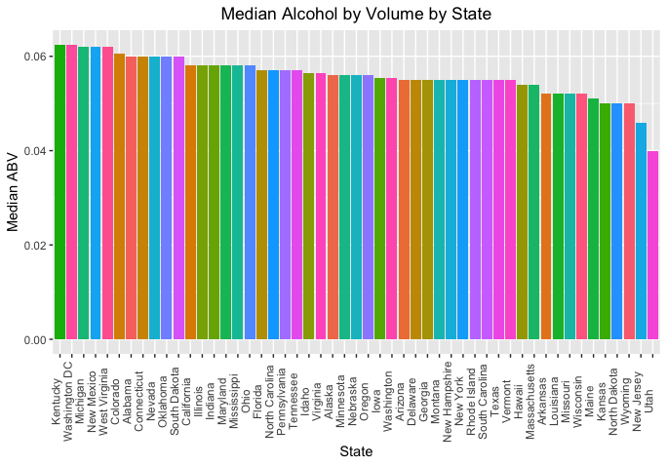
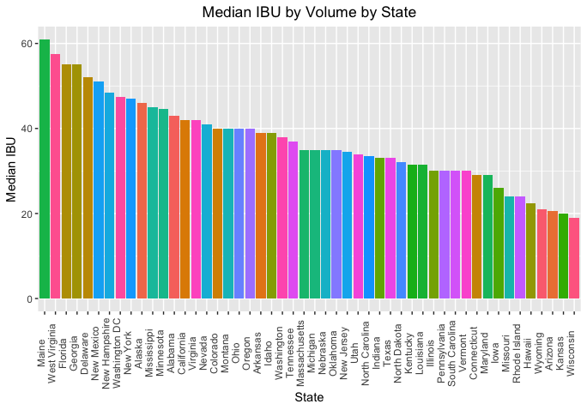
ABV & IBU Medians by State
Median ABV is relatively consistent
Range : 4% (Utah) - 6.25% (Kentucky & Washington DC, tie)
75%: 5.5% - 5.8%
Median: 5.6%.
Colorado produces the single highest ABV at 12.8%
Median IBU is relatively broad
Range: 19 units (Wisconsin)
- 61 units (Maine)
75%: 42 – 75 units
Median: 35 units.
Oregon produces the single most bitter beer at 138 IBU
Notes:
State to state, Median ABV is relatively consistent
between: 4% in Utah to 6.25% in Kentucky & Washington DC
With an overall median of: 5.6%.
on the other hand, there is a broad variability in Median IBU With a low of 19 units in (Wisconsin) to a high of 61 units in (Maine)
With an overall Median of 35 units.
Fun Fact: Oregon produces the single most bitter beer at 138 IBU, but science has shown that human taste buds cannot register IBU over 100, so this is more of a cache status, than a craft.

Slide 10
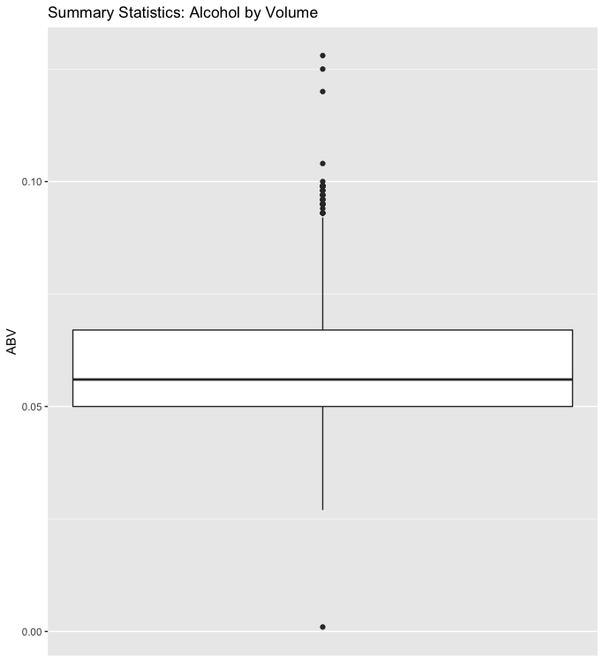
ABV – Summary
ABV across all data are much broader
Range: 0.1% - 12.8%
75%: 5% - 6.7%
Median: 5.6%
Mean: 6.0%
ABV for IPA
Range: 2.7% - 9.9%
75%: 6.2 % - 7.5%
Median: 6.8%
Mean: 6.9%
Opportunity: Craft breweries are producing lots of IPA, but none of them can produce it with low ABV
Notes:
Digging deeper into ABV, we see much greater variability across individual beers, with a Range: 0.1% - 12.8%, with 75% of these falling between 5%-6.7%
ABV for IPA is a bit higher, as we’d expect, with a Median of 6.8%
Craft breweries are producing lots of IPA, but none of them can produce it with low ABV

Slide 11
Opportunity
Opportunities
Americans loves complex, bitter beers
A-B InBev beers fall in the lower half of the IBU distribution
Craft breweries are producing lots of IPA, but none of them can produce it with low ABV
Global increase in demand for zero- and low-ABV beverages
Patented ZERO process
Challenges
IPA development is slow
Market is discerning/fickle
It is much easier to penetrate the craft market through partnership than through in-house development
Recommendation
Partner with a strong established brewer that has a notable (award-winning?) IPA and a portfolio of strong contenders
Notes:
To recap the opportunities, the American market devours IPA, A-B America needs to expand its taste portfolio, and there are many craft breweries producing beers that could compliment our portfolio of offerings and set us up to create new, non-alcoholic offerings with our ZERO process.
We know from experience it is much easier to penetrate the market through partnership, and our competitors have already done this such as Heineken partnership with Lagunitas IPA

Slide 12
Next Steps
Analyze beers and breweries to find best fit partner
Beer portfolio analysis by brewery
HR studies of brewery core values
Production expansion analysis
Logistics
Real state
Tax incentives
Notes:
Next steps to follow this recommendation would be to Analyze the dataset for for the best fit partner, including beer portfolio analysis of each brewery, including sales data. An HR analysis of the short list for breweries sharing our core values, and production expansion analysis for logistics, real estate and state tax incentives.
Thank YOU for your time!
Questions?

Slide 13
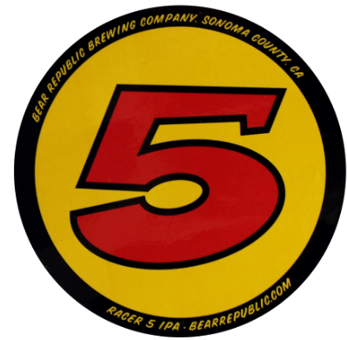
Closing Reel - Teaser
Great taste shouldn’t slow you down
MACH
Fast. Not faded.
Drink Wiser

