Slide 2
Day 2: Advanced survival course
Flexible parametric survival models (continued)
Nicole De La Mata

Slide 3
Overview
Brief overview: Competing risks in flexible parametric survival
Worked example:
Data preparation
Fitting flexsurvspline
Cumulative hazard
Probability of events
Data exercise

Slide 4
Concepts

Slide 5
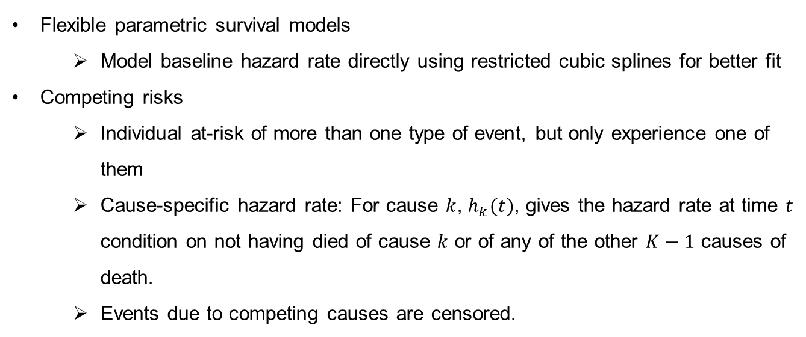
Recap
Flexible parametric survival models
      Model baseline hazard rate directly using restricted cubic splines for better fit
    Competing risks
      Individual at-risk of more than one type of event, but only experience one of them
      Cause-specific hazard rate: For cause $k$, $h_{k}(t)$, gives the hazard rate at time $t$ condition on not having died of cause $k$ or of any of the other $K−1$ causes of death.
      Events due to competing causes are censored.
Notes:
Implement using flexsurv package in R

Slide 6
Competing risks scenario
1
Death, cause 1
0
Alive
….
k
Death, cause k
Competing risk model with k causes of death

Slide 7
Flexible parametric survival models for competing risks
We can apply flexible parametric survival models using same approach.
Notes:
Implement using flexsurv package in R

Slide 8
Worked example

Slide 9
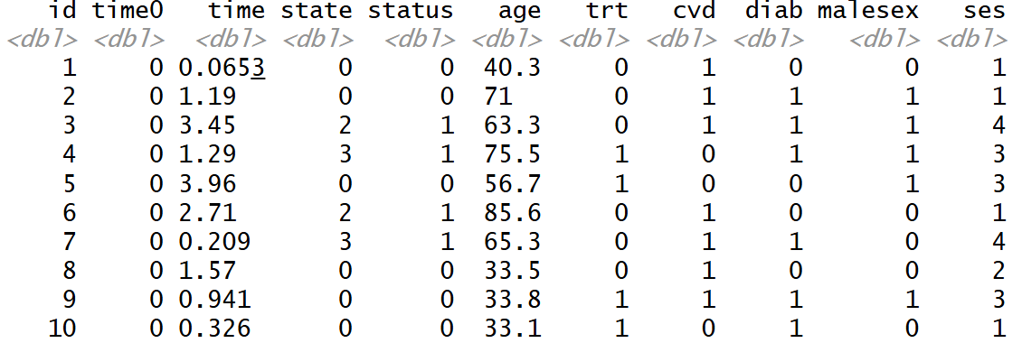
Worked example
Simulated data of 300 individuals.
CVD deaths vs other deaths.

Slide 10
Schematic of competing risks
State==2
CVD deaths
Trans==1
0
Alive
State==3
Other deaths
Trans==2

Slide 11
‘mstate’ package
Functions for data prep, descriptives, estimation and prediction in competing risks and multi-state models.

Slide 12
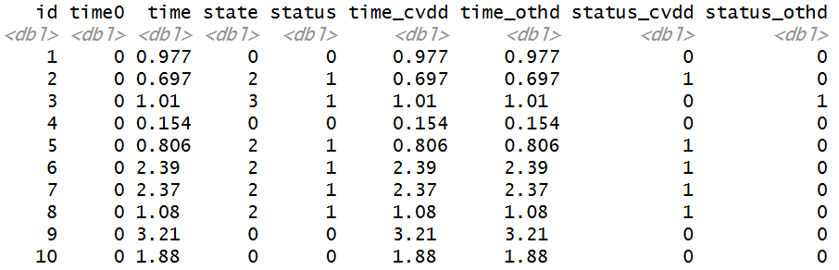
Data layout for ‘mstate’ package

Slide 13
Data output from ‘mstate’ package
#Transition matrix - 2 death outcomes
tmat <- transMat(x = list(c(2,3), c(), c()), names=c("Alive", "CVD death", "Other death"))
#Reshape using msprep
cvd_death_msp <- msprep(data=cvd_death, trans=tmat, time=c(NA, "time_cvdd", "time_othd"), status=c(NA, "status_cvdd", "status_othd"), keep=c("age", "cvd", "diab", “malesex", "ses"))

Slide 14
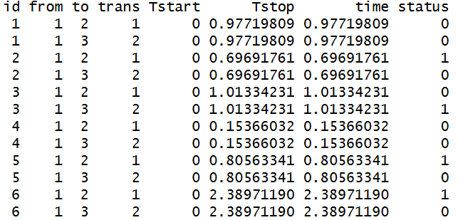
Data output from ‘mstate’ package

Slide 15
flexsurvspline
#Fit separate models for each cause of death
fs_cvdd <- flexsurvspline(Surv(Tstart, Tstop, status) ~ age10 + cvd + diab + malesex + ses + trt, data=cvd_death_msp, subset=(trans==1), k=1, scale="hazard")
fs_cvdd
fs_othd <- flexsurvspline(Surv(Tstart, Tstop, status) ~ age10 + cvd + diab + malesex + ses + trt, data=cvd_death_msp, subset=(trans==2), k=1, scale="hazard")
fs_othd

Slide 16
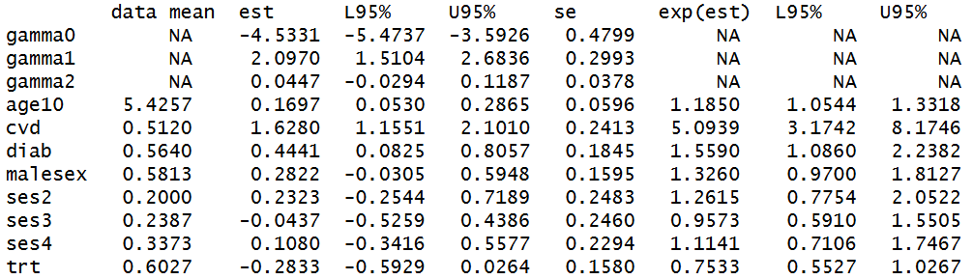
Flexsurvspline – CVD deaths

Slide 17
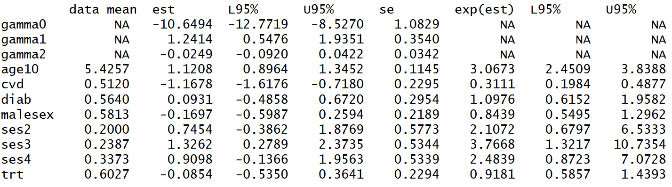
Flexsurvspline – Other deaths

Slide 18
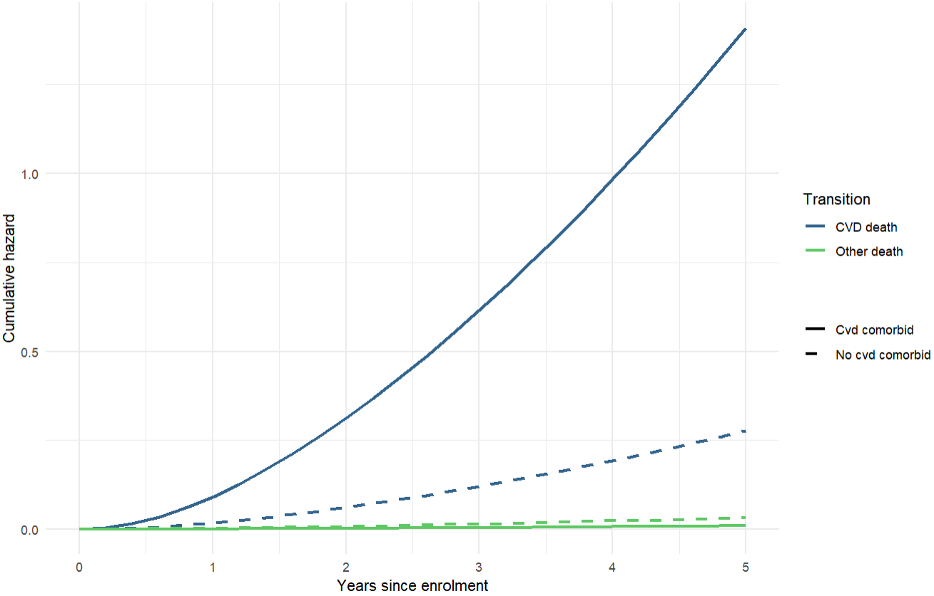
Cumulative hazard

Slide 19
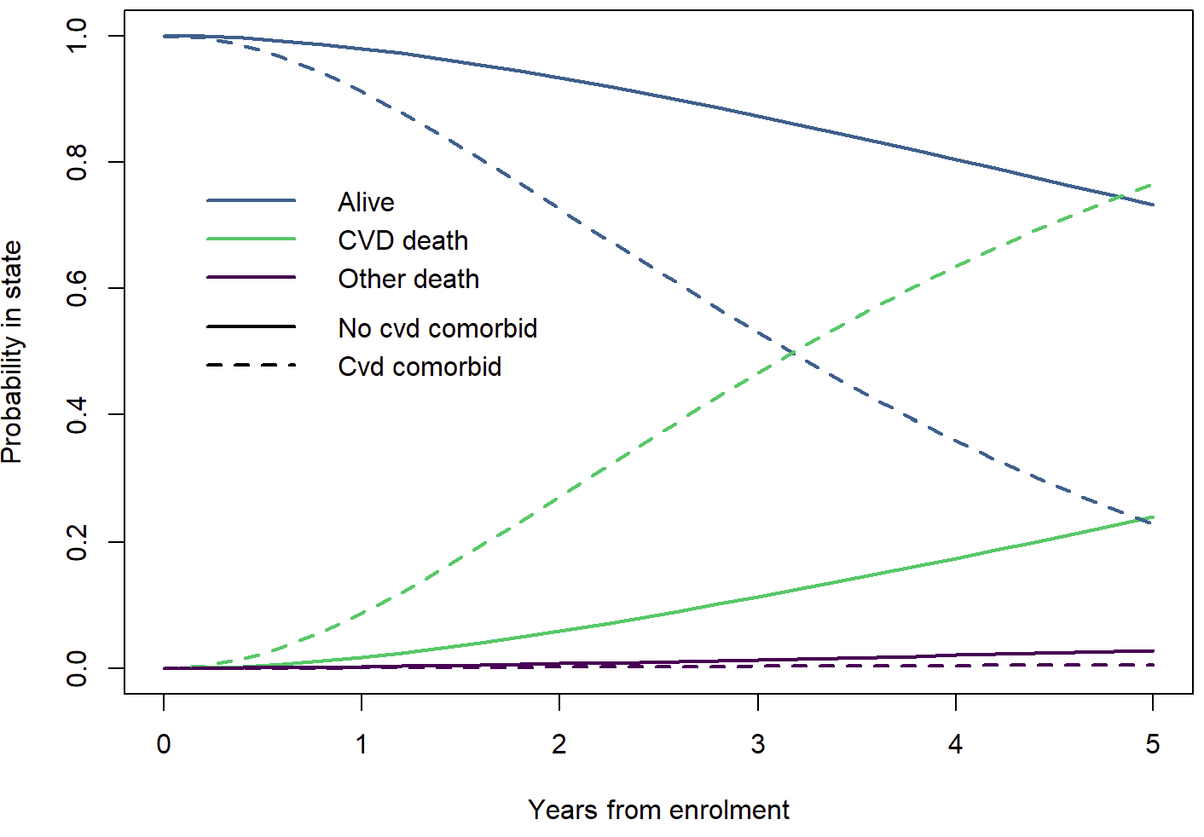
Probability of deaths

Slide 20
Data exercise

Slide 21
Data example
Real data (perturbed) of ~6500 dialysis patients
Variables
id: Unique patient identifier
time0: Start of being at risk (i.e. dialysis start date)
time: Follow-up time (i.e. death or last known follow-up)
deaths: indicator of death (2==CVD deaths, 3==Other death, 0==Still alive)
status: Event indicator (1==event occurred, 0==censored)
age: age in years at dialysis start
malesex: indicator for male sex (1==male, 0==female)
smoking: smoking status (C==current, N==never, F==former)
late: referral for kidney failure was late (1==late referral, 0==Not late referral)

