Slide 1

Flexible parametric survival models
Maarit Laaksonen

Slide 2
What is a flexible parametric survival model?
Introduced by Royston and Parmar in 2002, to bridge the gap between standard parametric models (like Weibull) and semi-parametric models (like Cox proportional hazards)
The flexibility in these models comes from the use of restricted cubic splines (polynomials) to model the log-cumulative hazard or log-hazard function rather than the hazard itself
Rather than assuming a simple linear trend, the model uses these splines joined at specific time points or ‘knots’ to capture complex, irregular, or multi-modal hazard shapes that simpler models would miss
Unlike piecewise models, which require splitting data into time intervals, flexible parametric models (FPM) provide smooth, continuous estimates of survival and hazard functions
While flexible parametric model is the broad category for any parametric model that uses splines, the Royston-Parmar model is its most famous implementation (and used in flexsurvspline)

Slide 3
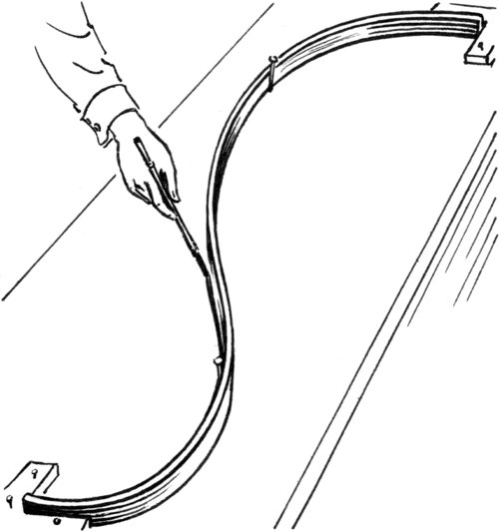
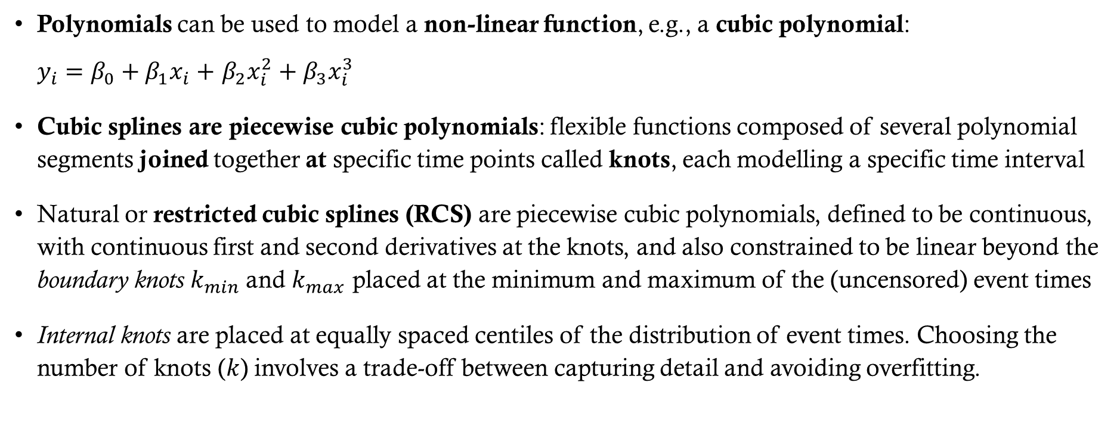
Key concepts
Polynomials can be used to model a non-linear function, e.g., a cubic polynomial:
$y_{i}=β_{0}+β_{1}x_{i}+$ $β_{2}x_{i}^{2}+$ $β_{3}x_{i}^{3}$
Cubic splines are piecewise cubic polynomials: flexible functions composed of several polynomial segments joined together at specific time points called knots, each modelling a specific time interval
Natural or restricted cubic splines (RCS) are piecewise cubic polynomials, defined to be continuous, with continuous first and second derivatives at the knots, and also constrained to be linear beyond the boundary knots $k_{min}$and $k_{max}$ placed at the minimum and maximum of the (uncensored) event times
Internal knots are placed at equally spaced centiles of the distribution of event times. Choosing the number of knots ($k$) involves a trade-off between capturing detail and avoiding overfitting.

Slide 4
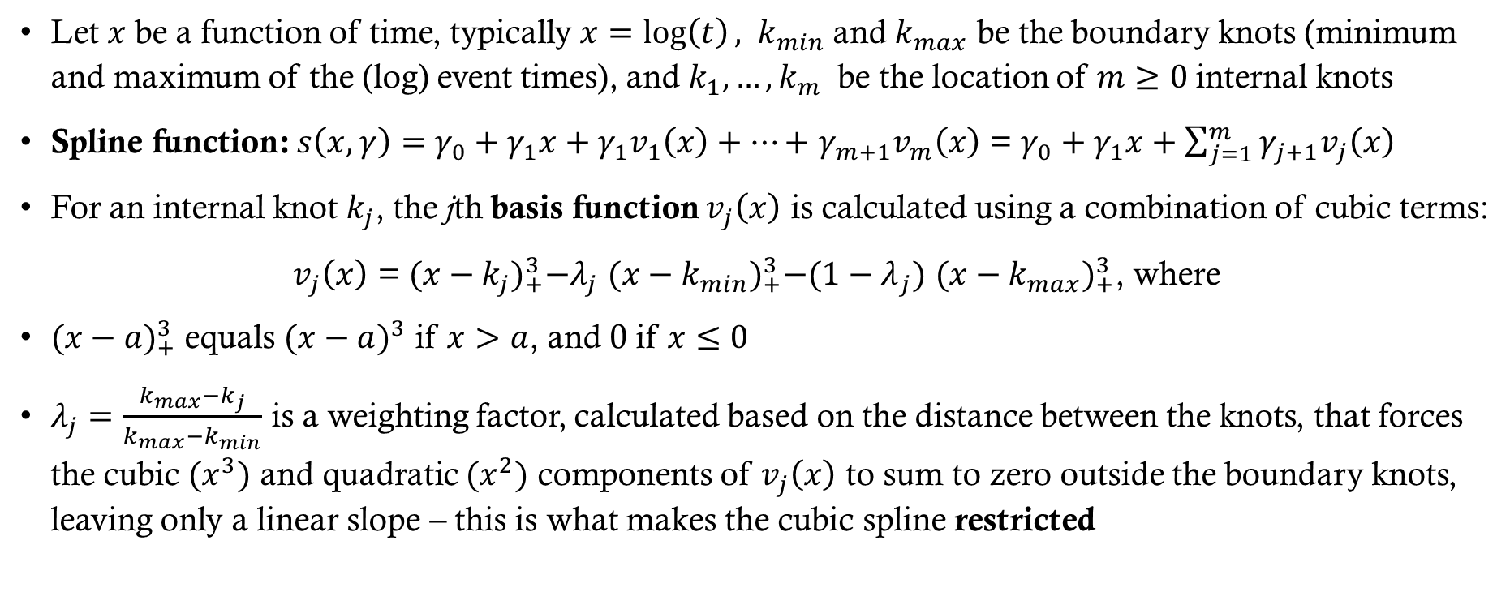
spline function and basis calculation
Let $x$ be a function of time, typically $x=log\left(t\right),$ $k_{min}$and $k_{max}$ be the boundary knots (minimum and maximum of the (log) event times), and $k_{1},…,k_{m}$ be the location of $m≥0$internal knots
Spline function: $s\left(x, γ\right)=$ $γ_{0}+γ_{1}x+γ_{1}v_{1}\left(x\right)+…+$ $γ_{m+1}v_{m}\left(x\right)$ = $γ_{0}+γ_{1}x+\sum_{j=1}^{m}{γ_{j+1}v_{j}\left(x\right)}$
For an internal knot $k_{j}$, the jth basis function $v_{j}\left(x\right)$ is calculated using a combination of cubic terms:
$v_{j}\left(x\right)$ = ${(x−k_{j})}_{+}^{3}−λ_{j}$ ${(x−k_{min})}_{+}^{3}−{(1−λ}_{j}) {(x−k_{max})}_{+}^{3}$, where
${(x−a)}_{+}^{3}$equals ${(x−a)}^{3}$ if $x>a$, and 0 if $x≤0$
$λ_{j}=\frac{k_{max}{−k}_{j}}{k_{max}{−k}_{min}}$ is a weighting factor, calculated based on the distance between the knots, that forces the cubic ${(x}^{3})$ and quadratic ${(x}^{2})$ components of $v_{j}\left(x\right)$ to sum to zero outside the boundary knots, leaving only a linear slope – this is what makes the cubic spline restricted

Slide 5
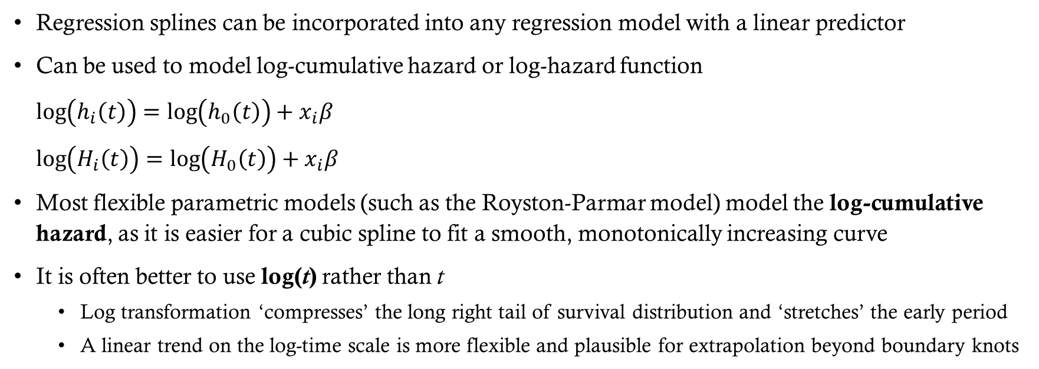
How do flexible parametric models work?
Regression splines can be incorporated into any regression model with a linear predictor
Can be used to model log-cumulative hazard or log-hazard function
$\log\left(h_{i}\left(t\right)\right)=\log\left(h_{0}\left(t\right)\right)+x_{i}β$
$\log\left(H_{i}\left(t\right)\right)=\log\left(H_{0}\left(t\right)\right)+x_{i}β$
Most flexible parametric models (such as the Royston-Parmar model) model the log-cumulative hazard, as it is easier for a cubic spline to fit a smooth, monotonically increasing curve
It is often better to use log(t) rather than t
  Log transformation ‘compresses’ the long right tail of survival distribution and ‘stretches’ the early period
  A linear trend on the log-time scale is more flexible and plausible for extrapolation beyond boundary knots

Slide 6
The log-cumulative hazard framework
Royston and Parmar thus designed their flexible parametric model as a direct extension of the Weibull model, that is linear when you plot the log-cumulative hazard against log-time

Slide 7
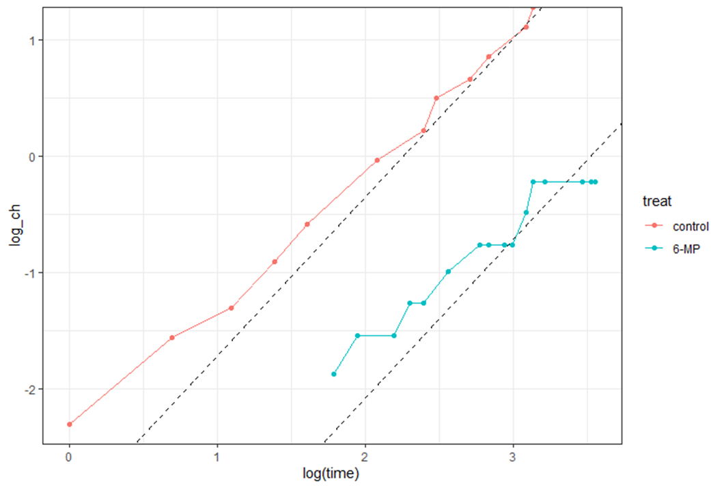
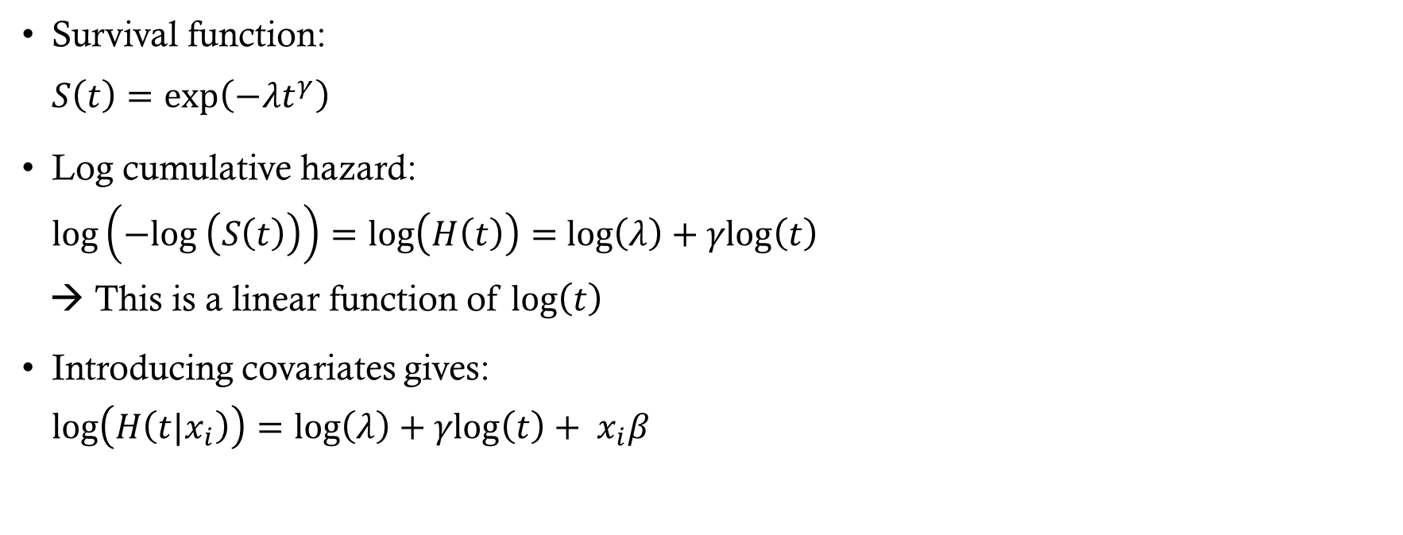
Weibull Model
Survival function:
$S\left(t\right)=\text{exp}\left({−λt}^{γ}\right)$
Log cumulative hazard:
$\text{log}\left(−\text{log} \left(S\left(t\right)\right)\right)=$ $\text{log}\left(H\left(t\right)\right)=$ $\text{log}\left(λ\right)+γ\text{log}\left(t\right)$
→ This is a linear function of $\text{log}\left(t\right)$
Introducing covariates gives:
$\text{log}\left(H\left(t|x_{i}\right)\right)=$ $\text{log}\left(λ\right)+γ\text{log}\left(t\right)+ x_{i}β$

Slide 8
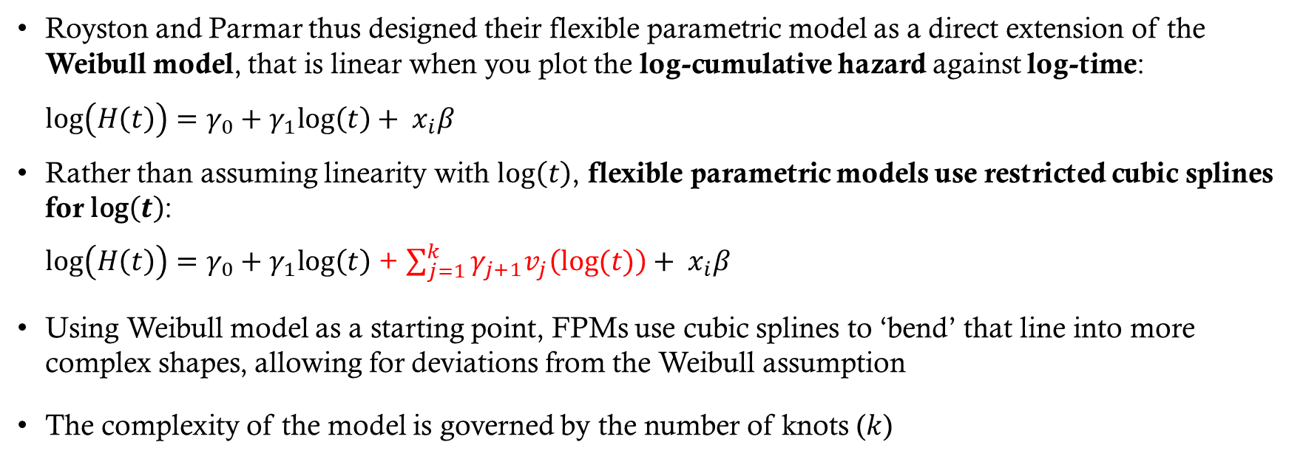
The log-cumulative hazard framework
Royston and Parmar thus designed their flexible parametric model as a direct extension of the Weibull model, that is linear when you plot the log-cumulative hazard against log-time:
$\text{log}\left(H\left(t\right)\right)=γ_{0}+γ_{1}\text{log}\left(t\right)+ x_{i}β$
Rather than assuming linearity with $\text{log}\left(t\right)$, flexible parametric models use restricted cubic splines for $\text{log}\left(t\right)$:
$\text{log}\left(H\left(t\right)\right)=γ_{0}+γ_{1}\text{log}\left(t\right)$ + $\sum_{j=1}^{k}{γ_{j+1}v_{j}\left(log⁡(t)\right)}+ x_{i}β$
Using Weibull model as a starting point, FPMs use cubic splines to ‘bend’ that line into more complex shapes, allowing for deviations from the Weibull assumption
The complexity of the model is governed by the number of knots ($k$)

Slide 9
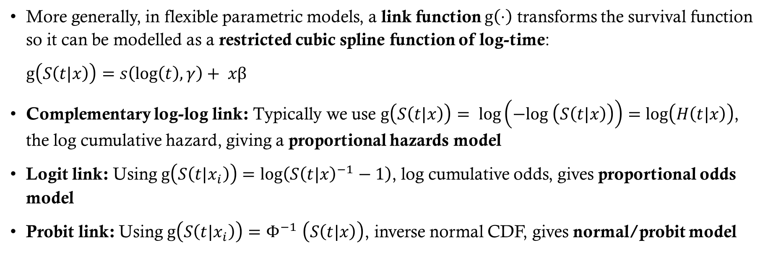
Generalisations of flexible parametric models
More generally, in flexible parametric models, a link function $g\left(⋅\right)$ transforms the survival function so it can be modelled as a restricted cubic spline function of log-time:
$g\left(S\left(t|x\right)\right)=$ $s\left(\text{log}\left(t\right), γ\right)+ xβ$
Complementary log-log link: Typically we use $g\left(S\left(t|x\right)\right)= \text{log}\left(−\text{log} \left(S\left(t|x\right)\right)\right)=$ $\text{log}\left(H\left(t|x\right)\right)$, the log cumulative hazard, giving a proportional hazards model
Logit link: Using $g\left(S\left(t|x_{i}\right)\right)=\text{log}\left({S\left(t|x\right)}^{−1}−1\right)$, log cumulative odds, gives proportional odds model
Probit link: Using $g\left(S\left(t|x_{i}\right)\right)=Φ^{−1}$ $\left(S\left(t|x\right)\right)$, inverse normal CDF, gives normal/probit model

Slide 10
Why flexible parametric survival models?
Beyond the other benefits of parametric models, flexible parametric models can capture a wider range of hazard shapes (and thus biological realities) than standard parametric models
Often the standard choice when proportional hazards fail, as they easily allow for time-dependent effects (e.g., the impact of a treatment changes over the duration of the study)
Because they are fully parametric, they allow for calculation of absolute measures of effect (like absolute risks and rates) which are difficult to obtain from Cox models
When hazard is complex and of interest, single hazard ratio fails to capture the complete story, and/or the proportional hazards assumption is violated or appropriate

Slide 11
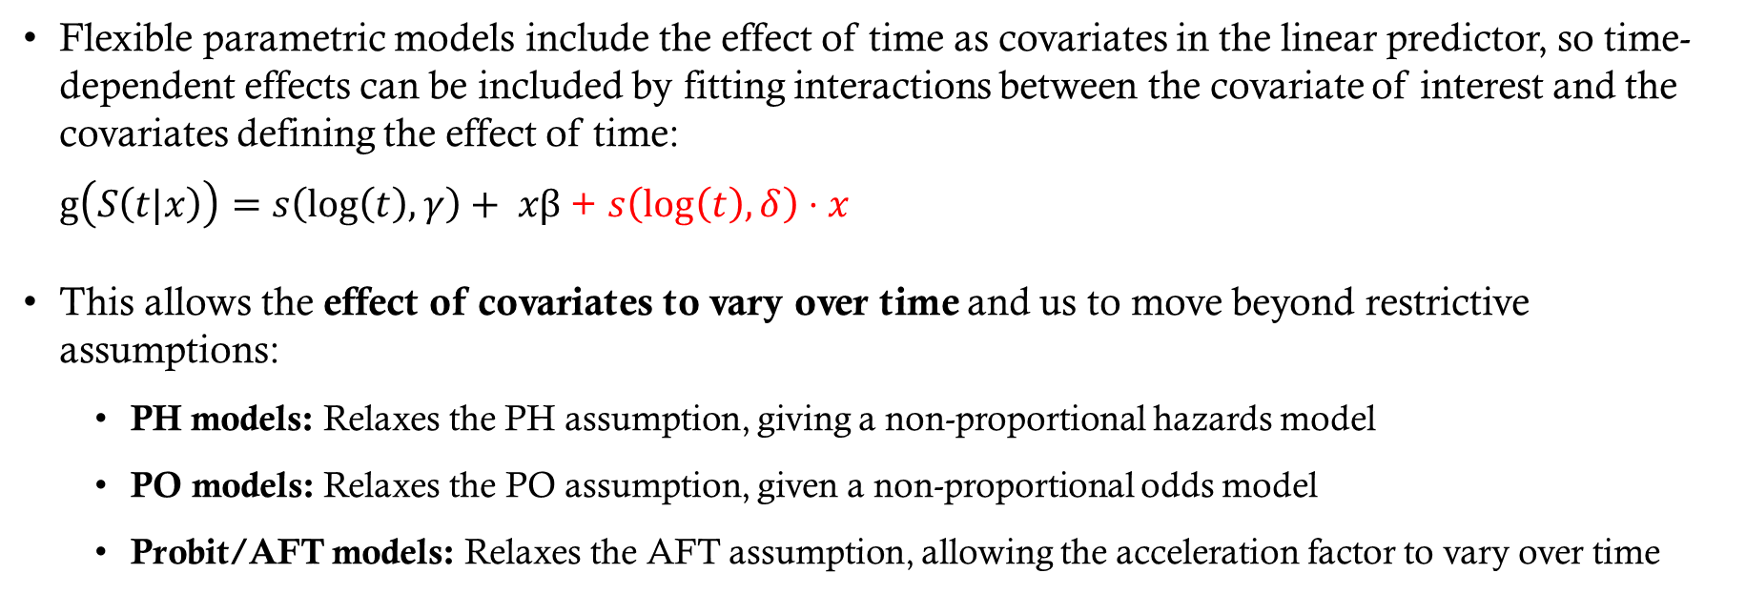
Modelling time-dependent effects
Flexible parametric models include the effect of time as covariates in the linear predictor, so time-dependent effects can be included by fitting interactions between the covariate of interest and the covariates defining the effect of time:
$g\left(S\left(t|x\right)\right)=$ $s\left(\text{log}\left(t\right), γ\right)+ xβ$ + $s\left(\text{log}\left(t\right), δ\right)⋅x$
This allows the effect of covariates to vary over time and us to move beyond restrictive assumptions:
  PH models: Relaxes the PH assumption, giving a non-proportional hazards model
  PO models: Relaxes the PO assumption, given a non-proportional odds model
  Probit/AFT models: Relaxes the AFT assumption, allowing the acceleration factor to vary over time

Slide 12
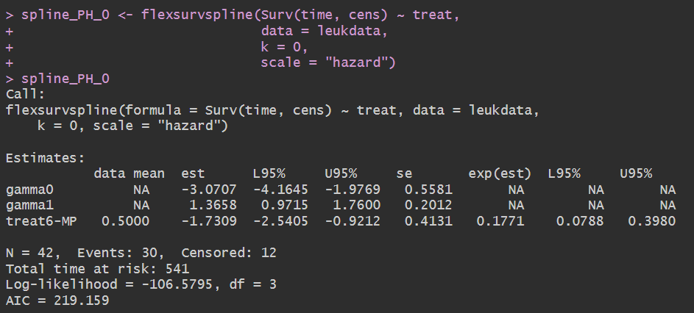
Royston-parmar ph model – r example
Can be estimated using flexsurvspline from the flexsurv package:
Same as the Weibull PH model
Notes:
0 knots

Slide 13
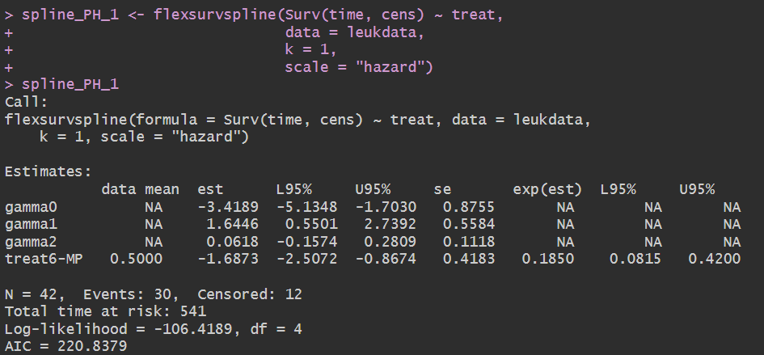
Royston-parmar ph model – r example
Can be estimated using flexsurvspline from the flexsurv package:
Notes:
1 knot

Slide 14
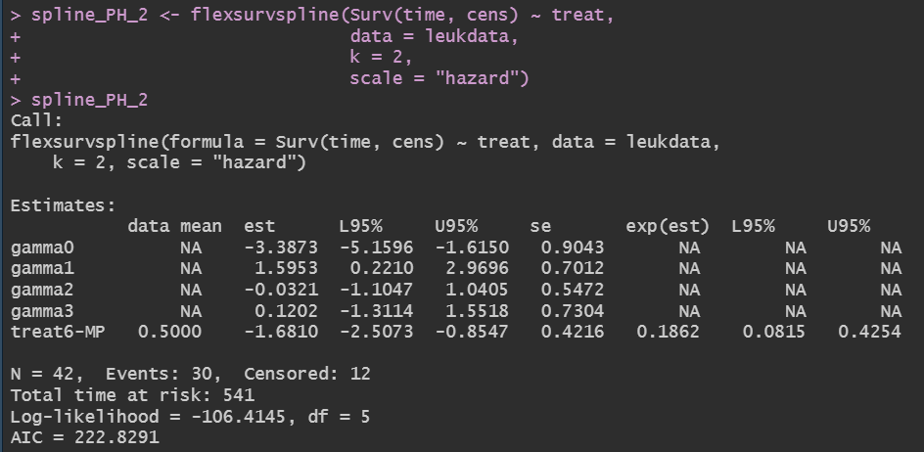
Royston-parmar ph model – r example
Can be estimated using flexsurvspline from the flexsurv package:
Notes:
2 knots

Slide 15
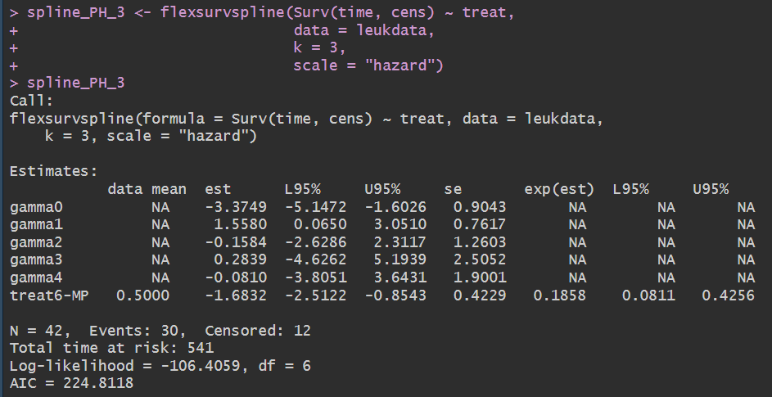
Royston-parmar ph model – r example
Can be estimated using flexsurvspline from the flexsurv package:
Notes:
3 knots

Slide 16
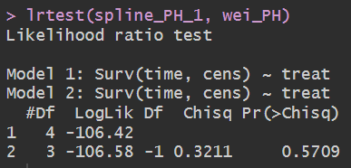
How many knots to use?
We can use AIC and BIC to help us select how many knots to use
As the Weibull model is nested within the flexible parametric proportional hazards model, we can also use the likelihood ratio test to determine which model provides a better fit for the data:
Usually 2 or 3 knots are enough to capture even more complex hazards
The default knot positions tend to work fairly well
Notes:
If the improvement in fit (likelihood) is greater than the penalty for the new parameter, the AIC/BIC decreases (model with more knots is better)
If the improvement in fit is marginal and does not justify the extra parameter, the AIC/BIC increases

Slide 17
R Data example 2
Cohort: 686 patients with primary node positive breast cancer from the German Breast Cancer Study Group (1984–1989).
Primary event: Time to recurrence (recurrence-free survival)
Censoring: When patients did not experience recurrence or death

Slide 18
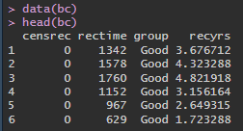
R Data example 2
These data are available from bc in the flexsurv package:
rectime: Recurrence-free survival time in days
recyrs: Recurrence-free survival time in years
censrec: Recurrence or death / censoring indicator (1 = dead/recurrence, 0 = censored)
group: A 3-level prognostic factor with levels "Good", "Medium", and "Poor"

Slide 19
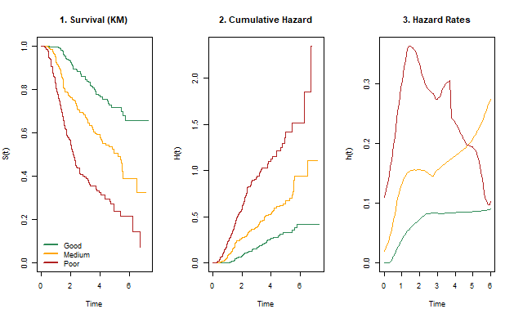
Survival, cumulative hazard and hazard
Notes:
We can now see from the hazard plot that the hazards are not monotonic like in the Weibull model and that the "Poor" prognostic group has a much sharper, earlier peak in risk compared to the "Good" group. If the proportional hazards assumption held, the hazard for the "Poor" group would be a constant multiple of the hazard for the Good group across the entire follow-up. Instead, the gap between the groups changes, being very wide in the first 2-3 years and then begins to narrow.

Slide 20
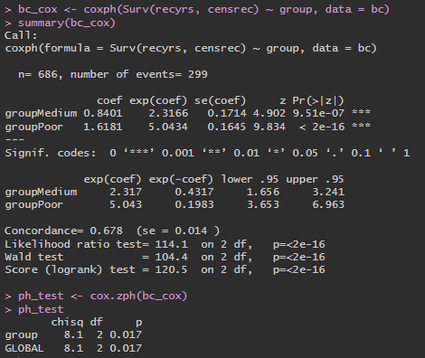
Proportional hazards assumption
We can try to fit a Cox model to these data and test the proportional hazards assumption:
Notes:
We can see a significant p-value (0.017), indicating that the proportional hazards assumption was violated.

Slide 21
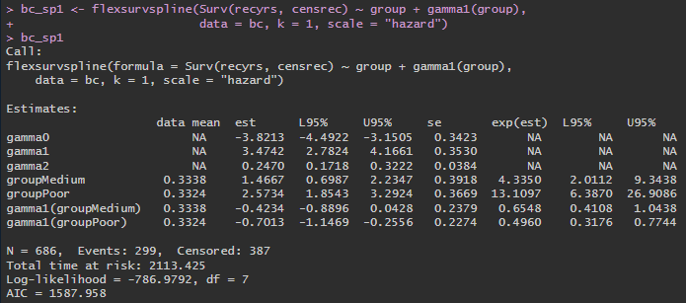
Flexible parametric model (1 knot)
We can fit a FPM with time-dependent effect, by adding a term gamma1(group)to the model:
Notes:
Now the hazard ratio varies over time and the $\exp(est)$ of the interaction term tells us the 'speed' and 'direction' of that move.
If it's less than 1, the groups are becoming more similar over time; if it's greater than 1, they are diverging.
Here, at year 1, the "Poor" group has 13.1 times and the "Medium" group 4.3 times the risk of the "Good" group.
However, for every unit increase in log-time, those risk ratios drop by 50% and 35% (multiplied by 0.5 and 0.65), respectively.
This suggests that the difference between the groups is greatest early on and diminishes as time passes.

Slide 22
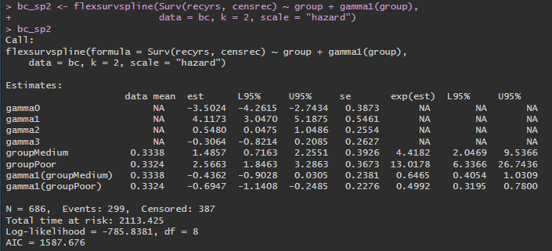
Flexible parametric model (2 knots)
We can fit a FPM with time-dependent effect, by adding a term gamma1(group)to the model:
Notes:
Now the hazard ratio varies over time and the $\exp(est)$ of the interaction term tells us the 'speed' and 'direction' of that move.
If it's less than 1, the groups are becoming more similar over time; if it's greater than 1, they are diverging.
Here, at year 1, the "Poor" group has 13.1 times and the "Medium" group 4.3 times the risk of the "Good" group.
However, for every unit increase in log-time, those risk ratios drop by 50% and 35% (multiplied by 0.5 and 0.65), respectively.
This suggests that the difference between the groups is greatest early on and diminishes as time passes.

Slide 23
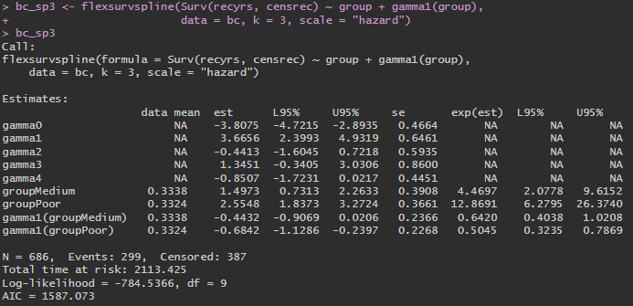
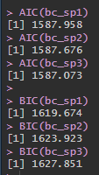
Flexible parametric model (3 knots)
We can fit a FPM with time-dependent effect, by adding a term gamma1(group)to the model:
Notes:
While adding additional knots reduces AIC slightly, the additional parameters increase BIC significantly, so we choose the model with 1 knot.

Slide 24
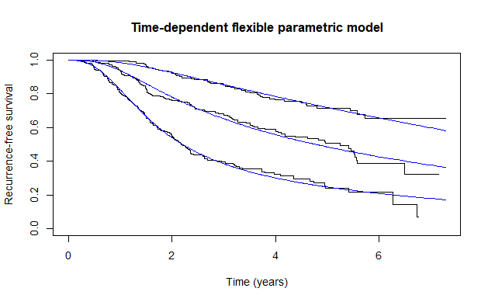
Survival
Notes:
We can see that it fits quite well.

Slide 25
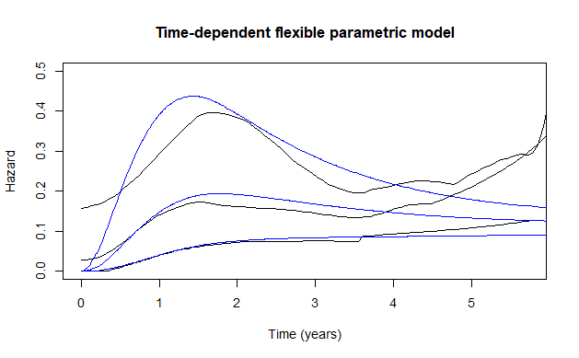
hazard
Notes:
We can see that it fits quite well.

Slide 26
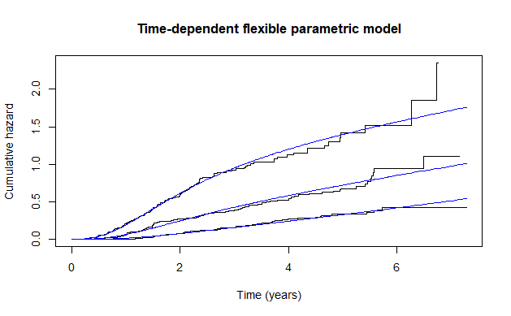
Cumulative hazard
Notes:
We can see that it fits quite well.

Slide 27
summary
Flexible parametric models bridge the flexibility of a Cox model and the mathematical completeness of a parametric model
The use of restricted cubic splines allows for modelling complex hazard shapes
While they provide the hazard ratio, they also allow you calculate absolute risks and extrapolate survival beyond the observed follow-up period
If proportional hazards assumption is violated, time-dependent effects can be easily integrated into the spline framework

