Slide 1



Survivor Stats Society
Fourth session: Joint modelling: Cox model and linear mixed model
Farzaneh Boroumand

Slide 2

Motivation for A joint model
Extended Cox models treat the time-varying covariate as if it were “external”!
But eGFR is often an internal covariate, meaning:
  It is influenced by the underlying health of the graft
  It may change because the graft is failing
  It may be measured more often when the patient is failing
This creates feedback loops that extended Cox models cannot handle!

Slide 3


Motivation for A joint model
Graft function ↓ → more tests → lower eGFR measurements
→ appears riskier → exaggerates effect.

Slide 4
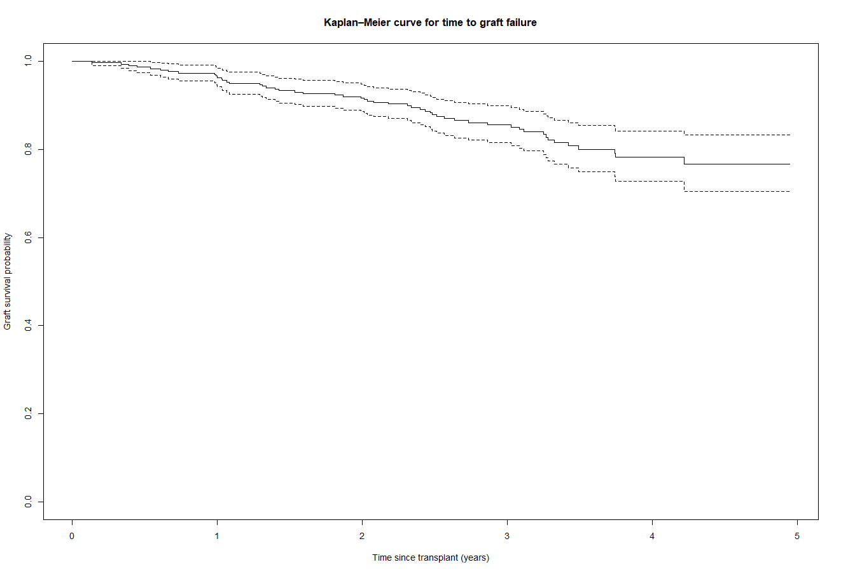
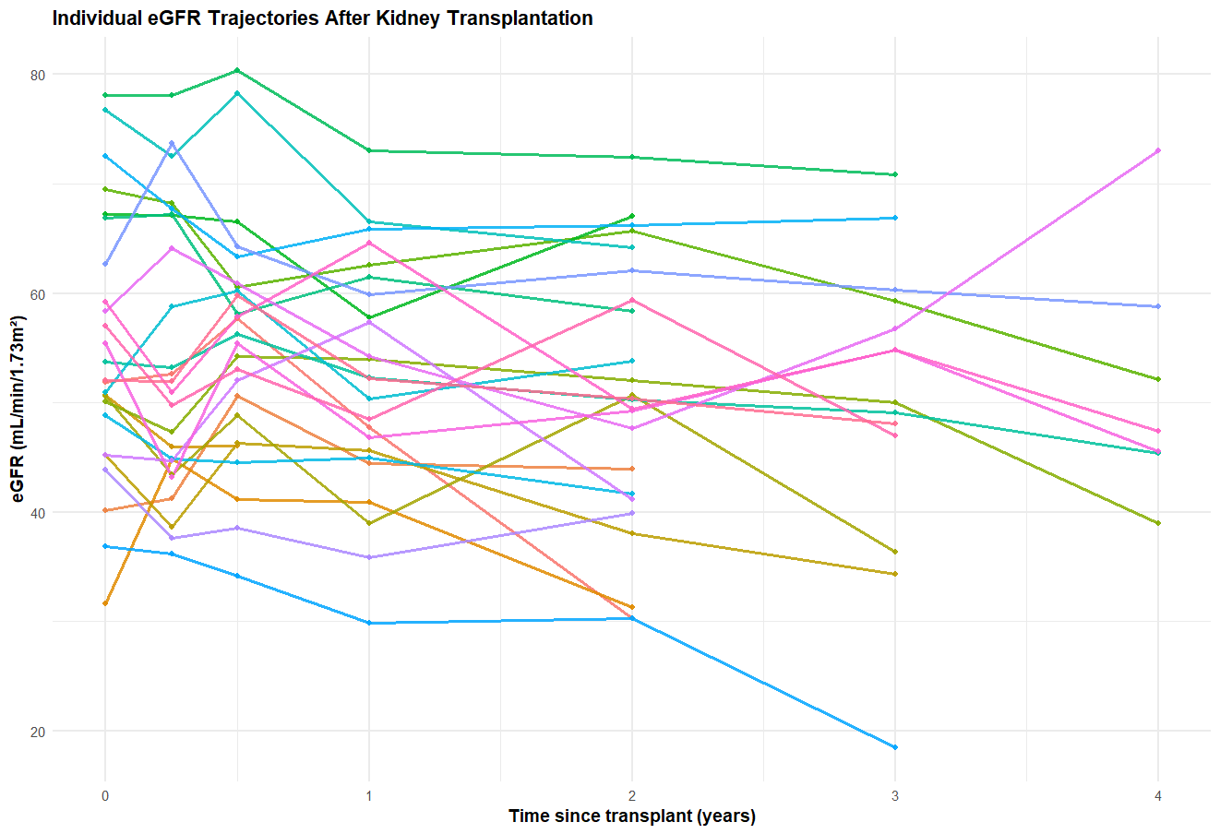
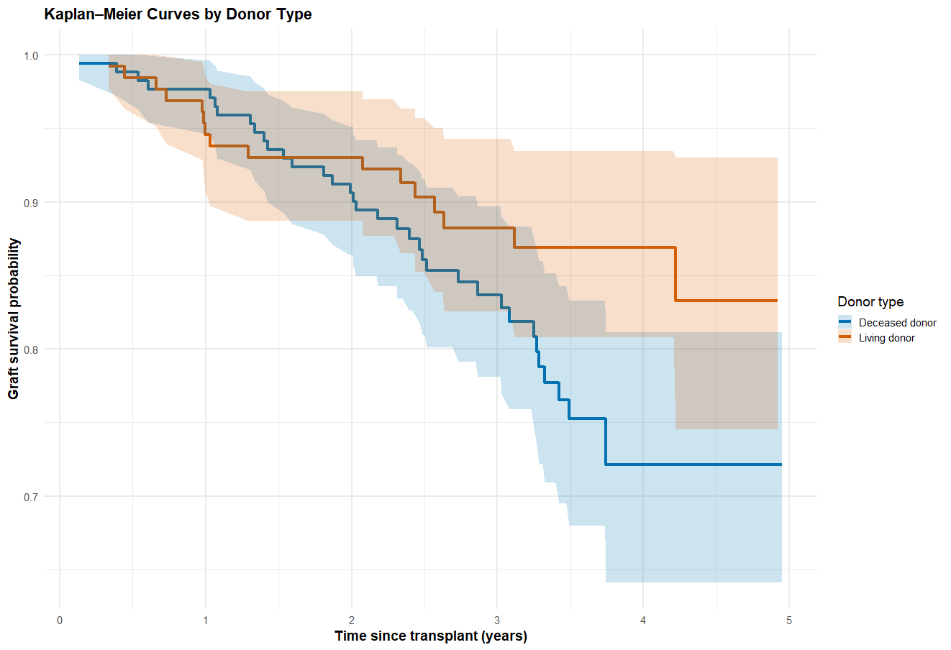
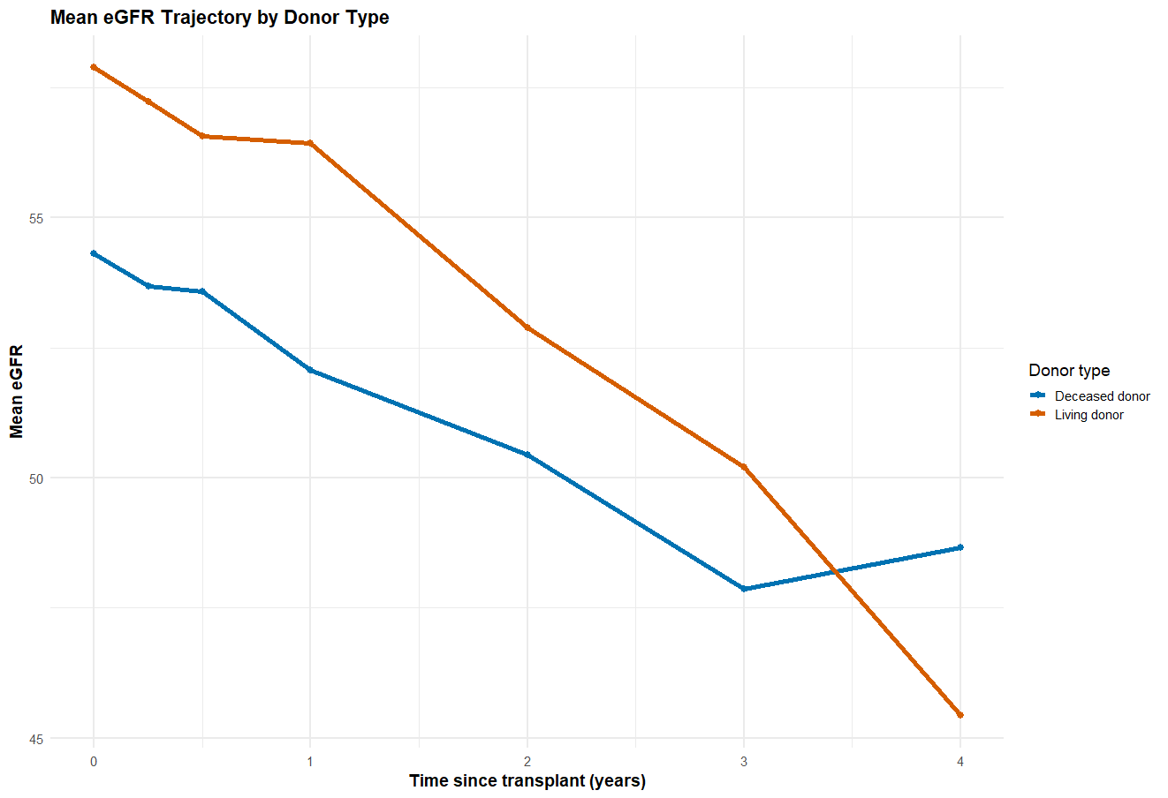
Joint models: link the longitudinal and the survival process
🔗 Shared random effects linking the two processes.

Slide 5

What Joint Models Solve?
They allow eGFR to be an internal time-varying covariate
They account for correlations between eGFR and risk of graft failure
They handle varying measurement times
They reduce bias caused by feedback loops
They improve prediction of graft loss

Slide 6
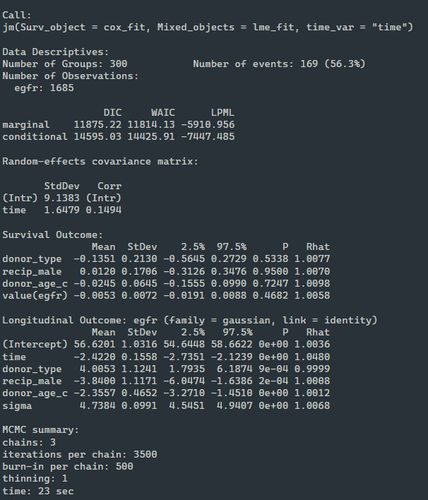
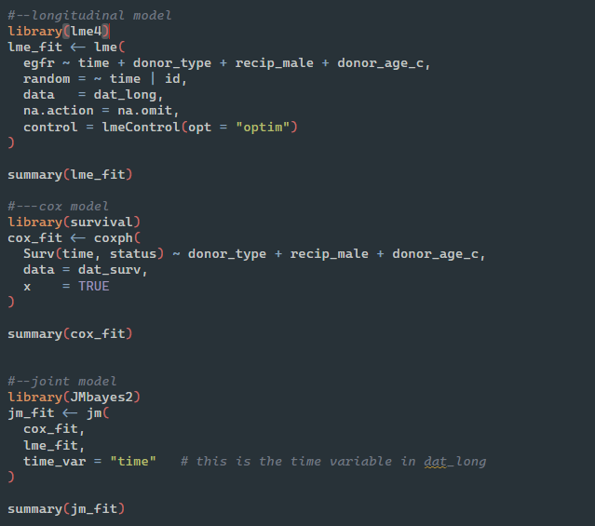
Fit a joint model

Slide 7
Interpretation
Longitudinal Model — eGFR Trajectories
Parameter | Estimate | Interpretation
Intercept | 56.6 | Mean eGFR at transplant time for reference group (deceased donor, female, donor age 50).
time | –2.42 | eGFR declines by ~2.4 mL/min per year on average (p < 0.001).
donor_type | +4.0 | Living donor kidneys start with ~4 mL/min higher eGFR and maintain better function over time.
recip_male | –3.84 | Male recipients have lower eGFR by ~3.8 units.
donor_age_c | –2.36 | For each 10 years older donor (relative to age 50), eGFR is ~2.4 units lower.
sigma | 4.74 | Residual SD (variability in eGFR not explained by model).
Notes:
eGFR declines over time
living donors have better eGFR
older donor age → lower eGFR
male recipients → lower eGFR

Slide 8
Interpretation
Survival Model — Risk of Graft Failure
Covariate | Estimate | Interpretation
donor_type | –0.135 | Living donors have slightly lower hazard, but effect is small and not statistically meaningful.
recip_male | +0.012 | No real difference in hazard for male recipients.
donor_age_c | –0.024 | Donor age has no clear effect on hazard after adjusting for eGFR.
value(egfr) | –0.0053 | The current value of eGFR is associated with lower hazard, but effect is small and not significant.

Slide 9
Interpretation
The Association Parameter (value(egfr))
value(egfr) = –0.0053
Interpretation:
Holding all else constant, each 1 mL/min higher eGFR is associated with a ~0.5% lower hazard of graft failure.
Or:
For a 10-unit decrease in eGFR, the hazard increases by ~5%.
But because: 95% CI includes 0 and p ≈ 0.47

Slide 10
Conclusion
In this joint model, eGFR declines over time and is strongly influenced by donor type, donor age, and recipient sex.
The association between current eGFR and graft failure hazard is negative—as expected—but small and not strongly supported by the data.
Random effects reveal substantial between-patient heterogeneity in baseline eGFR and rate of decline.

Slide 11
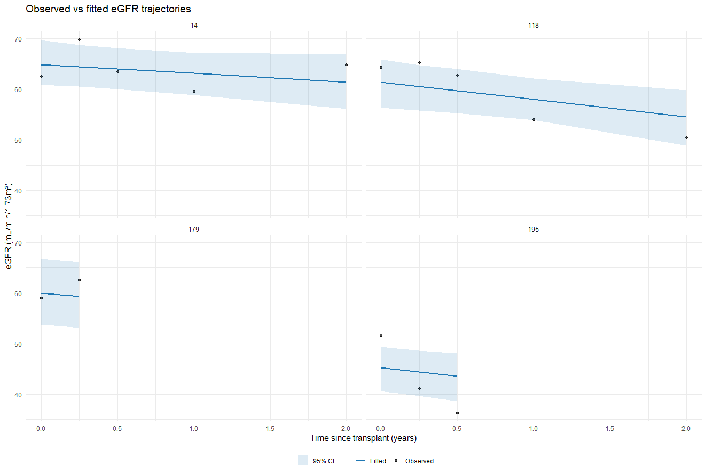
Prediction plots
Observed eGFR values (black points)
Fitted eGFR trajectory from the longitudinal mixed model (blue line)
95% posterior credible interval for the predicted trajectory (light blue shading)

Slide 12

Any questions?

