Slide 1



Survivor Stats Society
Third session: Cox model when PH assumption is violated
Farzaneh Boroumand

Slide 2
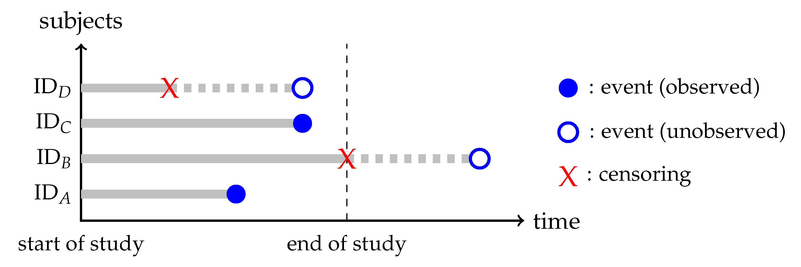
Survival data
Data that measures the time until a specific event occurs.
Example: the time from the transplantation surgery to a particular event, such as graft failure, patient death, or rejection.

Slide 3
What is the main feature of Survival data?
Outcome is composite a time variable and a binary variable that shows the status of event.
ID | Event (Death) | Time to event (month)
A | 1 | 18
B | 0 | 24
C | 1 | 20
D | 0 | 16
(month)
24
Notes:
Both event and time are our outcome

Slide 4
What Can We Model in Survival Analysis?
Goal | Question | Model Type | What We Get
1. Estimate chance of surviving | What’s the probability of still being event-free at time t? | Kaplan-Meier, parametric models | Survival curves
2. Estimate average survival time | How long do people survive, on average, up to a time point? | RMST regression | Average time survived (RMST)
3. Estimate risk over time | What’s the risk of the event at each time point? | Cox model, parametric models (e.g., Weibull) | Hazard ratios (e.g., treatment effect)
4. Compare event types | What’s the chance of dying from cause A vs. cause B? | Competing risks models | Cumulative incidence curves

Slide 5
What Can We Model in Survival Analysis?
Goal | Question | Model Type | What We Get
5. Predict specific time points | When will 50% of people experience the event? | Quantile survival models | Median survival time
6. Model time directly | How much longer does one group survive than another? | Accelerated failure time (AFT) models | Time ratios
7. Study repeated events | What happens when events can occur more than once? | Recurrent event models | Rate of events
8. Understand causal effects | What would happen if we changed treatment or exposure? | Causal survival models (IPW, g-formula) | Causal estimates like survival curves or RMST

Slide 6
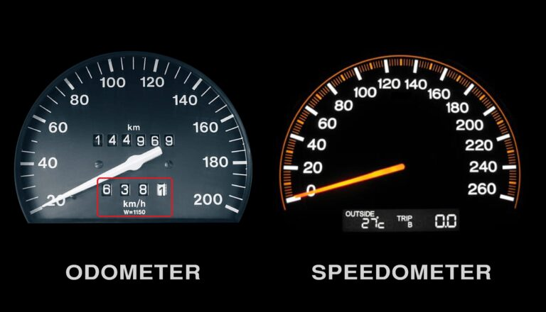
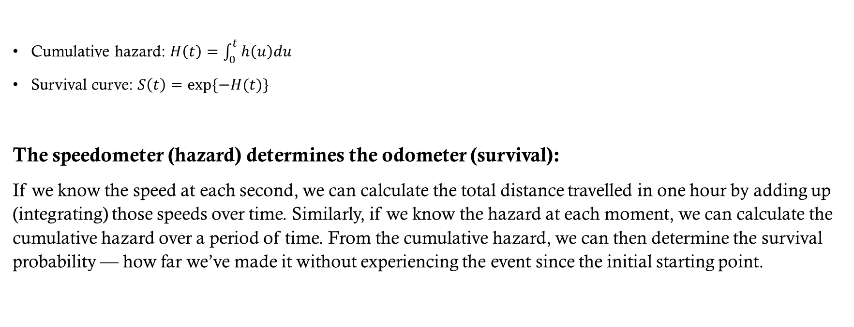
The link between Hazard to Survival
survival
Hazard at each moment
Cumulative hazard: $H\left(t\right)=\int_{0}^{t}{h\left(u\right)du}$
Survival curve: $S\left(t\right)=exp⁡\{−H(t)\}$
The speedometer (hazard) determines the odometer (survival):
If we know the speed at each second, we can calculate the total distance travelled in one hour by adding up (integrating) those speeds over time. Similarly, if we know the hazard at each moment, we can calculate the cumulative hazard over a period of time. From the cumulative hazard, we can then determine the survival probability — how far we’ve made it without experiencing the event since the initial starting point.

Slide 7



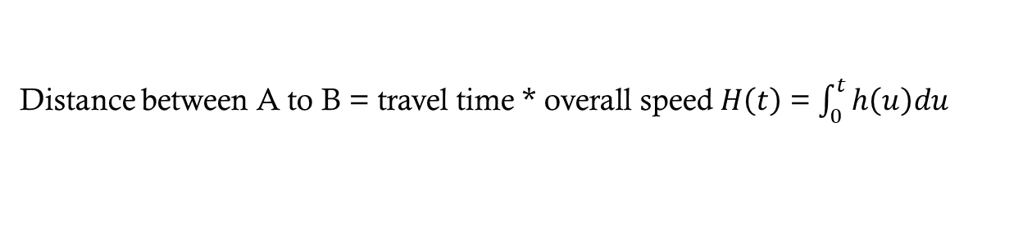
The link between Hazard to Survival
h(t=1)
h(t=5)
h(t=10)
A
B
Distance between A to B = travel time * overall speed $H\left(t\right)$ = $\int_{0}^{t}{h\left(u\right)du}$

Slide 8



PH Assumption
t=1
t=5
t=10

Slide 9
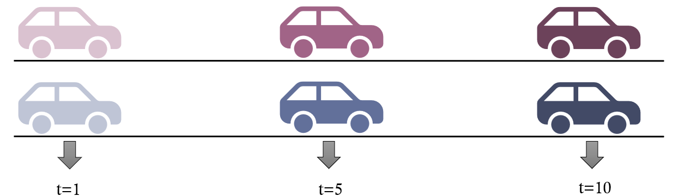
PH Assumption
The proportion of the pink car’s speed compared to the blue car’s speed remains constant over time.
For example, if the pink car is twice as fast as the blue car at any moment, it stays twice as fast throughout the journey.
This doesn’t mean their speeds are fixed — both can change over time.
For instance, at t = 1 the pink car may be going 4 km/h while the blue car is going 2 km/h,
and at t = 10 the pink car might be going 16 km/h while the blue car is going 8 km/h.
The ratio (2:1) stays the same — that’s the essence of the proportional hazards assumption.

Slide 10
PH Assumption violation
t=1
t=5
t=10

Slide 11
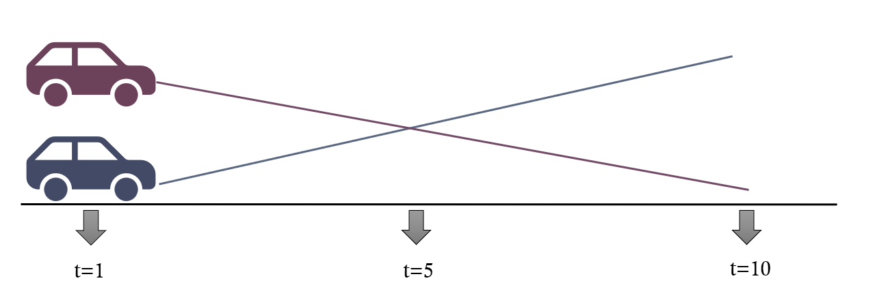
PH Assumption violation
When the proportional hazards assumption is violated,
the proportion (or ratio) of the pink car’s speed compared to the blue car’s speed changes over time.
For example, at the beginning of the journey (t = 1),
the pink car might be twice as fast as the blue car (4 km/h vs. 2 km/h).
But later, at t = 10, the blue car might catch up or even go faster (pink = 8 km/h, blue = 10 km/h).
This means the hazard ratio is not constant — the relative difference between the two cars varies as time progresses.
In survival analysis, this indicates that the effect of the covariate changes over time, violating the PH assumption.

Slide 12
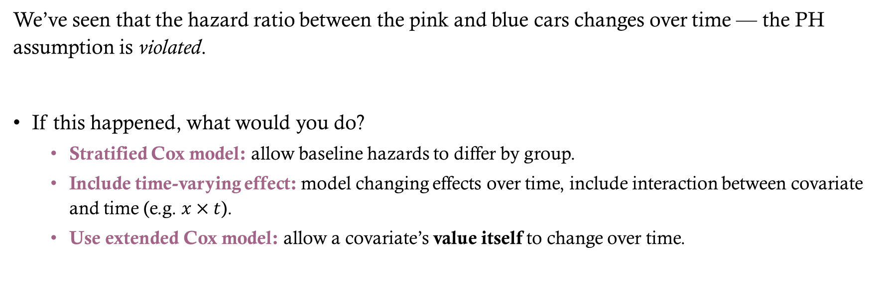
How Would You Address the Violation?
We’ve seen that the hazard ratio between the pink and blue cars changes over time — the PH assumption is violated.
If this happened, what would you do?
  Stratified Cox model: allow baseline hazards to differ by group.
  Include time-varying effect: model changing effects over time, include interaction between covariate and time (e.g. $x×t$).
  Use extended Cox model: allow a covariate’s value itself to change over time.

Slide 13
Example:
Outcome:
  time from the transplantation surgery to a graft failure
  Status of graft failure
Main Exposure : type of donor
Covariates:
  Age of donor
  Recipient gender
  eGFR at time of transplant

Slide 14
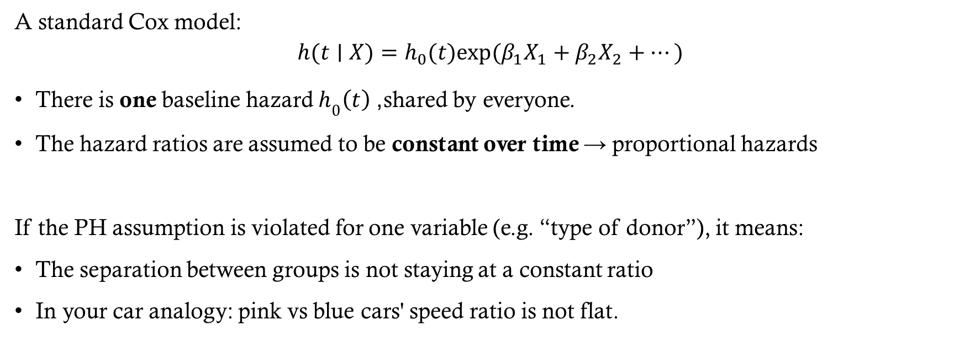
stratified Cox model
A standard Cox model:
$$h(t∣X)=h_{0}​(t)exp⁡(β_{1}​X_{1}​+β_{2}​X_{2}​+…)$$
There is one baseline hazard $h_{0}\left(t\right)$, shared by everyone.
The hazard ratios are assumed to be constant over time → proportional hazards
If the PH assumption is violated for one variable (e.g. “type of donor”), it means:
The separation between groups is not staying at a constant ratio
In your car analogy: pink vs blue cars' speed ratio is not flat.

Slide 15
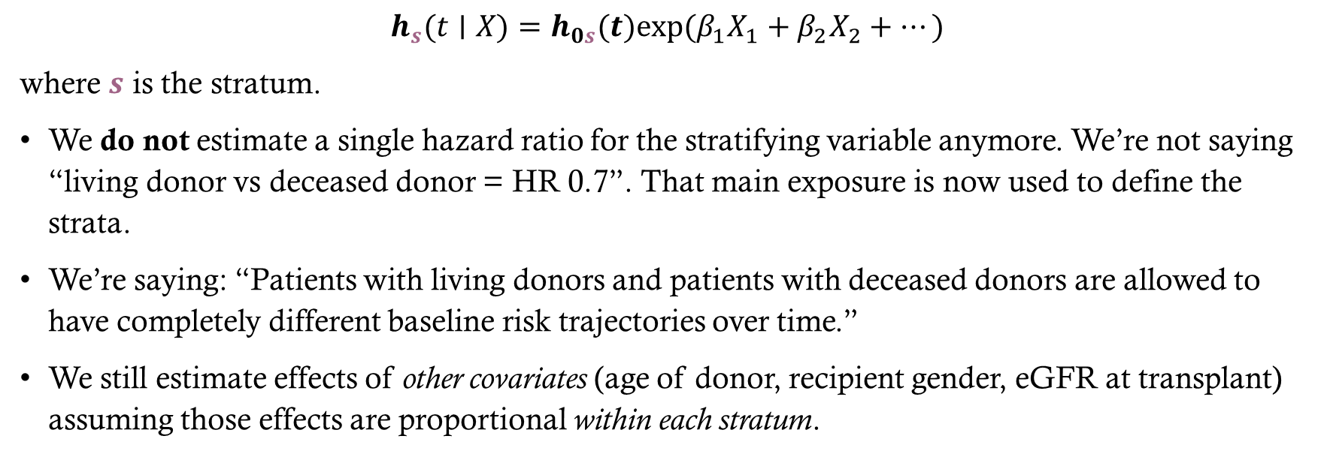
stratified Cox model
$$h_{s}​(t∣X)=h_{0s}​(t)exp⁡(β_{1}​X_{1}​+β_{2}​X_{2}​+…)$$
where $s$ is the stratum.
We do not estimate a single hazard ratio for the stratifying variable anymore. We’re not saying “living donor vs deceased donor = HR 0.7”. That main exposure is now used to define the strata.
We’re saying: “Patients with living donors and patients with deceased donors are allowed to have completely different baseline risk trajectories over time.”
We still estimate effects of other covariates (age of donor, recipient gender, eGFR at transplant) assuming those effects are proportional within each stratum.
Notes:
The stratified Cox model says:
“OK, let’s stop forcing these groups to share the same baseline hazard.
Each group gets its own baseline hazard curve.”

Slide 16
stratified Cox model
Stratification = “parallel Cox models with different baselines, but same slopes for the other covariates.”
When to use:
  The PH violation is driven by that one variable (donor type).
  You still care about adjusting for it, but you don't necessarily need its hazard ratio.
When not to use:
  You actually want the hazard ratio for that exposure as your primary scientific question.
  (Because after stratifying on donor type, you no longer get a single HR comparing donor types.)

Slide 17
Example:
Outcome:
  time from the transplantation surgery to a graft failure
  Status of graft failure
Main Exposure : type of donor
Covariates:
  Age of donor
  Recipient gender
  eGFR at time of transplant

Slide 18
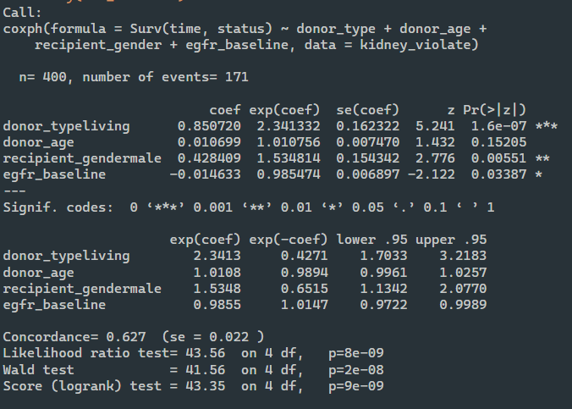
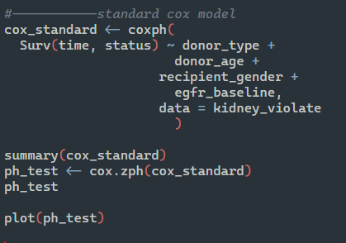
Standard Cox model

Slide 19
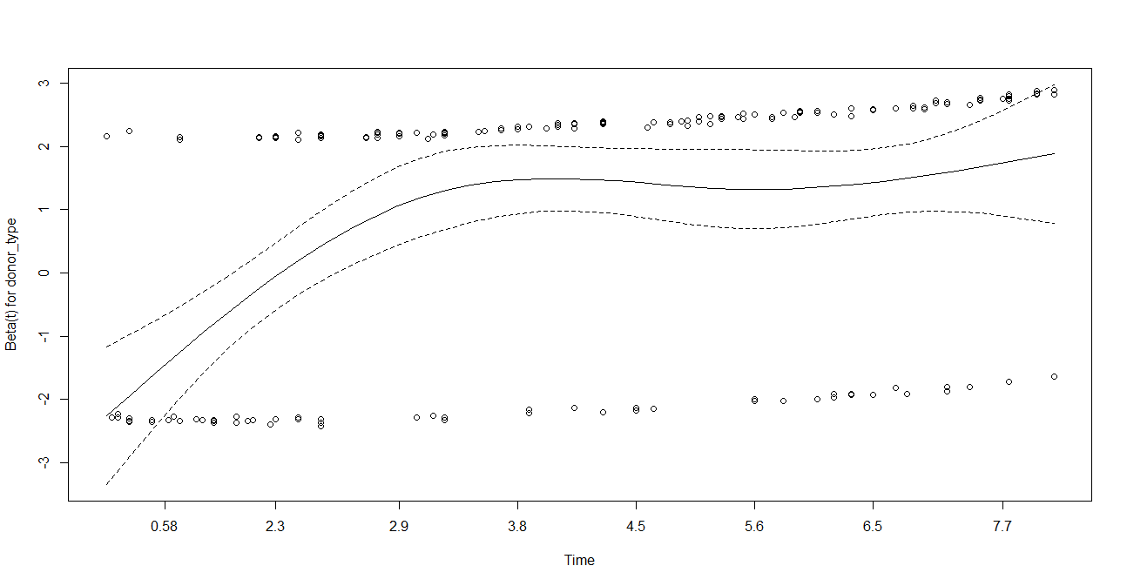
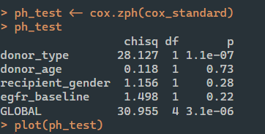
Standard Cox model

Slide 20
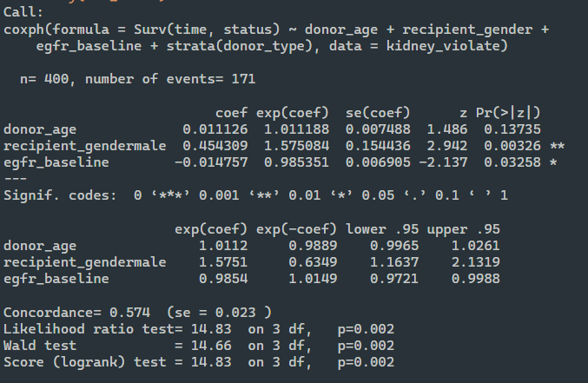
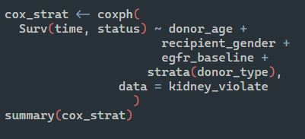
stratified Cox model

Slide 21
stratified Cox model (interpretation)
Variable | HR (exp(coef)) | 95% CI | p-value | Interpretation
Donor age | 1.01 | 0.997–1.03 | 0.14 | Not statistically significant. Within each donor type, the donor’s age has a small, non-significant tendency toward higher risk of graft failure.
Recipient gender (male) | 1.58 | 1.16–2.13 | 0.003 | Statistically significant. Male recipients have about 58% higher hazard of graft failure compared with female recipients, after adjusting for donor age and eGFR and within each donor type.
eGFR at transplant | 0.99 | 0.97–1.00 | 0.033 | Statistically significant. Each one-unit increase in baseline eGFR is associated with roughly a 1.5% lower hazard of graft failure, holding other factors constant and within each donor type.

Slide 22
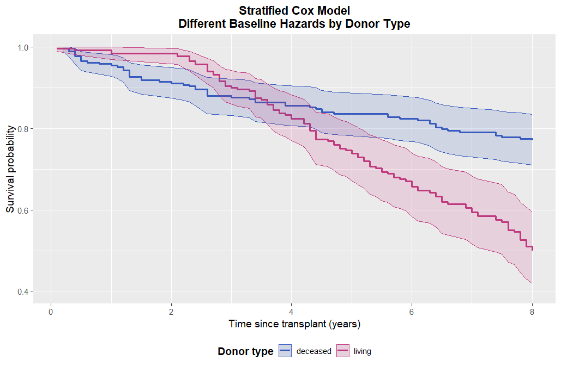
stratified Cox model
What about donor type?
Stratifying by donor type allows each group to have its own baseline hazard curve, effectively removing the need to assume a constant hazard ratio over time.
The curves demonstrate that living and deceased donor grafts follow different survival trajectories — exactly what we expect when the PH assumption is violated.

Slide 23
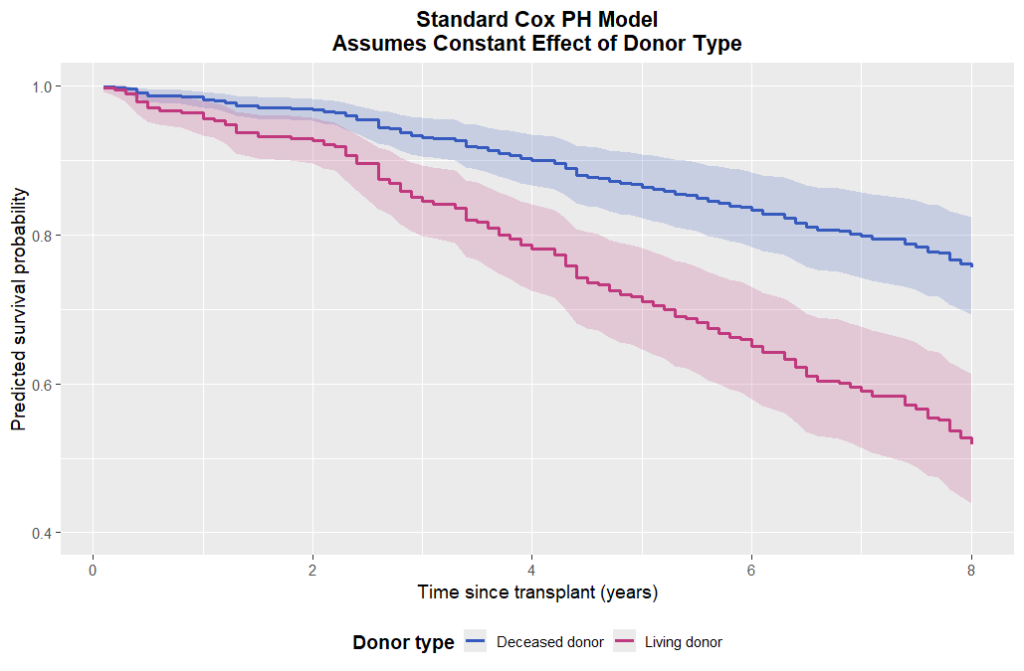
Standard cox vs stratified cox (PH violated)

Slide 24
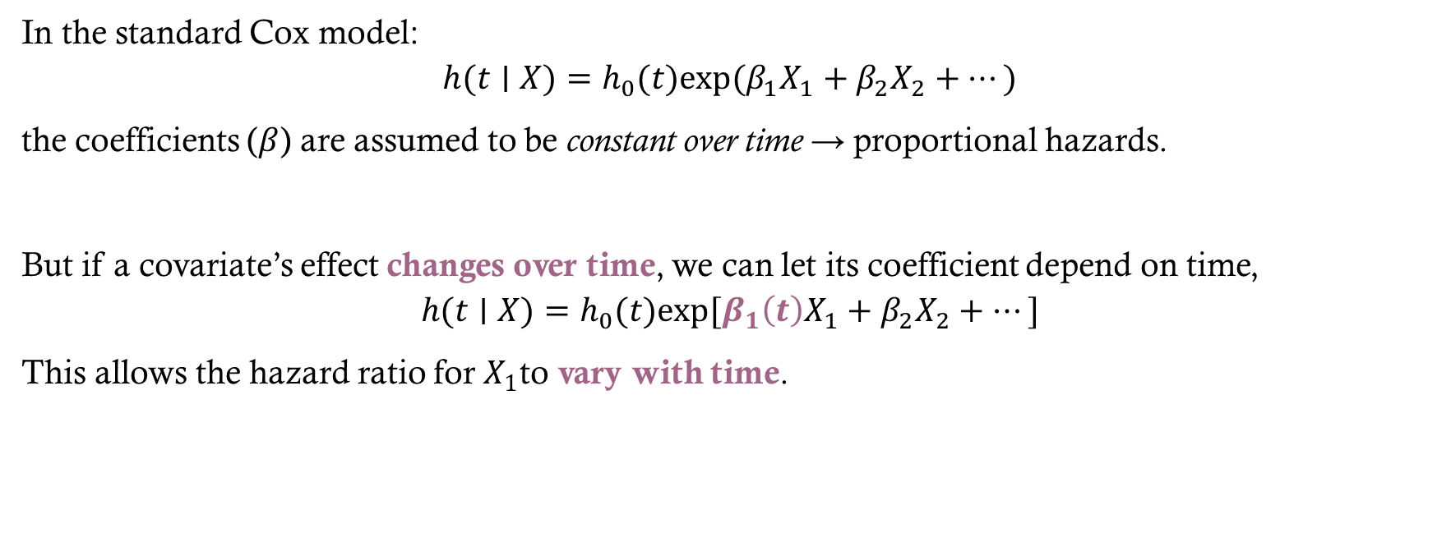
Including Time-Varying effects
In the standard Cox model:
$$h(t∣X)=h_{0}​(t)exp⁡(β_{1}​X_{1}​+β_{2}​X_{2}​+…)$$
the coefficients ($β$) are assumed to be constant over time → proportional hazards.
But if a covariate’s effect changes over time, we can let its coefficient depend on time,
$$h(t∣X)=h_{0}​(t)exp⁡[β_{1}​\left(t\right)X_{1}​+β_{2}​X_{2}​+…]$$
This allows the hazard ratio for $X_{1}$to vary with time.

Slide 25
Including Time-Varying effects
When to Use It:
  You detect a PH violation for a variable (e.g. donor_type) but you still want an explicit effect estimate rather than stratifying it away.
  For example, early after transplant, living donors may be protective; later, that advantage may diminish or reverse.

Slide 26
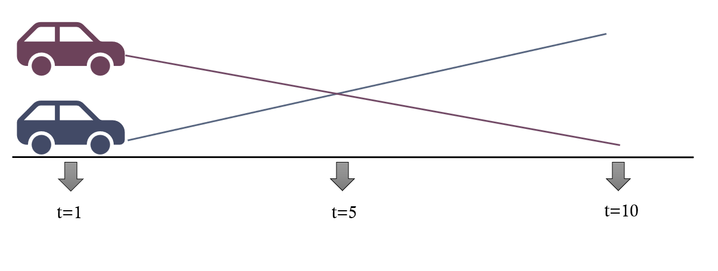
Including Time-Varying effects
“Instead of assuming the pink and blue cars keep the same speed ratio forever,
we now let the ratio change as the road gets longer — maybe the pink car starts faster, but the blue one catches up.”

Slide 27
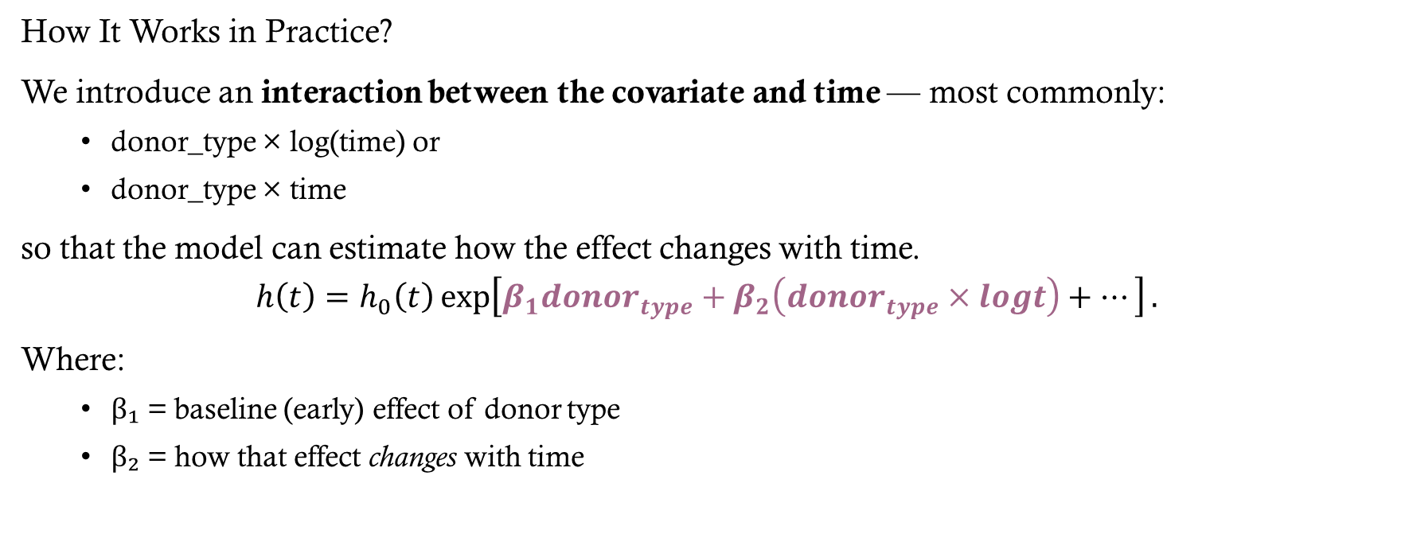
Including Time-Varying effects
How It Works in Practice?
We introduce an interaction between the covariate and time — most commonly:
  donor_type × log(time) or
  donor_type × time
so that the model can estimate how the effect changes with time.
$$h\left(t\right)=h_{0}​\left(t\right)\exp\left[β_{1}​donor_{type}+β_{2}​\left(donor_{type}×logt\right)+…\right].$$
Where:
  β₁ = baseline (early) effect of donor type
  β₂ = how that effect changes with time

Slide 28
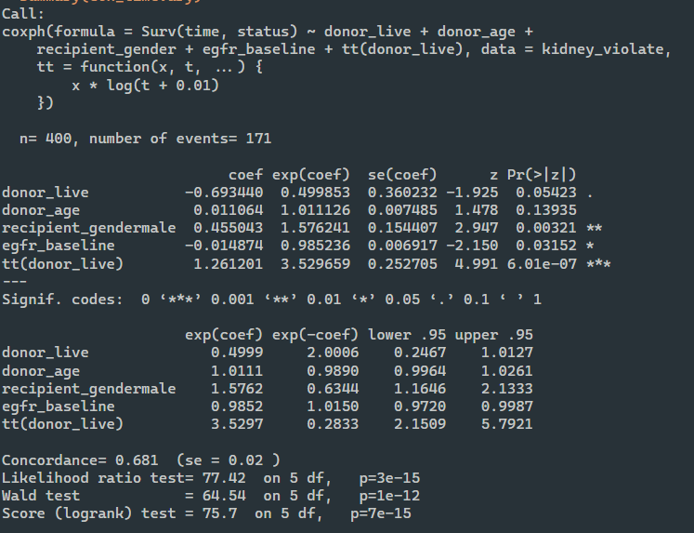
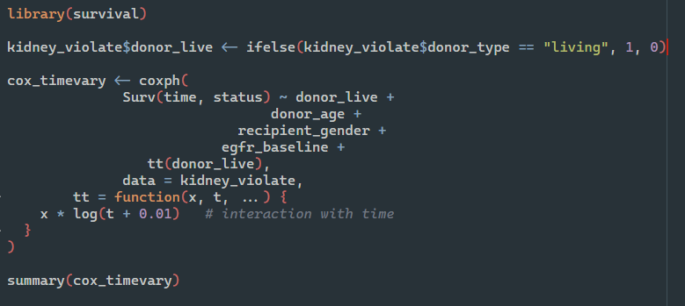
Including Time-Varying effects

Slide 29
Including Time-Varying effects
Variable | HR (exp(coef)) | 95% CI | p-value | Interpretation
donor_live | 0.50 | 0.25 – 1.01 | 0.054 (≈ 0.05) | At the start of follow-up (when log t ≈ 0), recipients of a living donor kidney have about 50 % lower hazard of graft failure compared to deceased-donor recipients.
tt(donor_live) | 3.53 | 2.15 – 5.79 | < 0.001 *** | The effect of living donor changes significantly over time: the HR increases by roughly a factor of 3.5 for each unit increase in log(time). In other words, the early advantage from living donors diminishes as time goes on.
donor_age | 1.01 | 1.00 – 1.03 | 0.14 | Older donor age shows a small, non-significant trend toward higher hazard.
recipient_gender (male) | 1.58 | 1.16 – 2.13 | 0.003 ** | Male recipients have about 58 % higher hazard of graft failure than females, adjusting for other factors.
egfr_baseline | 0.99 | 0.97 – 1.00 | 0.032 * | Each 1-unit higher baseline eGFR reduces the hazard of graft failure by roughly 1.5 %, indicating better baseline kidney function is protective.

Slide 30
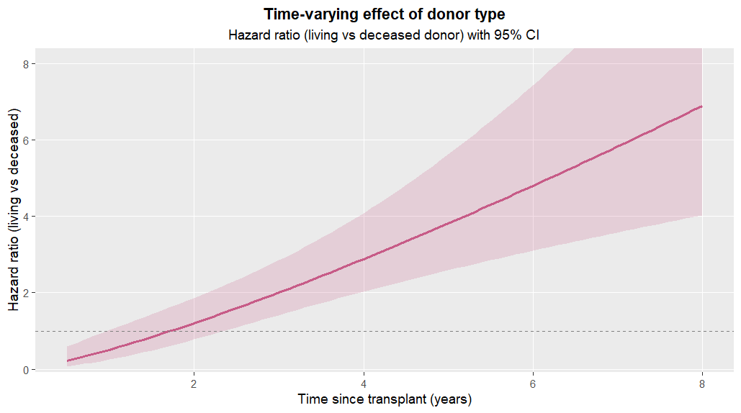
Including Time-Varying effects
The HR steadily increases and crosses 1 after roughly 1–2 years, indicating the early survival advantage of living donors diminishes.
By 5–8 years, the HR > 2–3, suggesting higher hazard among living-donor grafts in the later period.
The confidence band widens with time because there are fewer events and greater uncertainty at longer follow-up.

Slide 31
Example:
Outcome:
  time from the transplantation surgery to a graft failure
  Status of graft failure
Main Exposure : type of donor
Covariates:
  Age of donor
  Recipient gender
  eGFR at time of transplant

Slide 32

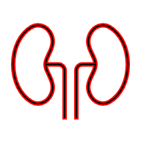
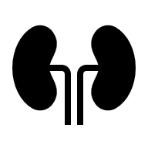
time-varying vs Time- fixed covariates
eGFR
Donor type
Donor type
Time of Transplant
End of the study

Slide 33

time-varying covariates can cause PH Violation!

Slide 34
Extended Cox model (time-varying covariates)
When do we use this?
  Some predictors actually change over time (e.g. kidney function, BP, medication use)
  We believe “current value” of that predictor matters for risk right now, not just the baseline value
Key idea:
We split each patient’s follow-up into intervals and update the covariate value for each interval.
  “eGFR at year 1 predicts risk between year 1–2… and if eGFR worsens, your risk changes after that.”

Slide 35
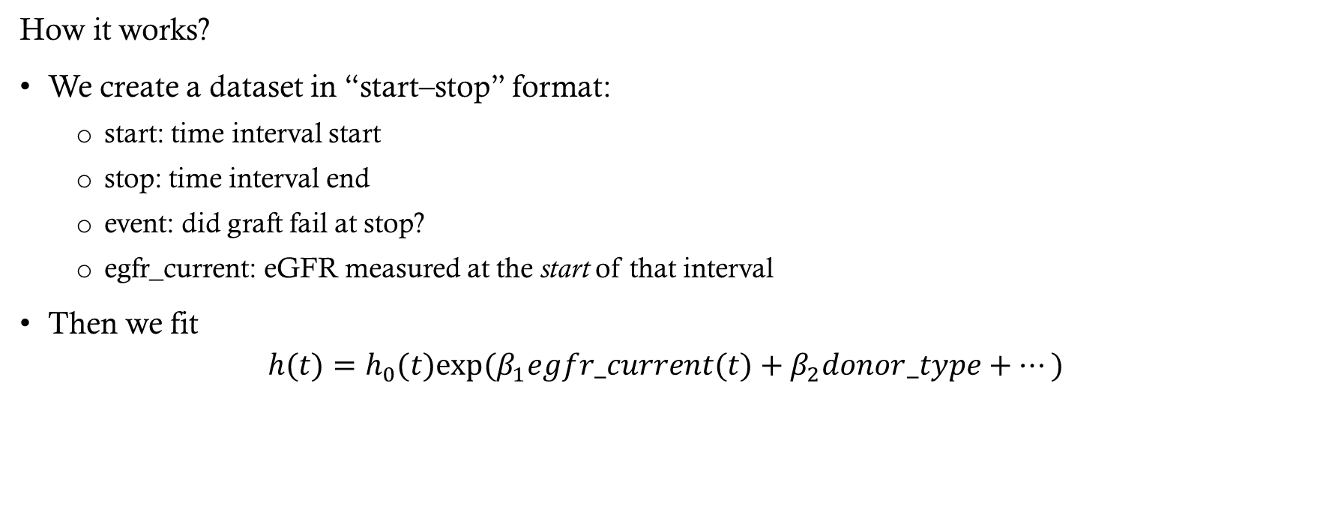
Extended Cox model (time-varying covariates)
How it works?
We create a dataset in “start–stop” format:
  start: time interval start
  stop: time interval end
  event: did graft fail at stop?
  egfr_current: eGFR measured at the start of that interval
Then we fit
$$h(t)=h_{0}​(t)exp⁡(β_{1}​egfr_current(t)+β_{2}​donor_type+…)$$
eGFR

Slide 36
Extended Cox model (time-varying covariates)
Why this addresses PH violation:
  PH was violated partly because “risk profile changes over time.”
  The extended Cox model explicitly updates the covariates over time instead of pretending they’re frozen at baseline.
  This is different from stratification and different from adding x × time: here the value itself is time-dependent
Notes:
Extended Cox ≠ “changing effect of a fixed baseline covariate,”
Extended Cox = “the covariate value itself changes through follow-up.”

Slide 37
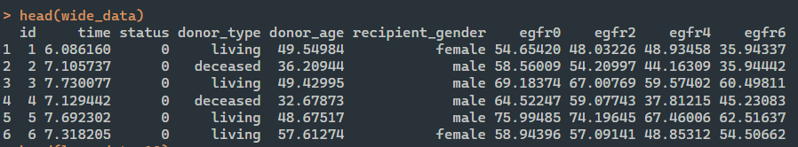
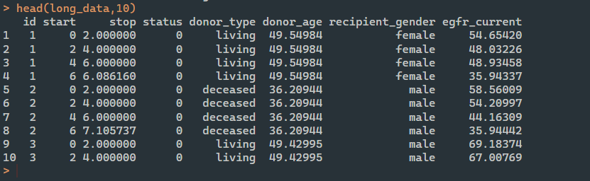
Extended Cox model (time-varying covariates)

Slide 38
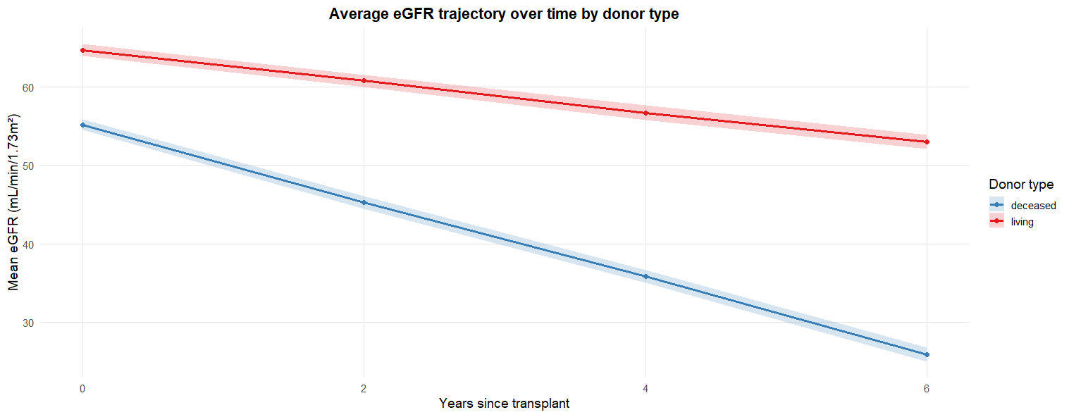
Extended Cox model (time-varying covariates)
Change of eGFR over time

Slide 39
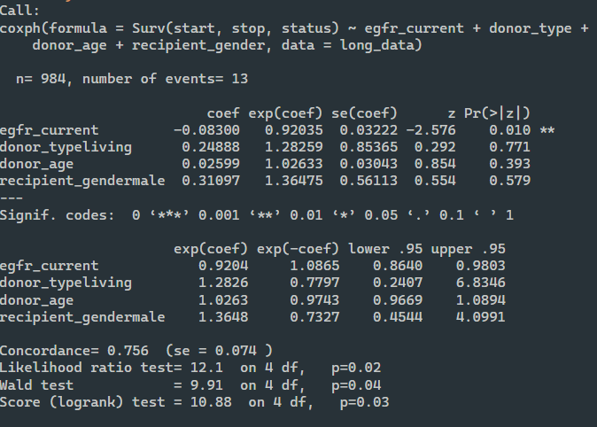
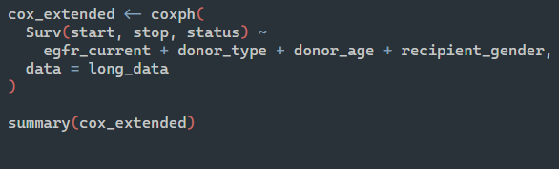
Extended Cox model (time-varying covariates)

Slide 40
Extended Cox model (time-varying covariates)
Variable | HR (95% CI) | p-value | Interpretation
eGFR_current | 0.92 (0.86 – 0.98) | 0.01 | Each 1 mL/min/1.73 m² higher current eGFR is associated with about an 8 % lower instantaneous hazard of graft failure, holding other factors constant.
Donor type (living vs deceased) | 1.28 (0.24 – 6.83) | 0.77 | No significant difference in hazard once time-updated eGFR is included.
Donor age | 1.03 (0.97 – 1.09) | 0.39 | No evidence of donor-age effect.
Recipient gender (male vs female) | 1.36 (0.45 – 4.10) | 0.58 | No significant gender difference.

Slide 41
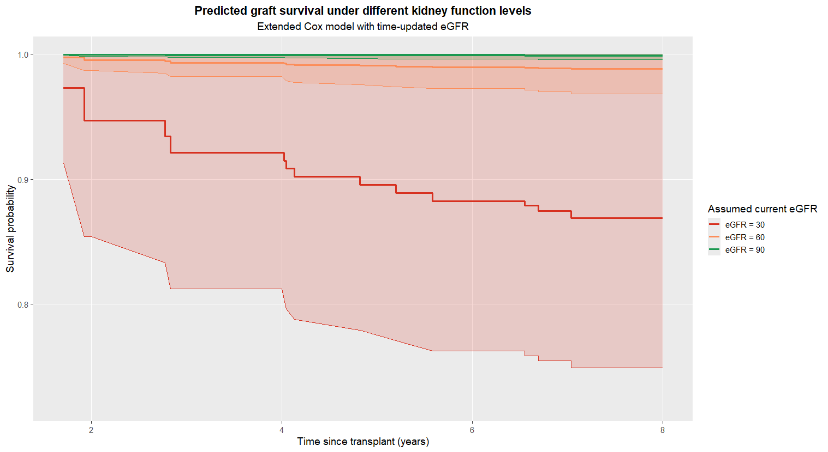
Extended Cox model (time-varying covariates)
eGFR Level | Interpretation
eGFR = 90 (green) | Very stable graft survival. The curve remains near 1.0 over time — meaning patients maintaining this level of kidney function have very low risk of graft failure.
eGFR = 60 (orange) | Slightly higher risk, but still good survival. The probability of graft survival remains high (>95 %) over 8 years.
eGFR = 30 (red) | Markedly reduced survival. The curve declines more steeply, showing a pronounced increase in the risk of graft loss over time.

Slide 42

What If
What if the decline in eGFR over time reflects underlying changes in other clinical factors, rather than acting as an isolated predictor?
And those same variables may also affect the risk of graft failure.

