Slide 2
Advanced survival concepts and analysis

Slide 3
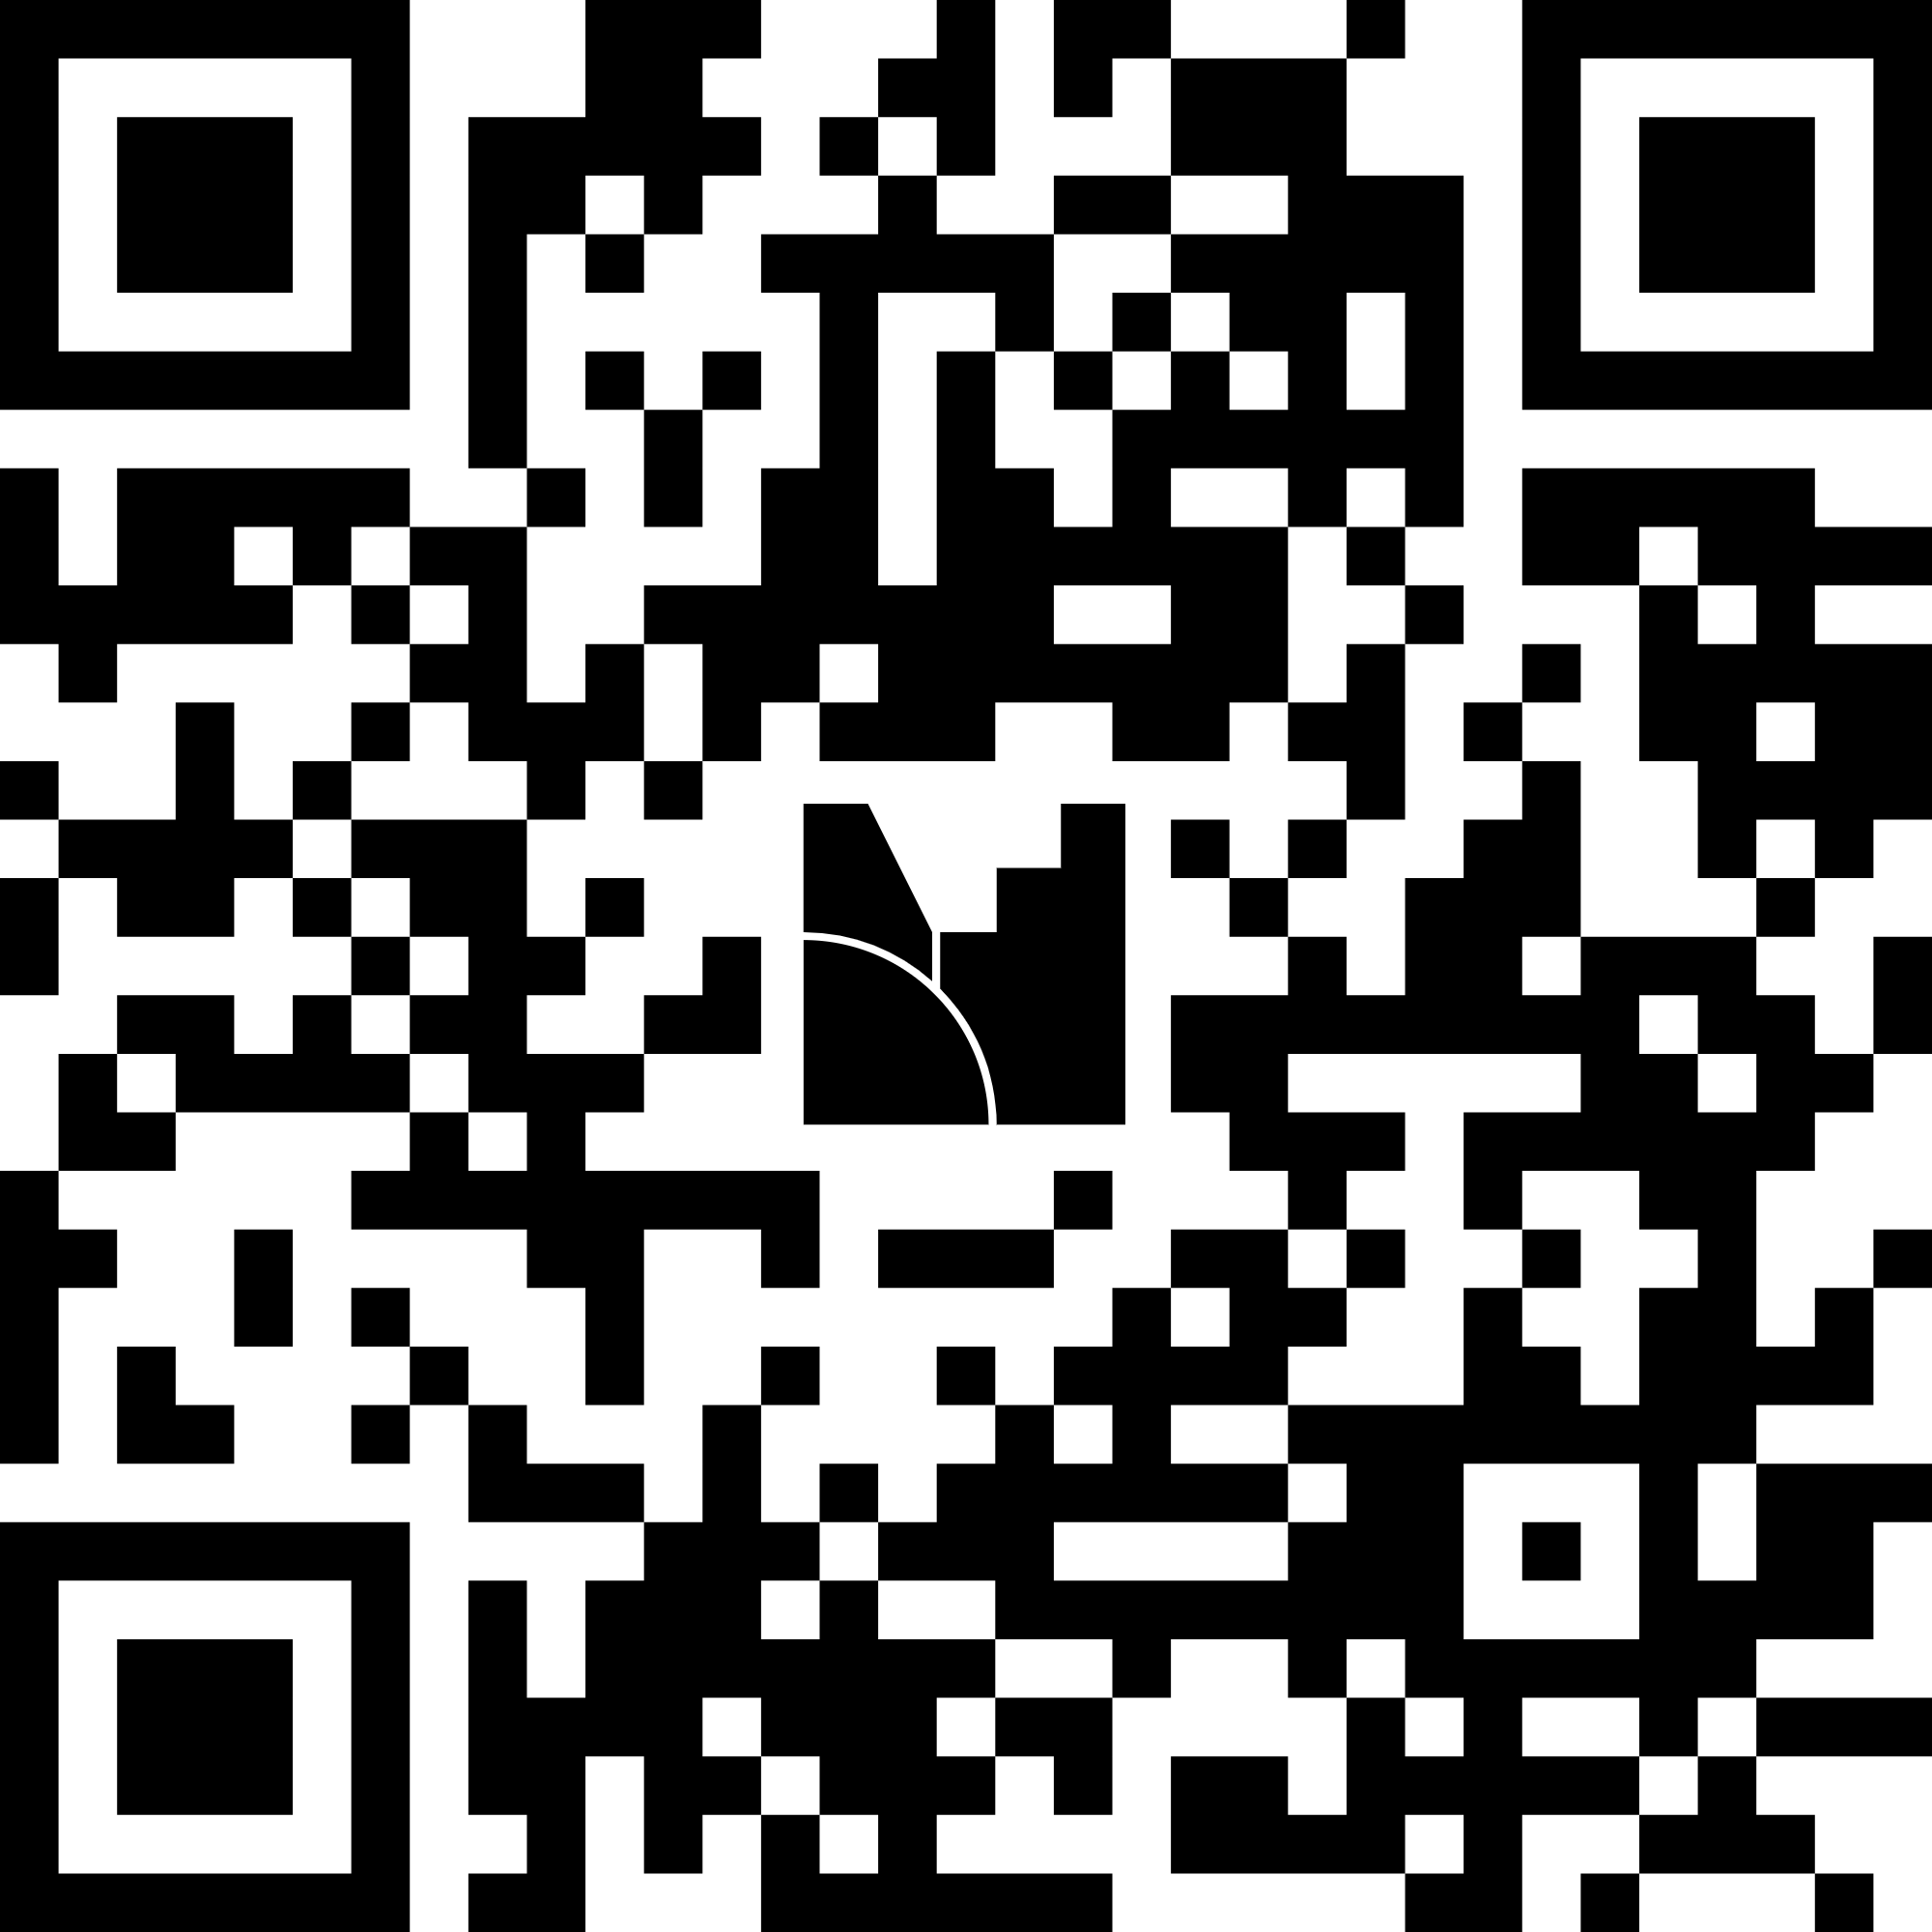
Welcome to the workshop!
https://www.menti.com/ali3mewmqpo7

Slide 4
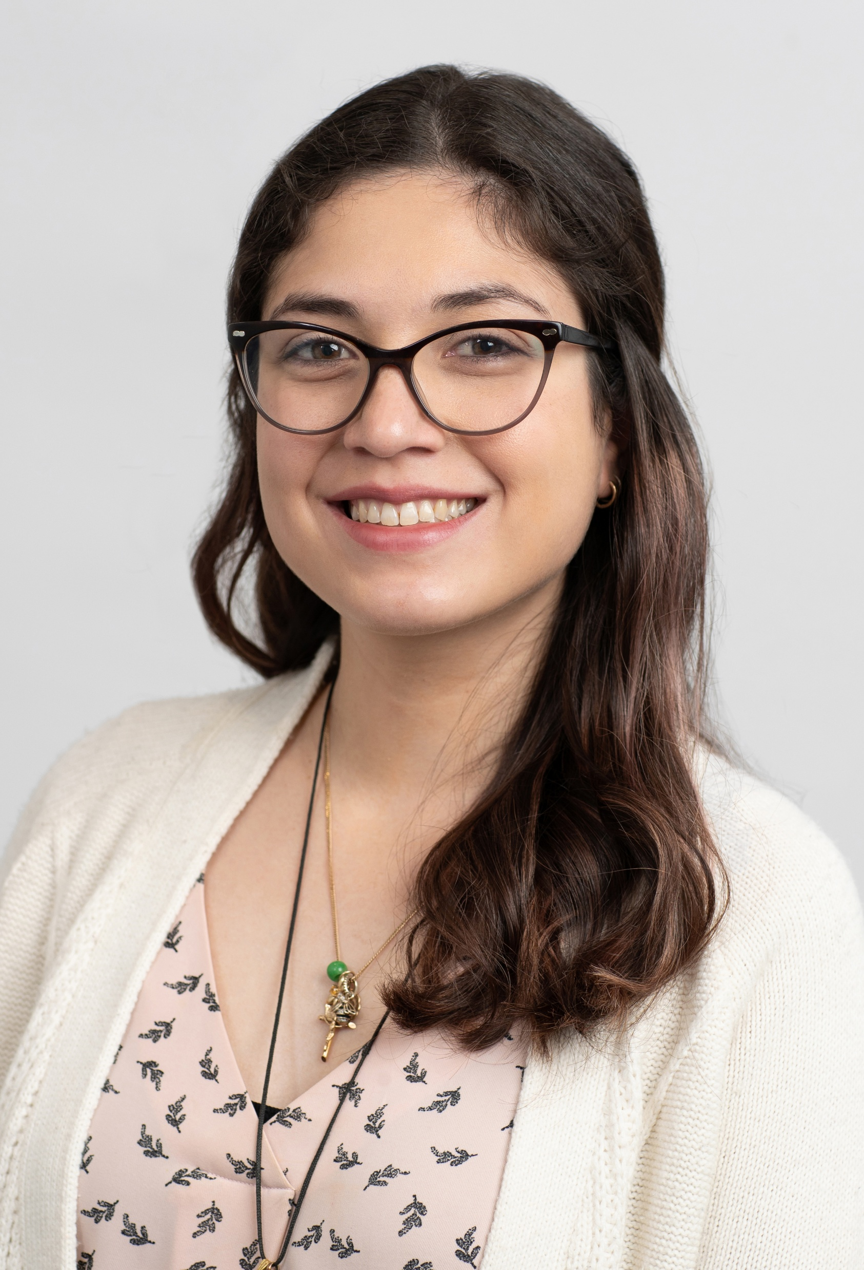
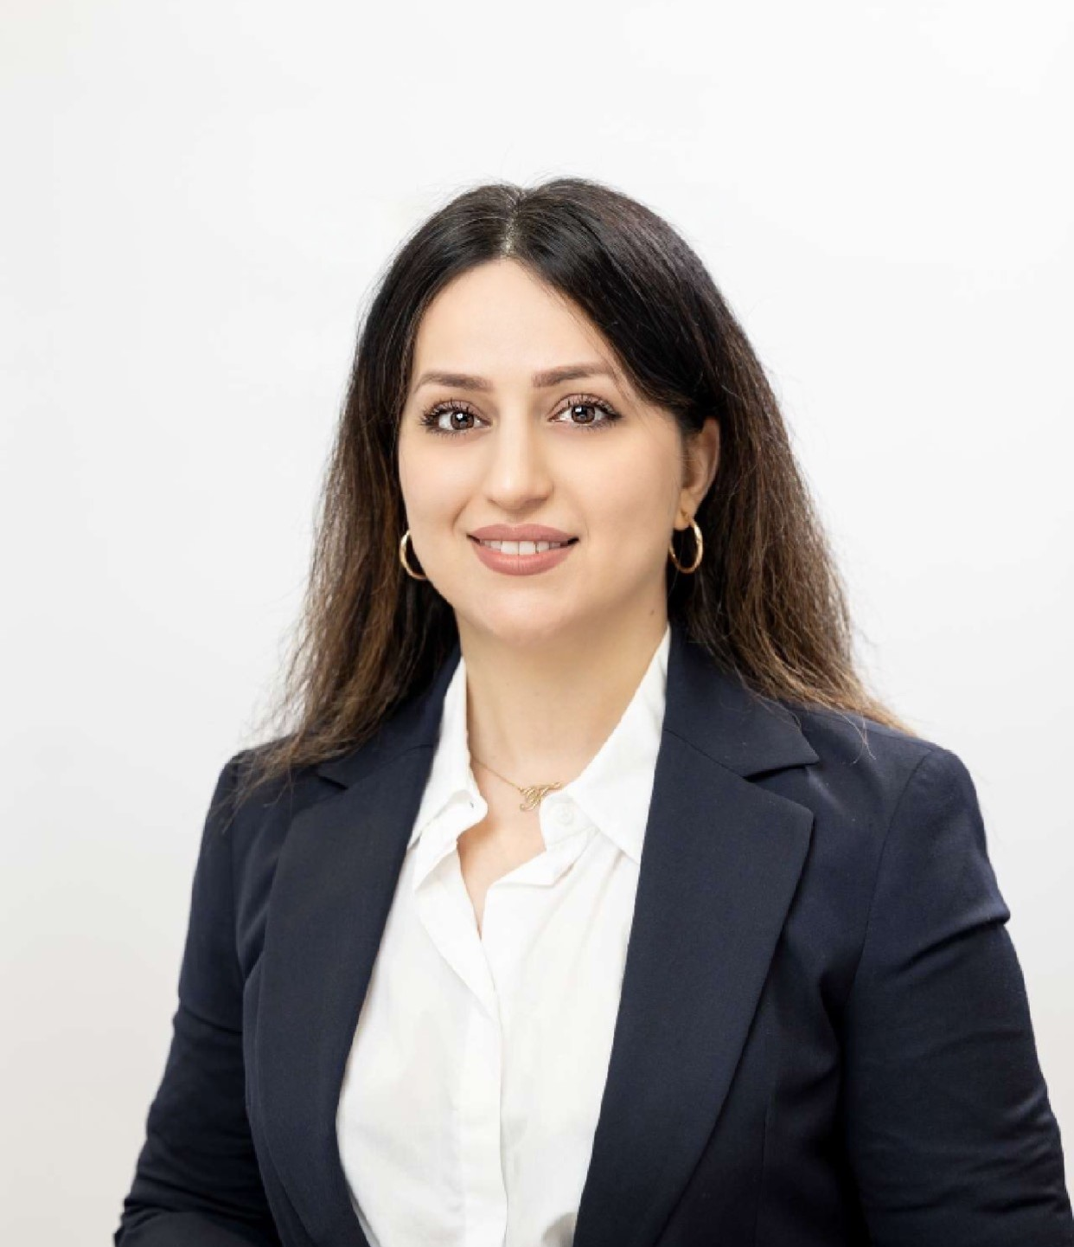
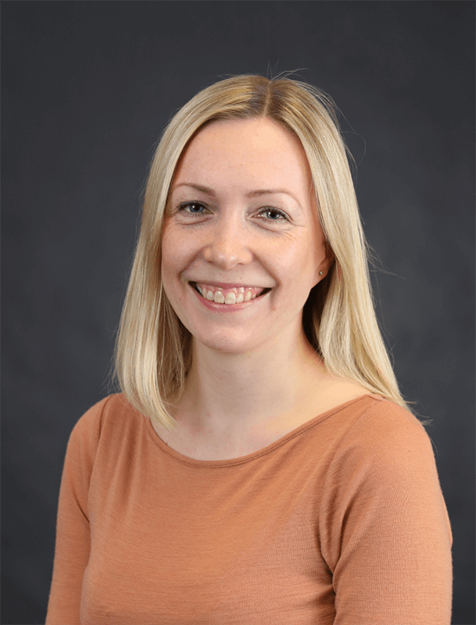
Meet the presenters
Dr Nicole De La Mata
Dr Farzaneh Boroumand
A/Prof Maarit Laaksonen

Slide 5





Housekeeping – emergency procedures
  In the unlikely event of an emergency, you may be required to evacuate. All University staff, students and visitors are required to respond to emergency alarms and follow instructions.
    Check for any sign of immediate danger
    Shutdown equipment/processes that cannot be left unattended
    Locate your closest exit
    Follow the green exit signs to find your way out of the building (do not use lifts)
    Proceed to the assembly area, a safe distance from the building, while waiting until the emergency is over.

Slide 6



Your role in ensuring a safe campus
  We are committed to providing a safe and healthy learning environment that is free from bullying, unlawful harassment and discrimination.
  You can ensure the safety of yourself and your peers by understanding your rights and responsibilities, which are detailed in our Student Charter.
  If you experience or witness any form of behaviour that breaches the Student Charter or our codes of conduct, you can report it to our Student Affairs team.
  Our support services, including the Wellbeing team and Safer Communities Office, can support you in dealing with any threats to your safety. You can connect with these teams via the Student Portal.

Slide 7
Facilities housekeeping
Room locations
Bathroom locations
Food locations

Slide 8
Overview of the workshop
Introductory concepts of survival analysis
No prerequisites, but practical applications in R
Targeted to biostatisticians, health data researchers, epidemiologists, public health professionals and physicians/clinicians.
Must bring your own laptop and R
**First time running course – feedback welcome**

Slide 9
Topics covered
Cox model PH assumption violated
Joint modelling
Parametric survival modelling
Flexible parametric survival modelling
Competing risks
Multi-state survival modelling
Additional readings may be needed.
Extended concepts will be referred to other resources

Slide 10
Timetable – Day 1
Time | Topic | Presenter
9:00 – 9:15 | Welcome & Overview | Nicole
9:15 – 11:20 | PH assumption violation in Cox | Farzaneh
11:20 – 11:30 | Break
11:30 – 12:30 | Joint modelling | Farzaneh
12:30 – 1:15 | Lunch
1:15 – 2:00 | Joint modelling (continued) | Farzaneh
2:00 – 2:50 | Parametric survival models | Maarit
2:50 – 3:00 | Break
3:00 – 3:50 | Flexible parametric survival models | Maarit
3:45 – 4:00 | Wrap up | Maarit

Slide 11
Timetable – Day 2
Time | Topic | Presenter
9:00 – 9:15 | Recap & Overview | Nicole
9:15 – 11:00 | Competing risks models | Maarit
11:00 – 11:10 | Break
11:10 – 12:30 | Flexible parametric survival (continued) | Nicole
12:30 – 1:15 | Lunch
1:15 – 2:50 | Multi-state modelling | Nicole
2:50 – 3:00 | Break
3:00 – 3:50 | Multi-state modelling (continued) | Nicole
3:45 – 4:00 | Wrap up | Maarit

Slide 12
Resources and Navigation
Github: https://github.com/NicoleDeLaMata/AdvancedSurvival
Data
Coding
Presentations
Recordings
Quarto webpage: https://nicoledelamata.github.io/AdvancedSurvival/
Additional exercise data (suggested solutions following workshop)
At conclusion, zip file of resources will be sent and Github accessible for 1 week before closing public access.

Slide 13

Questions?

