Slide 1

Covid-19
Health Data
Data Analytics Bootcamp
Tarak Patel, Nicole Lund & Anne Niemiec

Slide 2



Hypotheses
We expect to see a significant ramp-up
in vaccine allocation with time. Aside from
known anomalies like the Texas storm in March.
We expect to see larger quantities of Pfizer
vaccines being allocated to states with the
greatest population density due to storage
requirements and larger quantities of
Johnson and Johnson vaccines being
allocated to states with lower population densities.
We believe the distribution ratios between
the first and second dose will invert
over time with early dates showing a
higher level of 1st dose allocations and
later dates showing a higher level
of 2nd dose allocations.
We believe that states should be
administering vaccines quickly
based on the allotments.

Slide 3
Vaccines Evaluated
Pfizer
Moderna
J & J

Slide 4
Data Sources
1
Pfizer Vaccine Allocation:
4
Covid Cases and Deaths
https://data.cdc.gov/Vaccinations/COVID-19-Vaccine-Distribution-Allocations-by-Juris/saz5-9hgg
https://data.cdc.gov/Case-Surveillance/United-States-COVID-19-Cases-and-Deaths-by-State-o/9mfq-cb36
2
Moderna Vaccine Allocation:
5
State Abbreviations List
https://data.cdc.gov/Vaccinations/COVID-19-Vaccine-Distribution-Allocations-by-Juris/b7pe-5nws
https://www.infoplease.com/us/postal-information/state-abbreviations-and-state-postal-codes
3
J & J Vaccine Allocation:
6
Vaccines Administered
https://data.cdc.gov/Vaccinations/COVID-19-Vaccine-Distribution-Allocations-by-Juris/w9zu-fywh
https://ourworldindata.org/us-states-vaccinations

Slide 5
Datasets
Timeframe
Vaccines
Demographics
12/14/20-4/19/21
Pfizer, Moderna, and J&J
Population, median age, household income, poverty rate and unemployment rate
#
!
USA
Allocations
Infections
States and territories
When the vaccines are established by the US Government
Date in which the state or territory records transmission and deaths

Slide 6

Questions Posed
What can we learn about the allocation of vaccines nationwide referencing a common date?
Summarized
Individual states; cumulative
Project Outline
How does the information vary based on demographic?
Allocations normalized by state relative to population
Reported Covid-19 cases based on poverty at state level
Reported Deaths based on poverty at state level
Correlation between # vaccines allotted and reported # deaths (nationwide and by state)
What can we gleam from…..
xxx

Slide 7

Exploration & Cleanup
Summarized data restrictions- move to bottom
With select plots, it was necessary to omit territories (e.g. Puerto Rico) and government affiliations
Vaccine Allocation
Set zero value for null values
State Naming Conventions
Utilized state codes as common index
Normalized Data
Adequately measured the number of days from the original start date (12/14/20) and removed all case and death data prior to this date.

Slide 8

Analysis
We will present visualizations that will help illustrate the current situation related to the Covid-19 pandemic and where we stand relative to vaccinations at a state level within the United States.

Slide 9
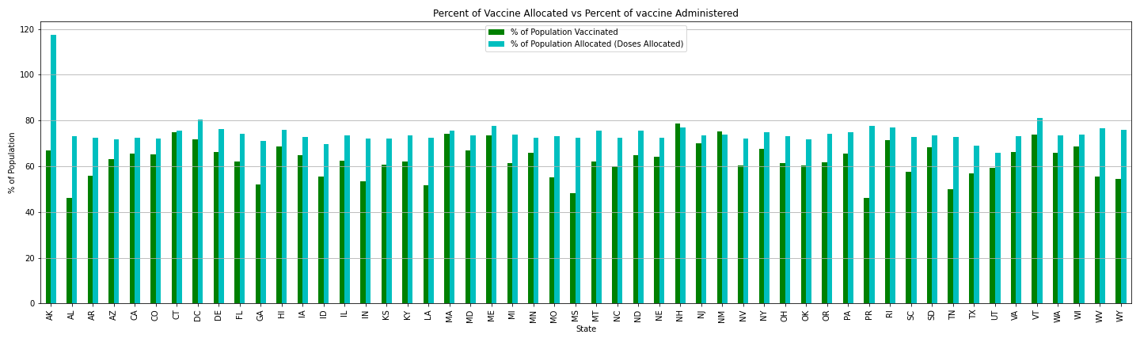
Anomaly
Commentary: How well are states distributing the vaccines received from the CDC.
This figure represents the percent of vaccines allocated versus the percent of vaccines administered. This is a calculation based on the number of doses. Keep in mind that two of the three vaccines in our dataset require two doses (Pfizer & Moderna). The majority of states are adequately administering the vaccines upon receipt from the CDC. New Hampshire and New Mexico reflect a higher number of vaccines received versus administered and we suspect it is related to the indigenous population and their diligence within the tribal community to administer them quickly; while we suspect Alaska has experienced challenges with administering the vaccination based on population density.

Slide 10
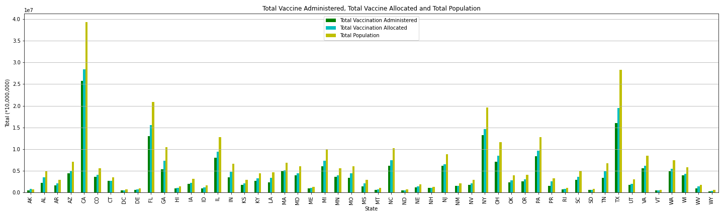
Commentary: How many doses were administered by state?
This figure displays the relationship between the population and the number of vaccines allocated and administrated. As you can see, California
and Texas have a large task ahead.

Slide 11
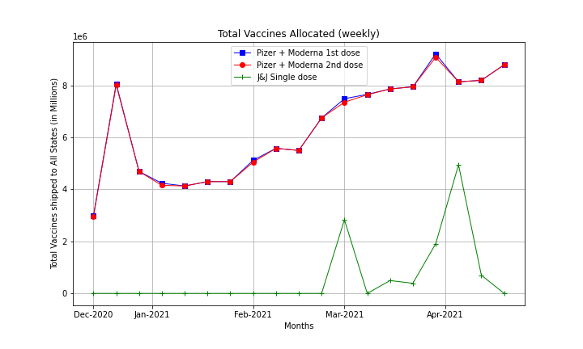
Commentary: How does the CDC handle the multi dose allocation in their distribution values.
The CDC has allocated both doses for Pfizer and Moderna at the time of allocation.

Slide 12
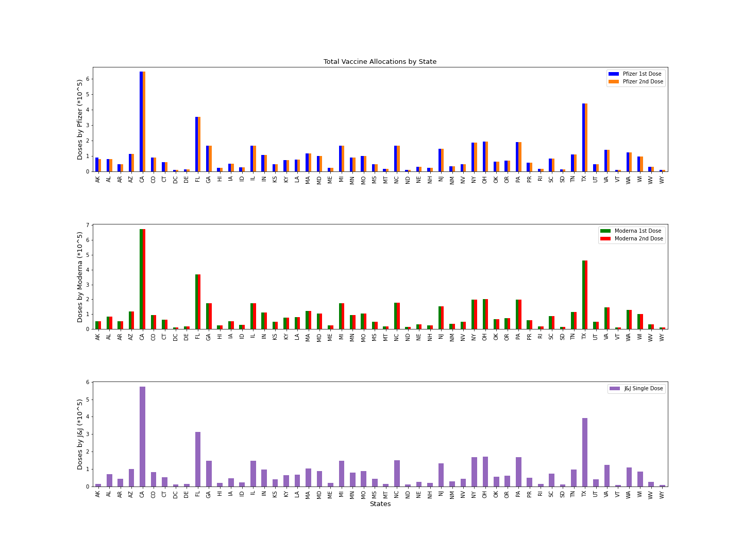
Commentary: Note, these images contain the number of total vaccines allocated by state. In figures 1 & 2, you will notice the bars mirror each other due to the fact that the patient is automatically scheduled for the 2nd dose (Pfizer & Moderna) at the time of receiving their first dose; hence the allocation for dose two is the same value as dose one. In the third figure, you only see one bar, since J&J is a single dose vaccine. However, it appears that CA has received a higher number of doses of Moderna versus Pfizer and J&J.

Slide 13
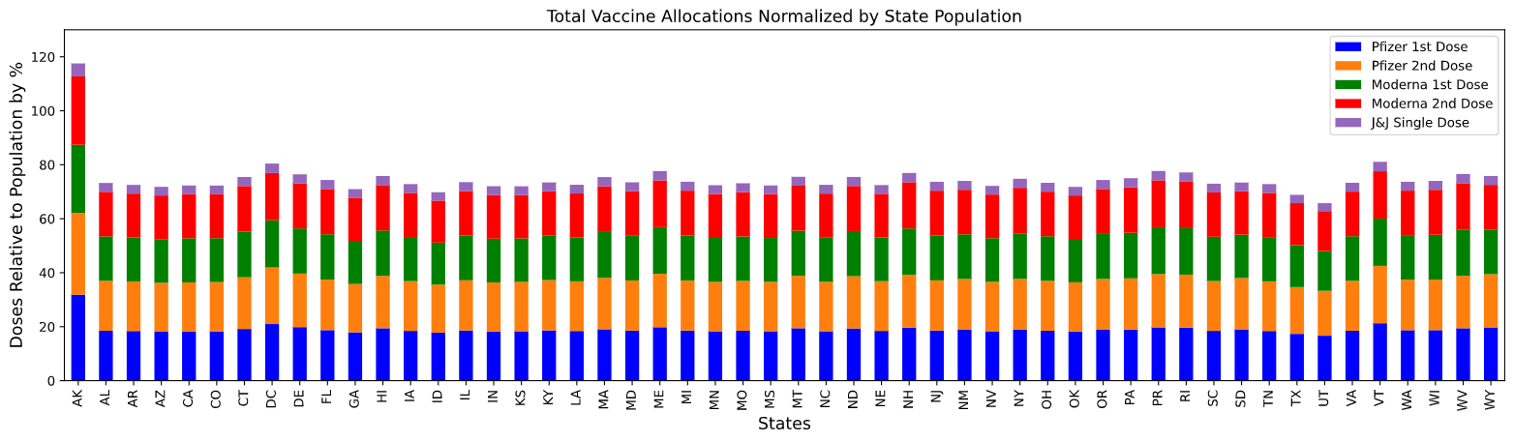
Commentary: In this figure, once the population value is normalized, it portrays a more even allocation for all states with the exception of Alaska by percentage. We believe the reasoning is based on the density of population and they report monthly on distribution versus weekly like the other states. We used population to compare vaccine allocation of states with various sizes. The values are similar/same for Pfizer since the doses are automatically scheduled for you.

Slide 14
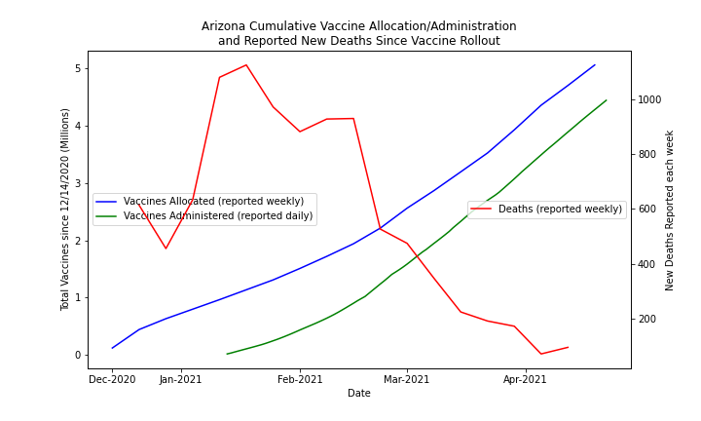
Commentary:

Slide 15
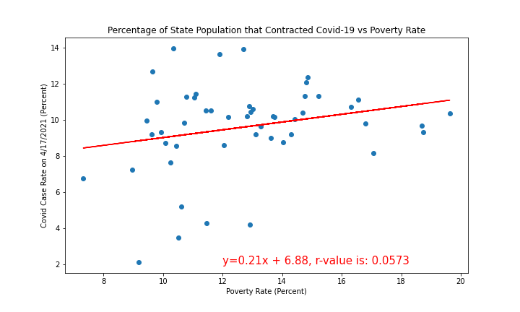
Commentary:

Slide 16
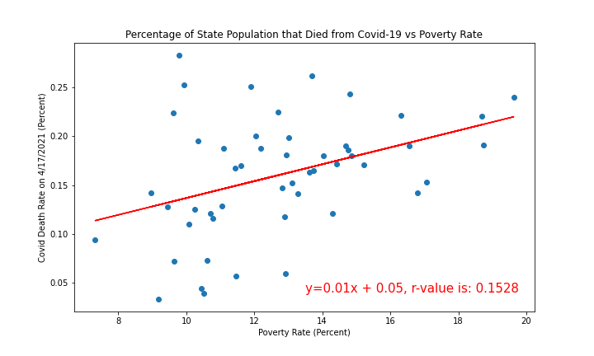
Commentary:

Slide 17
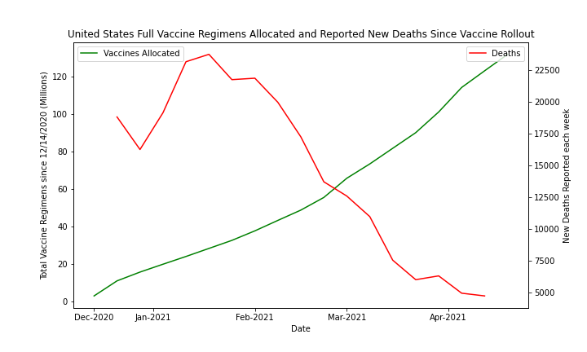
Commentary:

Slide 18
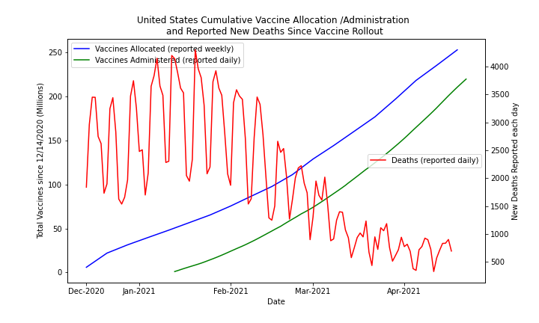
Commentary:

Slide 19
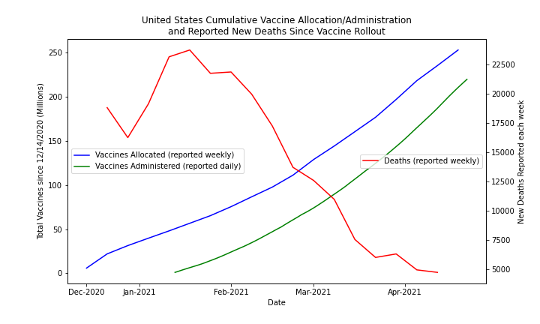
Commentary:

Slide 20

Conclusions
xxxxxxx

Slide 21
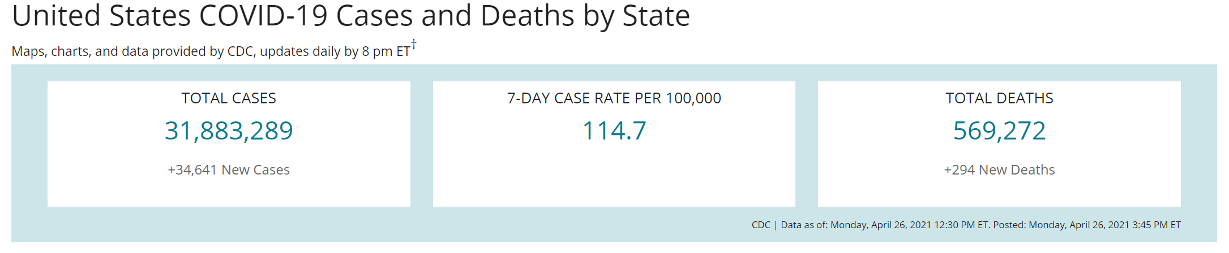
Covid-19 Pandemic
Include # of doses administered as of 4/19; include total % of US Population having received at least one dose (62.1%).
J&J
Pfizer
Moderna

Slide 22



FOUNDERS OR TEAM SLIDE
Katy White
Peter White
Kimberly Clark
Co-Founder
Co-Founder
Co-Founder
Investment generally results in acquiring an asset also
Investment generally results in acquiring an asset also
Investment generally results in acquiring an asset also

Slide 23

OUR
SERVICE
Emergency
Investment generally results in acquiring an asset also the asset is available
Maternity
Investment generally results in acquiring an asset also the asset is available
Nursing
Investment generally results in acquiring an asset also the asset is available

Slide 24
Title
Subtitle
Your Title
Your Title
Your Title
Your Title
Your Title
A good business plan starts with a summary
A good business plan starts with a summary
A good business plan starts with a summary
A good business plan starts with a summary
A good business plan starts with a summary

