Slide 1
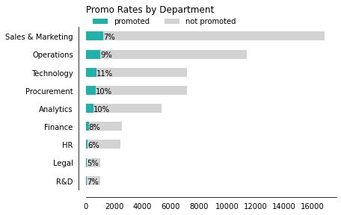
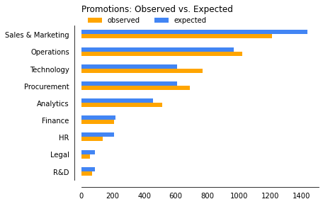
Summary
The purpose of this analysis is to estimate a model to determine the factors that influence an employee at a multinational corporation receiving a promotion. I will use a synthesized data set to demonstrate how to perform logistic regression and interpret the regression coefficients. These coefficients communicate the strength and direction of the relationships between the explanatory variables and the outcome variable, promotion, to explain which holds the most weight.
The promotion rate for the organization is 9% but we’re observing fewer promotions than expected in HR, Legal, and Sales & Marketing, Additionally, there are more than expected in Technology and Procurement. All other departments fall within a normal range.
I am going to be build separate models for three departments - HR, Technology, and Operations so we can isolate the key influences for promotions in each unit. For the initial variable selection, I used generation, gender, region, awards won, variables related to performance.

Slide 2
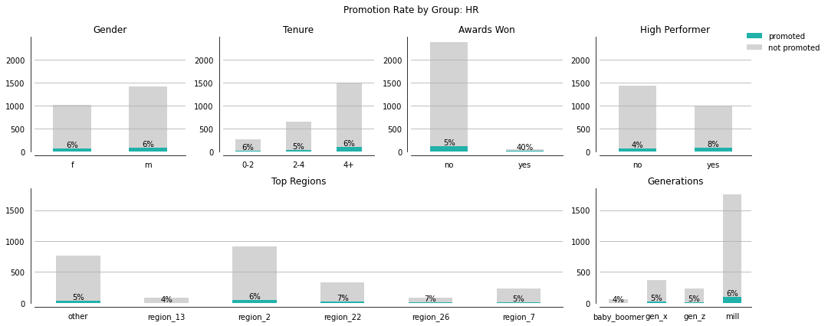
HR Promotions: Overview
The organization promotion rate for HR is 6% which is 3 percentage points lower than the company overall.
We considered the impact that gender, awards won, performance, generation and region had on whether someone got promoted.
Winning an award had the biggest effect followed by high performance. However, only 2% of the employees in this department (n = 45) received an award.

Slide 3
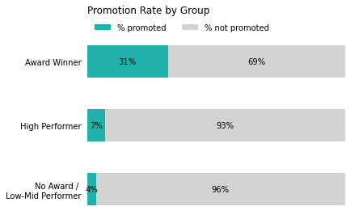
HR Promotions: Drivers
High performers are 2X as likely to get promoted as the baseline group - low to mid performers who haven’t won an award.
Employees who’ve won awards are 12X as likely to earn a promotion than the baseline group regardless of performance status.

Slide 4
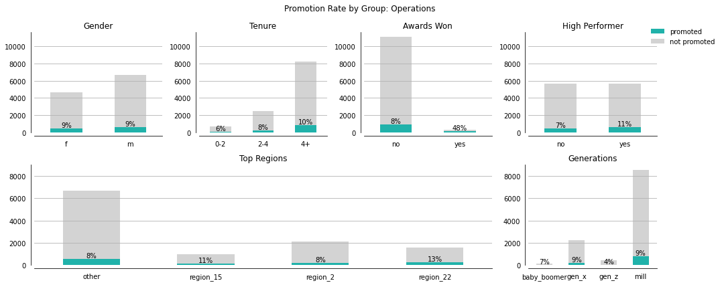
Operations Promotions: Overview
The organization promotion rate for Operations is 9% which is the same as the organization’s average. As observed with the HR department, employees who’ve won awards and high performers have increased odds of receiving a promotion. Gender didn’t play a role in an employee’s odds of promotion.
Additionally, there was an association between high performance and region, and high performance ant tenure

Slide 5
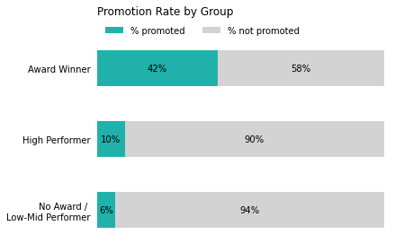
Operations Promotions: Drivers
High performers are 1.5X as likely to get promoted as the baseline group - low to mid performers who haven’t won an award.
Employees who’ve won awards are 10X as likely to earn a promotion than the baseline group regardless of performance status.

Slide 6
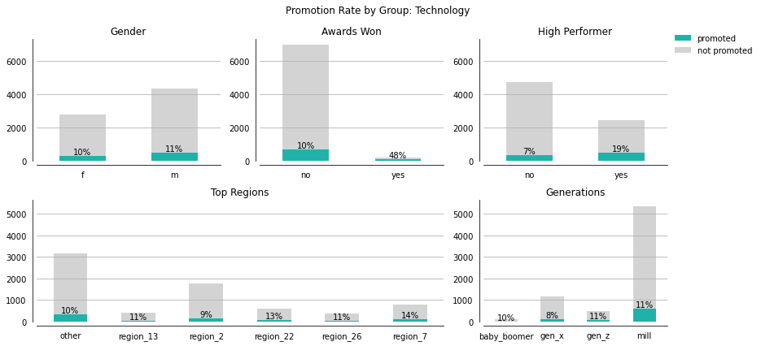
Tech Promotions: Overview
TBD

