Slide 1
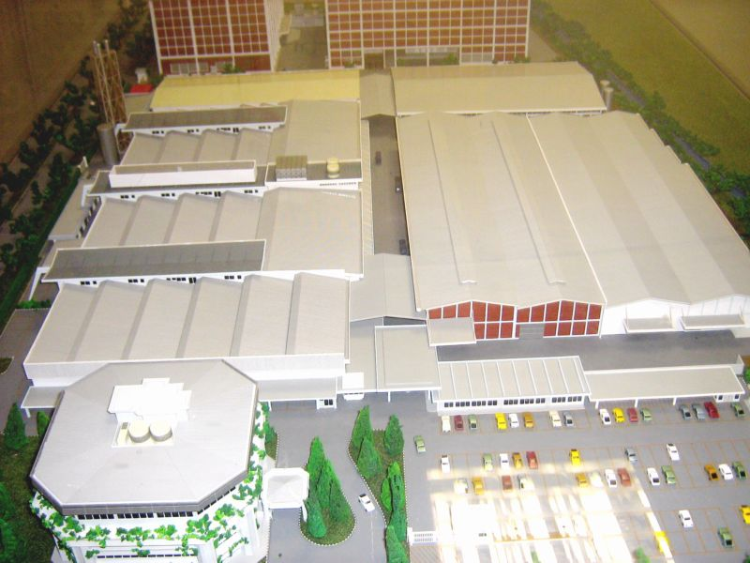
BRITISH AMERICAN TOBACCO

