Slide 1
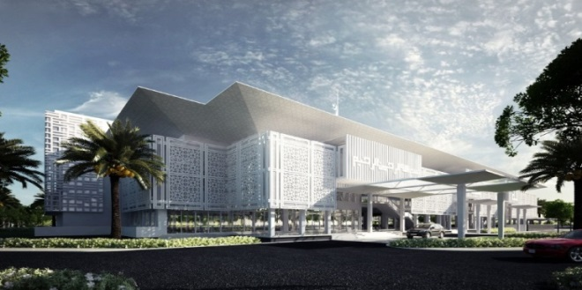
Cyberjaya Mosque – GBI Facilitator

