Slide 1
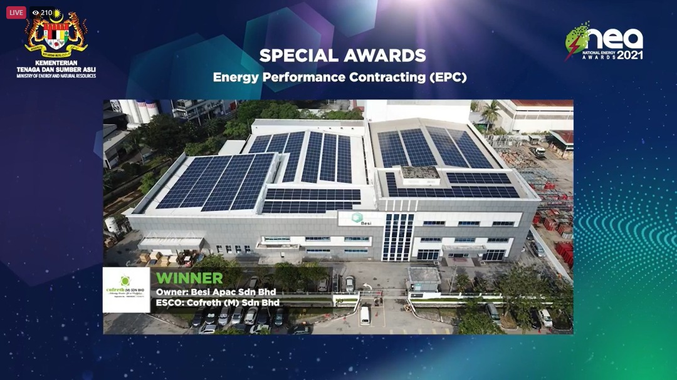
Energy Performance Contracting (EPC) Project

