Slide 1
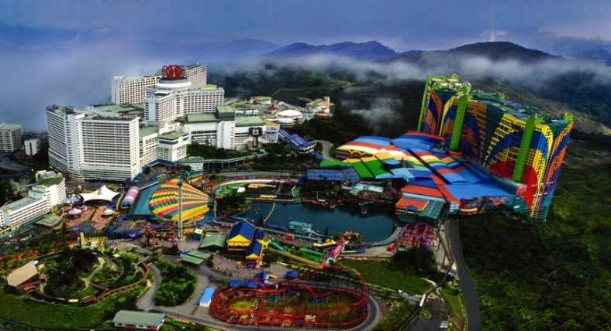
Energy Audit Projects
Genting Highland Hotels & Casino

Slide 2
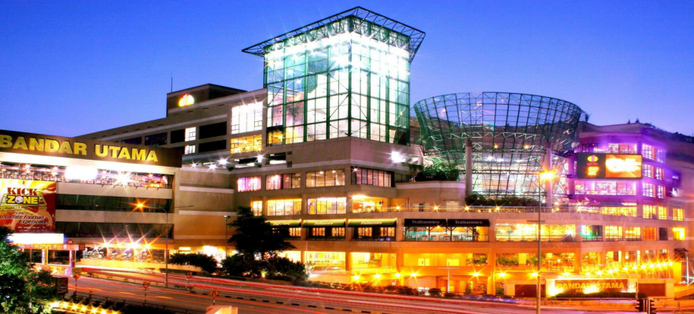
Energy Audit Projects
One Utama Shopping Centre

