Slide 1
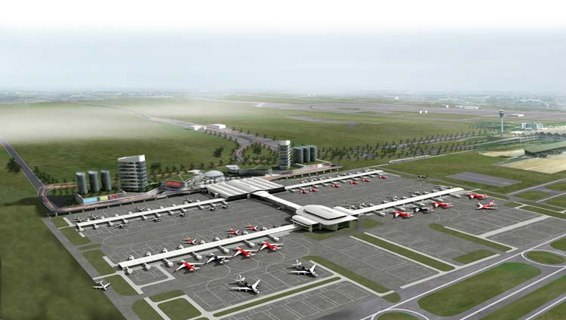
Green Building Consultancy-KLIA 2

