Slide 1
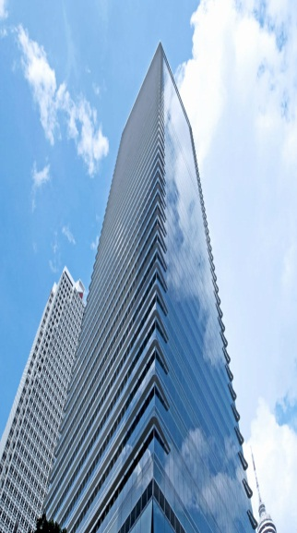
Green Building Consultancy - Menara AIA Capsquare

