Slide 1
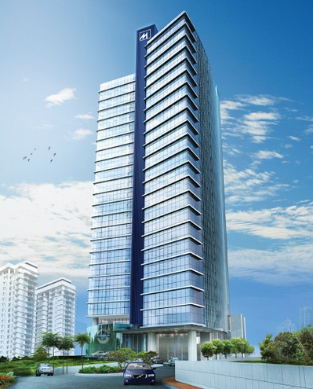
Green Building Consultancy
PNB 1194
(MAS Office Tower & Hotel)

