Slide 1

AGENTIC AI FOR HEALTHCARE
CONTENT MANAGEMENT
From Policy Interpretation to Auditable Rule Generation
Yue Shen (Nicole)
University of Chicago · 07/07/2026

Slide 2

PROBLEM
EVOLUTION
ARCHITECTURE
DEMO
RECOMMEND
OPPORTUNITIES
THE PROBLEM
Healthcare policy (coding rules, coverage policies, clinical guidelines) is:
High-volume and constantly changing
Written in natural language
Difficult to translate into executable rules
Yet payers need precise, auditable rules to process claims correctly and avoid payment errors.
Today, policy-to-rule translation relies primarily on manual work: slow, expensive, and error-prone.
$31.7B
Medicare FFS Improper Payments
FY2024
▸ Insufficient documentation is the leading cause
Source: CMS Fiscal Year 2024 Improper Payments Fact Sheet

Slide 3
PROBLEM
EVOLUTION
ARCHITECTURE
DEMO
RECOMMEND
OPPORTUNITIES
THE EVOLUTION
TRADITIONAL
GENAI QA
AGENTIC AI
Analyst reads and interprets policy manually
• Slow, labor-intensive
• Inconsistent coverage
• Hard to scale
Analyst asks questions about policy via LLM
• Faster access to answers
• Just Q&A, not structured
• Not directly actionable
System retrieves, drafts, tests, and flags
• End-to-end automation
• Auditable output
• Human-in-the-loop
▲ This is what I built

Slide 4
PROBLEM
EVOLUTION
ARCHITECTURE
DEMO
RECOMMEND
OPPORTUNITIES
MY POC: ARCHITECTURE
POLICY
DOCUMENTS
AGENT
PLANNING
RULE
EXTRACTION
DETERMINISTIC
ADJUDICATION
PAY / DENY / REVIEW
+ CITATIONS
RETRIEVAL
Core Design: LLM handles interpretation and extraction; deterministic engine handles adjudication
Evidence Retrieval
Structured Rule Output
Auditable Decisions
Searches policy documents with semantic matching and relevance scoring
Produces JSON rules with conditions, actions, exceptions, and source citations
Tests rules against sample claims, then returns PAY / DENY / REVIEW cited to the policy

Slide 5
PROBLEM
EVOLUTION
ARCHITECTURE
DEMO
RECOMMEND
OPPORTUNITIES
LIVE DEMO
RETRIEVAL → EXTRACTION → ADJUDICATION

Slide 6
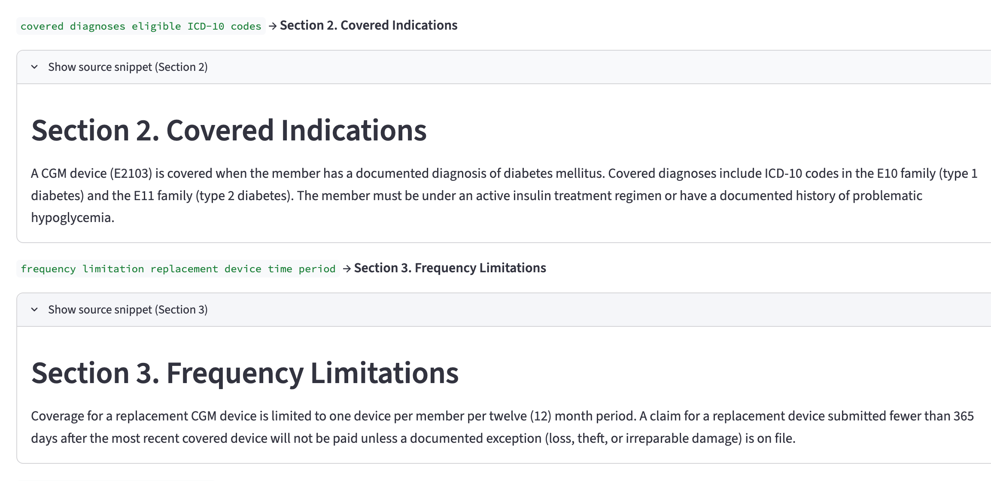
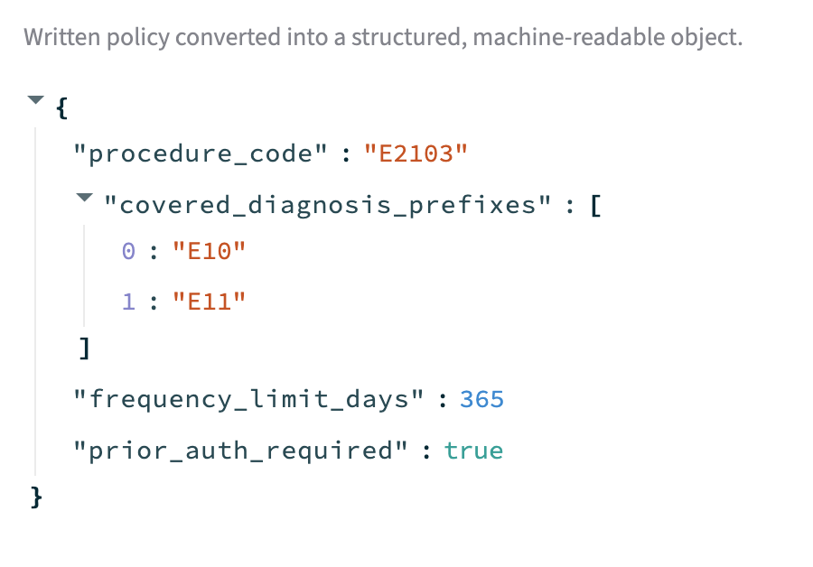
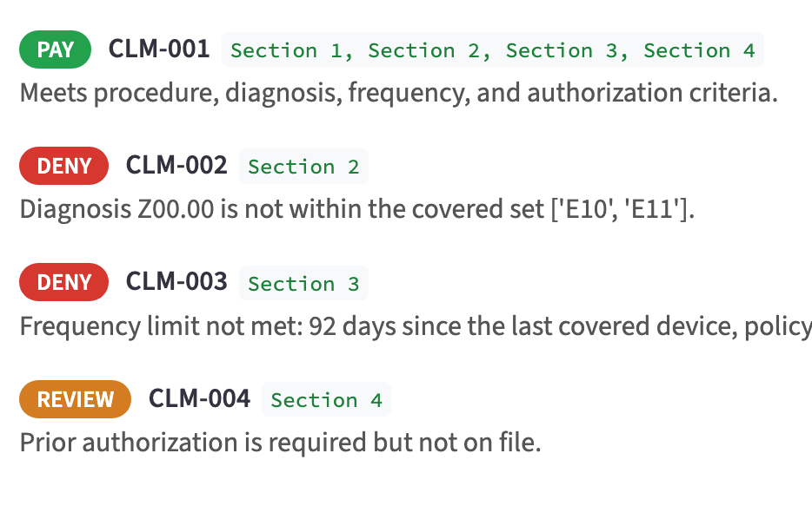
PROBLEM
EVOLUTION
ARCHITECTURE
DEMO
RECOMMEND
OPPORTUNITIES
WHAT THE DEMO SHOWS
1. Policy Retrieval
2. Structured Rule (JSON)
3. Adjudication + Citations
Each decision is traceable to specific policy language — enabling auditability and analyst oversight.

Slide 7
PROBLEM
EVOLUTION
ARCHITECTURE
DEMO
RECOMMEND
OPPORTUNITIES
STRATEGIC RECOMMENDATION
Pilot a human-in-the-loop policy-to-rule copilot
WHAT IT DOES
WHY THIS DESIGN
HOW TO PHASE
Automates the full pipeline from policy documents to executable rules:
• Evidence retrieval from source policies
• Rule drafting in structured formats
• Exception flagging for analyst review
Analysts remain in control at every step.
Separates concerns for risk management:
• LLM handles handles interpretation
• Rules engine handles recommended decisions
This preserves auditability and consistency.
Phase 1: Narrow policy domain (e.g., one coverage policy)
Phase 2: Validate outputs against existing manual rules
Phase 3: Expand coverage with analyst feedback loops
Phase 4: Deploy to production with human-in-the-loop governance
Aligns with Cotiviti's augmented intelligence principles: AI augments human expertise, never replaces it.

Slide 8
PROBLEM
EVOLUTION
ARCHITECTURE
DEMO
RECOMMEND
OPPORTUNITIES
OPPORTUNITIES & THREATS
OPPORTUNITIES
THREATS
▸ Cycle acceleration: faster policy-to-rule turnaround
▸ Reduced improper payments: fewer documentation errors
▸ Analyst augmentation: experts focus on complex cases
▸ Full auditability: every decision traces to source policy
▸ Extraction accuracy: LLM may misinterpret nuanced policy
▸ Requires human-in-the-loop: not fully autonomous
▸ Governance overhead: model versioning and revalidation
▸ Model drift: policy changes may degrade performance
Responsible, near-term, and I built a working prototype to prove it.
Live Demo · GitHub Repository · nicoleshen09@gmail.com
THANK YOU

