Slide 1
INTEROGARI
A elaborat: Untila Nicoleta

Slide 2
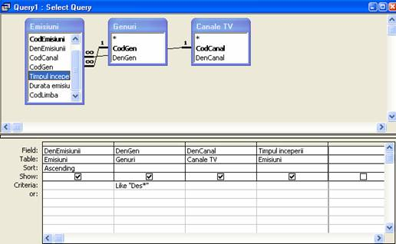
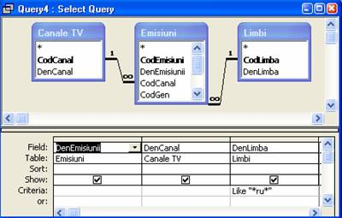
Ce sunt interogarile?

Slide 3

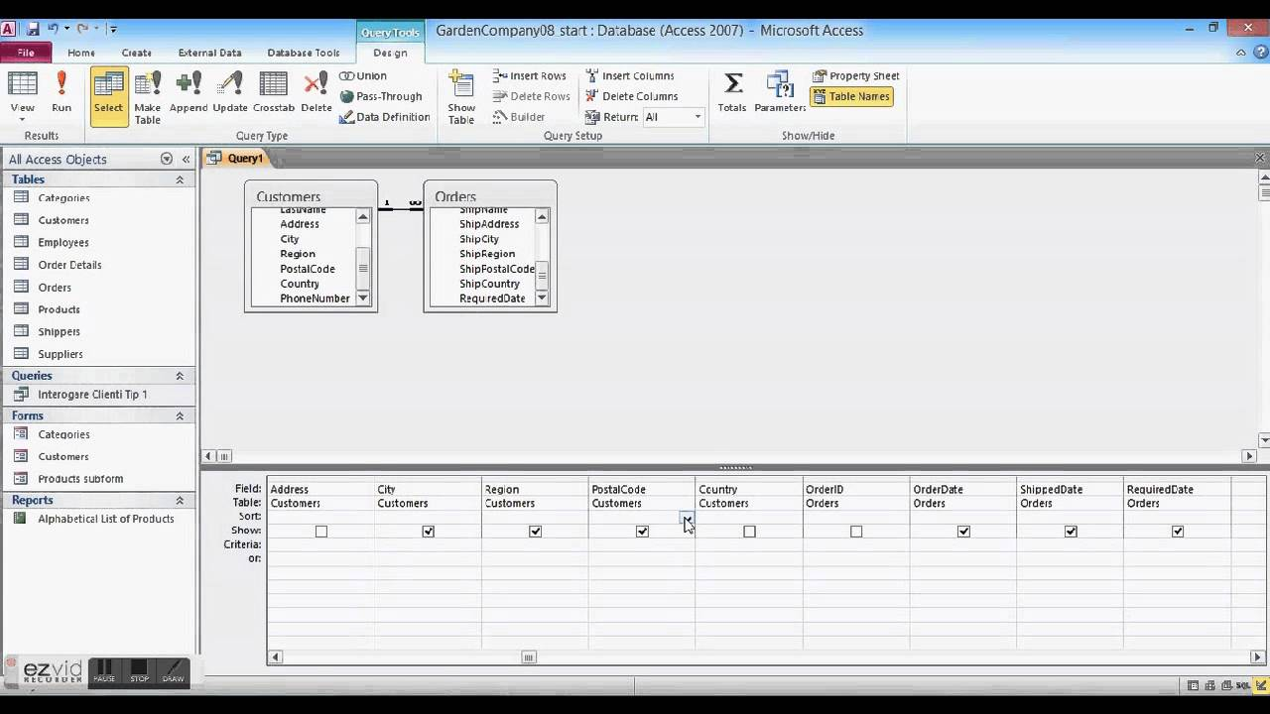
Clasificarea interogarilor
1. Interogare de selectie;
2.Interogari de excludere a unor inregistrari;
3. Interofgari de modificare a unor inregistrari;
4. Interogari de grupare si totalizare;
5. Interogari incrucisate;

Slide 4
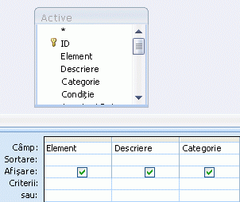
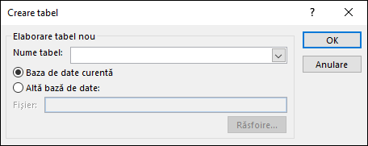
Crearea unei interogări de tip creare tabel

Slide 5
Date bibliografice:
1. https://www.google.com/search?q=interogari&rlz=1C1GGRV_enMD751MD751&source=lnms&tbm=isch&sa=X&ved=0ahUKEwjmycCg7N3eAhUMKewKHW0VBmkQ_AUIDigB&biw=1366&bih=657#imgrc=ga3xcmkm5CP82M:
2. http://www.scritub.com/stiinta/informatica/access/Interogari-Access131146165.php
3.Informatica - Manual pentru clasa a XII-a;
4.https://www.google.com/search?q=interogari+de+selectie&rlz=1C1GGRV_enMD751MD751&source=lnms&tbm=isch&sa=X&ved=0ahUKEwjNpLad3-DeAhXH2qQKHdELD4oQ_AUIDigB&biw=1366&bih=608#imgrc=tv5bDIwmxo6mWM:;
5.https://www.google.com/search?q=Crearea+unei+interog%C4%83ri+de+tip+creare+tabel&rlz=1C1GGRV_enMD751MD751&source=lnms&tbm=isch&sa=X&ved=0ahUKEwic0sad6ODeAhUH2qQKHWPLAS8Q_AUIDigB&biw=1366&bih=657#imgrc=Iw43mefJiYl71M:;

