Slide 1
Chapter 02
Operators and
Programming Constructs
吴宣为
扬州大学信息工程学院

Slide 2
Outline
Using Data Types and Literals
Using Various Operators
Using Conditional Constructs
Using Loop Constructs

Slide 3
Outline
Using Data Types and Literals
Using Various Operators
Using Conditional Constructs
Using Loop Constructs

Slide 4
Using Data Types and Literals
Integer Types
Name | CTS Type | Range (min:max)
sbyte | System.SByte | -128:127 (-2⁷:2⁷-1)
short | System.Int16 | -32,768:32,767 (-2¹⁵:2¹⁵-1)
int | System.Int32 | -2,147,483,648:2,147,483,647 (-2³¹:2³¹-1)
long | System.Int64 | -9,223,372,036,854,775,808: 9,223,372,036,854,775,807 (-2⁶³:2⁶³-1)
byte | System.Byte | 0:255 (0:2⁸-1)
ushort | System.UInt16 | 0:65,535 (0:2¹⁶-1)
uint | System.UInt32 | 0:4,294,967,295 (0:2³²-1)
ulong | System.UInt64 | 0:18,446,744,073,709,551,615 (0:2⁶⁴-1)
int i = 32, j, k = 0222; //同时声明3个变量，j未初始化
//▲注意 k 为十进制数，而不是八进制！
j = 0X5cD;
Console.WriteLine("i={0}, j={1:x}, k={2}", i,j,k);
//▼注意下面右边字面常量的后缀(后缀不分大小写)：
long L = 56789L; //L大写比较醒目，否则易与数字1混淆。
uint u = 36u;
ulong UL = 36UL;
i=32, j=5cd, k=222

Slide 5
Using Data Types and Literals
Floating-Point Types
double d1 = 5.6D, d2 = .9, d3 = 3.14E14d; //后缀D或d可以省略
double d4 = 10.; //编译Error! (有小数点时：小数部分不能省略)
float f = 3.14; //编译Error! (必须加后缀F或f，否则表示double)
The decimal Type
decimal a1 = 22M, a2 = 4.1E5M, a3 = 22.14, a4 = 22; //编译Error!
//decimal类型字面常量是浮点型的，后面需要跟 M 或 m
Name | CTS Type | Description | Significant Figures | Range (approximate)
float | System.Single | 32位单精度 | 7 | ±1.5 × 10⁻⁴⁵ to ±3.4 × 10³⁸
double | System.Double | 64位双精度 | 15/16 | ±5.0 × 10 ⁻³²⁴ to ±1.7 × 10³⁰⁸
Name | CTS Type | Description | Significant Figures | Range (approximate)
decimal | System.Decimal | 128位高精度 | 28 | ±1.0 × 10⁻²⁸ to ±7.9 × 10²⁸

Slide 6
Using Data Types and Literals
The Boolean Type
bool b1 = true, b2 = false;
Console.WriteLine("b1 = {0}, b2 = {1}.", b1, b2);
The Character Type
char c1 = 'A'; // 或 '\x0041' 或'\u0041'
char c2 = '\'', c3 = '\n', c4 = '\r', c5 = 'a', c6 = '0';
Console.WriteLine("{0:X2},{1:X2},{2:X2},{3:X2},{4:X2},{5:X2}",
(int)c1, (int)c2, (int)c3, (int)c4, (int)c5, (int)c6);
Name | CTS Type | Range (approximate)
bool | System.Boolean | true, false
b1 = True, b2 = False.
Name | CTS Type | Values
char | System.Char | Represents a single 16-bit (Unicode) character
41,27,0A,0D,61,30

Slide 7
Using Data Types and Literals
Predefined Reference Types
string dir1 = "C:\csharp\book"; //编译Error! 不认识'\c'
string dir2 = "C:\\csharp\\book";
string dir3 = @"C:\csharp\book";
string info1 = @"I must say: ""I Have a Dream!""";
string info2 = @"This string Covers
TWO LINES";
Console.WriteLine("dir2={0}\ndir3={1}\ninfo1={2}\ninfo2={3}",
dir2, dir3, info1, info2);
Name | CTS Type | Description
object | System.Object | The root type. All other types in the CTS are derived (including value types) from object.
string | System.String | Unicode character string
dir2=C:\csharp\book
dir3=C:\csharp\book
info1=I must say: "I Have a Dream!"
info2=This string Covers
TWO LINES

Slide 8
Outline
Using Data Types and Literals
Using Various Operators
Using Conditional Constructs
Using Loop Constructs

Slide 9
Category | Operator
Arithmetic | + - * / %
Logical | & | ^ ~ && || !
String concatenation | +
Increment and decrement | ++ --
Bit shifting | << >>
Comparison | == != < > <= >=
（从右至左结合）Assignment | = += -= *= /= %= &= |= ^= <<= >>=
Member access (for objects and structs) | .
Indexing (for arrays and indexers) | []
Cast | ()
Conditional (the Ternary Operator) | ?: （从右至左结合）
Delegate concatenation and removal (in Chap 7▼) | + -
Object Creation | new
Type information | sizeof (unsafe code only) is typeof as
Overflow exception control | checked unchecked
**Indirection and Address | * -> & (unsafe code only) []
**Namespace alias qualifier (in Chap 2▼) | ::
Null coalescing operator | ??
▼Ref: Professional C# 2005 with .NET 3.0 by Christian Nagel et al. Wrox Press 2007 (1798 pages)

Slide 10
Group | Operators
Primary | () . [] x++ x-- new typeof sizeof checked unchecked default delegate
Unary | + - ! ~ ++x --x (T)x
Multiplication/division | * / %
Addition/subtraction | + –
Bitwise shift operators | << >>
Relational | < > <= >= is as
Comparison | == !=
Logical/Bitwise AND | &
Logical/Bitwise XOR | ^
Logical/Bitwise OR | |
Boolean AND | &&
Boolean OR | ||
Null coalescing operator | ? ?
Ternary operator | ? :
Assignment | = += –= *= /= %= &= |= ^= <<= >>=
▼Ref: Professional C# 2005 with .NET 3.0 by Christian Nagel et al. Wrox Press 2007 (1798 pages)

Slide 11
Using Various Operators
基本赋值运算符：＝
算术运算符：+ - * / %
  关于%运算：
    C#可以操作浮点数， 而C++中，只能针对整数
    a % b = c中，c 始终与 a 同号
  关于++、--:
    C#可以操作浮点型变量， 而C++中，只能针对整型变量
  double dd = 3.14;
  Console.WriteLine("{0}, {1}, {2}, {3}",
  -7 % 5, -7 % (-5), 7 % (-5), ++dd);
关系运算符：== != < > <= >=
  if(a = b) …
    //b赋值给a: 当a, b不是bool型时，编译会出错
-2, -2, 2, 4.14

Slide 12
Using Various Operators
条件逻辑运算符：& | ^ && || !
int i = 2, j = 4;
bool b = i>j && j++ > i--;
Console.WriteLine("b = {0}, i = {1}, j ={2}", b, i, j);
b = i>j & j++ > i--;
Console.WriteLine("b = {0}, i = {1}, j ={2}", b, i, j);
位运算符：& | ^ ~ << >>
  右移位(>>)注意最高位（符号位）用什么填充。
    x为无符号数(byte, ushort, uint或ulong)时
      最高位以0填充
    x为带符号数(sbyte, short, int或long)时
      最高位始终不变(仍填充原来的符号位)
b = False, i = 2, j =4
b = False, i = 1, j =5

Slide 13
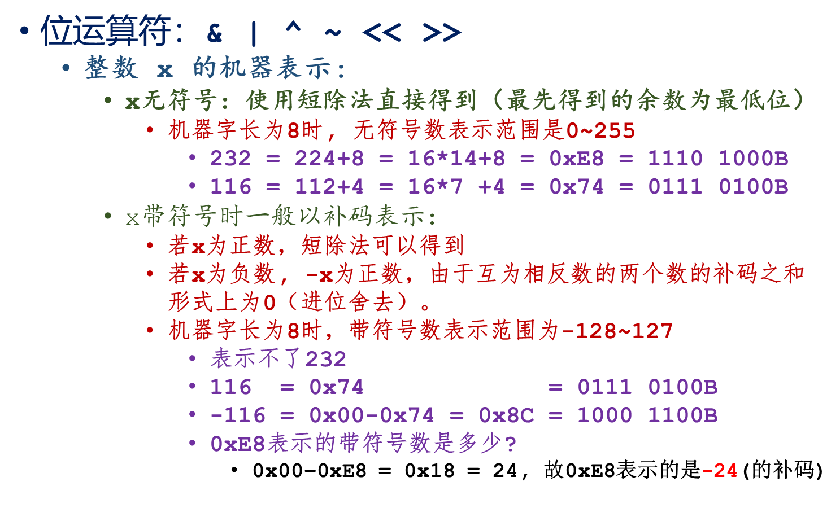
Using Various Operators

Slide 14
Using Various Operators
位运算符：& | ^ ~ << >>
    例1：
    sbyte b1 = -24;
    byte b2 = 232;
    Console.WriteLine("{0:X2}, {1:X2}", b1, b2);
    Console.WriteLine("b1 >>= 2 : {0} = {0:X2}", b1 >>= 2);
    Console.WriteLine("b2 >>= 2 : {0} = {0:X2}", b2 >>= 2);
    Console.WriteLine(“(byte)b1 : {0}, (sbyte)b2 : {1}",
    (byte)b1, (sbyte)b2);
E8, E8
b1 >>= 2 : -6 = FA
b2 >>= 2 : 58 = 3A
(byte)b1 : 250, (sbyte)b2 : 58

Slide 15
Using Various Operators
位运算符：& | ^ ~ << >>
    例2（做练习）：
    sbyte b1 = -116;
    byte b2 = 116;
    Console.WriteLine("{0:X2}, {1:X2}", b1, b2);
    Console.WriteLine("b1 >>= 2 : {0} = {0:X2}", b1 >>= 2);
    Console.WriteLine("b2 >>= 2 : {0} = {0:X2}", b2 >>= 2);
    Console.WriteLine("(byte)b1 : {0}, (sbyte)b2 : {1}",
    (byte)b1, (sbyte)b2);
8C, 74
b1 >>= 2 : -29 = E3
b2 >>= 2 : 29 = 1D
(byte)b1 : 227, (sbyte)b2 : 29

Slide 16
Using Various Operators
位运算符：& | ^ ~ << >>
    例3：
    sbyte b1 = -6;
    sbyte b2 = 35;
    Console.WriteLine(" b1:{0:X8}, b2:{1:X8}", b1, b2);
    Console.WriteLine("-b1:{0:X8}, -b2:{1:X8}", -b1, -b2);
    Console.WriteLine("b1 & b2 : {0} = {0:X8}", b1 & b2);
    Console.WriteLine("b1 | b2 : {0} = {0:X8}", b1 | b2);
    Console.WriteLine("b1 ^ b2 : {0} = {0:X8}", b1 ^ b2);
    Console.WriteLine("~b1 : {0} = {0:X8}", ~b1);
    Console.WriteLine("~b2 : {0} = {0:X8}", ~b2);
b1:000000FA, b2:00000023 ←注意这里的橙色部分(-6: 类型是sbyte)
-b1:00000006, -b2:FFFFFFDD ←注意这里的橙色部分(-35:类型是int)
b1 & b2 : 34 = 00000022
b1 | b2 : -5 = FFFFFFFB ←注意这里的橙色部分(-5:类型是int)
b1 ^ b2 : -39 = FFFFFFD9
~b1 : 5 = 00000005
~b2 : -36 = FFFFFFDC

Slide 17
Using Various Operators
复合赋值运算符：
  += –= *= /= %= &= |= ^= <<= >>=
条件运算符: ?:
字符串连接运算符: +
  int year = 2015;
  int month = 9;
  Console.WriteLine("It's " + year
  +(month.ToString().Length > 1 ?
  month.ToString() : ("0"+month)));
  Console.WriteLine(year
  +(month.ToString().Length > 1 ?
  month.ToString() : ("0"+month))
  + " is the month of today!");
  Console.WriteLine(year + month + "=" + year + month);
It's 201509
201509 is the month of today!
2024=20159

Slide 18
Using Various Operators
类型转换
  隐式转换
    sbyte, byte, …, uint, ulong ← int型常量值（特定范围）
      sbyte b1 = -120;
    sbyte, byte, short, ushort, char 型变量进行算术或按位运算时，在正式运算前，这些变量会隐式转换为int型再进行运算
      这样可以减少可能的“误差传递”
      sbyte b1 = 80, b2 = -28;
      sbyte b3 = b1 + b2; //编译Error!
      // b3 = (sbyte)(b1 + b2); //√
      b1 += b2; //OK
    char型的数值可以隐式转换为ushort, int, uint, long, ulong, float, double或decimal型，但任何数据类型都不能隐式转换为char类型（如有需要，必须显示转换）

Slide 19
Using Various Operators
类型转换
  隐式转换
    由算术运算符、关系运算符或位运算符中的二元运算符组成的表达式要求两个数据类型相同，若经过上述转换后仍不相同，系统按照图所示进行隐式转换以使两个操作数具有相同数据类型。
sbyte short int long float double
byte ushort uint ulong decimal
    对于赋值运算，若左右操作数数据类型不同，右操作数将尝试按以上规则隐式转换为左操作数的类型，并将转换后的值赋给左操作数。如果不能转换，编译将出错。

Slide 20
Using Various Operators
类型转换
  隐式转换
    特别注意:
      float 、double两者与decimal之间无法隐式转换。
        常量表达式 1M + 2.4或2.4F + 3.14M均是错误的。
      int, uint, long到float的转换或者long到double的转换都有可能损失精度，但大小不受影响。
      不能做 long ◇ ulong的运算, ◇代表任意的二元运算。
        因为没有任何一种整型能容纳这种运算的所有可能取值

Slide 21
Outline
Using Data Types and Literals
Using Various Operators
Using Conditional Constructs
Using Loop Constructs

Slide 22
Using Conditional Constructs
Conditional constructs allow the selective execution of statements, depending on the value of expression associated with them.
The comparison operators are required for evaluating the conditions.
The various conditional constructs are:
  The if…else construct
  The switch…case construct

Slide 23
Using Conditional Constructs
The if…else Construct
  The if…else conditional construct is followed by a logical expression where data is compared and a decision is made on the basis of the result of the comparison.
  The following is the syntax of the if…else construct:
if (expression)
{
statements;
}
else
{
statements;
}

Slide 24
Using Conditional Constructs
The if…else Construct (Cont’d)
  The if…else constructs can be nested inside each other.
  When if…else construct is nested together, the construct is known as cascading if…else constructs.

Slide 25
Using Conditional Constructs
The switch…case Construct
  The switch…case construct is used when there are multiple values for a variable.
  The following is the syntax of the switch…case construct:
switch (VariableName)
{
case ConstantExpression_1:
statements;
break;
case ConstantExpression_2:
statements;
break;

Slide 26
Using Conditional Constructs
The switch…case Construct (Cont’d)
…
case ConstantExpression_n:
statements;
break;
default:
statements;
break;
}

Slide 27
Outline
Using Data Types and Literals
Using Various Operators
Using Conditional Constructs
Using Loop Constructs

Slide 28
Using Loop Constructs
Loop structures are used to execute one or more lines of code repetitively.
The following loop constructs are supported by C#:
  The while loop
  The do…while loop
  The for loop

Slide 29
Using Loop Constructs
The while Loop
  The while loop construct is used to execute a block of statements for a definite number of times, depending on a condition.
  The following is the syntax of the while loop construct:
while (expression)
{
statements;
}

Slide 30
Using Loop Constructs
The do…while Loop
  The do…while loop construct is similar to the while loop construct.
  Both iterate until the specified loop condition becomes false.
  The following is the syntax of the do…while loop construct:
do
{
statements;
} while (expression);

Slide 31
Using Loop Constructs
The following figure shows the difference between the do…while and while loop construct.
while
do while
Execute body of Loop
Evaluate
Condition
False
True
Evaluate
Condition
False
Execute body of Loop
True

Slide 32
Using Loop Constructs
The for Loop
  The for loop structure is used to execute a block of statements for a specific number of times.
  The following is the syntax of the for loop construct:
  for (initialization; termination; increment/decrement)
  {
  statements
  }

Slide 33
Using Loop Constructs
The for Loop
  The following figure shows the sequence of execution of a complete for loop construct.
Initialization
Evaluate
Condition
False
Exit the for Loop
True
Body of the for Loop
Increment/ Decrement

Slide 34
Using Loop Constructs
The break and continue Statements
  The break statement is used to exit from the loop and prevents the execution of the remaining loop.
  The continue statement is used to skip all the subsequent instructions and take the control back to the loop.

Slide 35
THANKS

