Slide 1
Chapter 09
Multithreaded Applications
吴宣为
扬州大学信息工程学院

Slide 2
Outline
Implement threads
Define the life cycle of a thread
Implement multiple threads
Identify the thread priority
Use synchronization in threads
Identify communication between processes

Slide 3
Outline
Implement threads
Define the life cycle of a thread
Implement multiple threads
Identify the thread priority
Use synchronization in threads
Identify communication between processes

Slide 4
Implement threads
  A thread is defined as the execution path of a program.
  You can define a unique flow of a control in a program, using a thread.
  Threads are used to run applications that perform large and complex computations.
  A process that is executed using one thread is known as a single-threaded process, where the process is a running instance of a program.
  Single-threaded application can perform only one task at a time. You have to wait for one task to complete before another task can start.

Slide 5

Implementing Threads (Cont’d.)
  The following figure shows a single-threaded process.
  To execute more than one task at a time, you can create multiple threads in a program.
  A process that creates two or more threads is called a multithreaded process.

Slide 6
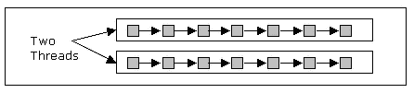
Implementing Threads (Cont’d.)
  The following figure shows a multithreaded process.

Slide 7
The Thread Model in C#
  In single-threaded systems, an approach called event loop with polling is used.
  Polling is the process in which a single event is executed at a time.
  In the event loop with polling approach, a single thread runs in an infinite loop till its operation is completed.
  In a single-threaded application if the thread is suspended from execution because it is waiting for a system resource, the entire program stops executing.
  In multithreading, the time for which a thread waits for the CPU time can be utilized to perform another task.

Slide 8
The Thread Model in C#(Contd.)
  In C#, you will use the Thread class to work with threads.
  The System.Threading.Thread class is used to construct and access individual threads in a multithreaded application.

Slide 9
The Main Thread
  The main thread is created automatically on the start up of a C# program execution.
  The threads which are created exclusively using the Thread class are called as child threads, where the main thread is called a parent thread or a primary thread.
  You can access a thread using the CurrentThread property of the Thread class.

Slide 10
Working with Threads
  In C#, you create a thread by creating an object of type Thread, giving its constructor a ThreadStart reference, and calling the new thread’s Start() method.
  The new thread starts executing asynchronously with an invocation of the thread’s method.
  There are various methods available with the Thread class. Using these methods, you can control the execution of threads. Few of these methods are:
    Start(): Starts a thread.
    Sleep(): Makes the thread to pause for a period of time.
    Abort(): Terminates the thread.
    Suspend(): Suspends a thread. If the thread is already suspended it has no effect.
    Resume(): Resumes the suspended thread.

Slide 11
Creating Threads
You can create threads by extending the Thread class.
The extended thread class calls the Start() method to begin the child thread execution. Following is an example of creating threads:
  ThreadStart ChildRef = new
  ThreadStart(ChildThreadCall);
  Thread ChildThread = new Thread(ChildRef);
  ChildThread.Start();

Slide 12
Managing Threads
  There are many tasks you might need to perform to manage the activity or life of a thread.
  You can manage all these tasks by using the various thread methods available with the Thread class.
  The static Thread.Sleep() method calls the static CurrentThread method, which then pauses that thread for the specified amount of time.

Slide 13
Destroying Threads
  If the thread is required to be destroyed, the Thread.Abort() method will allow you to accomplish the task.
  The runtime aborts the thread by throwing a ThreadAbortException. This exception cannot be caught.
  If the finally block is present in the method, the runtime will send the control to it.

Slide 14
Outline
Implement threads
Define the life cycle of a thread
Implement multiple threads
Identify the thread priority
Use synchronization in threads
Identify communication between processes

Slide 15
Thread Life Cycle
  The lifecycle of a thread starts when an object of the System.Threading.Thread class is created. The life cycle of the thread ends with task execution.
  There are various states in the life cycle of a thread. These states are:
    The Unstarted state
    The Runnable state
    The Not Runnable state
    The Dead state
  Let us understand the life cycle of the thread with the help of the following figure.

Slide 16
Thread Life Cycle (Cont’d)
Start()
Started
Work Completed
Stopped

Slide 17
Thread Life Cycle (Cont’d)
Start()
Started
Suspend()
Suspended
Resume()

Slide 18
Thread Life Cycle (Cont’d)
Start()
Started
Sleep()
Wait/Join
Sleep
Interrupt()
Time Expires

Slide 19
Thread Life Cycle (Cont’d)
Start()
Started
Thread Responds to
Stop Request
Abort()
Stop Request
Stopped

Slide 20
The Unstarted State
  When an instance of the Thread class is created, the thread enters the unstarted state.
  A new thread is an empty object of the Thread class, and no system resources such as memory are allocated to it.

Slide 21
The Runnable State
  The thread remains in the unstarted state until the program calls the Start() method of the Thread class, which places the thread in the runnable state and immediately returns control to the calling thread.
  This state is also called as the ready or started state.
  The newly started thread and any other threads in the program execute concurrently.

Slide 22
The Not Runnable State
A thread is not in the runnable state if it is:
  Sleeping
    A thread is put into the sleeping mode by calling the Sleep() method.
    A sleeping thread enters the runnable state after the specified time of sleep has elapsed.
  Waiting
    A thread can be made to wait for some specified condition to be satisfied by calling the Wait() method.
    The thread can be notified of the condition by invoking the Pulse() method of the Thread class.
  Blocked
    A thread could be blocked by an I/O operation.
    When the thread is blocked, it enters the not runnable state.

Slide 23
The Dead State
  A running thread enters the dead state when the statements of the threads method are complete.
  This state is also called the terminated state.
  A program can force a thread into the dead state by calling the Abort() method of the Thread class on the appropriate thread object.

Slide 24
Outline
Implement threads
Define the life cycle of a thread
Implement multiple threads
Identify the thread priority
Use synchronization in threads
Identify communication between processes

Slide 25
Introducing Multithreading
  Multithreading helps to perform various operations simultaneously and saves users’ time.
  Multithreading allows you to achieve multitasking in a program.
  Multitasking is the ability to execute more than one task at the same time.
  Multitasking can be divided into the following categories:
    Process-based multitasking
    Thread-based multitasking
  Let us understand multithreading with the help of an example.

Slide 26

A lady is working on a computer.

Slide 27

The lady is eating an apple, reading a book, and working on a computer simultaneously.

Slide 28
Advantages of Multithreading
  Improved performance
    ~ provides improvement in the performance of the processor by simultaneous execution of computation and the I/O operations.
  Minimized system resource usage
    ~ minimizes the use of system resources by using threads, which share the same address space and belong to the same process.
  Simultaneous access to multiple applications
    ~ provides access to multiple applications at the same time as the CPU can switch from one thread to another.
  Program structure simplification
    ~ simplifies the structure of complex applications, such as multimedia applications. Each activity can be written in separate methods that makes complex program easy to design and code.

Slide 29
Limitations of Multithreading
  Race condition
    When two or more threads simultaneously access a variable, at least one thread tries to write a value in the variable.
    This is called the race condition, which is caused by the lack of synchronization between two threads.
  Deadlock condition
    This condition arises in a computer system when two threads wait for each other to complete their operations before performing their individual action. As a result, the two threads become locked and the program fails.
  Lock starvation
    This limitation arises when the execution of a thread is postponed because of its low priority.

Slide 30
Creating Multiple Threads
  You can create multiple threads in a program by using the Thread class.

Slide 31
Outline
Implement threads
Define the life cycle of a thread
Implement multiple threads
Identify the thread priority
Use synchronization in threads
Identify communication between processes

Slide 32
Identifying the Thread Priority
  One of the attributes that controls the behavior of a thread is its priority.
  The .NET Runtime Environment executes threads based on their priority.
  The threads are fixed-priority scheduled. Each thread with its priority has its position in the thread queue of the processor.

Slide 33
Defining Thread Priority
  Thread priority is the property that specifies the priority of one thread with respect to the priority of another thread.
  Thread priority can be defined as:
    Above normal
    Below normal
    Highest
    Lowest
    Normal
  A thread with higher priority runs before threads, which have lower priority.
  If C# encounters another thread with higher priority, the current thread is pushed back, and the thread with the higher priority is executed.

Slide 34
Setting the Thread Priority
  You can set the thread priority after it is created using the Priority property of the Thread class.
  The following syntax shows how to set the thread priority:
    NewThread.Priority = ThreadPriority.Highest;

Slide 35
Setting the Thread Priority (Contd.)
  If multiple threads with the same priority are available, the scheduler cycles through the threads in that priority, giving each thread a fixed time slice in which to execute.
  As long as a thread with a higher priority is available to run, lower priority threads do not get to execute.
  When there are no more runnable threads at a given priority, the scheduler moves to the next lower priority and schedules the threads at that priority for execution.

Slide 36
Outline
Implement threads
Define the life cycle of a thread
Implement multiple threads
Identify the thread priority
Use synchronization in threads
Identify communication between processes

Slide 37
Using Synchronization in Threads
  In a multithreaded application, when threads need to share data with each other, the application should ensure that one thread does not change the data used by the other thread.
  C# enables you to coordinate the actions of multiple threads by using synchronized methods or synchronized statements.

Slide 38
Synchronizing Threads
  Synchronization of threads ensures that if two or more threads need to access a shared resource then that resource is used by only one thread at a time.
  Synchronization is based on the concept of monitoring. A monitor is an object that is used as a lock to the data members and methods of an instance (of a class).

Slide 39
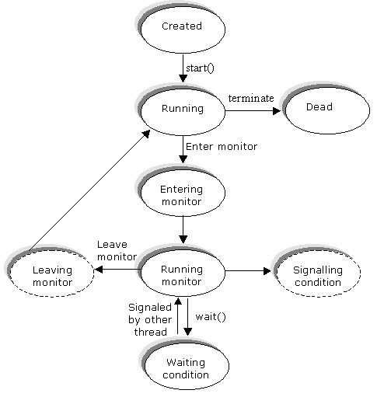
Synchronizing Threads (Contd.)
  The following figure shows how synchronization is maintained among threads.

Slide 40
Locking Code Using the Monitor Locks
The System.Monitor class enables you to serialize the access to blocks of code by means of locks and signals.

Slide 41
Using Monitor Locks with the C# lock Statement
  The other way to lock code is by using the C# lock statement.
  Although the C# lock statement does not support the full array of features found in the Monitor class, it enables you to obtain and release a monitor lock.
  To use the lock statement, simply specify the lock statement with the code being serialized in braces.
  The braces indicate the starting and stopping point of code being protected.

Slide 42
Outline
Implement threads
Define the life cycle of a thread
Implement multiple threads
Identify the thread priority
Use synchronization in threads
Identify communication between processes

Slide 43
Communication Between Processes
  A process is a running instance of a program.
  The communication between the processes at run time within the same computer or over a network is called the interprocess communication.
  To allow communication between various processes with a unique address space, the operating system's kernel acts as the communication channel.

Slide 44
Application Domain
  In .NET, threads execute in an application domain. A thread in one process cannot invoke a method in a thread that belongs to another process.
  In .NET, however, threads can cross the application domain boundaries, and a method in one thread can call a method of another application domain.
  The application domain is a logical process inside a physical process.

Slide 45
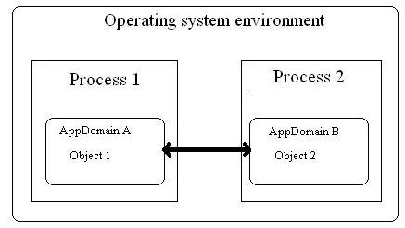
Application Domain (Contd.)
  The following figure shows application domains interacting with each other.

Slide 46
Application Domain (Contd.)
  The main purpose of application domain is to isolate your applications from other applications.
  Application domains run on a single process.
  You use the System.AppDomain class to manage application domains.

Slide 47
Outline
Implement threads
Define the life cycle of a thread
Implement multiple threads
Identify the thread priority
Use synchronization in threads
Identify communication between processes

Slide 48
THANKS

