Slide 1



THE TRIDENT · FACTORED AI & DATA HACKATHON 2026
Agente Crédito
LATAM
TRY IT
Live app
gentle-moss-06f3f1f0f.2.azurestaticapps.net
WORKFLOW 4 · CREDIT-PRODUCT INFORMATION AND ELIGIBILITY
A credit assistant a bank can switch on.
The model talks, rules decide, every figure is cited, and it knows when not to act. In Spanish and Portuguese, for Colombia, Mexico and Argentina.
Repository
github.com/NicolleMayol/
factored-hackathon-2026-the-trident
How to navigate
1 Home: the numbers and how it decides.
2 “See the customer experience”, then pick a test customer.
3 Ask for a rate, run a pre-check, then try “ignore your rules”.
Eladio Yovera
Data platform
Medallion pipelines and demand insights
Manuela Larrea
AI / ML
Agent, rules, retrieval, pre-score, evals
Nicolle Mayol
Service
Azure, CI/CD, load tests, front end
Notes:
Of the hackathon workflows, we chose workflow 4: credit-product information and eligibility. We are The Trident: Eladio on data, Manuela on AI and machine learning, Nicolle on the service. This is Agente Crédito LATAM, a credit assistant a bank can switch on. Everything on the next slides runs live at the link on the right; the home page is written for you, and from there you can try the customer chat with five test customers.

Slide 2
The most repeatable contact, and where an AI must never decide
THE TRIDENT · AGENTE CRÉDITO LATAM
Transactions
240,056 · 35%
PRODUCT CONTACTS
Product
150,863 · 22%
22%
Complaints
117,021 · 17%
Technical
102,899 · 15%
150,863 contacts · FCR 0.896
Sales
54,879 · 8%
Retention
20,578 · 3%
MX 50%
CO 30%
AR 20%
ABSORB
Absorb the repeatable
Solved on first contact 9 times in 10: the volume an assistant should take.
NEVER DECIDE
Never decide the edge
48% of Basic customers sit near the score cutoff; 15% have no score, 20% no income.
OUR CHOICE · WORKFLOW 4
It knows when not to act
Cited answers, a pre-check only with consent, and a person for every edge case.
Source: gold.contact_demand, 2023-06-17 → 2026-06-17 · about 138 product contacts a day
2
Notes:
Product questions are 22% of the bank's contacts: over 150 thousand in three years, half of them from Mexico. Nine in ten are already solved on the first contact, so this is work an assistant can take on. It is also where regulation leaves no room: an AI must never decide on credit. That is the line we designed around. The reading: absorb the repeatable, and never decide the edge. Almost half of Basic customers sit right on the score cutoff, and one in five has no declared income, so those cases go to a person. That is what The Trident built: an assistant that knows when not to act. That is why we chose workflow 4: it is the most repeatable contact, and it is exactly where the edge cases must go to a person.

Slide 3

The model talks. Rules decide. Every figure is cited.
THE TRIDENT · AGENTE CRÉDITO LATAM
AI + guardrail
No AI
Model as input
No AI
Human
Understand
Decide
Act
Verify
Escalate
Regex guardrail first, then Llama 3.3 70B
Versioned rules × scopes × country caps
Typed, authorized tools; the pre-score informs
No citation, no figure
Handoff with full context and reason
WHAT THE BANK SWITCHES ON · WHO GETS WHAT
Customer
Analyst
Bank
Cited answers in Spanish or Portuguese; a pre-check only with consent
Escalated cases arrive with summary, verified facts and reason
Versioned rules, country rate caps, every turn traced
LangGraph on Azure Functions · versioned YAML rules in policy/ · rate caps: SFC (CO), Banxico (MX), BCRA (AR)
3
Notes:
What the bank switches on serves three people: the customer gets cited answers in Spanish or Portuguese and a pre-check only after consent; the analyst gets escalated cases with the facts and the reason; the bank gets versioned rules, country rate caps and a trace for every turn. Every turn runs through five steps. A regex guardrail reads the message before the model, then Llama 3.3 70B extracts the intent as typed JSON. Decide has no AI: versioned rules, the token's scopes and each country's rate cap. Act only calls typed, authorized tools; the pre-score informs, it never approves. Verify has no AI either: a figure without a citation does not leave. And when it should not act, a person gets the case with full context.

Slide 4
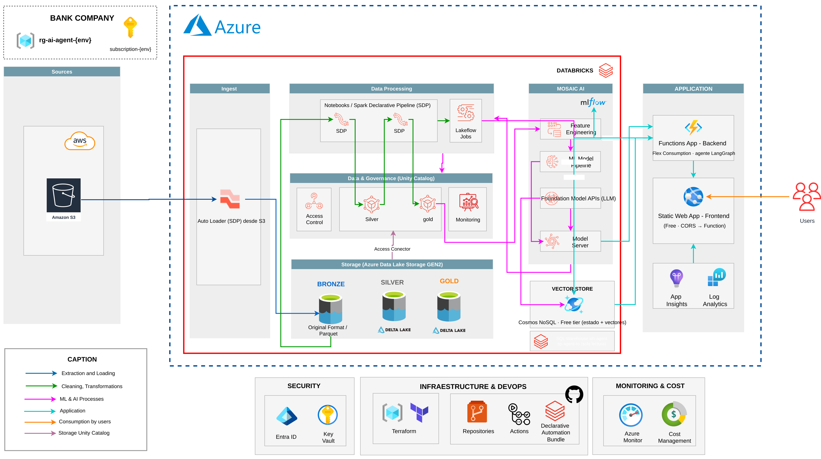
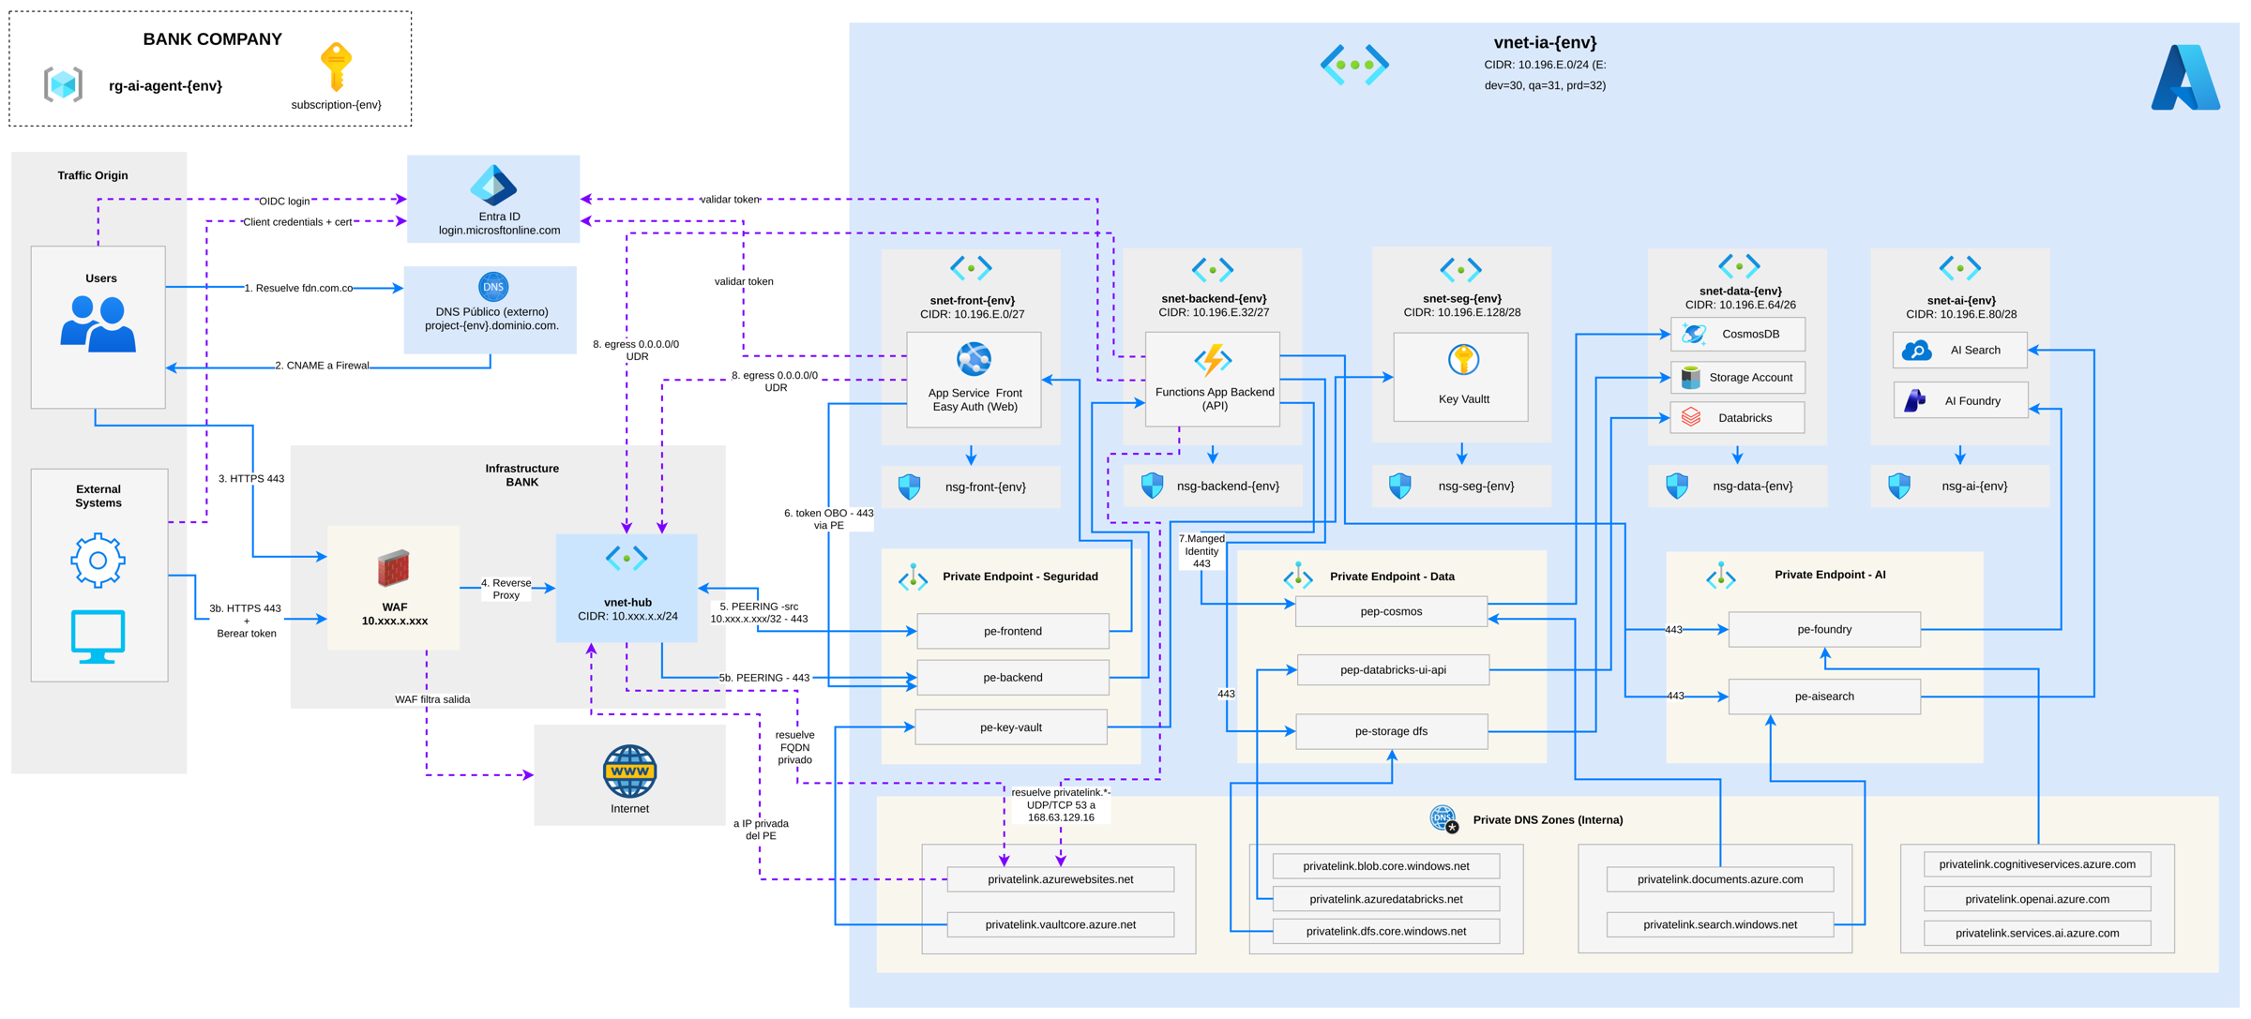
Built the way a bank runs it, all in code
THE TRIDENT · AGENTE CRÉDITO LATAM
DESIGN CHOICES A BANK CARES ABOUT
RAG · ES + PT
Answers only from bank policy
Hybrid search in Cosmos DB, bge-m3 embeddings. Recall@5: 1.0 es, 0.92 pt.
EXTERNAL SOURCES
Regulators as data, cited
SFC, Banxico and BCRA rate caps with URL and date. Attacks from MITRE ATLAS.
ORCHESTRATION
A fixed graph, not a free agent
LangGraph: the LLM never approves, versioned rules do. Same input, same decision, auditable.
TO-BE · IN A BANK
Private endpoints, WAF, Entra ID, hub-and-spoke
IaC
Terraform + Actions, approval gates
8
contracts first: 3 roles in parallel
29
ADRs, one per decision
1
own agent skill for docs as code
210
tests + eval on every PR
Open the to-be diagram ↗
diagrams/arquitectura.drawio (pages hackathon and to-be, exported by CI) · infra/ · docs/adr/ · .claude/skills/adr-hackathon
4
Notes:
This is the real architecture, drawn by the team with the official icons and exported by our CI. Data lands from S3 into Azure Data Lake, runs as a medallion on Databricks with Unity Catalog, and the gold tables feed the agent. The agent is LangGraph on Azure Functions, behind a static web app, with Llama 3.3 and bge-m3 on Databricks and Cosmos DB as the vector store. Three design choices matter to a bank. First, retrieval: answers come only from bank policy, with hybrid search in Spanish and Portuguese. Second, external sources: the regulators' rate caps are data with their URL and date, and our attack tests follow MITRE ATLAS. Third, the workflow: a fixed graph, not a free agent, so the model never approves and the same input always gets the same decision. On the right, the enterprise target: private endpoints, a WAF, Entra ID and a hub-and-spoke network, in the same diagram file. And all of it is code: Terraform, approvals, eight contracts first so three people worked in parallel, an ADR per decision, our own agent skill, and 210 tests plus the evaluation on every pull request.

Slide 5


It knows when not to act, on real data
THE TRIDENT · AGENTE CRÉDITO LATAM
0.98
0.019
0
Abstain accuracy
False action rate
Successful prompt injections
Injections · deterministic guardrail
0
0.267
Intent failures · prompt v1 → v2
3
11
Pre-score AUC · portfolio features
0.66
0.78
eval/run_eval.py (82 es/pt cases, 15 MITRE ATLAS) · eval/models.md · ml/train_prescore.py (134,037 customers)
5
Notes:
We measured what matters in banking: knowing when not to act. On 82 cases in Spanish and Portuguese, with every dependency real, abstain accuracy is 0.98 and the false action rate is 0.019. Of 15 MITRE ATLAS attacks, none got through: a guardrail with no AI took injections from 0.267 to zero. Prompt v2 cut intent failures from 11 to 3. And portfolio features lifted the pre-score AUC from 0.66 to 0.78; the model choice added nothing, so the simplest one won.

Slide 6
Live, all-real, and built to be operated.
THE TRIDENT · AGENTE CRÉDITO LATAM
Dependencies
p50, 10 users
p95, 10 users
Seconds, one axis
5/5 ok
2.7 s
17.5 s
live /api/healthz
89 turns in 1 min
target 8 s, missed
17.5
14.8
Cost
Tracing
Under load
$0.00035
Every turn
84 of 89
target 8 s
per turn
ops.agent_turns
answered; 5 safe handoffs, never a broken answer
4.7
p95 under load
pre-check p50, before
after the SQL memo
What's next, and why
p95 under load → provisioned LLM throughput and retry on rate limits
Real intent labels → label real call transcripts
CO and MX rate caps → official monthly figures, cited
k6 carga.yml, 10 users, 1 min · ops.agent_turns · App Insights · Azure Functions · Databricks · Cosmos DB · Terraform
6
Notes:
It runs live on Azure and Databricks, with every dependency real, and each turn leaves a trace with its cost. We load-tested the deployed app with ten users at once. The median turn takes 2.7 seconds. The 95th percentile is 17.5, above our 8-second target, and we say so. A per-customer SQL memo already cut the pre-check from 14.8 to 4.7 seconds; what is left is the queue of the pay-per-token model. Five of 89 turns hit its rate limit, and each one went to an advisor instead of giving a broken answer. What is next: provisioned throughput and a retry on rate limits for the p95, real call transcripts for intent labels, and the official monthly rate caps for Colombia and Mexico.

