Slide 1
Arm CCA vs TrustZone:
A Critical Comparative Review
Antonio Di Ponzio (s347920)
Nicolò Dalmazzo (s338766)

Slide 2
Table of Contents
Why Confidential Computing
Arm TrustZone
  Architecture and Downsides
Arm CCA
  Hardware and Software Components
Attestation in Arm CCA
  Delegated and Direct Attester
TrustZone vs CCA
  architecture/use cases/attestation comparison and considerations
Conclusion

Slide 3
Why Confidential Computing
cloud environments host large variety of services
  machine learning models
  multimedia services
  web applications
large adoption of multi-tenant environments
  multiple workloads coexist on same device
  need guarantees of isolation for sensitive computations
confidential computing protects data in use in terms of
  confidentiality
  integrity
two distinct security extensions for Arm architecture
  TrustZone
  Confidential Compute Architecture (CCA)

Slide 4
Arm TrustZone (I)
supports two security states
  non-secure state
  secure state
secure monitor provides
  security state switching
  context save and restore
two Physical Address Spaces (PAS)
  secure PAS (access granted only from secure state)
  non-secure PAS (access granted from both states)
different implementations of attestation mechanism
  no official standard
  constraints of IoT devices could lead to insecure implementations

Slide 5
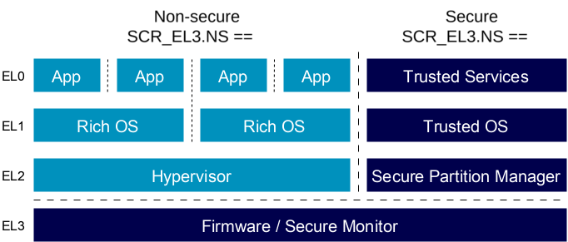
Arm TrustZone (II)

Slide 6
Arm TrustZone - Downsides
no support for multiple trusted execution environments (TEE)
  isolation performed at operating system level
  no mutual distrust between applications
secure monitor operates in secure state
  possible access from a compromised application
attestation implementations based on static claims
  no consideration on dynamic change of trusted services

Slide 7
Arm CCA (I)
support of four security states
  secure state
  non-secure state
  root state
  realm state
mutual isolation between realm VMs
  each application isolated from hypervisor and other realms
  no more limit on TEE instances
  mutual distrust between realm and secure state
root state reserved for Monitor
  no visibility from other security states

Slide 8
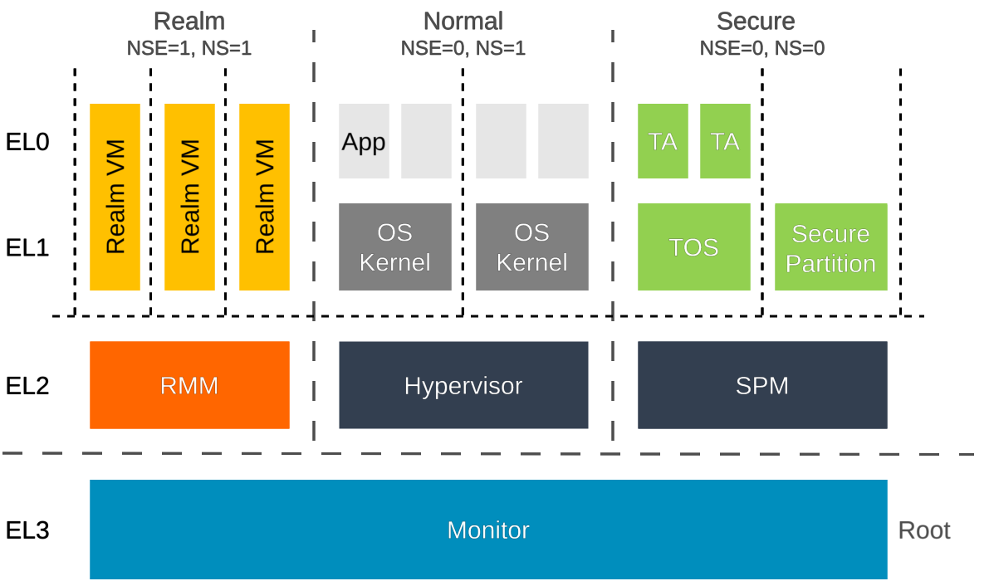
Arm CCA (II)

Slide 9
Arm CCA – Hardware components
Realm Management Engine (RME) provides hardware primitives
four PAS each associated to a security state
support of granular PAS filtering
  dynamic allocation of single pages
  information stored on Granule Protection Tables (GPTs)
  in case of failure Granule Protection Fault (GPF) reported
support of Memory Encryption Contexts (MEC)
  different for each realm
  configured at boot time and managed run-time by MPE
underlying hardware layer: Hardware Enforced Security (HES)
  key component for secure boot and attestation process
  enforced with memory shielded locations
  Root-of-Trust (RoT) for storage and for measurement

Slide 10
Arm CCA – Software components
Monitor is responsible for
  context switching between security states
  management of GPT
  platform attestation
  reference impelementation: TF-A by Trusted Firmware
Realm Management Monitor (RMM) manages realm VMs
  handling of hypervisor request to manage realms
  provides security primitives (host request validation, realm isolation)

Slide 11
Arm CCA – Software interfaces
three interfaces for communication between host and Realms
  Realm Management Interface (RMI)
  Realm Service Interface (RSI)
  Realm Host Interface (RHI)
Realm Management Interface
  enable host control of realms
  no guarantees of realms availability due to compromised host
Realm Service Interface
  provide services to realms
  attestation report request and accepting devices assigned to realms
Realm Host Interface
  enable direct communication between host and realms

Slide 12
Arm CCA – Attestation mechanism
Arm CCA provides support for the attestation process
attestation is divided in two steps
  platform attestation
  realm attestation
two tokens are cryptographically bounded
  avoid decoupling of tokens
specification is still an RFC draft

Slide 13
Arm CCA – Attester architecture (I)
specification follows the RATS Standard (RFC 9334)
  attester create evidences to send to the verifier
two different “attesting flavors”
  delegated attester
  direct attester
layered attester made up by two layers
  platform attester (the HES)
  realm attester (the RMM)

Slide 14
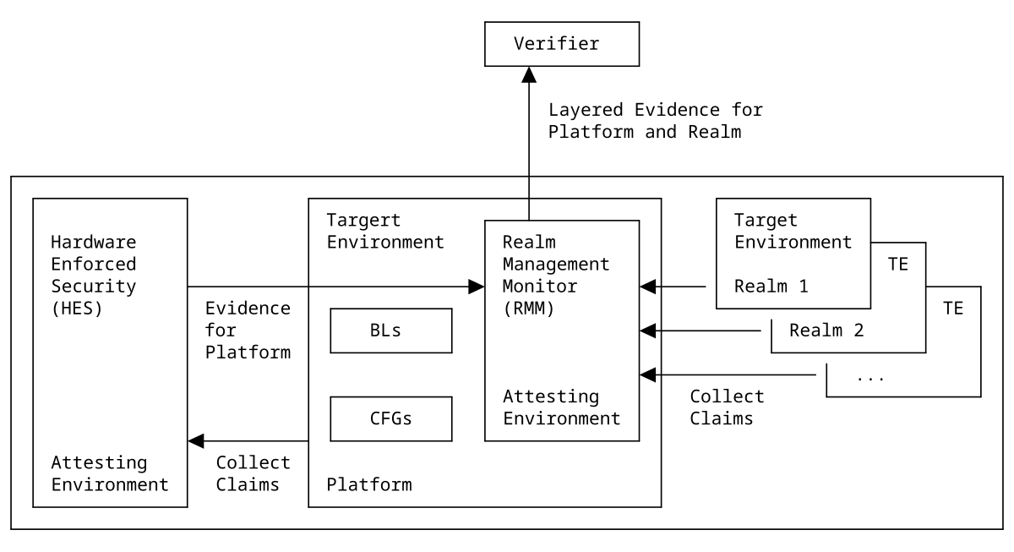
Arm CCA – Attester architecture (II)

Slide 15
Arm CCA – Delegated Attester
it needs two distinct key-pairs both generated by HES
  CCA Platform Attestation Key (CPAK) never leaves the HES
  Realm Attestation Key (RAK) leaves the HES
use of two keys is a trade-off for the sake of efficiency
  RAK is sent to RMM after its initialization
  so HES delegates RMM to sign realm claims
signing overhead is moved from HES to RMM
  no need to re-generate platform token at each attestation request
token binding through the hash of the RAK public key (fixed value)

Slide 16
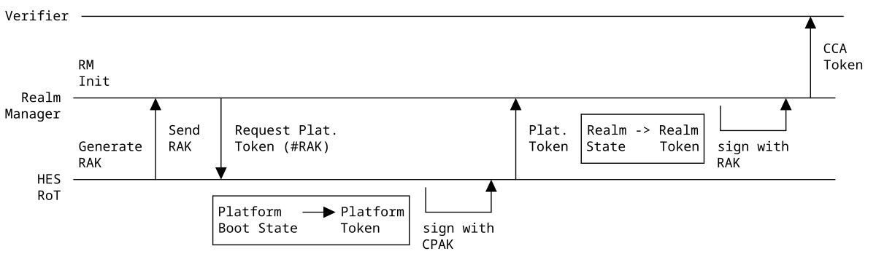
Arm CCA – Attestation Process

Slide 17
Arm CCA – Direct Attester
direct attester uses only one key-pair (CPAK)
  RMM is in charge only of collecting realm claims
  only platform claims are actually signed
RMM sends realm claims hash as challenge with platform token request to HES
  hash is signed with platform claims
  so realm claims are bounded to the platform token
no exposure of any key-pair externally to HES
HES cannot pre-compute platform token
  so there is more overhead on the HES
detailed description of direct attester is still a TODO in RFC draft

Slide 18
Arm TrustZone vs Arm CCA (I)
Arm CCA | Arm TrustZone
Ensure hardware-based mutual distrust between distinct TAs | Does not ensure hardware isolation between TAs
More flexible TA development | Complex TA development due to the lack of portable APIs
Flexible and unconstrained memory allocation for Realms | TAs cannot be large (few MB)
Does not guarantee availability of the Realm, only confidentiality and integrity | Ensures availability of the TA along with confidentiality and integrity

Slide 19
Arm TrustZone vs Arm CCA (II)
Arm TrustZone widely adopted in smartphone and IoT markets
instead Arm CCA is more suitable for server-side machine
  the VM-based approach ensures strong isolation between different services that run on the same machine
  highly employable for cloud-providers
VM-based approach could add a not-negligible overhead for smartphone and IoT markets
  however no official benchmarks are available yet

Slide 20
Arm TrustZone vs Arm CCA (III)
Arm does not provided any attestation standard for TrustZone
  different products presents different and closed solutions
CCA attestation is currently under standardization process
  will simplify implementation process
CCA attestation token leaves freedom to attester about what claims include into the token
  this foster compliance to the need-to-know principle
however CCA attestation token raised privacy concerns
  two different attestation token share same platform token
  companies relationships could be leaked
  end-point devices could be tracked among different services

Slide 21
Conclusion
Arm CCA solves several TrustZone downsides through
  virtualization-based approach
  RME hardware primitives
  dedicated root state
however there is a lot of work about some concerns
  privacy (for attestation)
  availability of the realms
  performance overhead of end-user devices

