Slide 1
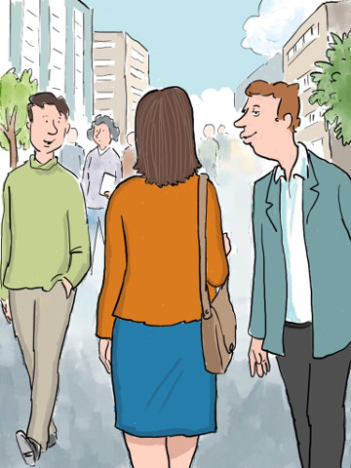


The Safest Path

Slide 2
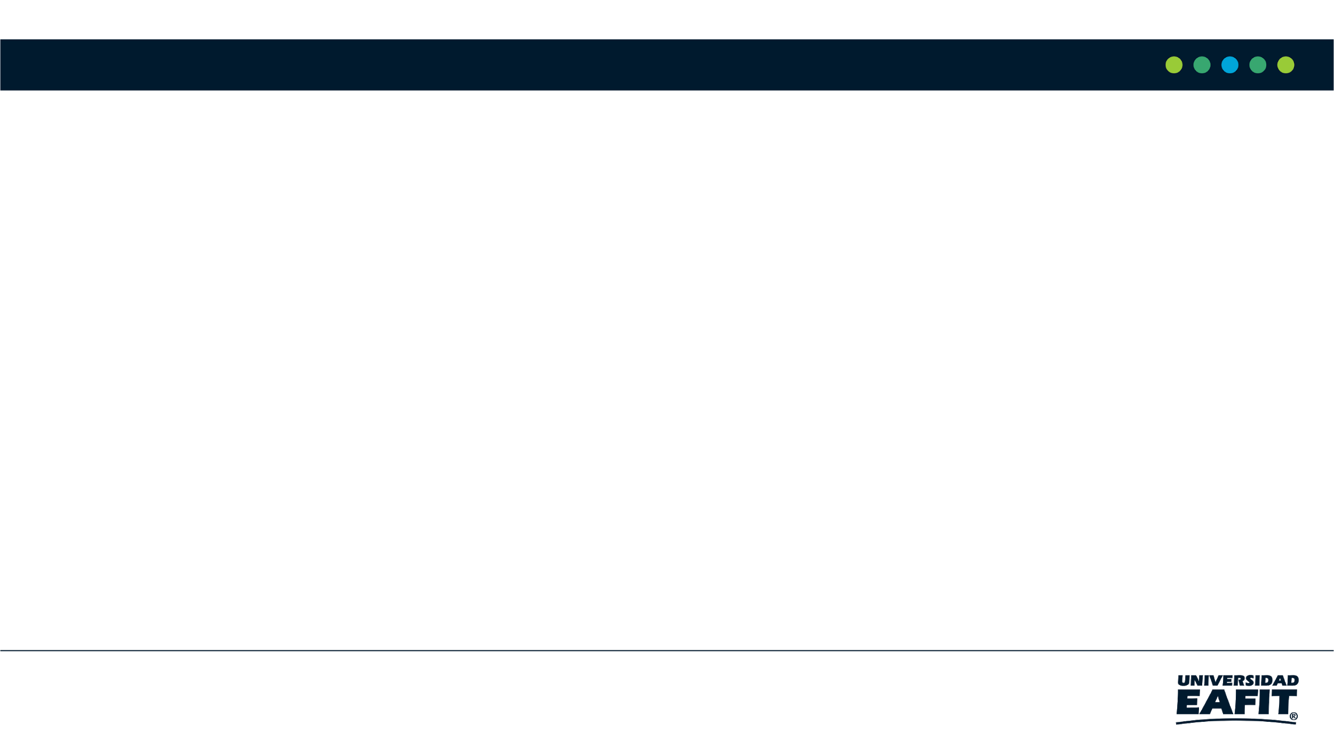
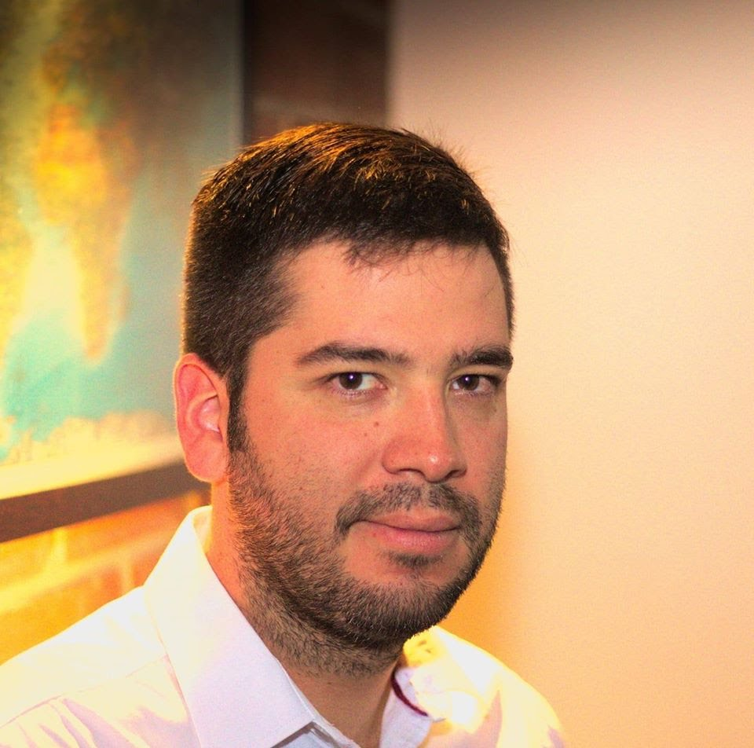


Team Presentation
Luciana
Pineda
Nicolas Moreno
Andrea Serna
Literature review
Mauricio
Toro
Data preparation
https://github.com/Nicorenox/ST0245-02-ProyectoV1-

Slide 3
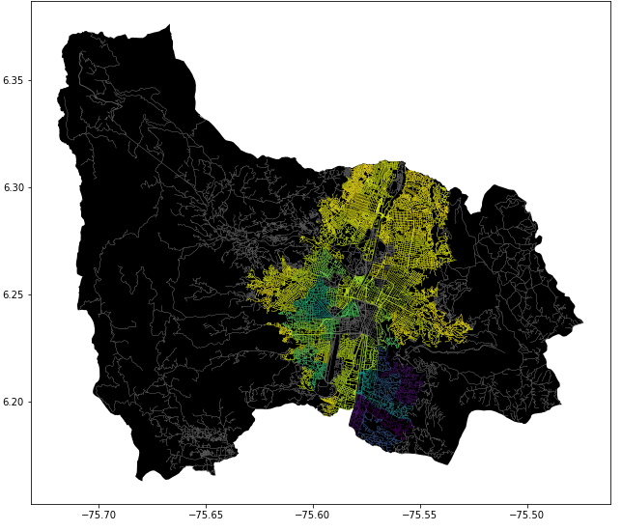
Problem Statement
Constrained Shortest Path Algorithm
Streets
of Medellín, Origin and Destination
Constrained
Shortest
Paths

