Slide 1


The Safest Path

Slide 2

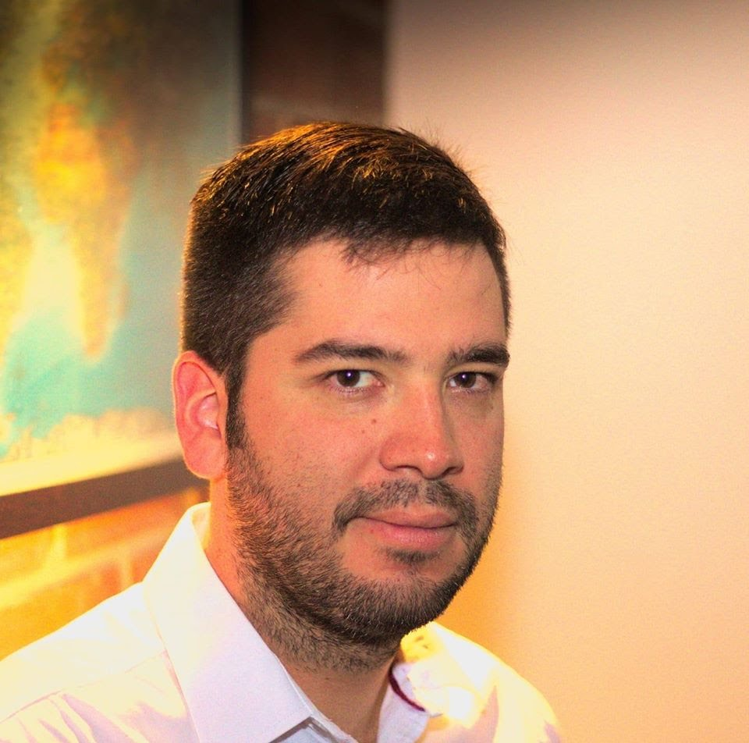


Team Presentation
First author
what did you do?
Second author
what did you do?
Andrea Serna
Literature review
Mauricio
Toro
Data preparation
https://github.com/Nicorenox/ST0245-02-Proyecto-/security/policy

Slide 3
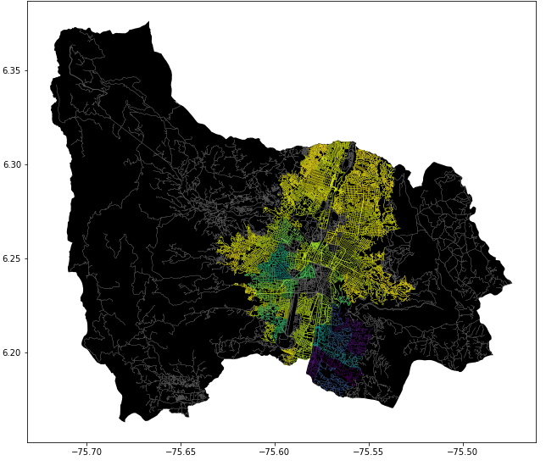
Problem Statement
Constrained Shortest Path Algorithm
Streets
of Medellín, Origin and Destination
Constrained
Shortest
Paths

