Slide 1
Statistics / Graphics
For rural and city apartments distribution

Slide 2
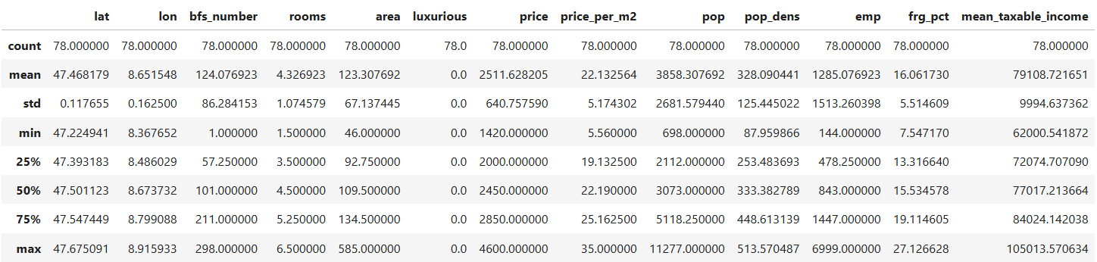
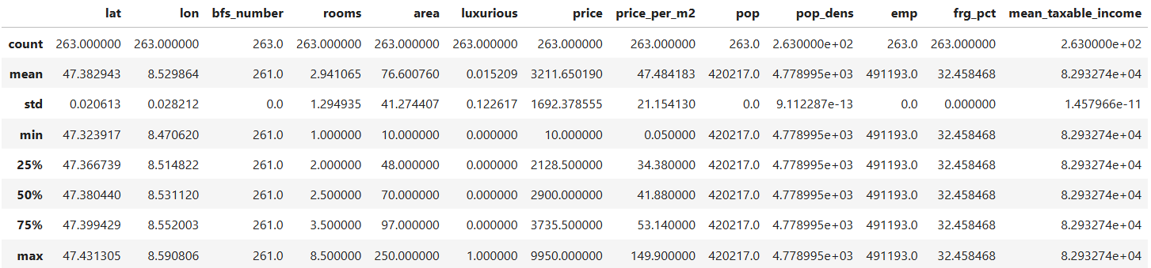
Summary statistics of numeric variables
Rural:
City:

Slide 3
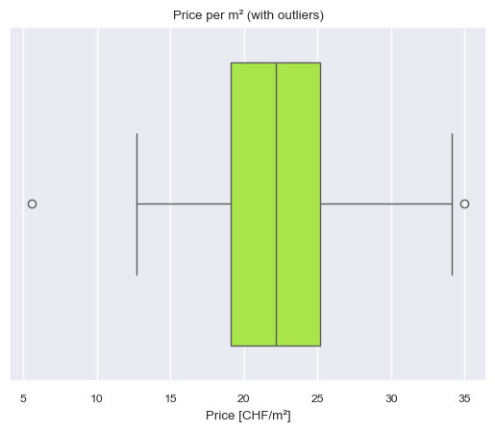
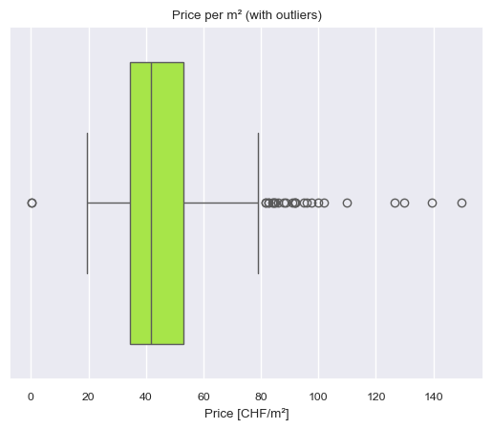
Boxplots of prices per m2
Rural:
City:

Slide 4
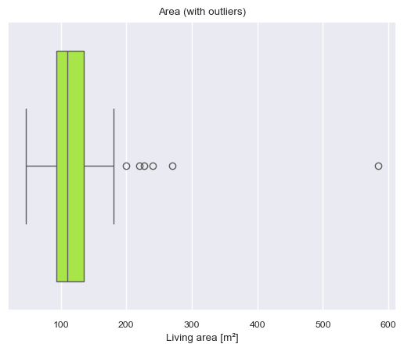
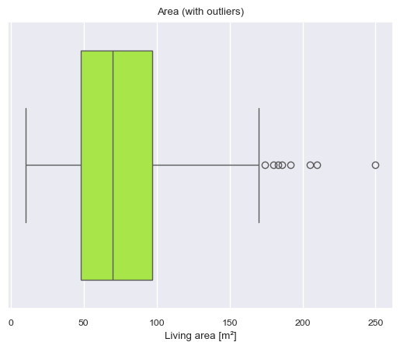
Boxplots of areas
Rural:
City:

Slide 5
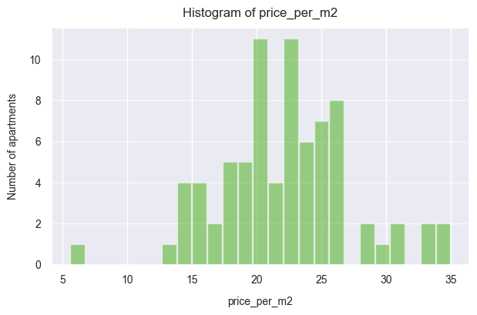
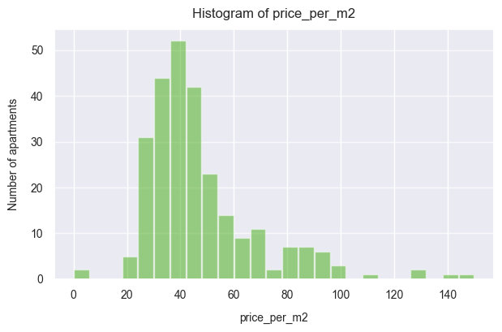
Histograms of prices per m2
Rural:
City:

Slide 6
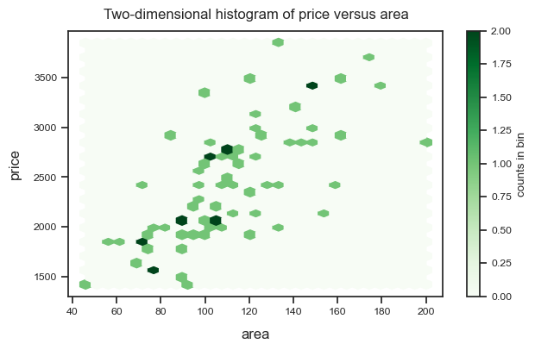
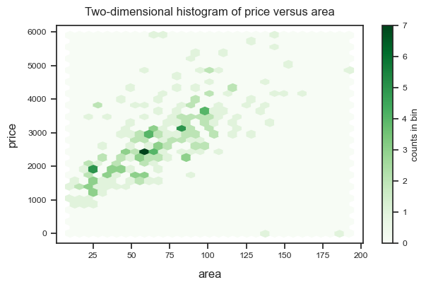
Histograms of areas
Rural:
City:

