Slide 1



矩阵求导入门
覃雄派

Slide 2
提纲
矩阵求导入门
矩阵求导入门

Slide 3
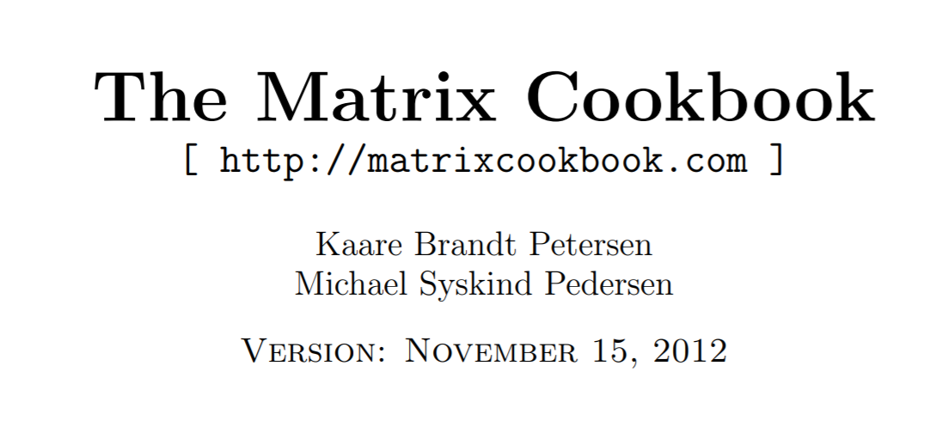
矩阵求导
矩阵求导参考资料
这里先进行简单入门，然后直接使用该cook book的一些结论
https://www.math.uwaterloo.ca/~hwolkowi/matrixcookbook.pdf

Slide 4

pause

Slide 5


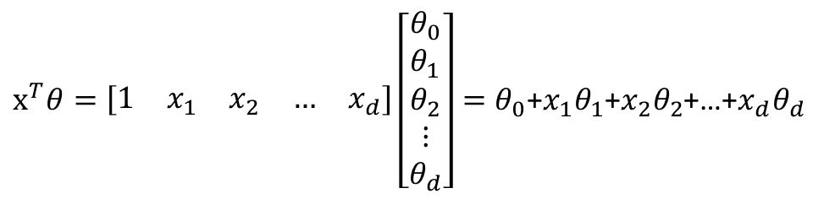
矩阵求导
矩阵求导入门
按照“列”组织向量
$$x=\left[\begin{aligned}1 \\ x_{1} \\ x_{2} \\ ⋮ \\ x_{d}\end{aligned}\right]$$
$$θ=\left[\begin{aligned}θ_{0} \\ θ_{1} \\ θ_{2} \\ ⋮ \\ θ_{d}\end{aligned}\right]$$
$x^{T}θ=\left[\begin{matrix}1 & x_{1} & x_{2} & … & x_{d}\end{matrix}\right]\left[\begin{aligned}θ_{0} \\ θ_{1} \\ θ_{2} \\ ⋮ \\ θ_{d}\end{aligned}\right]=θ_{0}$+${x_{1}θ}_{1}$+${x_{2}θ}_{2}$+…+${x_{d}θ}_{d}$
向量点乘

Slide 6



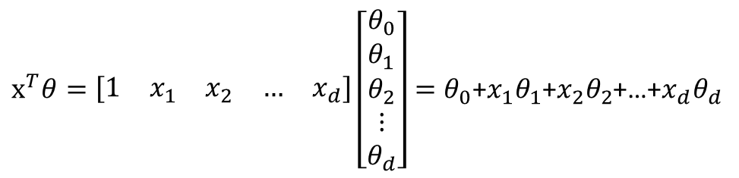
矩阵求导
1、$θ_{0}$+${x_{1}θ}_{1}$+${x_{2}θ}_{2}$+…+${x_{d}θ}_{d}$
对$θ_{0}$、$θ_{1}$、$θ_{2}$、…、$θ_{d}$
分别求导
2、得到
$$\begin{matrix}1 & x_{1} & x_{2} & … & x_{d}\end{matrix}$$
3、按照列向量来组织为$\left[\begin{aligned}1 \\ x_{1} \\ x_{2} \\ ⋮ \\ x_{d}\end{aligned}\right]$
矩阵求导入门
$$x=\left[\begin{aligned}1 \\ x_{1} \\ x_{2} \\ ⋮ \\ x_{d}\end{aligned}\right]$$
$$θ=\left[\begin{aligned}θ_{0} \\ θ_{1} \\ θ_{2} \\ ⋮ \\ θ_{d}\end{aligned}\right]$$
$x^{T}θ=\left[\begin{matrix}1 & x_{1} & x_{2} & … & x_{d}\end{matrix}\right]\left[\begin{aligned}θ_{0} \\ θ_{1} \\ θ_{2} \\ ⋮ \\ θ_{d}\end{aligned}\right]=θ_{0}$+${x_{1}θ}_{1}$+${x_{2}θ}_{2}$+…+${x_{d}θ}_{d}$

Slide 7


矩阵求导
1、$θ_{0}$+${x_{1}θ}_{1}$+${x_{2}θ}_{2}$+…+${x_{d}θ}_{d}$
对$θ_{0}$、$θ_{1}$、$θ_{2}$、…、$θ_{d}$
求导
2、得到
$$\begin{matrix}1 & x_{1} & x_{2} & … & x_{d}\end{matrix}$$
3、按照列向量来组织为$\left[\begin{aligned}1 \\ x_{1} \\ x_{2} \\ ⋮ \\ x_{d}\end{aligned}\right]$
矩阵求导入门
$$x=\left[\begin{aligned}1 \\ x_{1} \\ x_{2} \\ ⋮ \\ x_{d}\end{aligned}\right]$$
$$θ=\left[\begin{aligned}θ_{0} \\ θ_{1} \\ θ_{2} \\ ⋮ \\ θ_{d}\end{aligned}\right]$$
$x^{T}θ=\left[\begin{matrix}1 & x_{1} & x_{2} & … & x_{d}\end{matrix}\right]\left[\begin{aligned}θ_{0} \\ θ_{1} \\ θ_{2} \\ ⋮ \\ θ_{d}\end{aligned}\right]=θ_{0}$+${x_{1}θ}_{1}$+${x_{2}θ}_{2}$+…+${x_{d}θ}_{d}$
$$\frac{{∂x}^{T}θ}{∂θ }=\frac{{∂θ}^{T}x}{∂θ }=x$$
第一个重要公式

Slide 8
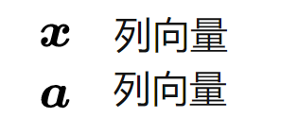
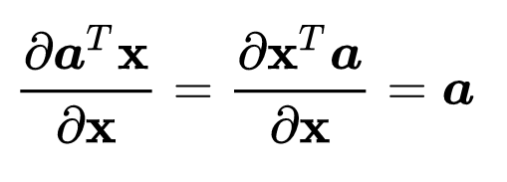

矩阵求导
1、$θ_{0}$+${x_{1}θ}_{1}$+${x_{2}θ}_{2}$+…+${x_{d}θ}_{d}$
对$θ_{0}$、$θ_{1}$、$θ_{2}$、…、$θ_{d}$
求导
2、得到
$$\begin{matrix}1 & x_{1} & x_{2} & … & x_{d}\end{matrix}$$
3、按照列向量来组织为$\left[\begin{aligned}1 \\ x_{1} \\ x_{2} \\ ⋮ \\ x_{d}\end{aligned}\right]$
矩阵求导入门
$$x=\left[\begin{aligned}1 \\ x_{1} \\ x_{2} \\ ⋮ \\ x_{d}\end{aligned}\right]$$
$$θ=\left[\begin{aligned}θ_{0} \\ θ_{1} \\ θ_{2} \\ ⋮ \\ θ_{d}\end{aligned}\right]$$
$x^{T}θ=\left[\begin{matrix}1 & x_{1} & x_{2} & … & x_{d}\end{matrix}\right]\left[\begin{aligned}θ_{0} \\ θ_{1} \\ θ_{2} \\ ⋮ \\ θ_{d}\end{aligned}\right]=θ_{0}$+${x_{1}θ}_{1}$+${x_{2}θ}_{2}$+…+${x_{d}θ}_{d}$

Slide 9
pause

Slide 10

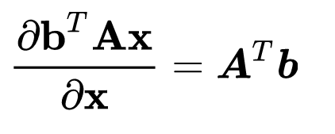
矩阵求导
矩阵求导入门
看作一个整体

Slide 11

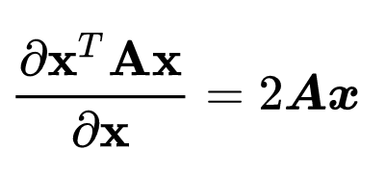
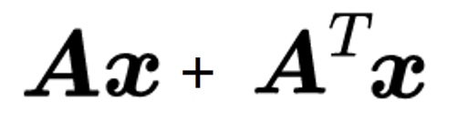
矩阵求导
矩阵求导入门
有两个x，分别求导，累加

Slide 12
矩阵求导
矩阵求导入门
有两个x，分别求导，累加
如果A是对称矩阵

Slide 13
pause

