Slide 1
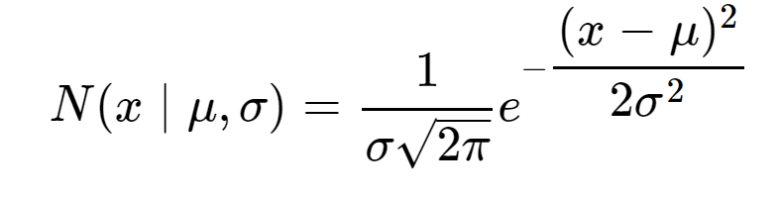
聚类：k-means、GMM
一维高斯分布
http://ethen8181.github.io/machine-learning/clustering/GMM/GMM.html

Slide 2
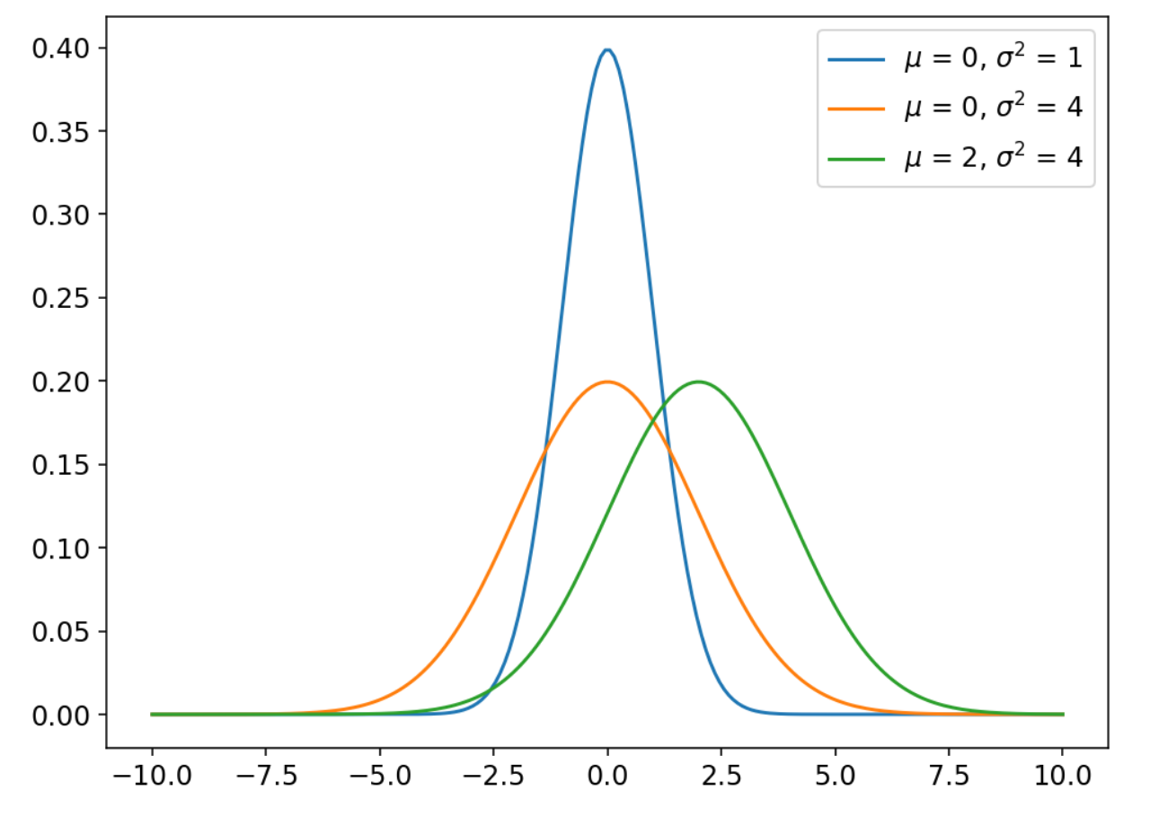
聚类：k-means、GMM
一维高斯分布
http://ethen8181.github.io/machine-learning/clustering/GMM/GMM.html

Slide 3
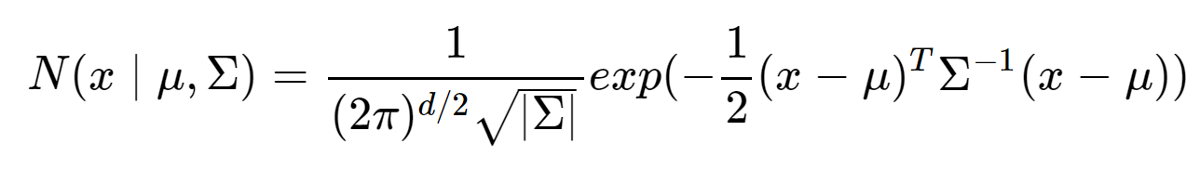
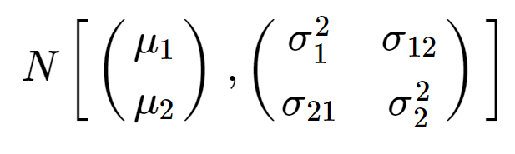

聚类：k-means、GMM
二维高斯分布
D表示d维
$∑$即$\left(\begin{matrix}σ_{1}^{2} & σ_{12} \\ σ_{21} & σ_{2}^{2}\end{matrix}\right)$
$∑^{−1}$为矩阵的逆矩阵
| $∑$|为矩阵的行列式
http://ethen8181.github.io/machine-learning/clustering/GMM/GMM.html

Slide 4
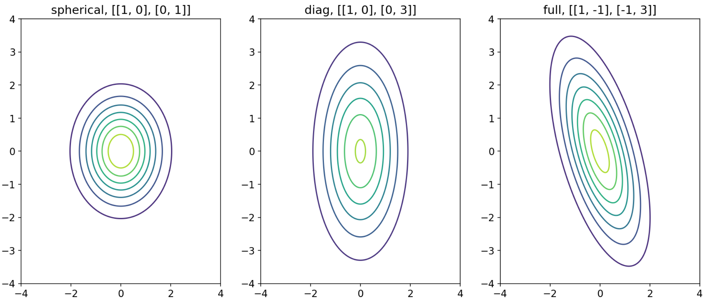
聚类：k-means、GMM
二维高斯分布
http://ethen8181.github.io/machine-learning/clustering/GMM/GMM.html

