Slide 1



特征工程+（ANOVA方差分析实例）
覃雄派

Slide 2
提纲
ANOVA实例
特征工程+（ANOVA方差分析实例）
https://www.spss-tutorials.com/anova-what-is-it/

Slide 3
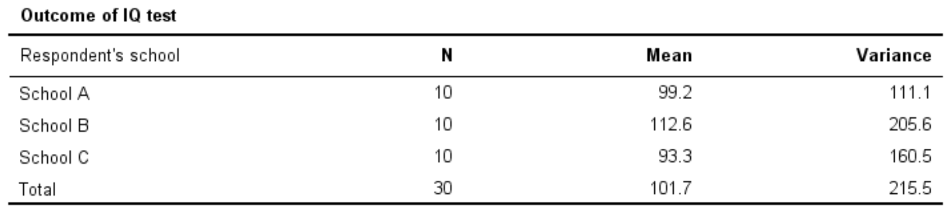
特征工程+（ANOVA方差分析实例）
A scientist wants to know if all children from schools A, B and C have equal mean IQ scores
Each school has 1,000 children
It takes too much time and money to test all 3,000 children
So a simple random sample of n = 10 children from each school is tested

Slide 4
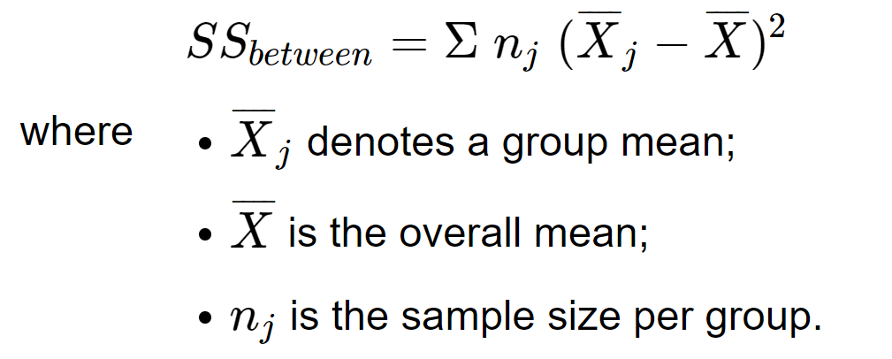
特征工程+（ANOVA方差分析实例）
1.We'll start off with the between-groups variance
sums of squares

Slide 5
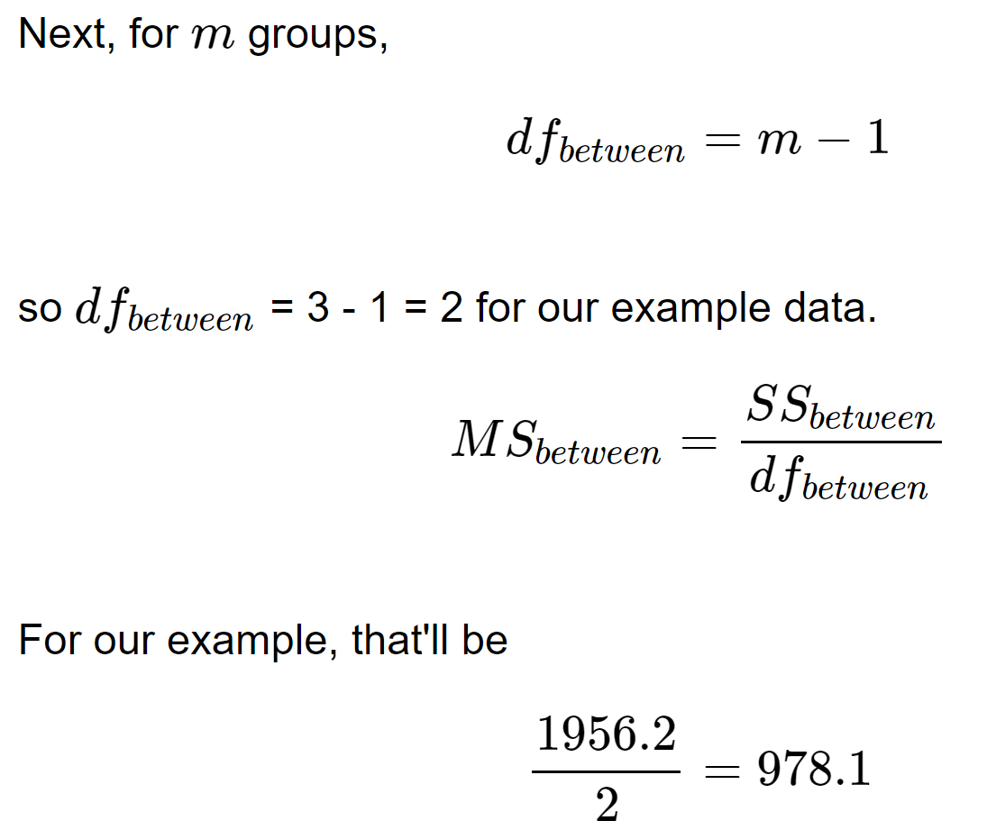
特征工程+（ANOVA方差分析实例）
1.We'll start off with the between-groups variance
mean squares

Slide 6
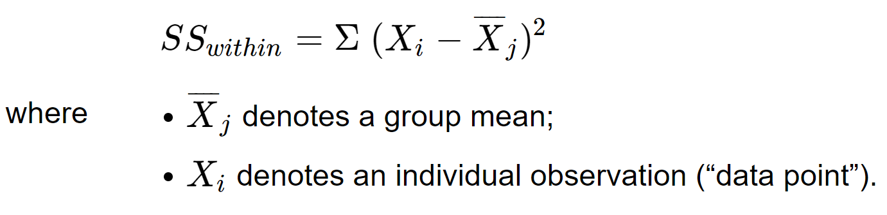
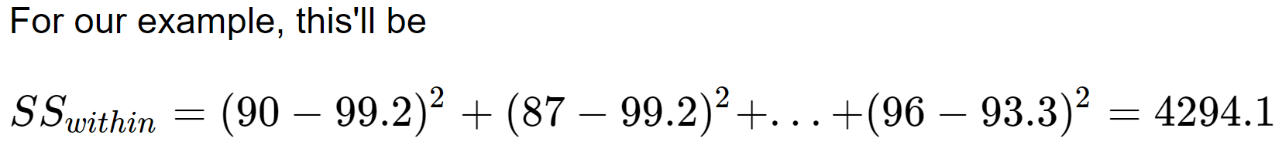
特征工程+（ANOVA方差分析实例）
2.We now turn to the within-groups variance
School A has 10个data point；School B has 10个data point ；school C has 10个data point

Slide 7
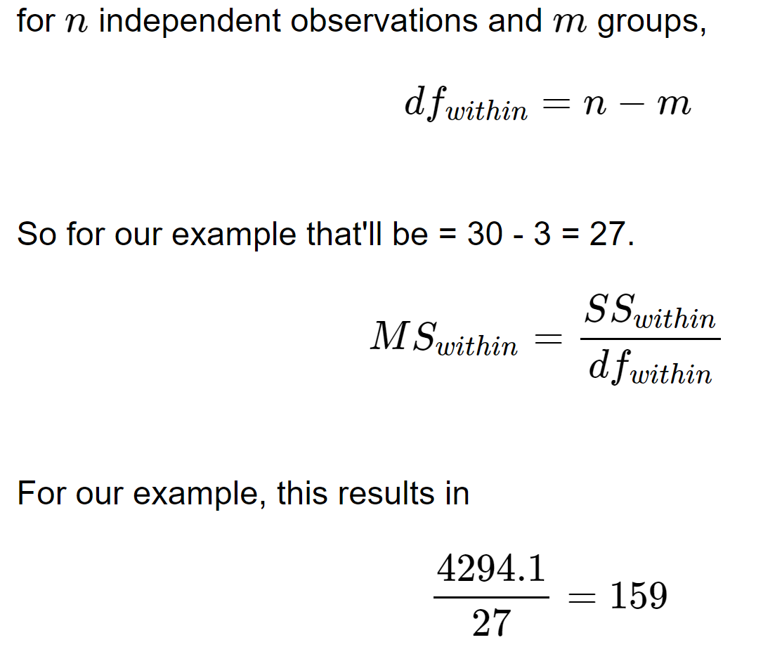
特征工程+（ANOVA方差分析实例）
2.We now turn to the within-groups variance

Slide 8
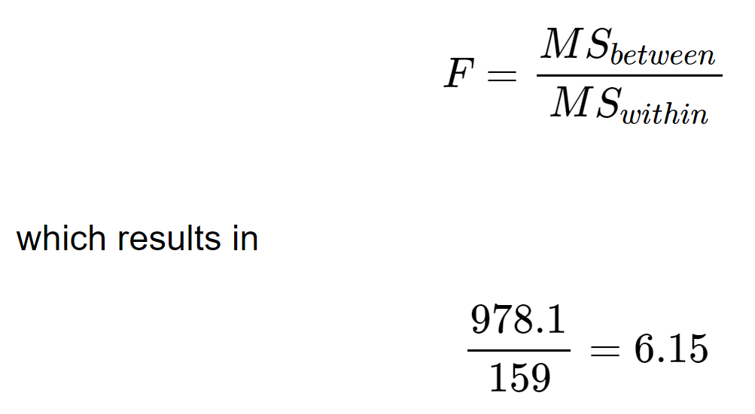
特征工程+（ANOVA方差分析实例）
3. We're now ready to calculate the F-statistic
请参考概率论相关内容

Slide 9
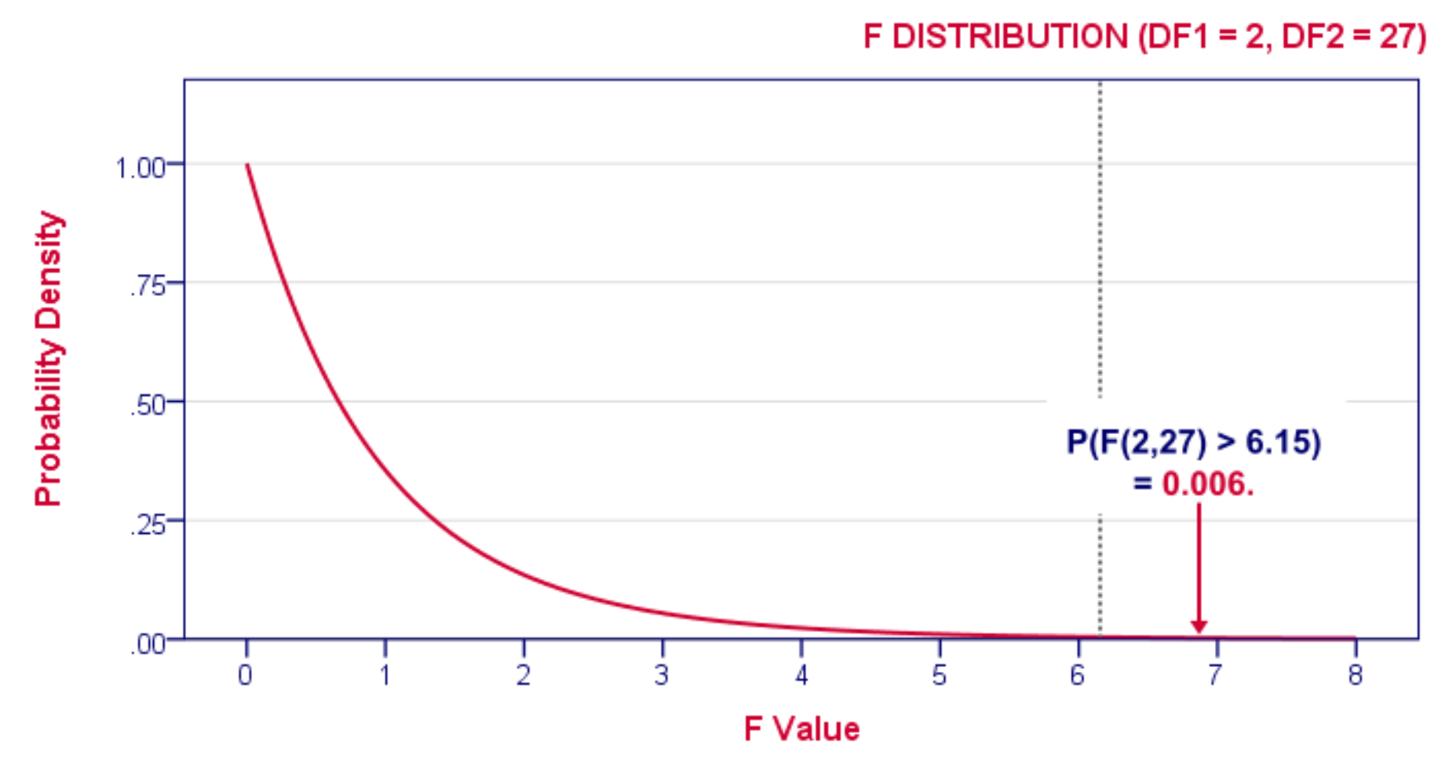
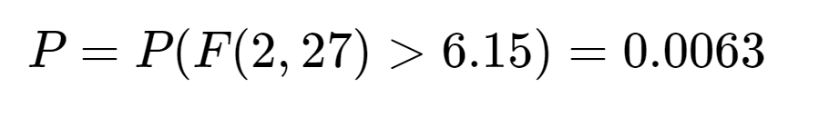
特征工程+（ANOVA方差分析实例）
4. Finally, Conclusion
Given this distribution, we can look up that the statistical significance. We usually report: F(2,27) = 6.15, p = 0.006
原假设：school A,B,C的IQ Mean没有大的差别
备择假设： school A,B,C的IQ Mean有大的差别
目前原假设成立的概率为0.0063，对于0.05的阈值来讲，概率很小，不可能成立
应该选择备择假设

Slide 10

pause

Slide 11
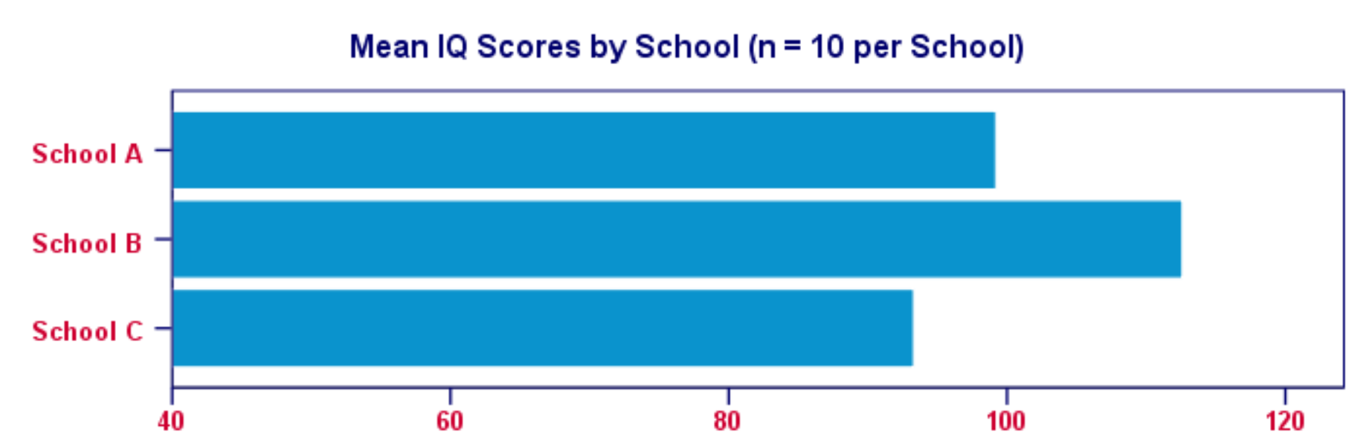
特征工程+（ANOVA方差分析实例）
visualization

Slide 12
pause

