Slide 1



特征工程
覃雄派

Slide 2
提纲
特征工程入门
Feature Transformation
Feature Extraction
Feature Selection
特征工程实践
特征工程

Slide 3
特征工程
特征工程
Feature Engineering is the way of extracting/selecting features from data and transforming them into formats that are suitable for Machine Learning algorithms
为机器学习模型，准备合适的特征
数据
机器学习模型
特征
https://towardsdatascience.com/feature-engineering-in-python-part-i-the-most-powerful-way-of-dealing-with-data-8e2447e7c69e

Slide 4
特征工程
特征工程
特征工程概览
包含3大块
1. Feature
Transformation
2. Feature
Extraction
3. Feature
Selection
1.1 Categorical - Label Encoding
1.2 Categorical - One Hot Encoding
1.3 Numeric - Binning
1.4 Numeric - Scaling
1.5 Log Transform
1.6 Handling Outliers
1.7 Imputation - Missing Value Handling
1.8 Invalid value
1.9 Feature Grouping
1.10 Feature Split
2.1 降维PCA
2.2 Feature Aggregation
……
3.1 Filter methods
3.2 Wrapper methods
3.3 Embedded methods

Slide 5
特征工程
Feature Engineering is divided into 3 broad categories
(1) Feature Transformation
It means transforming our original feature to the functions of original features
Scaling, discretization, binning and filling missing data values are the most common forms of data transformation
To reduce right skewness of the data, we can use log
……

Slide 6
特征工程
Feature Engineering is divided into 3 broad categories
(2) Feature Extraction
When the data to be processed through an algorithm is too large, it’s generally considered redundant
Analysis with a large number of variables uses a lot of computation power and memory
therefore we should reduce the dimensionality of these types of variables
It is a term for constructing combinations of the variables
For tabular data, we use PCA to reduce features
For image, we can use line or edge detection

Slide 7
特征工程
Feature Engineering is divided into 3 broad categories
(3) Feature Selection
All features aren't equal, There are certain features which are more important than other features to the accuracy of the model
It is all about selecting a small subset of features from a large pool of features
We select those attributes which best explain the relationship of an independent variable with the target variable
It is different from dimensionality reduction because the dimensionality reduction method does so by combining existing attributes, whereas the feature selection method includes or excludes those features
The methods of Feature Selection are Chi-squared test, correlation coefficient scores, LASSO, Ridge regression etc.

Slide 8

pause

Slide 9
特征工程
1. Feature Transformation
Machine learning algorithms sometimes expect data formatted in a certain way, and that is where feature engineering can help us
we need to apply some techniques so our data is compatible with the machine learning algorithm
相对于Feature Extraction
Feature Transformation的处理比较初级

Slide 10
特征工程
1. Feature Transformation
Categorical Feature Encoding
Some machine learning algorithms support categorical variables without further manipulation, but some don’t
That is why we use a categorical encoding
1.1Categorical - Label Encoding
Label encoding is converting each categorical value into some number
For example, the "species" feature contains 3 categories. We can assign value 0 to Adelie, 1 to Gentoo and 2 to Chinstrap

Slide 11
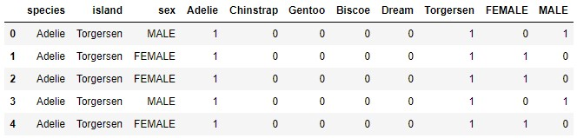
特征工程
1. Feature Transformation
1.2 Categorical - One Hot Encoding
It spreads the values in a feature to multiple flag features and assigns values 0 or 1 to them
This binary value represents the relationship between non-encoded and encoded features
For example, in our dataset, we have two possible values in "sex" feature: FEMALE and MALE
This technique will create two separate features labeled let’s say ‘FEMALE‘ and ‘MALE‘

Slide 12
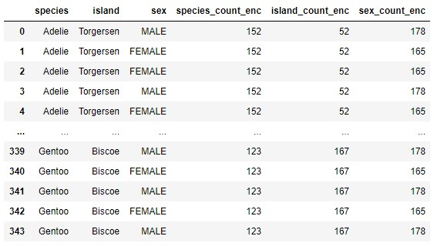
特征工程
1. Feature Transformation
1.2+ Categorical - Count Encoding
Count encoding is converting each categorical value to its frequency, i.e.. the number of times it appears in the dataset
Species属性的取值为Adelie的样本的频率为152次
每个样本，如果species属性的取值为Adelie，该列为152

Slide 13
特征工程
1. Feature Transformation
1.3 Numeric – Binning
Binning is a simple technique that groups different values into bins
For example, when we want to bin numerical features that would look like something like this:
0-10 → Low →0
10-50 → Medium →1
50-100 → High →2

Slide 14
特征工程
1. Feature Transformation
1.3 Numeric – Binning
Binning is a simple technique that groups different values into bins
However, we can bin categorical values too. For example, we can bin countries by the continent it is on:
Serbia → Europe →0
Germany → Europe →0
Japan → Asia →1
China → Asia →1
USA → North America →2
Canada → North America →2
The problem with binning is that it can downgrade performance
but it can prevent overfitting and increase the robustness of the machine learning model

Slide 15
特征工程
1. Feature Transformation
1.4 Numeric – Scaling
Scaling is done for one simple reason, if features are not in the same range, they will be treated differently by the machine learning algorithm
To put it in lame terms, if we have one feature that has a range of values from 0-10 and another 0-100, a machine learning algorithm might deduce that the second feature is more important than the first one just because it has a higher value
Some of machine learning algorithms even require that features look like standard normally distributed data

Slide 16

特征工程
1. Feature Transformation
1.4 Numeric – Scaling
(1) Standard Scaling
This type of scaling removes mean and scale data to unit variance. It is defined by the formula
where mean is the mean of the training samples, and std is the standard deviation of the training samples
We can use StandardScaler class of Scikit Learn library

Slide 17

特征工程
1. Feature Transformation
1.4 Numeric – Scaling
(2) Min-Max Scaling (Normalization)
The most popular scaling technique is normalization (also called min-max normalization and min-max scaling)
It scales all data in the 0 to 1 range. This technique is defined by the formula
We can use MinMaxScaler of Scikit learn library

Slide 18
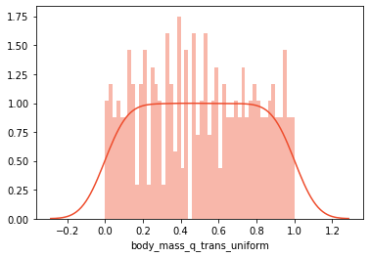
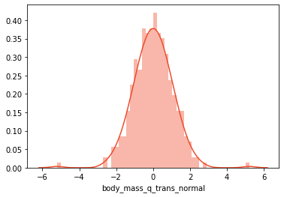
特征工程
1. Feature Transformation
1.4 Numeric – Scaling
(3) Quantile Transformation
sometimes machine learning algorithms require that the distribution of our data is uniform or normal
here is how it looks like when we transform our data to uniform distribution & normal distribution
We can achieve that using Quantile Transformer class of Scikit Learn library

Slide 19
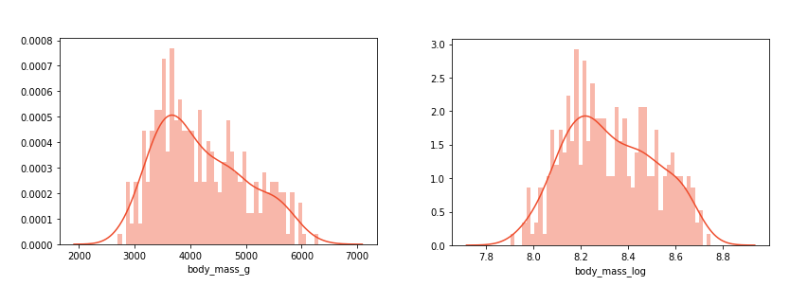
特征工程
1. Feature Transformation
1.5 Log Transform
This transformation brings many benefits. One of them is that the distribution of the data becomes more normal. In turn, this helps us to handle skewed data and decreases the impact of the outliers
It is important to note that data must be positive, so if you need a scale or normalize data beforehand
If we check the distribution of non-transformed data and transformed data we can see that transformed data is closer to the normal distribution

Slide 20
特征工程
1. Feature Transformation
1.6 Handling Outliers
Outliers are values that are deviating from the whole distribution of the data
Sometimes these values are mistakes and wrong measurements and should be removed from datasets, but sometimes they are valuable edge-case information
In a nutshell, we can use the Inter-quartile range to detect these points
Data between Q1 and Q3 is the IQR. Outliers are defined as samples that fall below Q1 – 1.5(IQR) or above Q3 + 1.5(IQR). We can do this using a boxplot

Slide 21
特征工程
1. Feature Transformation
1.6 Handling Outliers
Outliers are values that are deviating from the whole distribution of the data
Sometimes these values are mistakes and wrong measurements and should be removed from datasets, but sometimes they are valuable edge-case information
The other way for detecting and removing outliers would by using standard deviation
Here we need to define the factor by which we multiply the standard deviation. Usually, we use values between 2 and 4 for this purpose
Data in [mean – factor* standard deviation, mean + factor+* standard deviation] is normal, otherwise is outlier

Slide 22
特征工程
1. Feature Transformation
1.6 Handling Outliers
Outliers are values that are deviating from the whole distribution of the data
Sometimes these values are mistakes and wrong measurements and should be removed from datasets, but sometimes they are valuable edge-case information
Finally, we can use a method to detect outliers is to use percentiles
We can assume a certain percentage of the value from the top or the bottom as an outlier

Slide 23
特征工程
1. Feature Transformation
1.7 Imputation - Missing Value Handling
We can Drop the whole sample
Or we can replace missing values
Numeric feature：mean均值, mode众数, median中位数
Categorical feature：most frequent value

Slide 24
特征工程
1. Feature Transformation
1.8 Invalid value
invalid value is different from missing value
For the sex feature, the value should be MALE or Female
If the value is “.”, then it is invalid
Drop the whole sample
or replace missing value

Slide 25
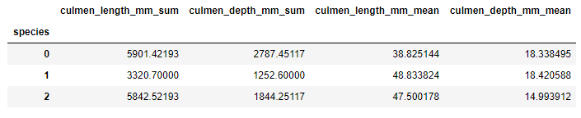
特征工程
1. Feature Transformation
1.9 Feature Grouping
sometimes we have observations that are spread over several rows. The goal of the Feature Grouping is to connect these rows into a single one and then use those aggregated rows
The main question when doing so is which type of aggregation function will be applied to features. This is especially complicated for categorical features
Here we grouped data by species value and for each numerical value we created two new features with sum and mean value

Slide 26
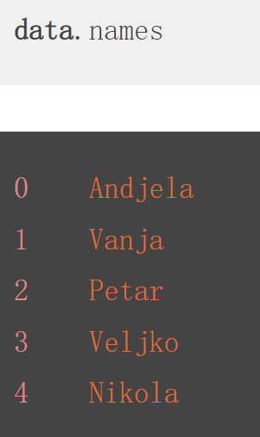
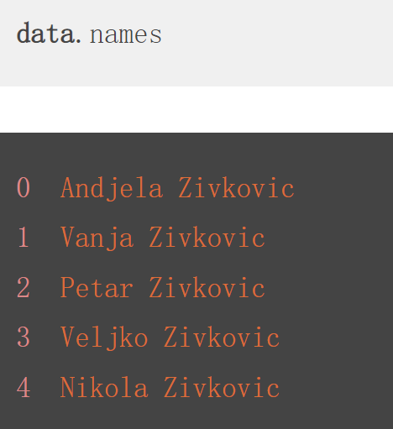
特征工程
1. Feature Transformation
1.10 Feature Split
Sometimes, data is not connected over rows, but over columns
if we want to extract only first name from this feature
This technique is called feature splitting and it is often used with string data
Name → last name, first name

Slide 27
pause

Slide 28
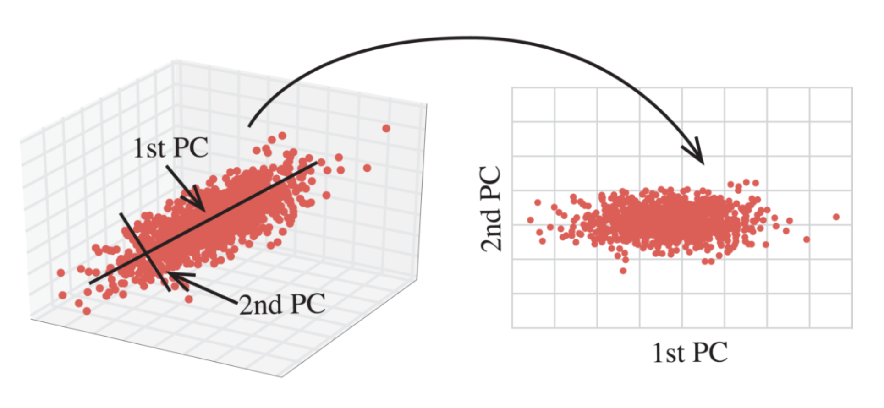
特征工程
相对于Feature Transformation
Feature Extraction的处理更为深入
2. Feature Extraction
Dimension reduction
For example PCA
下图是3维到2维的降维示意图
PCA的原理这里不展开

Slide 29
特征工程
2. Feature Extraction
NLP(Natural Language Processing)
Tokenization
And NER
High level analysis
Named Entity Recognition
Tokenization
Text

Slide 30

特征工程
2. Feature Extraction
Price Time Series Data
Ta-Lib
Indicators
Data Aggregation
Indicators
Ta-Lib
Price Data

Slide 31
pause

Slide 32
特征工程
3. Feature Selection
什么是特征选择
Feature selection is also known as Variable selection or Attribute selection
Essentially, it is the process of selecting the most important/relevant features of a dataset
select those features in your data
that contribute most to the prediction variable or output in which you are interested

Slide 33
特征工程
Feature Selection is the process of selecting out the most significant features from a given dataset
In many cases, Feature Selection can enhance the performance of a machine learning model as well
3. Feature Selection
为什么要进行特征选择
Often, in a high dimensional dataset, there remain some entirely irrelevant, insignificant and unimportant features
the contribution of these types of features is often less towards predictive modeling as compared to the critical features
They may have zero contribution as well
Unnecessary resource allocation for these features
The machine model takes more time to get trained
These features act as a noise for which the machine learning model can perform terribly poorly
it can make your model very complicated which in turn may lead to overfitting
https://www.datacamp.com/community/tutorials/feature-selection-python?irclickid=VeXTYcVJ3xyLUZKzN30x7Q3FUkGwSCSRxzwvRQ0&irgwc=1

Slide 34
特征工程
3. Feature Selection
Benefits/Advantages of Feature Selection/importance of feature selection
Reduces Training Time：enables the machine learning algorithm to train faster, Less data means that algorithms train faster
improves the accuracy of a model if the right subset is chosen： Less misleading data means modeling accuracy improves
reduces Overfitting：Less redundant data means less opportunity to make decisions based on noise; Enhanced generalization by reducing Overfitting
reduces the complexity of a model and makes it easier to interpret; Simple models are easier to interpret
Avoid Bad learning behavior in high dimensional spaces

Slide 35
特征工程
3. Feature Selection
Difference between dimensionality reduction and feature selection
Both methods tend to reduce the number of attributes in the dataset
but a dimensionality reduction method does so by creating new combinations of attributes
Some examples of dimensionality reduction methods are Principal Component Analysis(PCA), Singular Value Decomposition(SVD), Linear Discriminant Analysis(LDA)
whereas feature selection methods
include and exclude attributes present in the data without changing them

Slide 36
特征工程
3. Feature Selection
特征选择的方法Types of feature selection
三类方法
1. Filter Method
2. Wrapper Method
3. Embedded Method
数值型特征和类别型特征的Selection办法是不一样的
https://towardsdatascience.com/feature-selection-with-pandas-e3690ad8504b

Slide 37
pause

Slide 38
特征工程
3. Feature Selection
3.1 Filter methods
Filter method relies on the general uniqueness of the data to be evaluated and pick feature subset, not including any mining algorithm
Filter method uses the exact assessment criterion which includes distance, information, dependency, and consistency
Filter methods are generally used as a data preprocessing step
不依赖机器学习算法，直接依赖数据的特点（某种评价指标），进行特征选择

Slide 39
特征工程
3. Feature Selection
3.1Filter methods
Filter methods are generally used as a preprocessing step
The selection of features is independent of any machine learning algorithms
Instead, features are selected on the basis of their scores in various statistical tests for their correlation with the outcome variable

Slide 40

特征工程
3. Feature Selection
3.1Filter methods
We can refer to the following table for defining correlation coefficients for different types of data
Some examples of filter methods include the Chi-squared test, information gain, and correlation coefficients
Mutual information回归问题
Pearson相关系数
线性判别分析
ANOVA
方差分析
卡方测试
information Gain
Lda models are used to predict a categorical variable (factor) using one or several continuous (numerical) features
Mutual information分类问题

Slide 41
特征工程
3. Feature Selection
3.1 Filter methods
3.1.1 Remove constant features
Constant features are those that show the same value, just one value, for all the observations of the dataset
This is, the same value for all the rows of the dataset
These features provide no information that allows a machine learning model to discriminate or predict a target
We can use variance threshold from scikit learn
Variance threshold from scikit learn is a simple baseline approach to feature selection
It removes all features which variance doesn’t meet some threshold
By default, it removes all zero-variance features, i.e., features that have the same value in all samples

Slide 42
特征工程
3. Feature Selection
3.1 Filter methods
3.1.2 Remove quasi-constant features
Quasi-constant features are those that show the same value for the great majority of the observations of the dataset. In general, these features provide little if any information that allows a machine learning model to discriminate or predict a target
But there can be exceptions, So we should be careful when removing these type of features
Identifying and removing quasi-constant features, is an easy first step towards feature selection and more easily interpretable machine learning models
To identify quasi-constant features, we can once again use the Variance Threshold function from scikit learn
Variance threshold from scikit learn is a simple baseline approach to feature selection
It removes all features which variance doesn’t meet some threshold

Slide 43
特征工程
3. Feature Selection
3.1Filter methods
3.1.3 Information Gain
Information gain calculates the reduction in entropy from the transformation of a dataset
It can be used for feature selection by evaluating the Information gain of each variable in the context of the target variable
Information gain or mutual information measures how much information the presence/absence of a feature contributes to making the correct prediction on the target
信息增益细节请参考

Slide 44
特征工程
3. Feature Selection
3.1 Filter methods
3.1.3 从Information Gain到mutual_info_classif
It estimates mutual information for a discrete target variable
Mutual information (MI) between two random variables is a non-negative value, which measures the dependency between the variables
It is equal to zero if and only if two random variables are independent, and higher values mean higher dependency
This function relies on nonparametric methods based on entropy estimation from k-nearest neighbors distances
It can be used for univariate features selection
Scikit Learn implementation
互信息细节请参考

Slide 45
特征工程
3. Feature Selection
3.1 Filter methods
3.1.3 从Information Gain到mutual_info_regression
Estimate mutual information for a continuous target variable
Mutual information (MI) between two random variables is a non-negative value, which measures the dependency between the variables
It is equal to zero if and only if two random variables are independent, and higher values mean higher dependency
The function relies on nonparametric methods based on entropy estimation from k-nearest neighbors distances
It can be used for univariate features selection
Scikit Learn implementation

Slide 46
特征工程
3. Feature Selection
3.1 Filter methods
3.1.4 Chi-square Test
The Chi-square test is used for categorical features in a dataset
Categorical属性→Categorical 目标变量
We calculate Chi-square between each feature and the target
and select the desired number of features with the best Chi-square scores
卡方检验细节请参考

Slide 47
特征工程
3. Feature Selection
3.1 Filter methods
3.1.4 Chi-square Test - Fisher Score
It is the chi-square implementation in scikit-learn
It computes chi-squared stats between each non-negative feature and class
This score should be used to evaluate categorical variables in a classification task
It compares the observed distribution of the different classes of target Y among the different categories of the feature
against the expected distribution of the target classes, regardless of the feature categories
Scikit Learn
chi-square implementation
We can perform a chi-square test to the samples to retrieve only the two best features from iris dataset

Slide 48
特征工程
3. Feature Selection
3.1Filter methods
3.1.5Mean Absolute Difference (MAD)
The mean absolute difference (MAD) computes the absolute difference from the mean value
The main difference between the variance and MAD measures is the absence of the square in the latter
The MAD, like the variance in that higher the MAD, higher the discriminatory power

Slide 49
特征工程
3. Feature Selection
3.1Filter methods
3.1.6 Variance Threshold
The variance threshold is a simple baseline approach to feature selection
It removes all features which variance doesn’t meet some threshold
By default, it removes all zero-variance features, i.e., features that have the same value in all samples
We assume that features with a higher variance may contain more useful information, but note that we are not taking the relationship between feature variables and target variables into account, which is one of the drawbacks of filter methods

Slide 50
特征工程
3. Feature Selection
3.1 Filter methods
3.1.7 ANOVA F-value For Feature Selection
Statistical tests can be used to select those features that have the strongest relationship with the output variable
For example the ANOVA F-value method is appropriate for numerical inputs and categorical data
Compute the ANOVA F-value for the provided sample
If the features are categorical, we will calculate a chi-square statistic between each feature and the target vector
However, if the features are quantitative, we will compute the ANOVA F-value between each feature and the target vector
The F-value scores examine if, when we group the numerical feature by the target vector, the means for each group are significantly different
方差分析(Analysis of Variance)
方差分析细节请参考

Slide 51
特征工程
Visualize Correlation-Matrix with Heat map
3. Feature Selection
3.1Filter methods
3.1.8 Correlation Coefficient以及共线性
Correlation is a measure of the linear relationship of 2 or more variables. Through correlation, we can predict one variable from the other
Good variables are highly correlated with the target
Correlated predictor variables provide redundant information
Variables should be correlated with the target but uncorrelated among themselves
"Good feature subsets contain features highly correlated with the target, yet uncorrelated to each other"

Slide 52
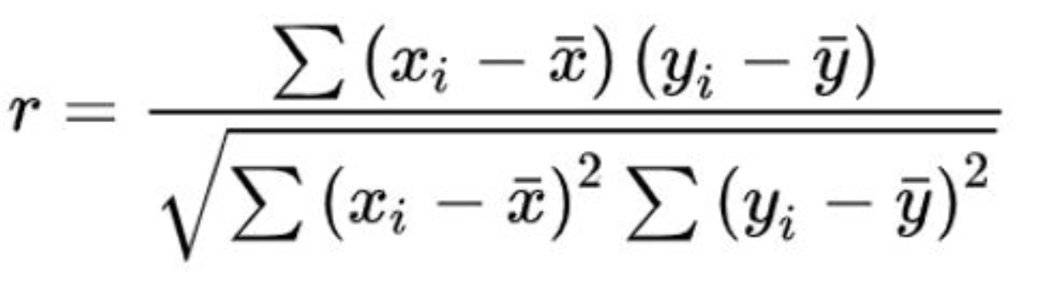
特征工程
Visualize Correlation-Matrix with Heat map
3. Feature Selection
3.1Filter methods
3.1.8 Correlation Coefficient以及共线性
We can use the Pearson Correlation
Using Pearson correlation returned coefficient values will vary between -1 and 1
A value closer to 0 implies weaker correlation (exact 0 implying no correlation)
A value closer to 1 implies stronger positive correlation
A value closer to -1 implies stronger negative correlation
可以保留相关系数绝对值大于等于0.5（阈值）的特征

Slide 53
特征工程
Visualize Correlation-Matrix with Heat map
3. Feature Selection
3.1Filter methods
3.1.8 Correlation Coefficient以及共线性
The logic behind using correlation for feature selection is that the good variables are highly correlated with the target
Furthermore, variables should be correlated with the target but should be uncorrelated among themselves（变量之间不应过多相关）
We should check if the selected variables are highly correlated with each other
This phenomenon is known as multi-collinearity
If they are, we would then need to keep just one of the correlated ones and drop the others

Slide 54
特征工程
3. Feature Selection
3.1Filter methods
In scikit learn
SelectKBest(scikit learn) select features according to the k highest scores
SelectPercentile(scikit learn) Select features according to a percentile of the highest scores
SelectKBest and SelectPercentile take as input a scoring function that returns univariate scores
For regression tasks: f_regression, mutual_info_regression
For classification tasks: chi2, f_classif, mutual_info_classif
The methods based on F-test estimate the degree of linear dependency between two random variables. They assume a linear relationship between the feature and the target
On the other hand, mutual information methods can capture any kind of statistical dependency, but being nonparametric, they require more samples for accurate estimation
https://machinelearningmastery.com/feature-selection-machine-learning-python/

Slide 55

特征工程
3. Feature Selection
3.1Filter methods：小结
The characteristics of these methods are as follows
These methods rely on the characteristics of the data (feature characteristics)
They do not use machine learning algorithms
These are model agnostic
They tend to be less computationally expensive
They usually give lower prediction performance than wrapper methods
They are very well suited for a quick screen and removal of irrelevant features
agnostic

Slide 56
pause

Slide 57
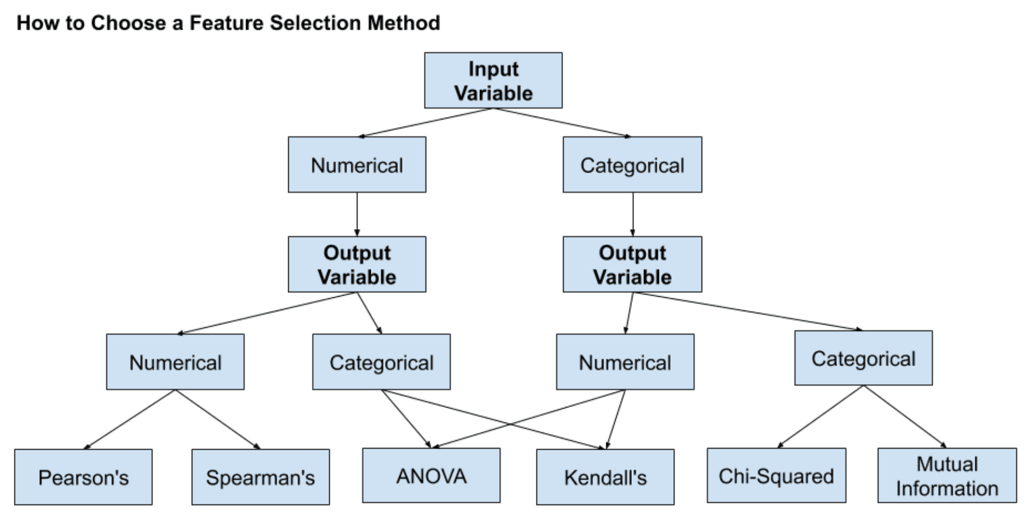
特征工程
3. Feature Selection
3.1Filter methods
How to choose the right feature selection method
We can see that there are lot of feature selection techniques available
The following graphic will serve as a guide on how to choose a feature selection method

Slide 58
特征工程
3. Feature Selection
3.1Filter methods
Numerical Input, Numerical Output
This is a regression predictive modeling problem with numerical input variables
The most common techniques are to use a correlation coefficient, such as Pearson’s for a linear correlation, or rank-based methods for a nonlinear correlation
The tests employed are as follows
Pearson’s correlation coefficient (linear)
Spearman’s rank coefficient (nonlinear)

Slide 59
特征工程
3. Feature Selection
3.1Filter methods
Numerical Input, Categorical Output
This is a classification predictive modeling problem with numerical input variables
This might be the most common example of a classification problem
Again, the most common techniques are correlation based, although in this case, they must take the categorical target into account
We can employ the following tests as follows
ANOVA correlation coefficient (linear)
Kendall’s rank coefficient (nonlinear)
Kendall does assume that the categorical variable is ordinal

Slide 60
特征工程
3. Feature Selection
3.1Filter methods
Categorical Input, Numerical Output
This is a regression predictive modeling problem with categorical input variables
This is a strange example of a regression problem (e.g. we will not encounter it often)
We can use the same “Numerical Input, Categorical Output” methods (described previously), but in reverse

Slide 61
特征工程
3. Feature Selection
3.1Filter methods
Categorical Input, Categorical Output
This is a classification predictive modeling problem with categorical input variables
The most common correlation measure for categorical data is the chi-squared test (contingency tables)
We can also use mutual information /information gain from the field of information theory
In fact, mutual information is a powerful method that may prove useful for both categorical and numerical data, e.g. it is agnostic to the data types

Slide 62
pause

Slide 63
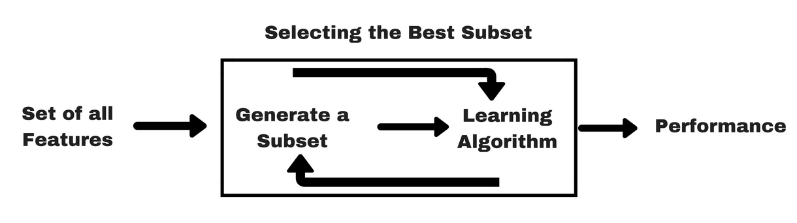
特征工程
3. Feature Selection
3.2Wrapper methods
a wrapper method needs one machine learning algorithm and uses its performance as evaluation criteria to evaluate features( independent variables)
This method searches for a feature sub set which is best-suited for the machine learning algorithm and aims to improve the mining performance
To evaluate the features, the predictive accuracy used for classification tasks and goodness of cluster is evaluated using clustering
The problem is essentially reduced to a search problem, some methods follows a greedy search approach by evaluating all the possible combinations of features against the evaluation criterion; These methods are usually computationally very expensive
The wrapper methods usually result in better predictive accuracy than filter methods
使用learning
algorithm

Slide 64
特征工程
3. Feature Selection
3.2Wrapper methods
Wrapper methods consists of the following techniques
Forward Selection
Backward Elimination
Exhaustive Feature Selection
Recursive Feature Elimination
Recursive Feature Elimination with Cross-Validation

Slide 65
特征工程
3. Feature Selection
3.2 Wrapper methods
3.2.1 Forward Selection
Forward selection is an iterative method in which we start with having no feature in the model
In each iteration, we keep adding the feature which best improves our model till an addition of a new variable does not improve the performance of the model
The procedure starts with an empty set of features. The best of the original features is determined and added to the reduced set
At each subsequent iteration, the best of the remaining original attributes is added to the set
Step forward feature selection starts by evaluating all features individually and selects the one that generates the best performing algorithm, according to a pre-set evaluation criteria
In the second step, it evaluates all possible combinations of the selected feature and a second feature, and selects the pair that produce the best performing algorithm based on the same pre-set criteria

Slide 66
特征工程
3. Feature Selection
3.2 Wrapper methods
3.2.1 Forward Selection
The pre-set criteria can be the ROC/AUC for classification and the R squared for regression for example
This selection procedure is called greedy, because it evaluates all possible single, double, triple and so on feature combinations. Therefore, it is quite computationally expensive, and sometimes, if feature space is big, even unfeasible
mlxtend python library has an implementation
ROC(Receiver Operating Characteristic)曲线
AUC(Area Under the Curve)面积
ROC和AUC为评价分类模型的指标

Slide 67
特征工程
3. Feature Selection
3.2Wrapper methods
3.2.2Backward Elimination
In backward elimination, we start with all the features and removes the least significant feature at each iteration which improves the performance of the model
The procedure starts with the full set of attributes
At each step, it removes the worst attribute remaining in the set
We repeat this until no improvement is observed on removal of features
mlxtend python library has an implementation

Slide 68
特征工程
3. Feature Selection
3.2 Wrapper methods
3.2.3 Combination of forward selection and backward elimination
The stepwise forward selection and backward elimination methods can be combined
so that, at each step, the procedure selects the best attribute from among the remaining attributes and removes the worst
mlxtend python library has an implementation

Slide 69
特征工程
3. Feature Selection
3.2 Wrapper methods
3.2.4 Exhaustive Feature Selection
It is a brute-force evaluation of each feature subset. In an exhaustive feature selection the best subset of features is selected, over all possible feature subsets, by optimizing a specified performance metric for a certain machine learning algorithm
For example, if the classifier is a logistic regression and the dataset consists of 4 features, the algorithm will evaluate all 15(2^{N} -1)feature combinations as follows:
all possible combinations of 1 feature/ all possible combinations of 2 features/ all possible combinations of 3 features/ all the 4 features
and select the one that results in the best performance (e.g., classification accuracy) of the logistic regression classifier
This is greedy algorithm as it evaluates all possible feature combinations
This is the most robust feature selection method covered so far
It is quite computationally expensive, and sometimes, if feature space is big, even unfeasible
mlxtend python library has an implementation

Slide 70
特征工程
3. Feature Selection
3.2 Wrapper methods
3.2.5 Recursive Feature elimination
It is a greedy optimization algorithm which aims to find the best performing feature subset
The Recursive Feature Elimination (or RFE) works by recursively removing attributes and building a model on those attributes that remain
It uses the model accuracy to identify which attributes (and combination of attributes) contribute the most to predicting the target attribute
RFE selects features by considering a smaller and smaller set of features(regressors)
Recursive feature elimination technique eliminates n features from a model by fitting the model multiple times and at each step, removing the weakest features

Slide 71
特征工程
3. Feature Selection
3.2 Wrapper methods
3.2.5 Recursive Feature elimination
The starting point is the original set of features
Less important features are recursively pruned from the initial set
The procedure is repeated until a desired set of features remain
number can either be a priori specified, or can be found using cross validation

Slide 72
特征工程
3. Feature Selection
3.2 Wrapper methods
3.2.5 Recursive Feature elimination
The RFE method takes the model to be used and the number of required features as input
It then gives the ranking of all the variables, 1 being most important
It also gives its support, True being relevant feature and False being irrelevant feature
First, the estimator is trained on the initial set of features and the importance of each feature is obtained either through a coef_ attribute(e.g., the coefficients of a linear model) or through a feature_importances_ attribute
Then, the least important features are pruned from the current set of features
That procedure is recursively repeated on the pruned set until the desired number of features to select is eventually reached
It then ranks the features based on the order of their elimination

Slide 73
特征工程
3. Feature Selection
3.2 Wrapper methods
3.2.5 Recursive Feature elimination with Cross-Validated (RFECV)
In scikit learn, RFE offers a variant – RFECV – designed to optimally find the best subset of regressors
Recursive Feature Elimination feature selection technique selects the best subset of features for the estimator by removing 0 to N features iteratively using recursive feature elimination
Then it selects the best subset based on cross-validation score
the accuracy or ROC/AUC of the model
Recursive Feature elimination 和 cross-validation结合

Slide 74
pause

Slide 75
特征工程
Difference between filter and wrapper methods
It might get confusing to differentiate between filter methods and wrapper methods in terms of their functionalities
Filter methods do not incorporate a machine learning model in order to determine if a feature is good or bad
whereas wrapper methods use a machine learning model and train it the feature to decide if it is essential or not
Filter methods are much faster compared to wrapper methods as they do not involve training the models
On the other hand, wrapper methods are computationally costly, and in the case of massive datasets, wrapper methods are not the most effective feature selection method to consider
When dealing with high-dimensional data, it is computationally cheaper to use filter methods

Slide 76
特征工程
Difference between filter and wrapper methods
(continue)
Filter methods may fail to find the best subset of features in situations when there is not enough data to model the statistical correlation of the features
but wrapper methods can always provide the best subset of features because of their exhaustive nature
Using features from wrapper methods in your final machine learning model can lead to overfitting as wrapper methods already train machine learning models with the features and it affects the true power of learning
But the features from filter methods will not lead to overfitting in most of the cases

Slide 77
pause

Slide 78
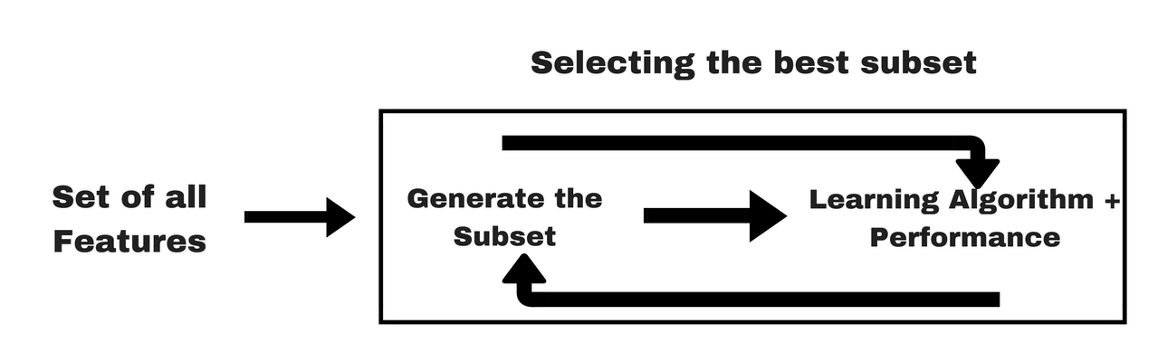
特征工程
3. Feature Selection
3.3 Embedded methods
In Embedded Methods, the feature selection algorithm is integrated as part of the learning algorithm.
Regularization methods are the most commonly used embedded methods which penalize a feature given a coefficient threshold
Regularization methods are also called penalization methods that introduce additional constraints into the optimization of a predictive algorithm (such as a regression algorithm) that bias the model toward lower complexity (fewer coefficients)
Some of the most popular examples of these methods are LASSO, RIDGE and Elastic Net regression which have inbuilt penalization functions to reduce overfitting

Slide 79
特征工程
3. Feature Selection
3.3 Embedded methods
3.3.1 Regularization methods—LASSO, Ridge Regression, Elastic Net
LASSO Regression (L1) Based Feature Selection
Lasso regression performs L1 regularization which adds penalty equivalent to absolute value of the magnitude of coefficients
Regularization consists in adding a penalty to the different parameters of the machine learning model to reduce the freedom of the model and in other words to avoid overfitting
In linear model regularization, the penalty is applied over the coefficients that multiply each of the predictors
From the different types of regularization, Lasso or L1 has the property that is able to shrink some of the coefficients to zero
If the feature is irrelevant, lasso penalizes it’s coefficient and make it 0
Therefore, that feature(coefficient = 0) can be removed from the model
请参考多元线性回归的“正则化”

Slide 80
特征工程
3. Feature Selection
3.3Embedded methods
3.3.1Regularization methods—LASSO, Ridge Regression , Elastic Net
LASSO Regression (L1) Based Feature Selection
Lasso regularization helps to remove non-important features from the dataset
increasing the penalization will result in increase the number of features removed
Therefore, we need to keep an eye and monitor that we don't set a penalty too high so that to remove even important features, or too low and then not remove non-important features.
If the penalty is too high and important features are removed
we will notice a drop in the performance of the algorithm and then realize that we need to decrease the regularization
请参考多元线性回归的“正则化”

Slide 81
特征工程
3. Feature Selection
3.3 Embedded methods
3.3.1 Regularization methods——LASSO, Ridge Regression , Elastic Net
此处不展开

Slide 82
特征工程
3. Feature Selection
3.3 Embedded methods
3.3.1 Regularization methods——LASSO, Ridge Regression, Elastic Net
此处不展开

Slide 83
特征工程
3. Feature Selection
3.3 Embedded methods
3.3.2 Random Forest Importance(Tree-based Feature Selection)
Decision trees or other tree-based models contain a variable importance output that can be used to decide, which feature to select for inclusion
Features that are closer to the root of the tree are more important than those at end splits, which are not as relevant

Slide 84
特征工程
3. Feature Selection
3.3 Embedded methods
3.3.2 Random Forest Importance(Tree-based Feature Selection)
Random forests are one the most popular machine learning algorithms. They are so successful because they provide in general a good predictive performance, low overfitting and easy interpretability
This interpretability is given by the fact that it is straightforward to derive the importance of each variable on the tree decision
In other words, it is easy to compute how much each variable is contributing to the decision

Slide 85
特征工程
3. Feature Selection
3.3 Embedded methods
3.3.2 Random Forest Importance(Tree-based Feature Selection)
Random forests consist of 4-12 hundred decision trees, each of them built over a random extraction of the observations from the dataset and a random extraction of the features. Not every tree sees all the features or all the observations, and this guarantees that the trees are de-correlated and therefore less prone to over-fitting
Each tree is also a sequence of yes-no questions based on a single or combination of features. At each node (this is at each question), the feature divides the dataset into 2 buckets, each of them hosting observations that are more similar among themselves and different from the ones in the other bucket
Therefore, the importance of each feature is derived by how "pure" each of the buckets is

Slide 86
特征工程
3. Feature Selection
3.3 Embedded methods
3.3.2 Random Forest Importance(Tree-based Feature Selection)
For classification, the measure of impurity is either the Gini impurity or the information gain. For regression the measure of impurity is variance
Therefore, when training a tree, it is possible to compute how much each feature decreases the impurity. The more a feature decreases the impurity, the more important the feature is
In random forests, the impurity decrease from each feature can be averaged across trees to determine the final importance of the variable
To give a better intuition, features that are selected at the top of the trees are in general more important than features that are selected at the end nodes of the trees, as generally the top splits lead to bigger information gains
by pruning trees below a particular node, we can create a subset of the most important features

Slide 87
pause

Slide 88
特征工程
Choose the right feature selection methods
Filter method vs. Wrapper method vs. Embedded method
Filter method is less accurate
It is great while doing EDA, it can also be used for checking multi co-linearity in data
Wrapper and Embedded methods give more accurate results but as they are computationally expensive
these method are suited when you have less features (~20)

Slide 89
pause

Slide 90
特征工程
特征工程实践
（1）
1. Imputation – missing values
2. Categorical Encoding
2.1 Label Encoding
2.2 One-Hot Encoding
2.3 Count Encoding
2.4 Target Encoding
2.5 Leave One Out Target Encoding
3. Handling Outliers
4. Binning
5. Scaling
5.1 Standard Scaling
5.2 Min-Max Scaling (Normalization)
5.3 Quantile Transformation
6. Log Transform
7. Feature Selection using SelectKBest(f_classif）
8. Feature Grouping
9. Feature Split

Slide 91
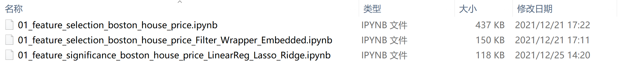
特征工程
特征工程实践
（1）
1. Regression forward selection
2. Regression backward selection
3. Regression stepwise selection
4. REF ← Linear Regression
4.1 REFCV ← Linear Regression
5. SelectKBest(score_func=f_regression)
6. Correlation
7. Lasso (L1) Based Feature Selection
8. Tree-based Feature Selection
（2）
1. Filter method ← correlation
2. Wrapper Method ← Backward Elimination
3. Wrapper Method ← REF (Linear Regression)
4. Embedded method ← Lasso
（3）
1. Linear regression(importances =lm.coef_)
2. Lasso regression (importances =lm.coef_)
3. Ridge regression (importances =lm.coef_)

Slide 92
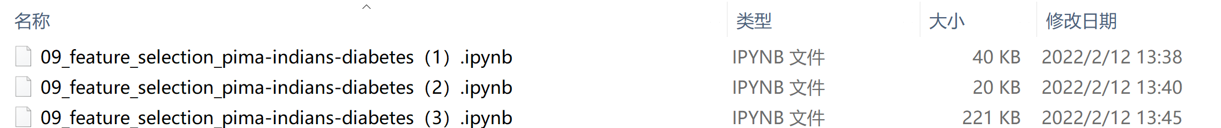
特征工程
特征工程实践
（1）
1. SelectKBest ← score_func=f_classif
2. RFE ← Logistic Regression
3. PCA ← n_components=3
4. ExtraTreesClassifier← feature_importances_
（2）
1. SelectKBest ← score_func=chi2
2. REF ← Logistic Regression
3. Regularization ← Ridge
（3）
1. Filter method ← information gain(mutual_info_classif)
2. Filter method ←Chi-square Test SelectKBest(chi2)
3. Filter Method ← Correlation Coefficient
4. Filter method ← Variance Threshold
5. Filter method ← Mean Absolute Difference (MAD)
6. Wrapper Methods ← Forward Feature Selection
7. Wrapper Methods ← Backward Feature Selection
8. Wrapper Methods ← Exhaustive Feature Selection
9. Wrapper Methods ← Recursive Feature Elimination
10. Embedded Methods ← LASSO Regularization (L1)
11. Embedded Methods ← Random Forest Importance

Slide 93
pause

Slide 94
思考题
1、特征工程的概念？
2、特征转换、特征抽取、特征选择？
3、特征转换的关键技术？
4、特征抽取的关键技术？
5、为什么要进行特征选择，特征选择的优势？
6、特征选择与降维的区别？
7、特征选择方法：Filter Method的关键技术？Filter Method技术的分类？
8、特征选择方法：Wrapper methods的关键技术？
9、特征选择方法：Embedded methods的关键技术？

Slide 95
pause

