Slide 1
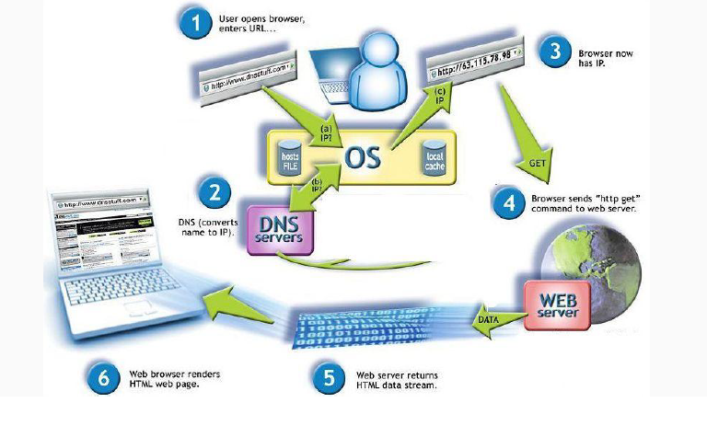
WWW Lifecycle

Slide 2
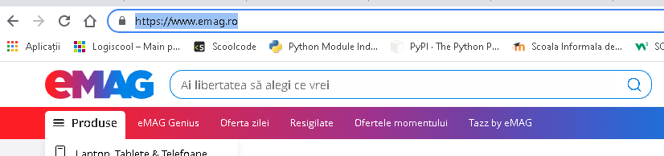
The user opens a browser and enters the URL:

Slide 3
2. The browser first queries the operating system to see if it knows what the user is looking.
3. As the OS does not know, then a DNS server is queried to find out the IP address from there.

Slide 4
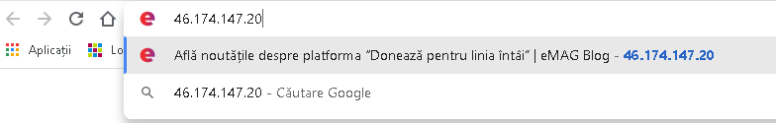
4.Now that the browser knows the IP address, it sends the command with the user's request to the WEB server.

Slide 5
5. It returns the required information to the browser in the form of 0 and 1.
6. The browser retrieves the information and displays it to the user in HTML format.

Slide 6
