Slide 1
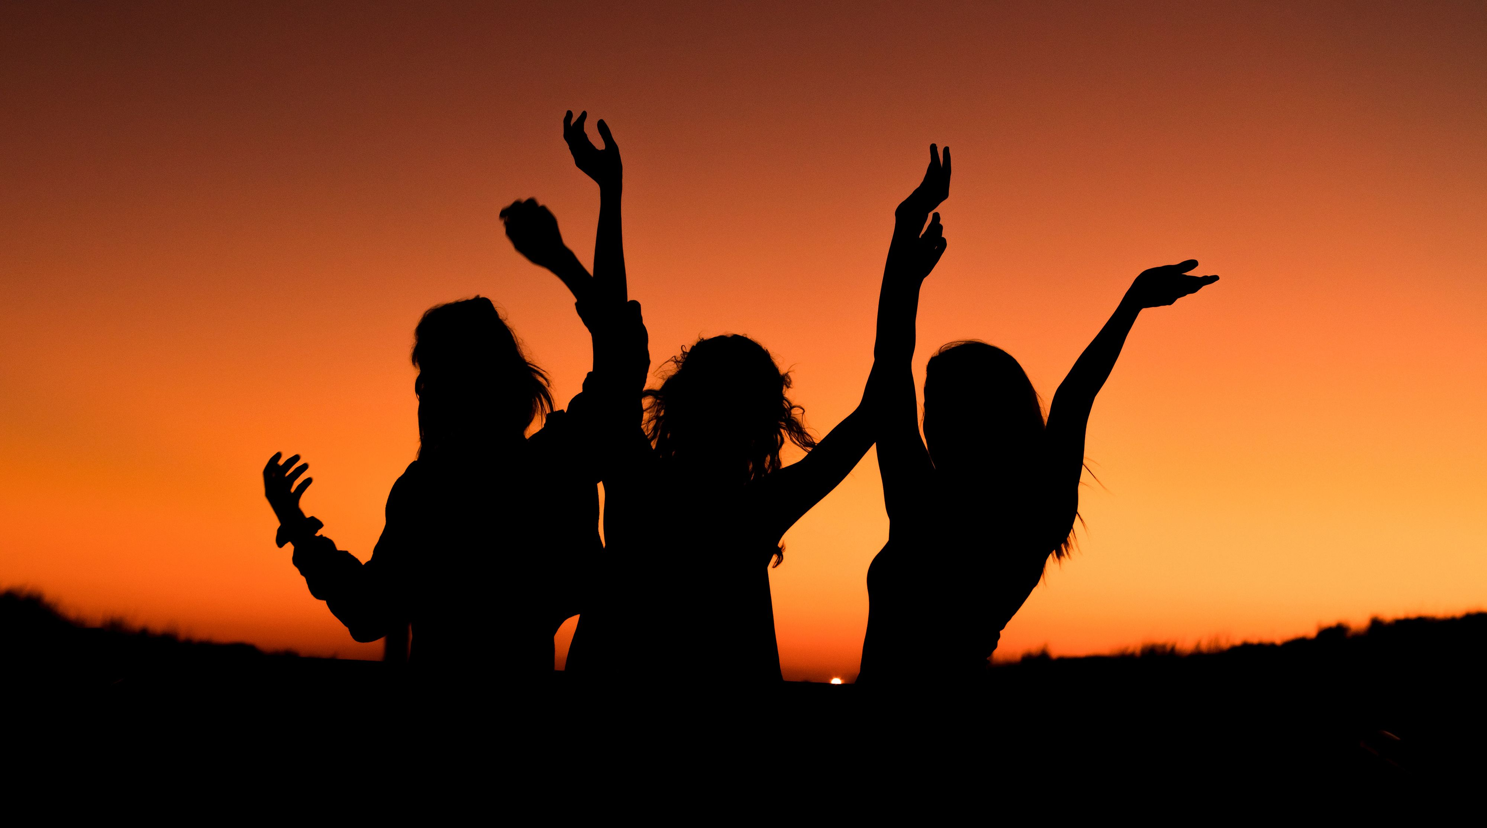
THE DAY YOU SAID GOODNIGHT
HALE

Slide 2
Take me as you are ,
Push me of the road
The sadness

Slide 3
I need this time to be with you
I`m freezing in the sun
I`m burning in the rain ,

Slide 4
The silence ,
I`m screaming
Calling out your name

Slide 5
And I do ,
reside in you life
Put out the fire with me and find

Slide 6
Yeah , You`ll lose
The sight of your circles
That’s what ill do
If we say goodbye

Slide 7
To be ,
Is all I got to be
And all that I see
And all that I need this time

Slide 8
To me ,
The life you gave me
The day you said goodnight

