Slide 1
RNS Institute of Technology Department of Information Science and Engineering
DESIGN AND ANALYSIS OF ALGORITHMS LABORATORY
(18CSL47)
Bus Route system
Staff in Charge: Mrs. Kusuma S Carried out by
Designation: Assistant Professor
Phanish SN(1RN19IS100)
Nidish G (1RN19IS094)
Neeraj Skanda BR (1RN19IS092)

Slide 2
CONTENTS
Abstract
Introduction
Objective of the project
Algorithm Design Technique
Project Architecture
Implementation modules
Results
Applications
Conclusion & Future Enhancements
References

Slide 3
Abstract
It represents simulation of real time Bus travel system with multiple routes and analyzing their results in different aspects.
Our project uses basic functions to simulate real life Bus travel system by calculating the cost by using Dijkstra’s shortest path algorithm and then does the processing based on appropriate conditions and then it presents the results out in a neat and understandable manner.

Slide 4
Introduction
Our project gives user a real time feel of the bus travel system.
It allows user to choose between multiple locations and then receives a route based on the best possible scenario.
Our project showcases the real world application of Dijkstra's Algorithm.

Slide 5
Objective of the project
The main objective of our project is to show how Dijkstra's works in a real world application use case.
The main specifications of our project are:
To find the route based on least cost
To get real world usage of theory concepts
To use stack concept to check the bus in that region.

Slide 6
Algorithm design technique
Mark all nodes unvisited. Create a set of all the unvisited nodes called the unvisited set.
Assign to every node a tentative distance value: set it to zero for our initial node and to infinity for all other nodes. Set the initial node as current.
For the current node, consider all of its unvisited Neighbours and calculate their tentative distances through the current node. Compare the newly calculated tentative distance to the current assigned value and assign the smaller one. For example, if the current node A is marked with a distance of 6, and the edge connecting it with a neighbour B has length 2, then the distance to B through A will be 6 + 2 = 8. If B was previously marked with a distance greater than 8 then change it to 8. Otherwise, the current value will be kept.
When we are done considering all of the unvisited neighbors of the current node, mark the current node as visited and remove it from the unvisited set. A visited node will never be checked again.
If the destination node has been marked visited (when planning a route between two specific nodes) or if the smallest tentative distance among the nodes in the unvisited set is infinity (when planning a complete traversal; occurs when there is no connection between the initial node and remaining unvisited nodes), then stop. The algorithm has finished.
Otherwise, select the unvisited node that is marked with the smallest tentative distance, set it as the new "current node", and go back to step 3.

Slide 7
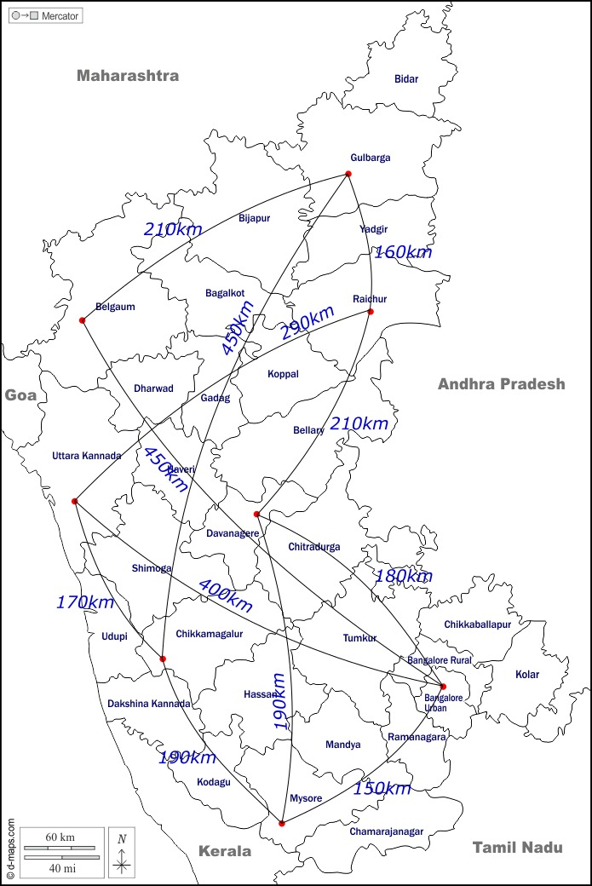
Project architecture

Slide 8
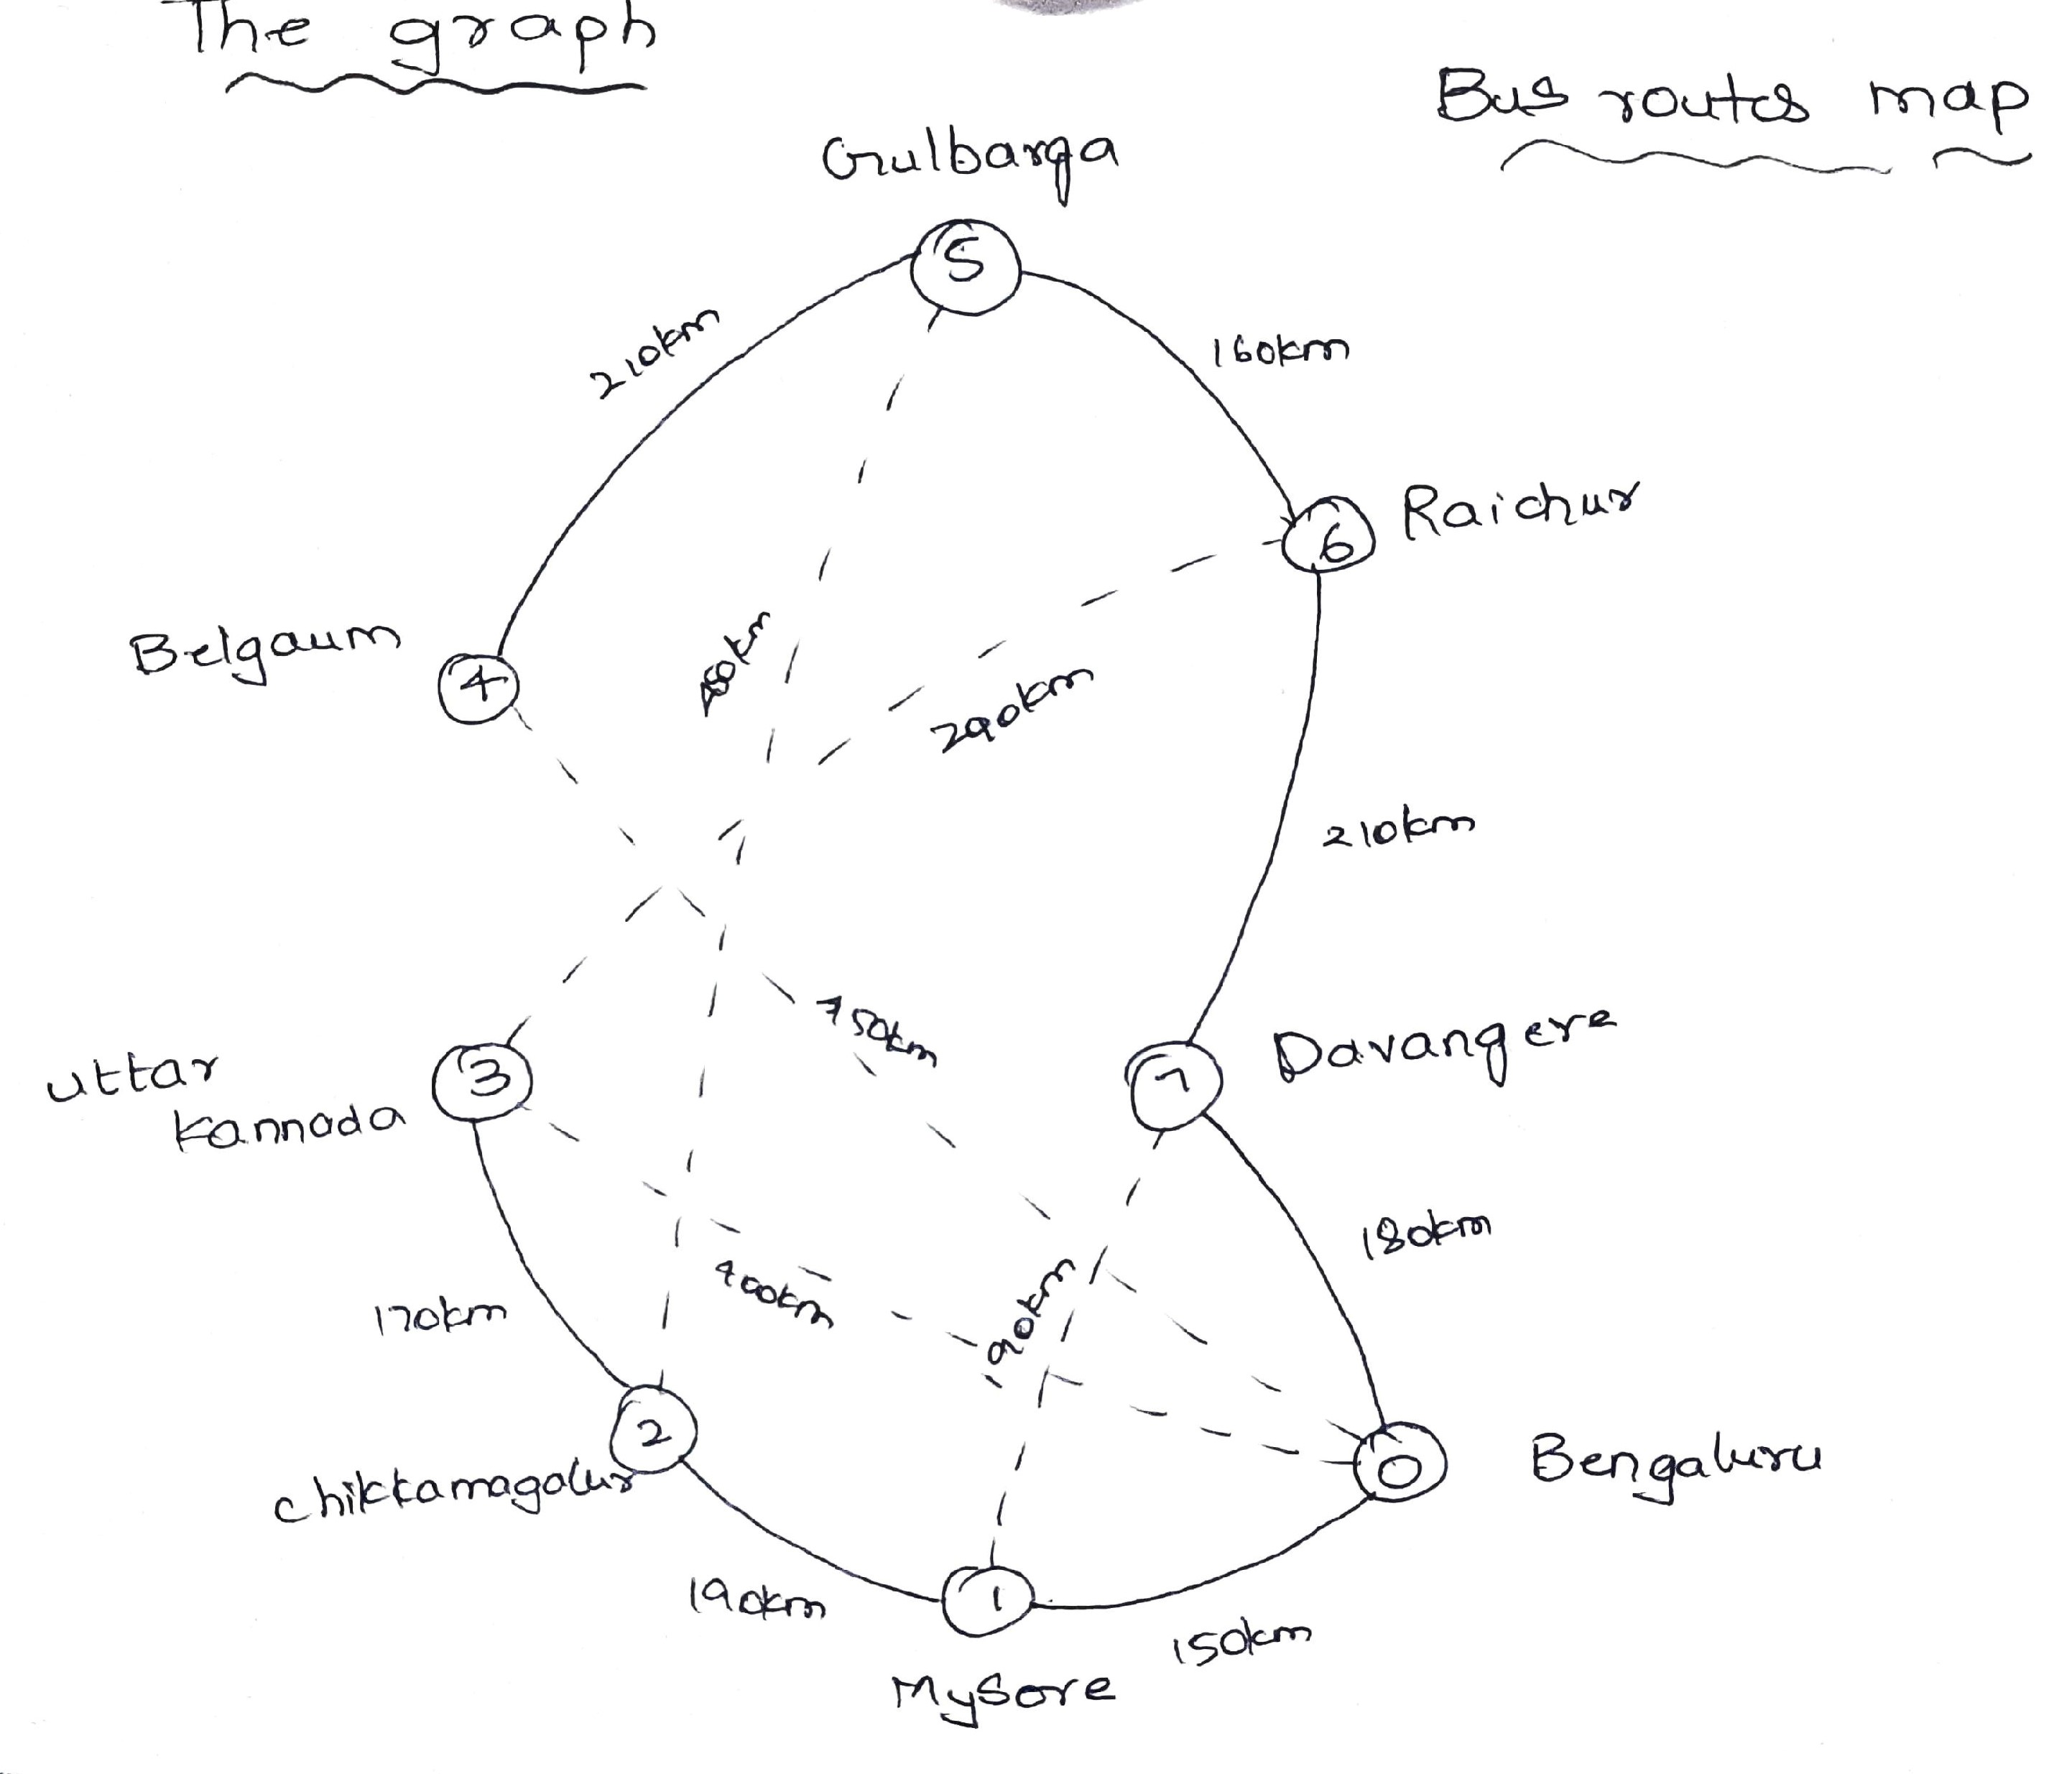
Project architecture

Slide 9
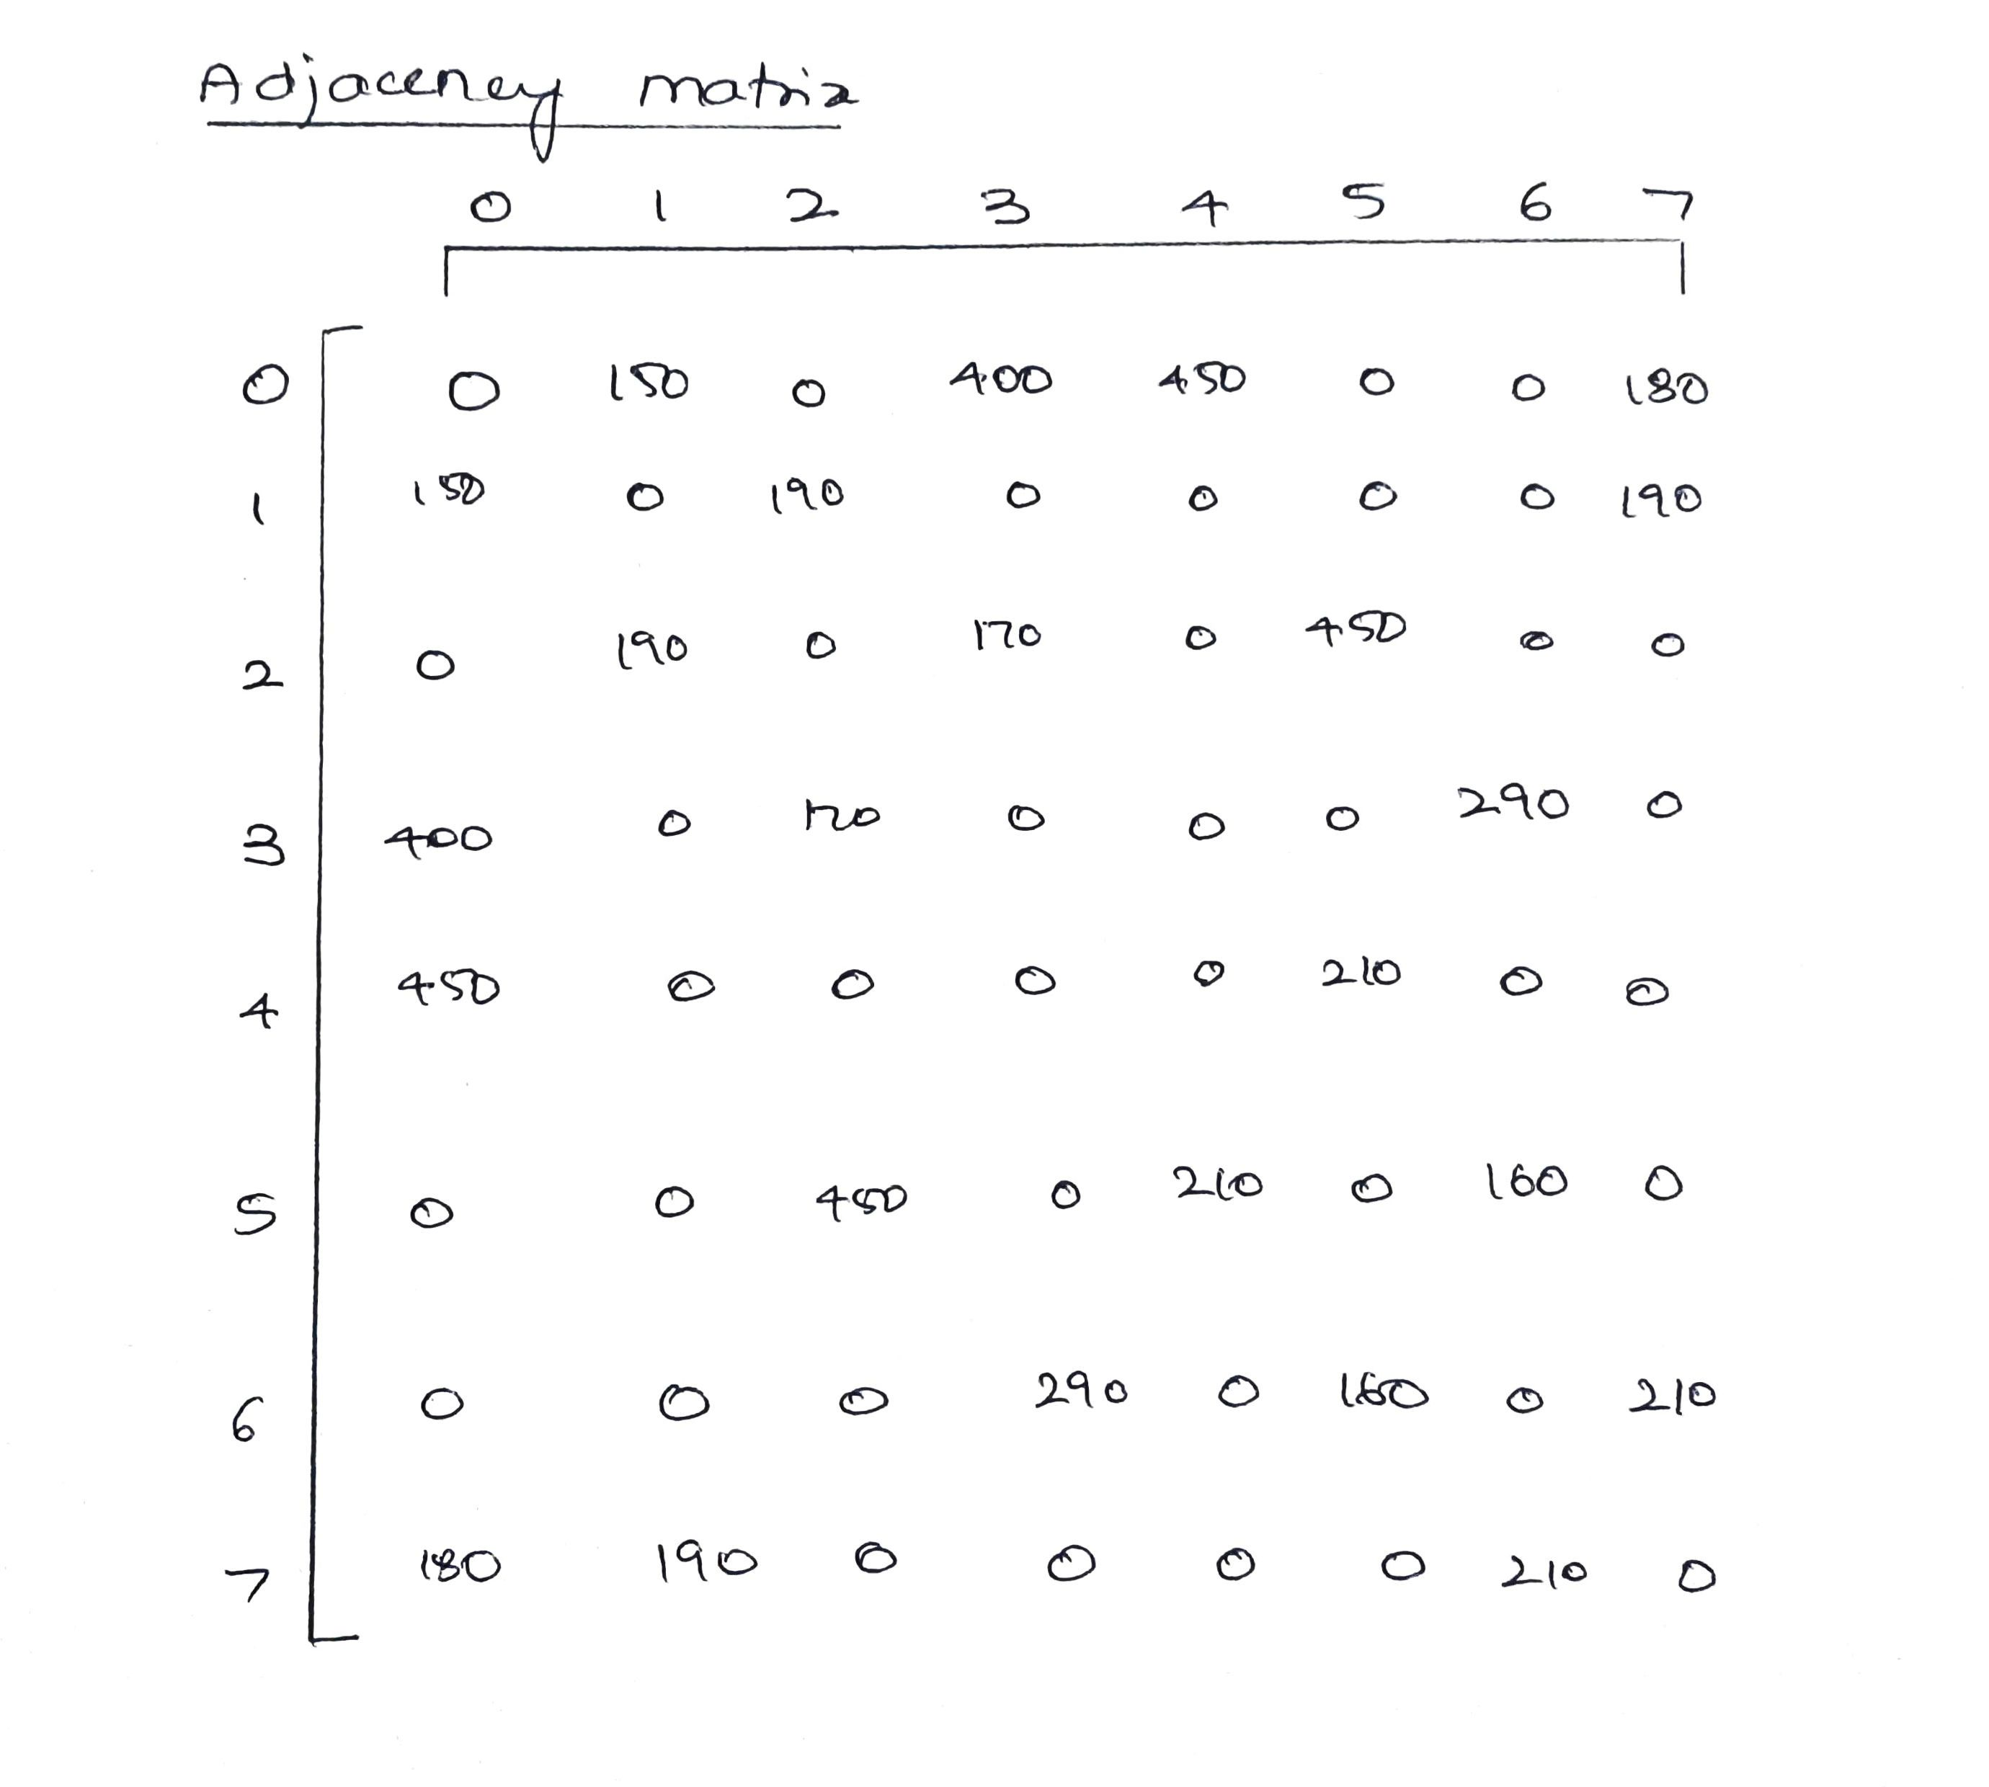
Project architecture

Slide 10
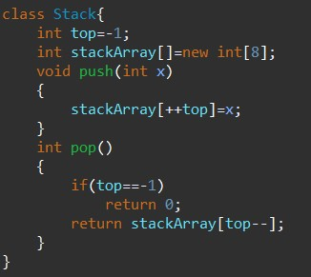
Implementaion modules
Basic implement of stack data structure
Class Stack does basic Push-Pop operation
Maximum Stack array Value is 8

Slide 11
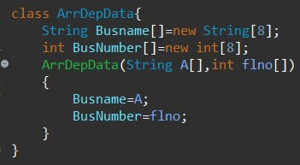
Implementaion modules
Saves the data of a bus station in the class as object of this class
Has members Busname and BusNumber and a constructor

Slide 12
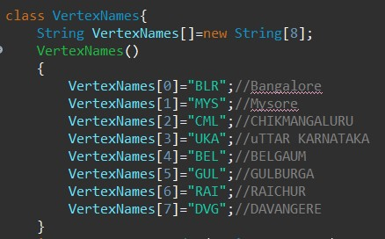
Implementaion modules
Class has VertexNames I.e. station names stored in "3 character" easily identifiable codes
Has constructor and member functions
getBusDepoasIndex()
getBusDepoName()

Slide 13
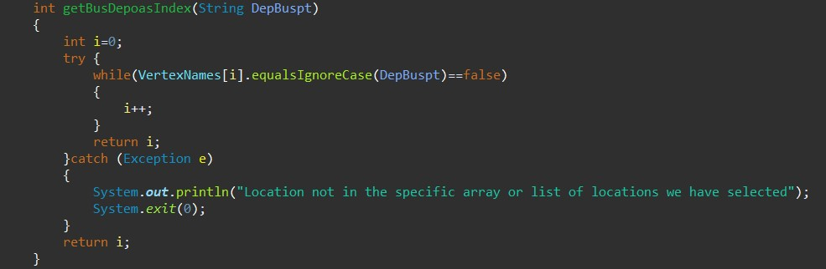
Implementaion modules
Takes input as string "3 character code" and converts it into int key value stored in the above array

Slide 14
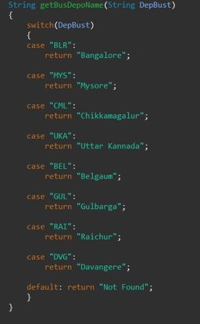
Implementaion modules
It takes input as string of and then returns the full name of the specific bus station.

Slide 15
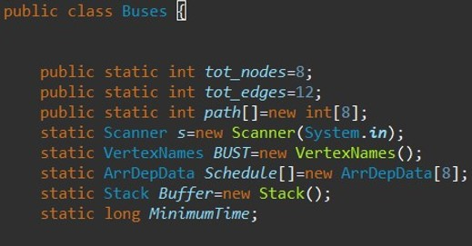
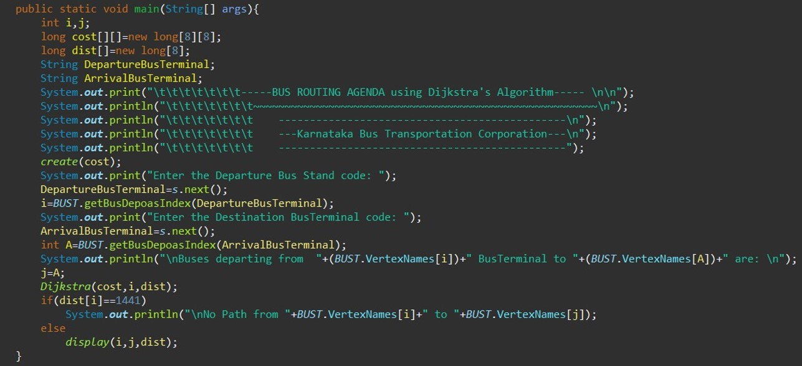
Implementaion modules
It is the main class of the program that consists of the main function and all the other code.
It has the printing of the display input, calling of the main Dijkstra algorithm and also calling of the display function

Slide 16
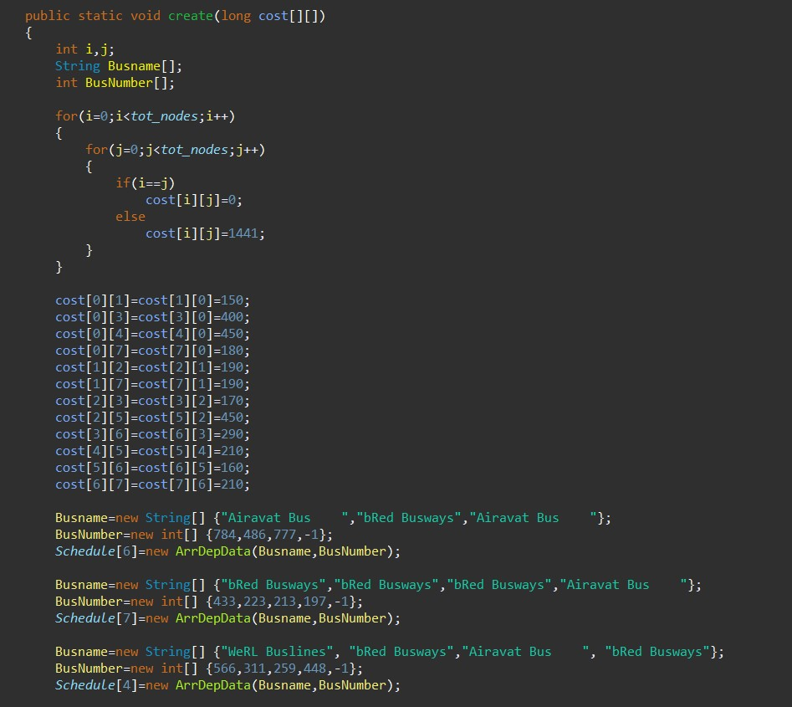
Implementation modules
Create the cost matrix
It also creates the data for the the Bus Locations telling which bus company is present at which specific location.
The bus data is mainly just for decoration/ visual purposes.
In real world this will be based on real time data
Actual creation of object above is done here and assigned to Schedule.

Slide 17
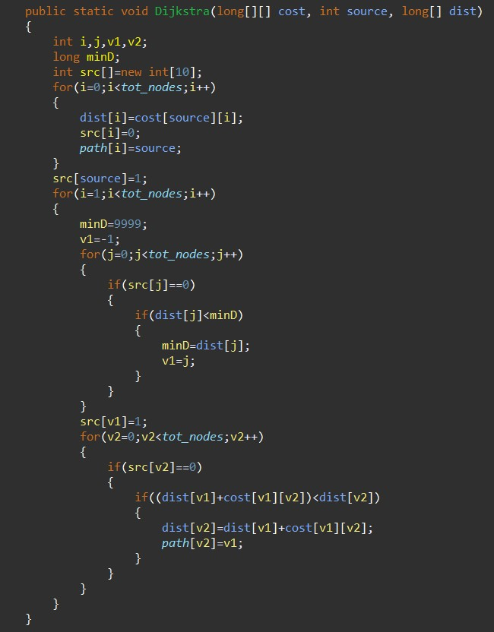
Implementaion modules
This is the main runner code of this program.
Here the algorithm of Dijkstra algorithm is done.
Initially put distance(time) from source to I.
initialize minimum distance to max
if(src[j]==0)//unvisited
dist[v2]=dist[v1]+cost[v1][v2];//path is from source to v1 to v2
path[v2]=v1;//path is via v1

Slide 18
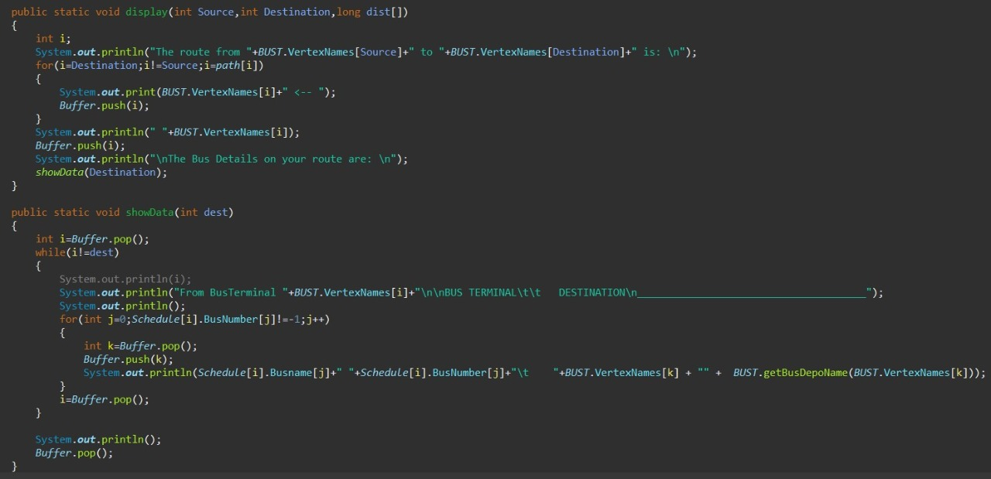
Implementaion modules
It is the main Display function which calls the show data function.
The show data function shows the buses stationed in that specific station and then shows the destination that it goes to.

Slide 19
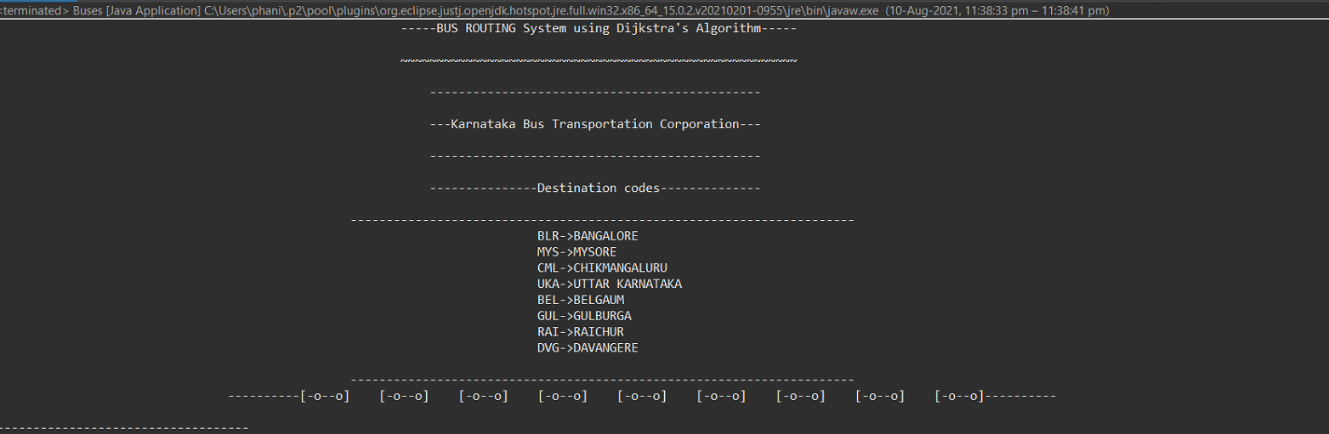
Results
Displays the short 3 character codes for each of the destinations and a small ascii art of the buses

Slide 20
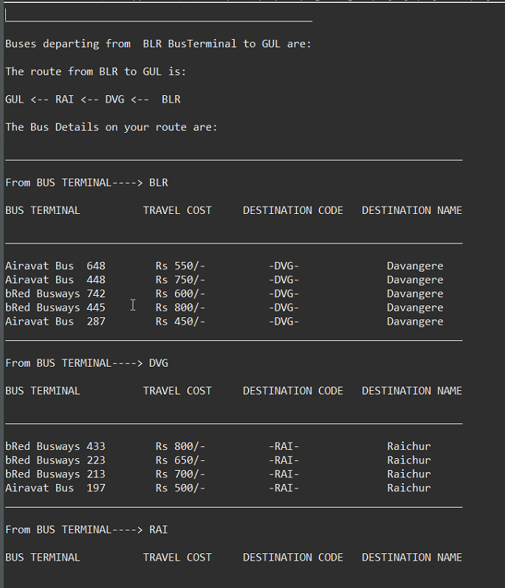
Results
Shows the route that the bus takes
It also highlights the bus terminal from and the bus terminal to and also the cost and destination name
This is the output for a multiple routes with stops in between as seen.
It goes from
BLR-> DVG-> RAI -> GUL

Slide 21
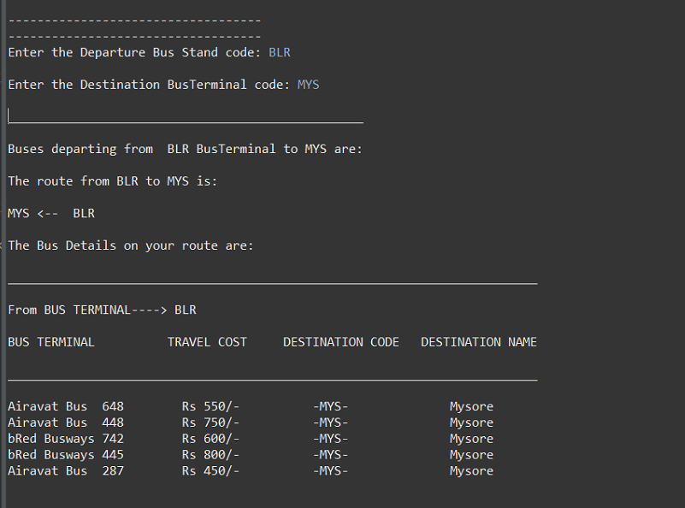
Results
This is the output for a Single route with no stops in between as seen.
It goes from
BLR-> MYS

Slide 22
Applications
This project can be further developed into a full-fledged full stack web app with a some more effort and some code rebasing and translation into more web friendly languages.
We hope to learn more about the algorithm by looking at one of its real world example

Slide 23
Conclusion and future enhancements
In our upcoming days, as we learn more about data structures, we plan to implement them and enhance this project further more.
We are also open to any type of suggestions/advises .
Permanent data storage and also add more limits to data inputs.
Adding a web interface for ease of use.

Slide 24
References
https://en.wikipedia.org/wiki/Dijkstra%27s_algorithm
https://www.geeksforgeeks.org/dijkstras-shortest-path-algorithm-greedy-algo-7/
https://github.com
https://vtu.ac.in

Slide 25
THANK YOU

