Slide 1
SPEECH EMOTION
RECOGNITION
Using MFCC , Vowel Region Features
and Pitch Synchronous
Aditya Raj Singh - 2022102067
Nida Shahnoor - 2022102007
REPO LINK

Slide 2
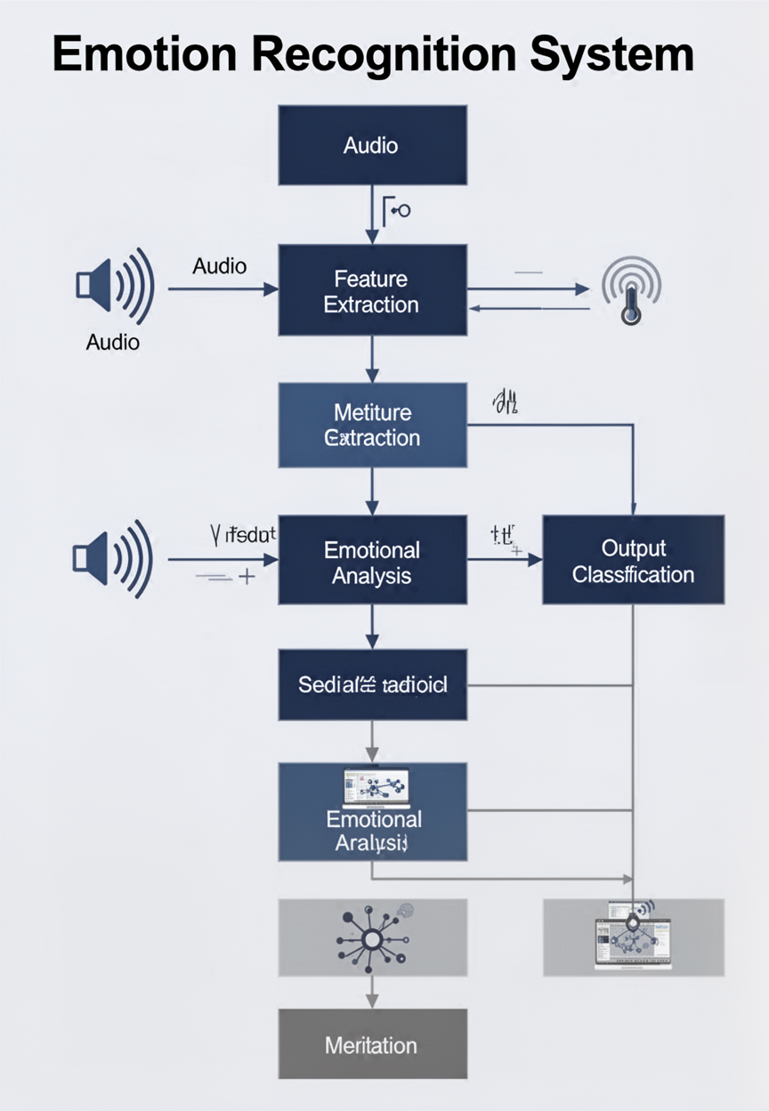
OBJECTIVE REVIEW
Speech Emotion Recognition (SER) aims to identify human emotions from speech signals using computational techniques.
Understanding emotions from speech has applications in: • Human-Computer Interaction • Mental Health Monitoring • Virtual Assistants and Call Centers
This project focuses on extracting meaningful features from speech signals and building a machine learning model to classify emotions.

Slide 3
Problem Statement & Motivation
Traditional models often rely on general features extracted from the entire speech signal, which may include silence, noise, and non-informative regions.
This can reduce the effectiveness of emotion classification.
Motivation: • Improve feature quality by focusing on meaningful speech regions • Handle class imbalance using data augmentation • Build a robust evaluation pipeline using classical Machine Learning (SVM) to validate feature extraction before transitioning to Deep Learning.
The goal is to develop a system that can accurately classify emotions from speech signals.

Slide 4
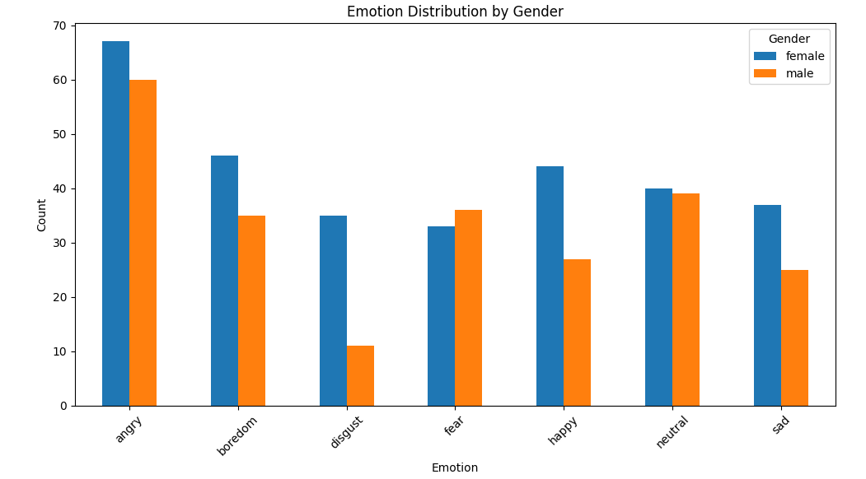
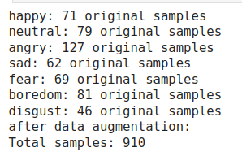
Dataset Description & Preprocessing
Dataset Used: EMO-DB (Berlin Emotional Speech Database):
Contains 535 speech recordings from 10 speakers (5 male, 5 female) Recorded in German with 7 emotion classes: Angry, Boredom, Disgust, Fear, Happy, Sad, Neutral
Challenges: Dataset is highly imbalanced (e.g., Angry has more samples than Disgust)
Preprocessing & Changes: Parsed filenames to extract speaker ID and emotion labels Applied data augmentation (noise addition, time-stretching) Balanced dataset to ~130 samples per class Normalized audio signals before feature extraction

Slide 5
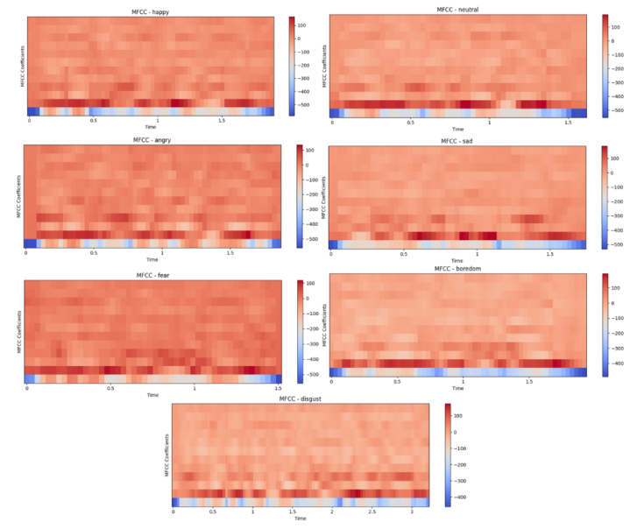
Mel-frequency cepstral coefficients : Overview
MFCCs represent the short-term power spectrum of speech in a way that mimics how the human auditory system perceives sound. They compress the most perceptually relevant spectral information into a small set of coefficients. In our pipeline we used 26 coefficients per frame.
C1 – C4 | Overall spectral tilt and gross vocal tract shape.Captures how energy is distributed across low vs high frequencies
C5 – C10 | Formant frequencies F1, F2, F3 vowel identity and quality.This range encodes the primary resonance peaks of the vocal tract. F1 reflects vowel height . F2 reflects vowel frontness. Emotional state directly changes how open and tense the vocal tract is, shifting these coefficients.
C11 – C16 | Spectral fine structure voice quality and breathiness Captures subtle resonance patterns related to glottal opening and voice quality.
C17 – C26 | Higher order spectral details articulation precision encodes precise articulatory movements

Slide 6
Mel-frequency cepstral coefficients
Angry High C1–C4 (tense vocal tract, raised energy). High delta-C1 (rapid formant movement). Short vowel duration. High F0 mean. Loud, clipped spectral shape. | Boredom Low C1 (low overall energy). Near-zero delta (flat, slow formant movement). Long vowel duration. Low F0 with near-zero slope. Monotone spectral envelope. | Disgust Mid C1–C6 with irregular pattern. High C11–C16 (non-modal voice quality — creaky/pressed). Irregular delta pattern. Distinct pause-before-emphasis rhythm.
Fear High C1–C4 (energy). Very high delta-delta (abrupt formant acceleration). High F0 std (jittery pitch). Breathy quality raises C11–C16. Rapid speech rate. | Happy High C1–C4. Rising delta-C5–C10 (rising F1/F2 — mouth opening on stressed vowels). High F0 slope. High C1 std (variable energy — bouncy rhythm). Wide spectral spread. | Sad Low C1 (soft speech). Falling delta-C1–C4 (energy decays within vowels). Negative F0 slope (falling pitch). Long vowel duration. Narrow, compressed spectral envelope
Neutral
Mid-range values across all coefficients. Near-zero delta and delta-delta (controlled, even articulation). Stable F0 with low std. Serves as the reference class all other emotions deviate from neutral in specific MFCC dimensions.

Slide 7
Vowel Region Detection: using ZCR and RMS
1
Normalize the raw speech signal to [0, 1] amplitude range
2
Compute frame-level RMS energy
Frame = 512 samples, hop = 128 samples. RMS measures loudness per frame.
3
Compute frame-level Zero-Crossing Rate (ZCR)
Counts zero crossings. Vowels (low ZCR) vs. Fricatives (high ZCR).
4
Compute frame-level spectral flatness (Wiener entropy)
Ratio of geometric to arithmetic mean. Vowel (near 0) vs. Fricative (near 1).
5
Apply three-way decision mask
Vowel if: RMS > threshold AND ZCR < 0.15 AND flatness < 0.3.
6
Apply minimum duration filter and gap merging
Drop < 50 ms. Merge < 30 ms (handles German glottal stops).
7
Final Vowel Region Output
Key limitation: All three signals (RMS, ZCR, flatness) operate directly on raw speech a mixture of vocal tract resonances and glottal excitation. Voiced consonants (/m/, /n/, /l/) share the same RMS+ZCR signature as vowels and leak into detected regions.

Slide 8
Vowel region extraction using VOP and VEP detection
1
Apply pre-emphasis filter to the raw signal
Boosts high frequencies, improves LPC stability. y[n] = x[n] − 0.97·x[n−1]
2
Perform LPC analysis and compute LP residual
3
Compute Hilbert envelope of the LP residual
4
Smooth Hilbert envelope with Hamming window and Apply First-Order Gaussian Derivative (FOGD)
5
Pick VOP and VEP candidates with two-stage filtering
6
Pair each VOP with the nearest following VEP
7
Final Vowel Region Output
Key advantage: Every decision is made on the LP residual the excitation source signal after vocal tract influence has been removed. Vowel onsets and offsets correspond to real changes in glottal phonation, not just energy level. RMS + ZCR answers "is this frame energetic and periodic?" a purely acoustic question. VOP/VEP answers "is glottal phonation starting or stopping here?" a physiological question directly tied to how emotion changes vocal fold behavior.

Slide 9
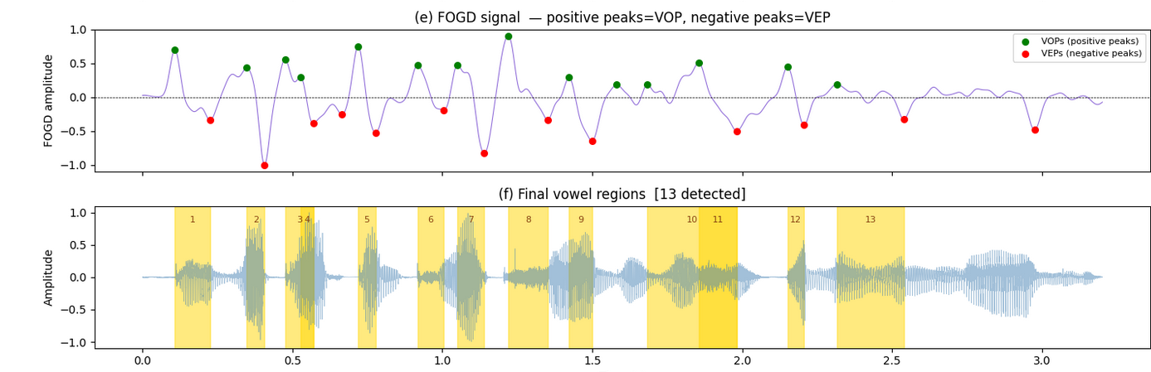
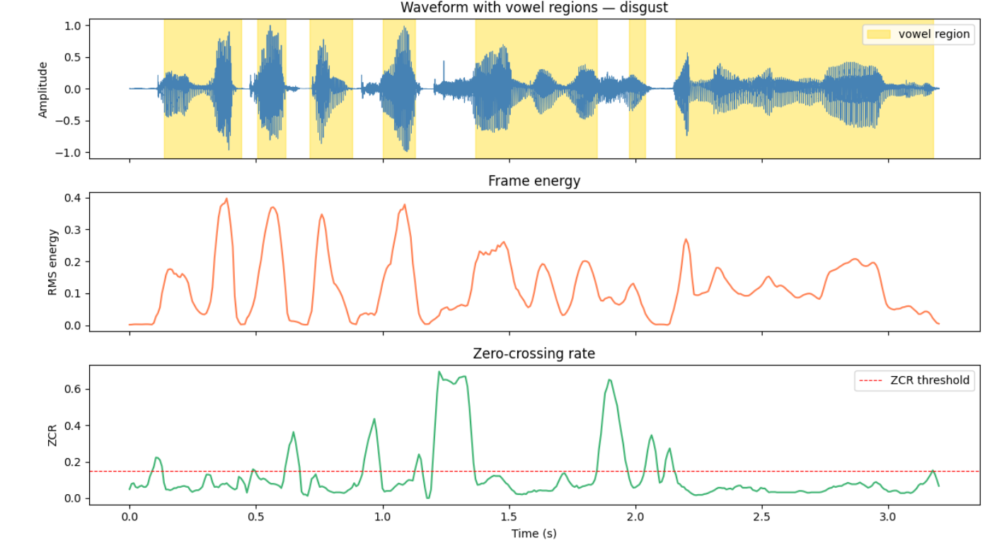

Slide 10
GCI Extraction Process
1
Differencing the Signal
Remove DC drift and emphasize high-frequency glottal energy.
2
Zero Frequency Filtering (ZFF)
Pass the signal through a 0-Hz resonator (leaky double integration) to isolate the glottal source.
3
Trend Removal
Subtract the local mean using a 2ms window to remove the vocal tract resonances (formants).
4
Epoch Detection
The positive zero-crossings of this filtered signal correspond exactly to the true Glottal Closure Instants (GCIs).
By mathematically isolating the glottal excitation source from the vocal tract filter via ZFF, we securely calculate pitch gaps without relying on black-box software tools.

Slide 11
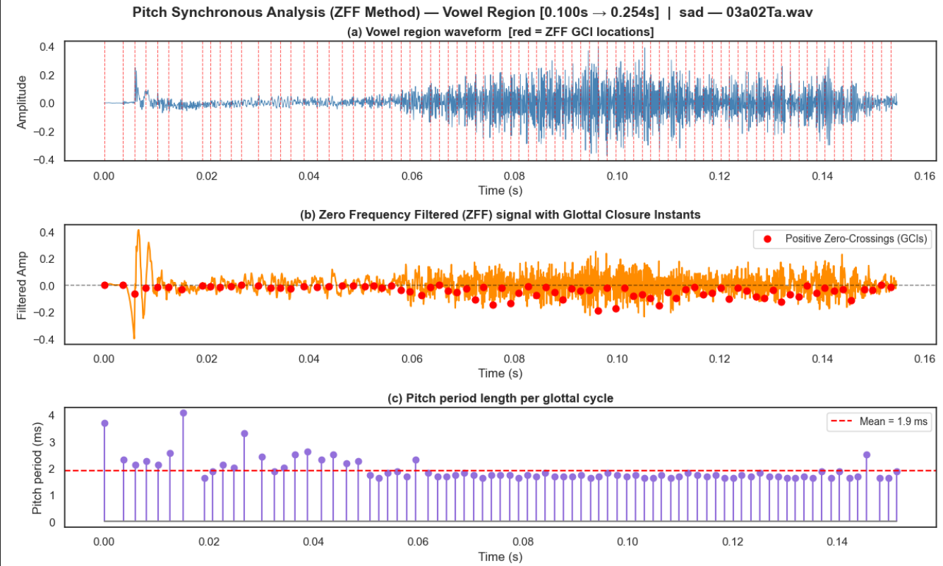

Slide 12
PSMFCC Extraction Pipeline
1
Start with raw speech signal s(n) and preprocessing
Sampling (8 kHz / 16 kHz in experiments)
2
Estimate pitch contour of speech
Identifying fundamental frequency F₀ to anchor the analysis.
3
Segment signal using pitch periods
Frame length = integer multiple of pitch period (e.g., 3 × P), Frame shift = 1 pitch period.
4
Refine boundaries and extract features
Find minimum energy points near boundaries; focus on periodic (voiced) parts.
5
Feature Vector Formation & Output
Apply conventional MFCC steps to extract 12 cepstral coefficients.
The Pitch-Synchronous Mel-Frequency Cepstral Coefficients (PSMFCC) pipeline ensures that feature extraction is locked to the physical periodicity of the voice. By ignoring non-periodic residuals and focusing on minimum energy boundaries, the resulting 12-dimensional feature vector sequence provides a more stable representation of voiced emotional content.

Slide 13
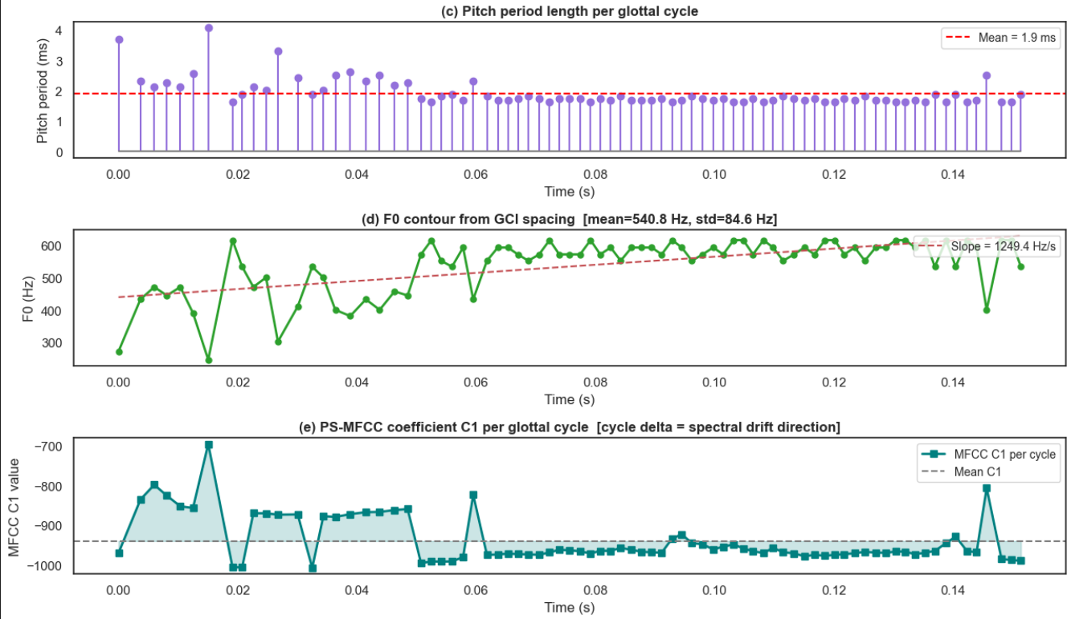
For SAD:

Slide 14
Support Vector Machine for SER
What SVM receives
Flattened fixed-length vector
5,200 dims (MFCCs) + vowel + pitch
Vowel-region features: RMS + ZCR based detection
epoch detection for pitch synchronous
Pipeline Details
Feature Aggregation: Convert frame-level → single vector
Scaling: Standardization (Z-score)
Kernel: RBF (Radial Basis Function)
Handles non-linear emotion boundaries
Characteristics Advantage:
Excellent on small datasets & robust to noise
Works Well in High-Dimensional Space
Non-linear Emotion Boundaries
Limitation:
Loses all temporal order
Cannot model inter-frame dependencies
Manual feature engineering required

Slide 15
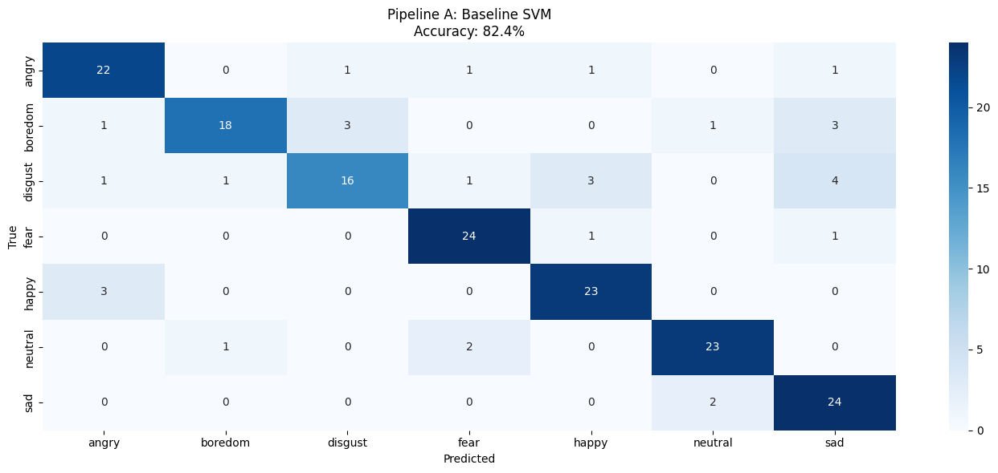
SVM is trained with mfcc , rms+zcr , gci pitch

Slide 16
BiLSTM for SER
Recurrent Backbone
Masking Layer
Masking(mask_value=0.0)
Ignores padded time steps
Prevents learning from fake data
First BiLSTM (128 units)
Bidirectional(LSTM(128, seq=True))
Captures short-term patterns
Outputs full sequence
Second BiLSTM (64 units)
Bidirectional(LSTM(64))
Compresses to single vector
Learns global emotional context
Classification Head
Dropout (0.3)
Prevents overfitting
Crucial for small datasets
Dense Layer (64 units)
Activation: 'relu'
Learns feature interactions
Batch Normalization
Stabilizes training
Faster convergence
Output Layer
Dense(num_classes, softmax)
Emotion probabilities
⚙️ Training Setup
Optimizer: Adam (lr = 0.001)
Loss: Categorical Crossentropy
Epochs: 40
Batch size: 32
Standard hyperparameters optimized for speech emotion datasets.

Slide 17
BiLSTM for SER
What BiLSTM receives
The BiLSTM model receives a sequence of frame-level feature vectors (e.g., PSMFCC or MFCC), where each time step represents acoustic information from a short segment of speech, allowing the model to learn temporal emotional patterns
BiLSTM advantages
Preserves temporal dynamics
Learns feature interactions automatically
Scales with more data
Accuracy improves significantly with larger datasets unlike SVM
BiLSTM limitations
Needs more data to shine
Risk of overfitting
Black box not interpretable
Cannot tell which frames or features drove the decision

Slide 18
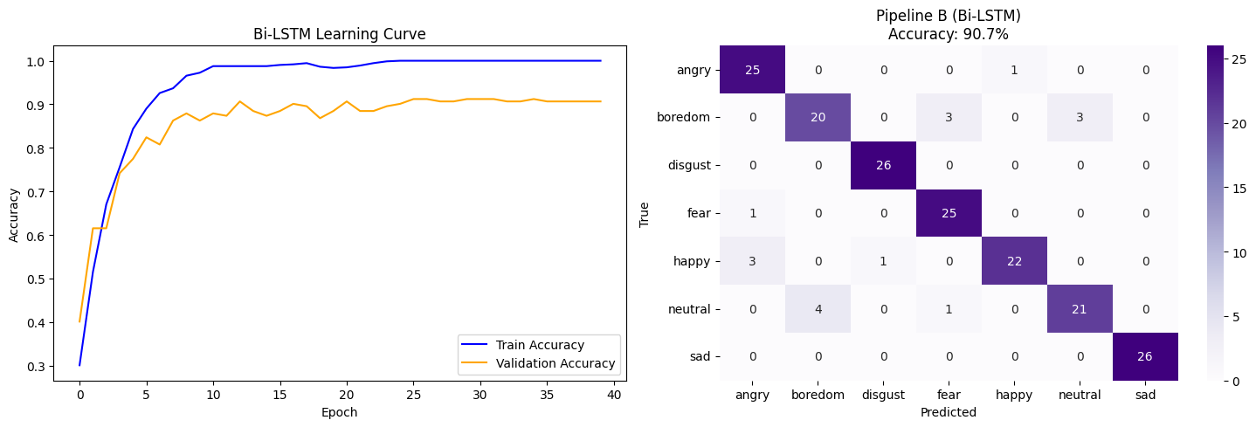
BiLSTM is trained with mfcc , vop/vep , gci+psmfcc

Slide 19
Future Scope of This Project
Cross-Language Generalization
Train on:
Multilingual datasets
Improve robustness across:
Accents
Languages
Speaking styles
Attention Mechanism
Add attention on top of BiLSTM
Focus on emotionally important frames
Transformer Models
Replace BiLSTM with:
Transformer / Conformer
Better long-range dependency modeling
REPO LINK

Slide 20
Thank You

