Slide 1
Library Management System
Database Design and Functional Overview

Slide 2
Aims of the Project
Provide efficient library operations for students and staff.
• Track book inventory, borrowing, and returns with accuracy.
• Manage user authentication and role-based access.
• Ensure fine calculation and status updates.
• Offer a reliable backend structure for integration with applications.

Slide 3
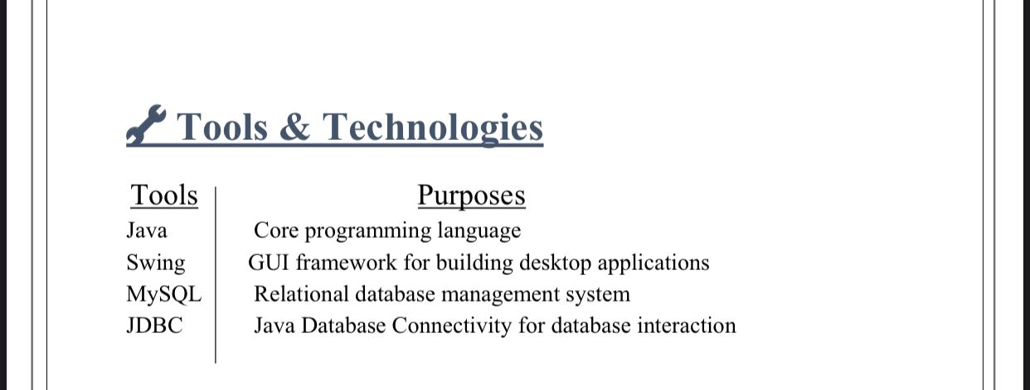

Slide 4
Application Structure
Uses Of Files

Slide 5
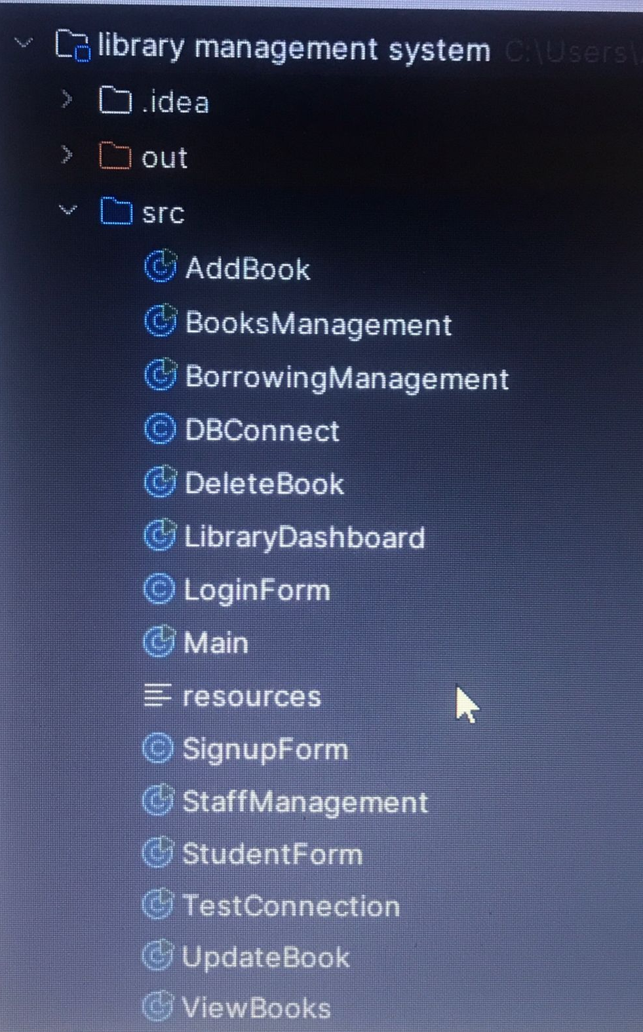
1. Main.java
Initializes the application and displays the login form.
2. DBConnect.java
Establishes a connection between Java and the MySQL database using JDBC.
3. LoginForm.java
Provides a login interface with email and password fields.

Slide 6
4. SignupForm.java
Allows new users to register by providing their name, email, and password.
5. Books Management
Central controller for book-related operations.
6. Staff Management
Manages staff data, including adding and updating staff information.
7. Borrowing System
Handles book borrowing transactions by students.

Slide 7
Database Overview
Database Name: library_db
Purpose:
1- Manage library operations including students, books, borrowings, staff, and users.
2- Tracks borrowings, due dates, fines, and user roles.
BOOKS
USER
BORROWINGS management
STAFF Management
STUDENT MAnagement
`
`

Slide 8
1- Table: students
Stores student information.
Fields:
1- student_id (PK)
2- name
3- Email
4- phone
5- Course
6- department,
7- registration_date

Slide 9
2- Table: books
Details of books in the library.
Fields:
1- book_id (PK),
2- title
3- author
4- publisher
5- isbn
6- genre
7- quantity,
8- available
9- published_year

Slide 10
3- Table: borrowings
Tracks student borrow activity.
Fields:
1- borrow_id (PK)
2- student_id (FK)
3- book_id (FK),
4- borrow_date
5- due_date
6- return_date
7- fine
Also includes: status, borrowing_status, fine_amount, fine_status

Slide 11
4- Table: staff
Information about staff members.
Fields:
1- staff_id (PK)
2-name
3- email,
4-phone
5- position
6- department
7-date_joined

Slide 12
5- Table: users
Handles login and authentication.
Fields:
1-user_id (PK)
2- name
3-email
4- password (hashed)

Slide 13
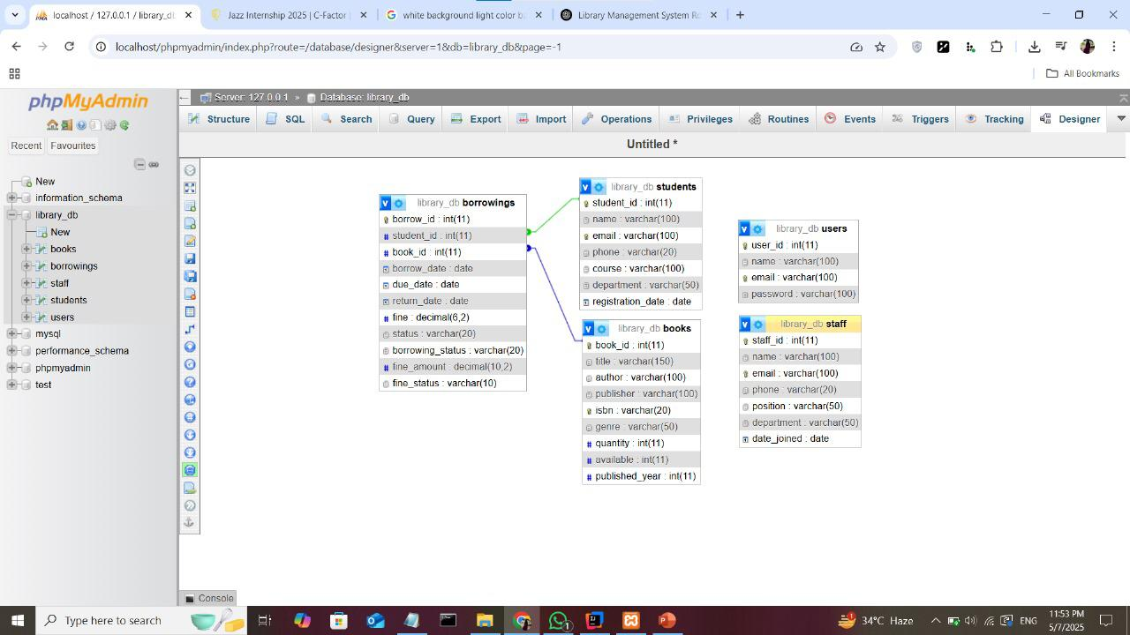

Slide 14
Database Relationships
borrowings.student_id → students.student_id
borrowings.book_id → books.book_id

Slide 16
Use Case Summary
• Students borrow books; tracked in borrowings.
• Book availability and status monitored.
• Fines and returns handled in borrowings.
• Staff manage operations; users login to access system.

Slide 17
IMPLEMENTING THE MODEL
Library Management Database Design

Slide 18
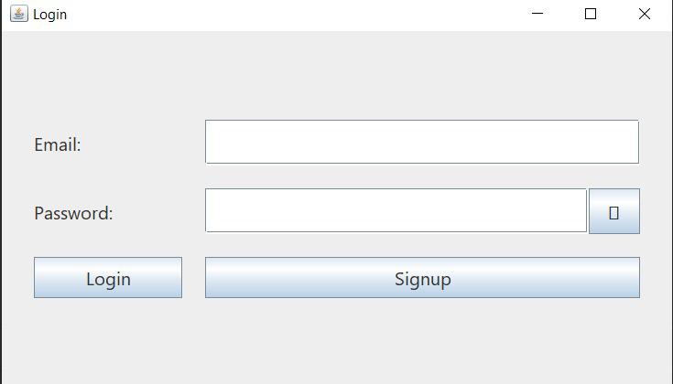

Slide 19
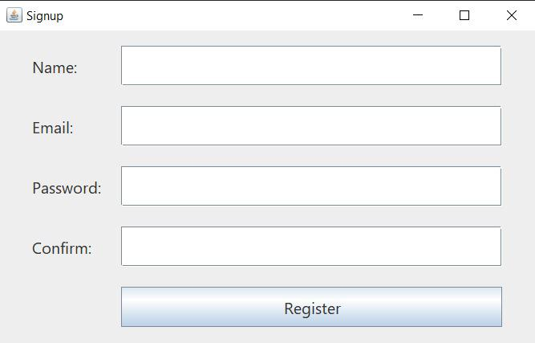

Slide 20
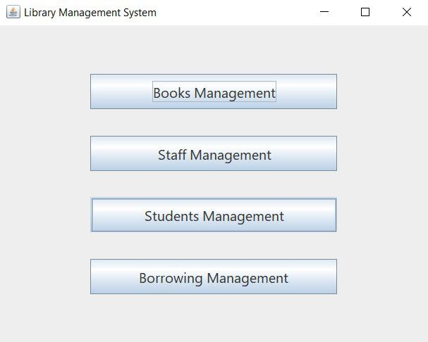

Slide 21
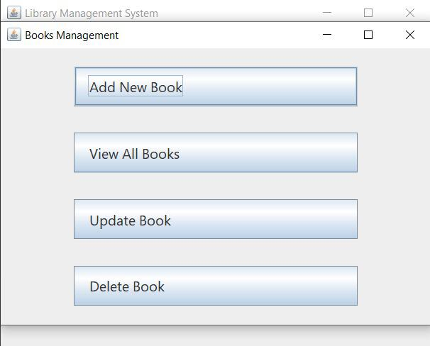

Slide 22
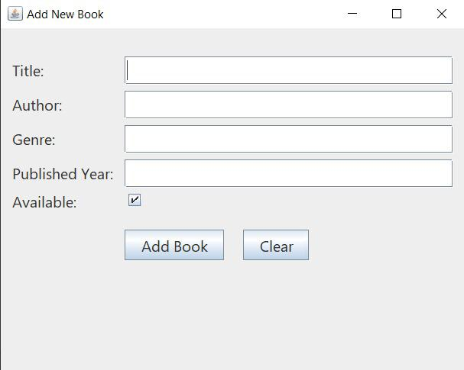

Slide 24
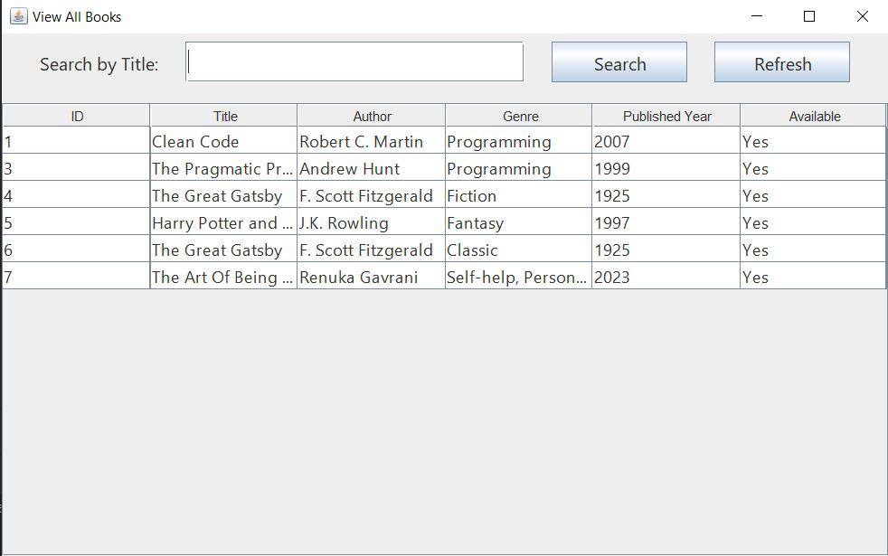

Slide 26
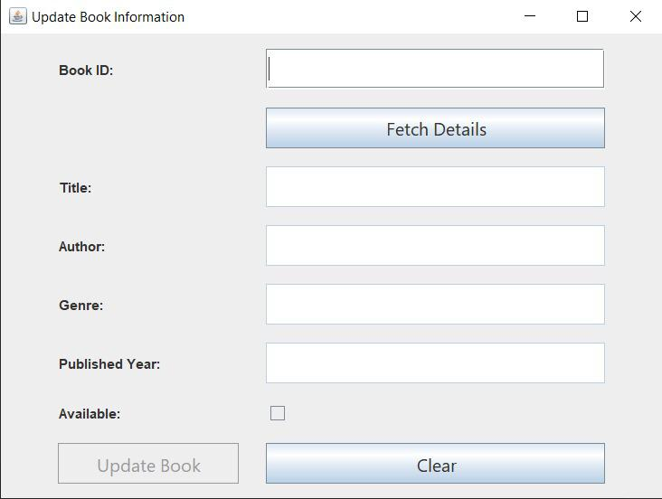

Slide 28
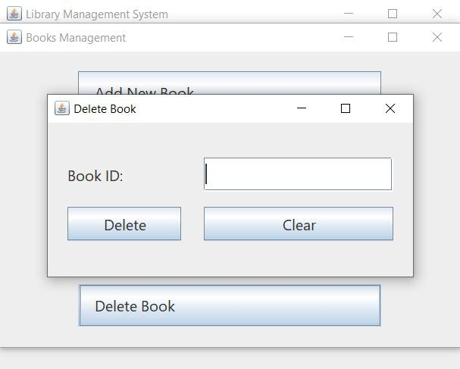

Slide 30
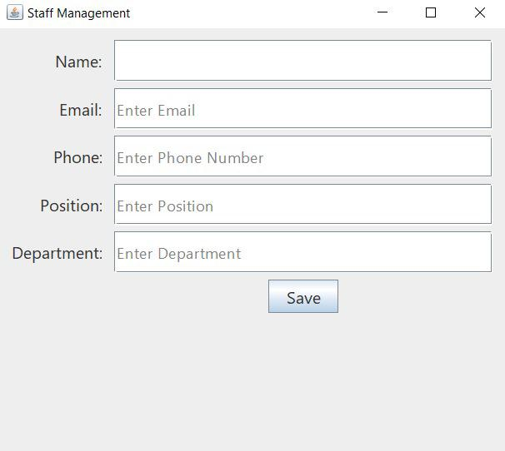

Slide 32
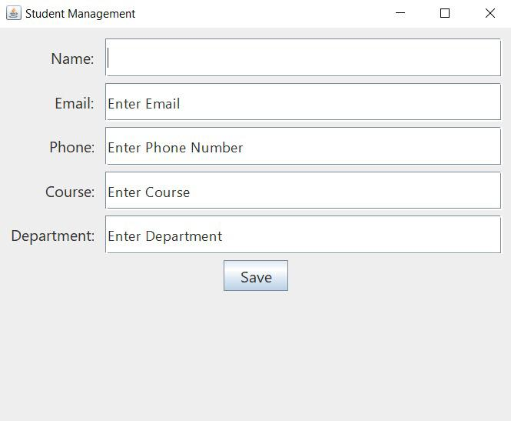

Slide 34
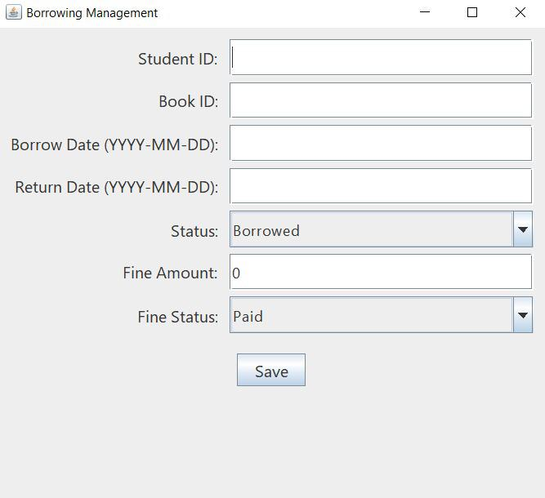

Slide 35


