Slide 1

Sprocket Central Pty Ltd
Data analytics approach
[Data Analyst Intern]-[Nida Attaraut]

Slide 2
Agenda
Introduction
Data Exploration
Model Development
Interpretation

Slide 3
Identify & Recommending High Value Customers
Introduction
Problem Outline
Sprocket Central is a company that specializes in high quality bike and accessories
The marketing team is looking to boost sales
To target 1000 new customers that will bring the highest values to the business
Approach for Data Analysis
Top Industries contributing the maximum profit and bike related sales
Bike related purchases for the 3 years based on Gender
Wealth segment by Age Category
Number of Cars State wise
Customer Classification

Slide 4
Data Exploration
Transactions Sheet:
Completeness: Missing data in Customer ID, Online order, Brand, and Product cells.
Validity: Product first sold date and List data entered incorrectly.
New Customer List Sheet:
Completeness: Missing data and blanks in Last names and Job titles.
Accuracy: Inaccurate date of birth.
Validity: Past 3 years data stored.
Customer Demographics:
Inconsistency: Inconsistent formatting in Gender and Address columns.
Irrelevancy: Default column incomprehensible and not useful.

Slide 5
Data Exploration
Customer Age Distribution
Customer Age Distribution lies between 30 to 60
Most Customers fall in 40-50 age category.
Age Group 40- 50 should be the Target Category

Slide 6
Data Exploration
Wealth Segment Distribution
The mass customer segmentation makes the highest Profit across the different age groups
Ma's customer age between 38 and 47 I like you to bring more profit for the company compared to other age clusters

Slide 7
Data Exploration
State wise Car Distribution
The customer state distribution chart shows that the majority of Sprocket Central's customers reside in New South Wales (NSW).
This suggests that Sprocket Central may want to focus on marketing efforts in these states.

Slide 8
Data Exploration
Bike Related Purchase by Gender
On average Female purchase percentage is slightly more than Males
Females have had 1%-5% higher bike related purchases compared to Males in the last 3 years
These trends are similar for both old and new customer data

Slide 9
Data Exploration
Top Job Industries : Max profits and Bike Related Purchases
The Highest Profits Industries are: Financial Services, Health Sector & Manufacturing
Others Industry Sectors have returned less than 1,000,000 in profits

Slide 10
Interpretation
Customer Profile
Based on the RFM score the platinum customers return the highest profits followed by gold silver and bronze.
Suggesting to target the platinum customers.

Slide 11
Model Deveplopment
Customer classification: Targeting high value customers
High-Value Customer Profile
Demographics:
Age: 38-47 years old
Gender: Primarily female
Location: Primarily residing in New South Wales (NSW) or Victoria (VIC)
Occupation:
Employed in the financial services, healthcare, or manufacturing industries

Slide 12
Interpretation
Customer Analysis Report
This report provides an overview of the customer data for Sprocket Central, a bicycle manufacturing company. The data was analyzed using various charts and graphs to identify trends and patterns in customer demographics, and wealth segmentation. The key findings of the analysis are as follows:
Customer Demographics: The majority of Sprocket Central's customers are between the ages of 31 and 61, with an average age of 42. They are predominantly male (72%) and reside in New South Wales (NSW) or Victoria (VIC).
Wealth Segmentation: The majority of Sprocket Central's customers are classified as Mass Customers (52%), followed by Affluent Customers (28%) and High Net Worth Customers (20%).

Slide 13
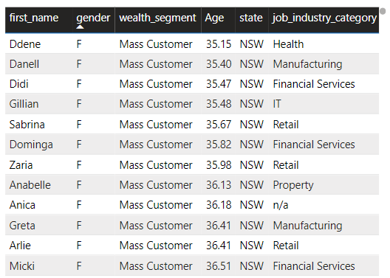
Interpretation
Summary Table For Target High Value Customers

