Slide 1


Enhancing Ultraviolet Communication Systems Using Machine Learning
Ultraviolet Comunication System

Slide 2


This Research Was Completed Through The Efforts of:
An-Najah National University
College of Information Technology & Artificial Intelligence
Network Information Security
Nidal Amira
12029884
DR.Amjad Hamammreh

Slide 3
Research Sections:
I
Introduction
I
D
Discussion
Integration System
R
M
Methodology
R
Recommendations
Research Questions
L
T
C
Conclusion
Literature Review
Transition to Simulation

Slide 4
Introduction
The rapid growth of data traffic in modern telecommunications, driven by the expansion of devices and services, has created a need for intelligent network systems based on data analysis and adaptive technologies. Ultraviolet communication (UVC), a form of electromagnetic communication operating within wavelengths of 40–400 nm, has emerged as a promising alternative due to its high data transmission rates and strong security features. However, despite its potential, UVC systems still face several challenges and have not yet been fully integrated with advances in artificial intelligence, motivating further research into applying machine learning to enhance their performance.

Slide 5
Literature Review
Foundations
Development
Implementation
Advancement
1920s–1960s
1960s–1990s
2000–2010
2010–Present
Early Foundations of UVC Systems
Theoretical Models and Experimental Development
Emergence of Practical UVC Systems
Advanced Modeling and Performance Enhancement

Slide 6

Research Gap
Benefits of UVC
Challengs of UVC
There is a gap
Implementation of UVC

Slide 7
Research Questions
?
Q1
Q2
Q3
How do environmental factors such as transmission distance, fog density, and dust concentration affect the performance of UVC systems?
Can machine learning models accurately predict key performance metrics such as Signal-to-Noise Ratio (SNR) and Bit Error Rate (BER)?
How effective is the proposed machine learning approach compared to traditional analytical models in modeling UVC channels?

Slide 8

Ultraviolet communication and Machine Learning Integration
Environmental Challenges in UVC
Role of Machine Learning
Impact of atmospheric conditions such as fog, scattering, and attenuation on system performance.
Machine learning enables systems to learn from data and adapt to changing environmental conditions.
System Inputs and Outputs
Limitations of Traditional Models
Inputs: distance, fog density, dust concentration, signal power. Outputs: BER and SNR.
Conventional models rely on simplified assumptions and fail to capture real-world dynamics.
Need for Intelligent Systems
Advantages of ML-Based Approach
Traditional systems require continuous human intervention and lack autonomous adaptation.
Provides accurate predictions, higher flexibility, and improved system performance.

Slide 9
Methodology
The system model is based on a simplified physics-inspired formulation to represent UVC behavior under different atmospheric conditions. A synthetic dataset of 500 samples (n = 500) was generated using uniform random distributions for transmission distance, fog density, dust concentration, and signal power. The Signal-to-Noise Ratio (SNR) is modeled as 𝑆𝑁𝑅=𝑃⋅120/𝑑(1+𝑓+𝑎) ​, where power increases signal quality while distance, fog, and dust reduce it. The Bit Error Rate (BER) is defined as BER=e^−SNR, reflecting the inverse relationship between SNR and transmission errors. These simplified equations are used to train and evaluate the machine learning model.

Slide 10
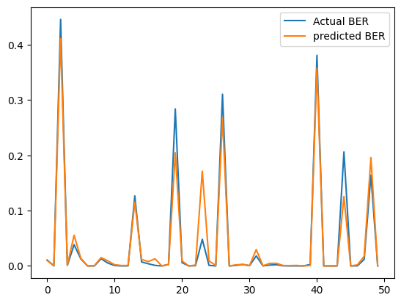
Transition to Simulation
BER Prediction
The implemented model achieved a Mean Squared Error (MSE) of 0.0004680276551369002, indicating high prediction accuracy. Comparison of the actual and predicted values of BER indicates that there is a high correlation between the two results, which depicts the efficiency of the machine learning model in representing the relationship between environmental conditions and signal degradation.

Slide 11
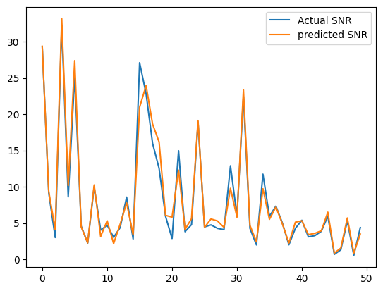
Transition to Simulation
NSR Prediction
he Mean Squared Error (MSE) was estimated to be about 5.50 which indicates a reasonable degree of prediction accuracy given the inherent variability and uncertainty inherent in the simulated environment. The comparatively small error value also helps to confirm the accuracy of the model predictions.

Slide 12
Discussion
The results show that the machine learning model successfully learned the nonlinear behavior of the UVC channel and achieved high prediction accuracy, demonstrating the effectiveness of data-driven modeling. However, the study is limited by the use of synthetic data, which may not fully represent real-world conditions.

Slide 13
Recommendations:
This research highlights the need to further explore advanced technologies that can be integrated with ultraviolet communication to improve performance and adaptability. It emphasizes developing a flexible framework that keeps up with rapid technological changes and continuously considers all factors affecting UV signal propagation. Such an approach can enhance communication efficiency and help address the challenges of dynamic and unpredictable environments.

Slide 14
Conclusion
This paper proposes a machine learning-based framework to improve the prediction of UVC system performance under varying atmospheric conditions. The results show that traditional methods struggle to capture the nonlinear behavior of UVC channels, while the Random Forest model effectively learns the relationship between environmental factors and performance metrics (BER and SNR). Simulation results demonstrate high prediction accuracy and improved system adaptability, reducing reliance on manual tuning. However, the study is limited by the use of synthetic data, and future work should focus on real-world validation and more advanced models.

Slide 15
References:
Ahmad, I., Shahabuddin, S., Malik, H., Harjula, E., Leppänen, T., Loven, L., ... and Riekki, J. (2020). Machine learning meets communication networks: Current trends and future challenges. IEEE access, 8, 223418-223460.
Chen, G., Wu, T., Yang, F., Wang, T., Song, J., and Han, Z. (2022). Ultraviolet-based UAV swarm communications: Potentials and challenges. IEEE Wireless Communications, 29(5), 84-90.
El-Shimy, M. A., and Hranilovic, S. (2015). Spatial-diversity imaging receivers for non-line-of-sight solar-blind UV communications. Journal of Lightwave Technology, 33(11), 2246-2255.
Geller, M., Johnson, G. B., Yen, J. H., and Clapp, G. A. (1986). Short-range UV communication links. In Proceedings of the Tactical Communication Conference (p. 60).

Slide 16
References:
Guo, L., Guo, Y., Wang, J., and Wei, T. (2021). Ultraviolet communication technique and its application. Journal of Semiconductors, 42(8), 081801.
Harvey, G. L. (1964). A survey of ultraviolet communication systems (No. NRL6037).
Koller, L. R. (1965). Ultraviolet Radiation. New York: John Wiley and Sons. 2nd ed.
Luettgen, M. R., Shapiro, J. H., and Reilly, D. M. (1991). Non-line-of-sight single-scatter propagation model. Journal of the Optical Society of America A, 8(12), 1964-1972.
Maclure, D. M., Chen, C., McKendry, J. J., Xie, E., Hill, J., Herrnsdorf, J., ... and Dawson, M. D. (2022). Hundred-meter Gb/s deep ultraviolet wireless communications using AlGaN micro-LEDs. Optics Express, 30(26), 46811-46821.

