Slide 1
Project - Online Banking
Group5
Project Lead & Frontend Lead - Nidamanuri Rahul Kumar
Backend Lead - Nishchith M

Slide 2
Team-5
Employee ID
2484917
2483797
2485507
2486709
2484853
2487742
2486674
2483929
2483745
2484174
2484851
NAME
Nidamanuri Rahul Kumar
Nishchith M
Pabbineedi Datta Sai Vinay
Palugulla Chaitanya
Paruchuri Raja Ravi Sankar
Pavitra X
Pradeep U
Princia Melita Dsouza
Pusa Pranay Teja
Rasamsetti Ramu
Rashmi X

Slide 3
Contents
Introduction
Objective
Modules for Online Banking
Tools & Languages Used
System Requirements
Features Available
Admin Flow & User Flow
Screen Shots Of Output
Bibliography
Conclusion

Slide 4
Introduction:
In Customer scenario computer is an essential part for human life. It provides better Facilities for storage and retrieval of information related to different areas of application.
The Online Banking looking for the services that are accurate and reliable for providing services to the customers.
The detail of online banking which are available in Bank is easily managed and organized by using this system.
The database for the customers can be managed by using this project.

Slide 5
Introduction:
In this Application we are going to provide online banking to the customer’s .
Customer’s can find various types of Account’s in this application the customer online banking web application to deposit, withdraw, and transfer money between accounts.
The User Interface is very user-friendly. The data are well protected for personal use and makes the data processing very fast.

Slide 6
Objective:
The main objective of the online banking system is to manage the details of accounts,internet,Banking,Transaction,Balance,Statement.
It manages all the information about accounts, Customer, Statement.
The project is totally built at administrative end and thus only the administrator is guaranteed the access.

Slide 7
Objective:
Practically : The system is quite stable and can be operated by the people with average intelligence. The Primary objective of the design is to deliver the requirement as delivered by the feasibility report.
Efficiency : We tried to involve accuracy, timeliness and comprehensiveness of system output.

Slide 8
Modules of online banking:
Admin
User
Login
Registration
Deposit
Withdraw
Transactions

Slide 9
Admin Portal Description:
It deals with all the back-end data generation and product information. The role of the admin is to:
Authorize the user
Grant access to user
Enable/disable the user
Authorize the Cheque Book requests

Slide 10
User Authorization:
After successful registration on the user portal. The user’s account will get activated automatically, the account number gets generated and he/she can proceed with banking activities. In case of failure, user has to re-register by providing the correct data. The admin also has a login to view the user details and perform actions accordingly.
Enabling/Disabling the User:
The admin can disable(block) the user if he/she is found to be suspicious. If the user is disabled, he/she cannot login and hence is restricted from performing transactions.
Authorizing Cheque Book Requests:
The admin has to authorize the user’s request for cheque book issue. Only upon admin’s confirmation, cheque books are issued to respective users.

Slide 11
User Portal Description:
Registration: The registration is the first step to get started with the application. The user will have to enter his first name, last name, email, phone number, address, username, password, date of birth, and select an identity card and enter its number identity provided. If the username given by the user is checked for duplication in the database, if a similar username exists then he or she will have to register with a new username. On registration the user information is passed and account will automatically activated.
Login:
The user can login with the username and password that he had provided on registration. The admin can also disable the account. So, for successful login the user has to enter correct username, correct password and the user has to be authorized.

Slide 12

Deposit:
The user can deposit money in his/her accounts by selecting the primary or savings accounts.
Withdraw:
The user can withdraw money from his/her by selecting the primary or savings accounts. The operation won’t go through if the amount to be withdrawn is more than the user's account balance.

Slide 13
Transfer:
The user can transfer money from his/her account to other accounts by entering his/her account number, the receiver's account number, the IFSC code of the receivers account. The operation won’t go through if the amount to be transferred is more than the user's account balance or the IFSC code of the receiver account is incorrect
Transaction History
In the view transaction history section, you can view transactions for a particular account. Both when money was deposited or withdrawn.
View Transfer History:
In the view transfer history section, you can view transfers for a particular account. Both when money was transferred or received from the account will be displayed

Slide 14

Cheque Book Request:
The user can request cheque books for his/her accounts by selecting the primary or savings accounts.. Once the request is confirm the admin can accept or reject the request till then the request is in pending state.

Slide 15
Advantages:
Cost efficiency
Less time consuming
Time-saving
Anytime anywhere
Easy Secured payments
Convenient
Information is private and confidential
Systematic
Facilitate useful information

Slide 16
Disadvantages:
Lack Of Security:
The paper document is less secure compared to an electronic system.
Time Consuming:
Manually managing is a very tough and time-consuming process.

Slide 17
SYSTEM REQUIREMENTS:
The Basic System Requirements for Running this project are listed below:
572 MB Random Access Memory
200 MB of Free Space on Hard Disk
Microsoft Windows XP or Linux or Equivalent OS
Web Browser Internet Explorer Version 10

Slide 18
Tools & Languages Used
Front End
Visual Studio
Angular
Html
CSS
BOOTSTRAP
Back End
MySQL Server
Spring Tool Suite
Eclipse IDE
Spring Boot

Slide 19
Features Available:
Admin
Login
View Users
Enable/Disable users
Chequebook KYC
User
Register
Deposit
Withdraw
Transfer
Chequebook Request

Slide 20
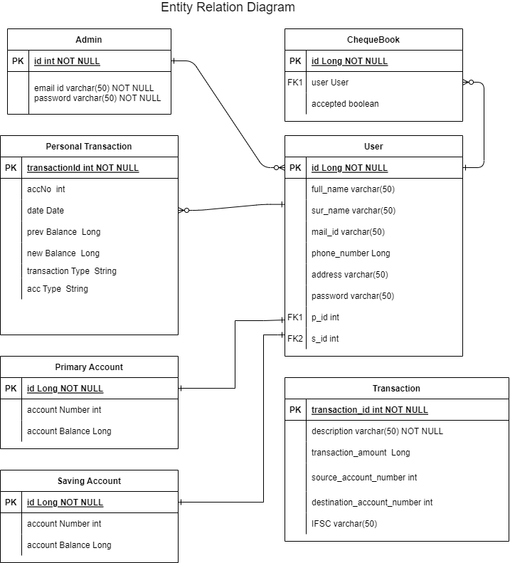

Slide 21
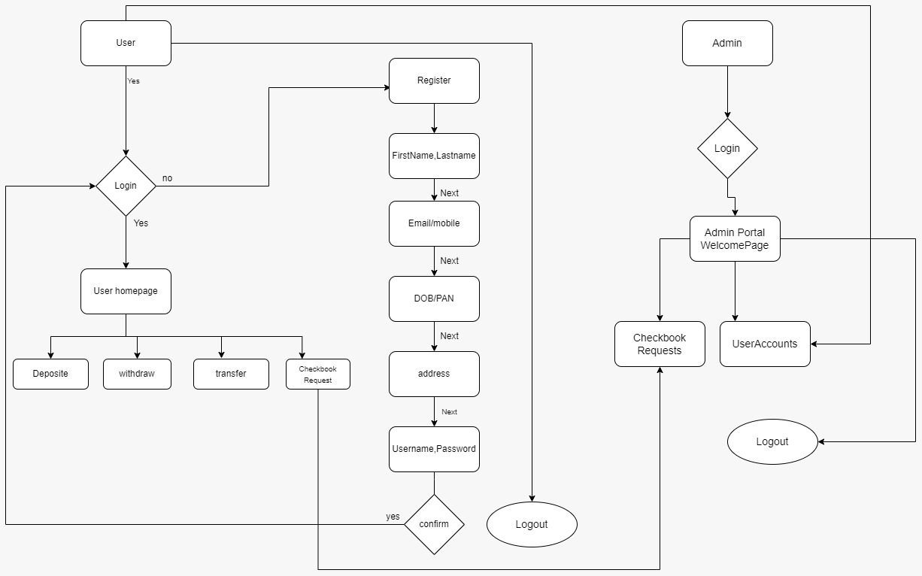
Work flow:

Slide 22
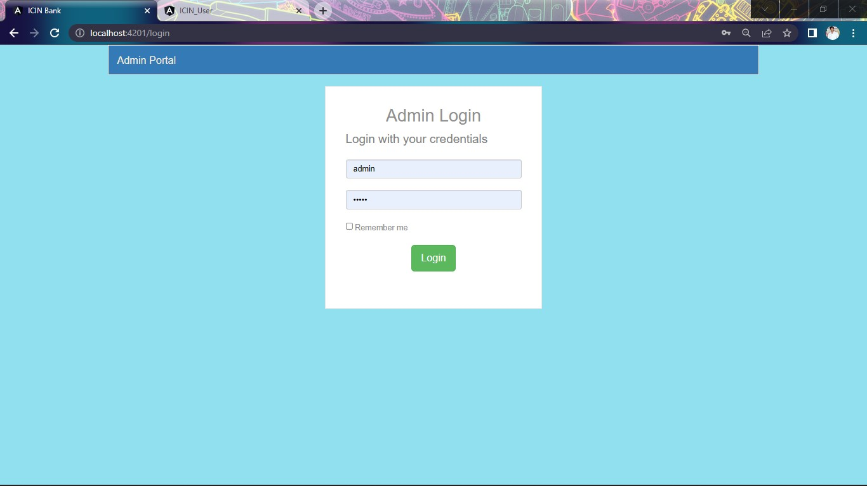
Snapshots:

Slide 23
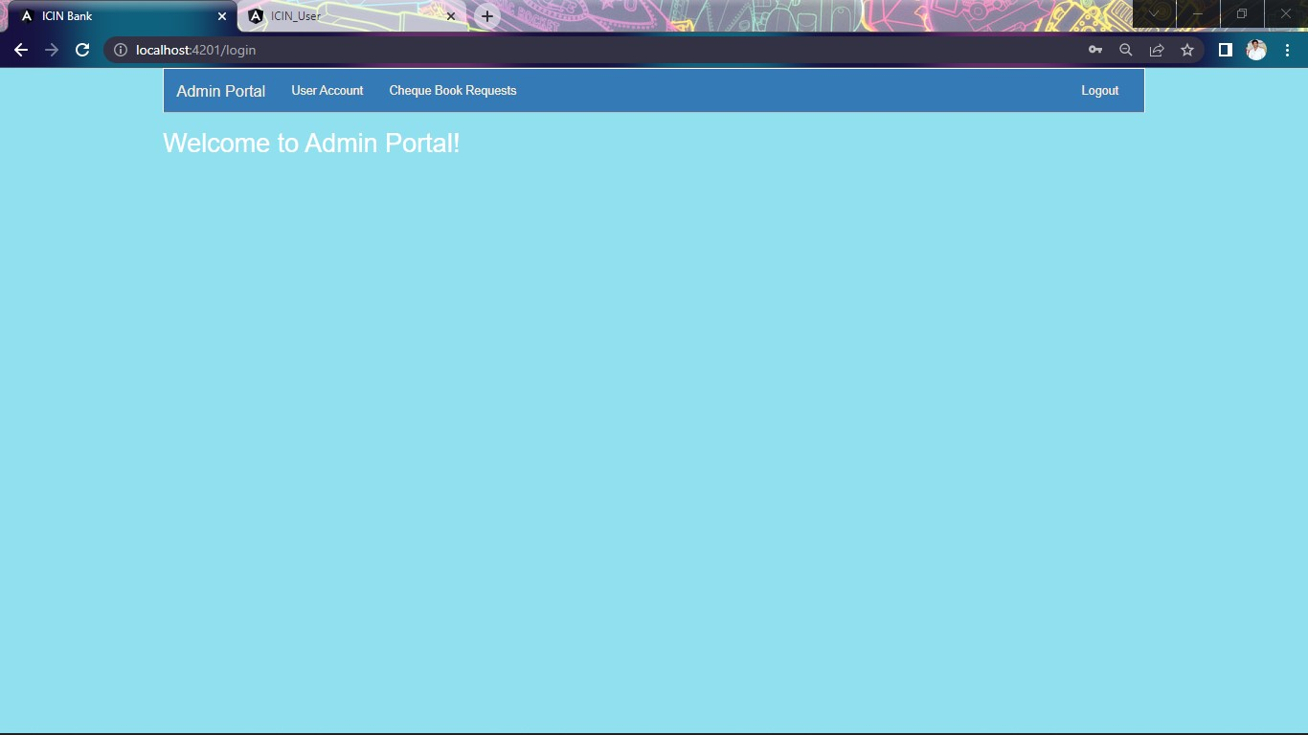
Snapshots:

Slide 24
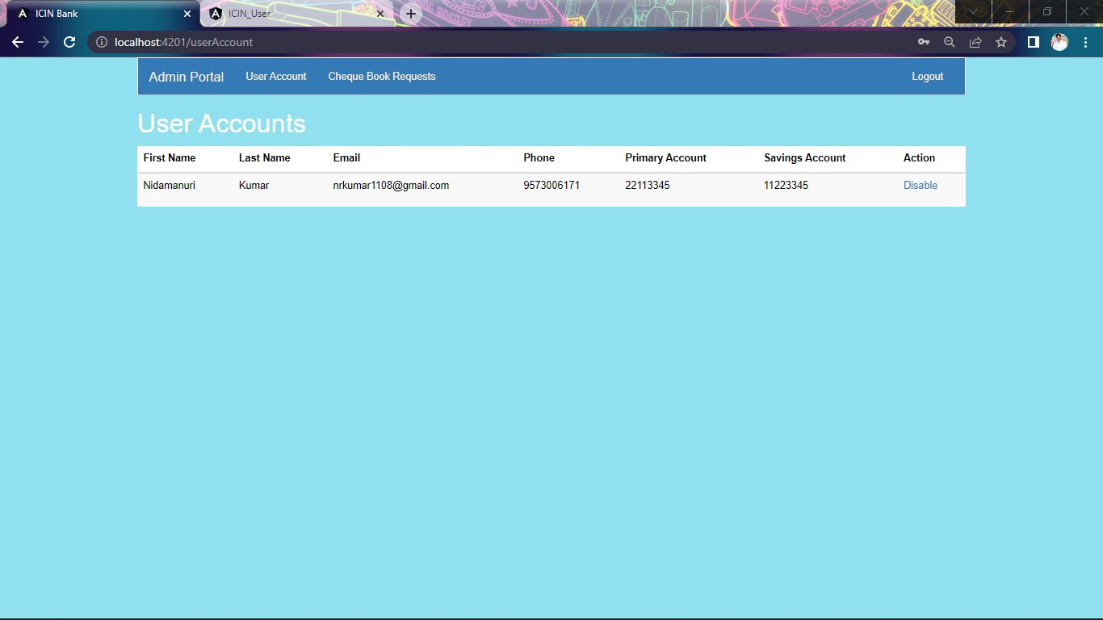
Snapshots:

Slide 25
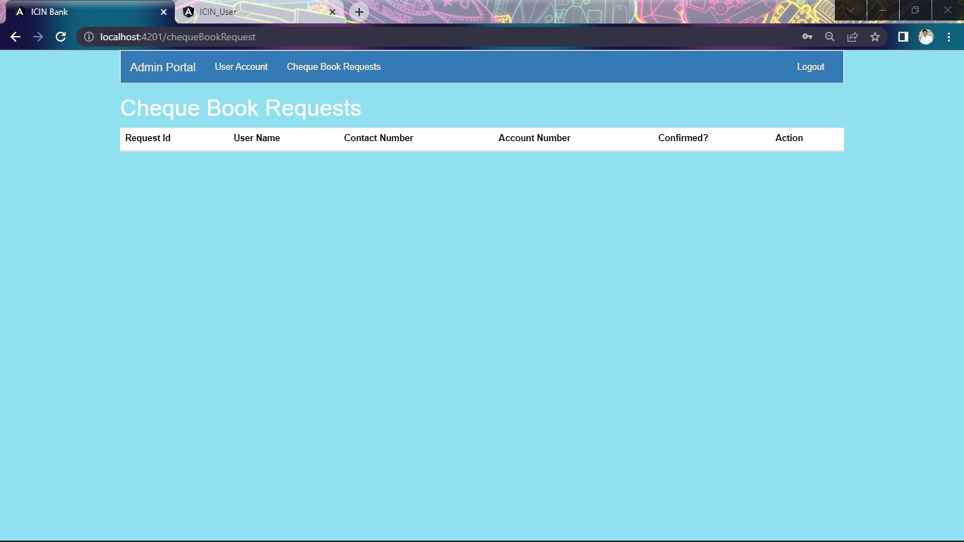
Snapshots:

Slide 26
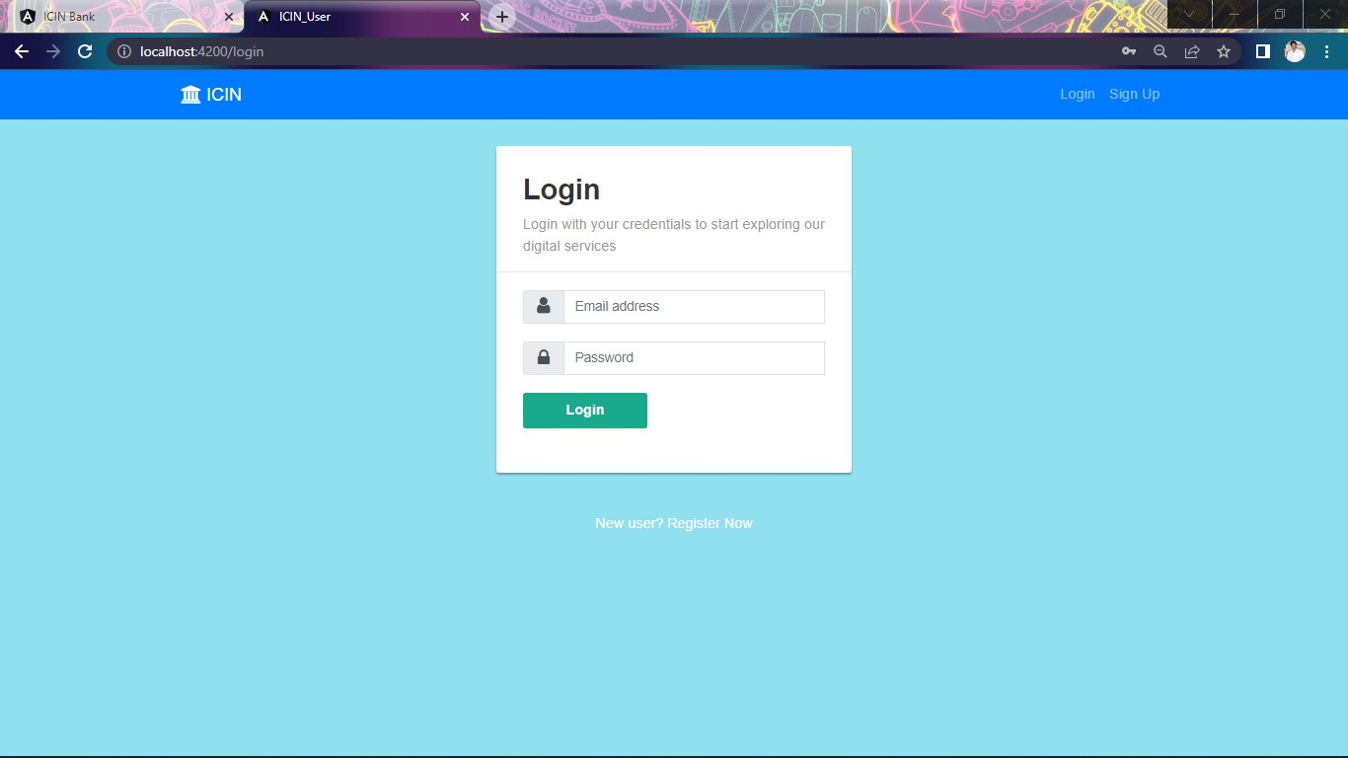
Snapshots:

Slide 27
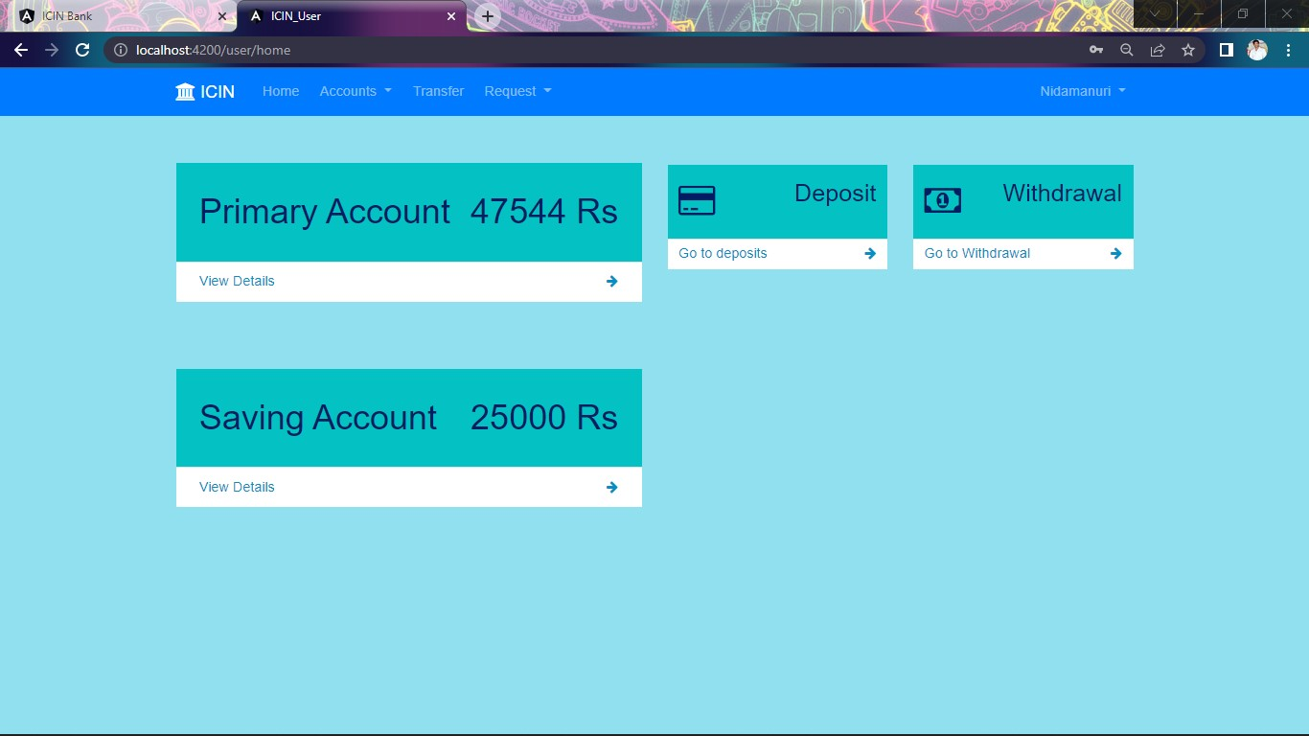
Snapshots:

Slide 28
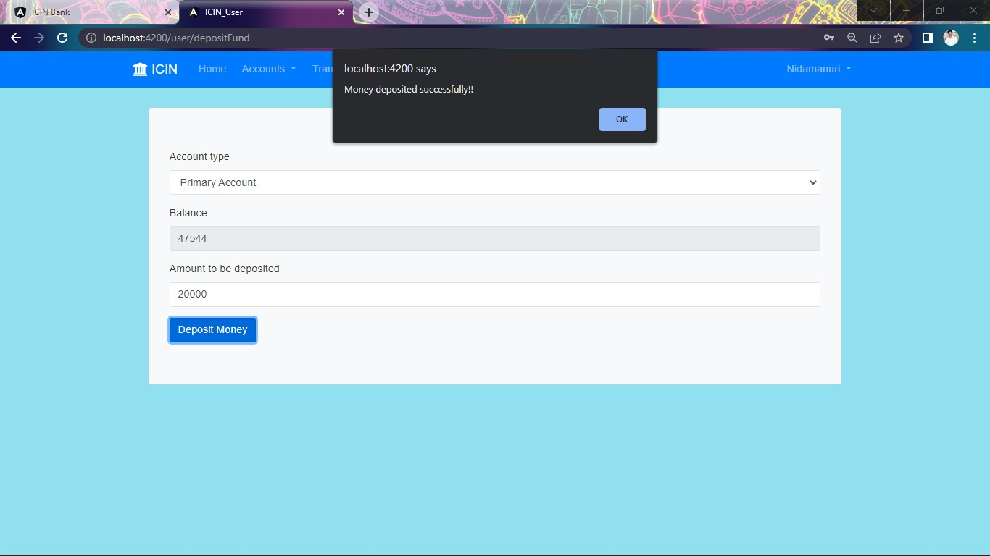
Snapshots:

Slide 29

Snapshots:

Slide 30

Snapshots:

Slide 31

Snapshots:

Slide 32
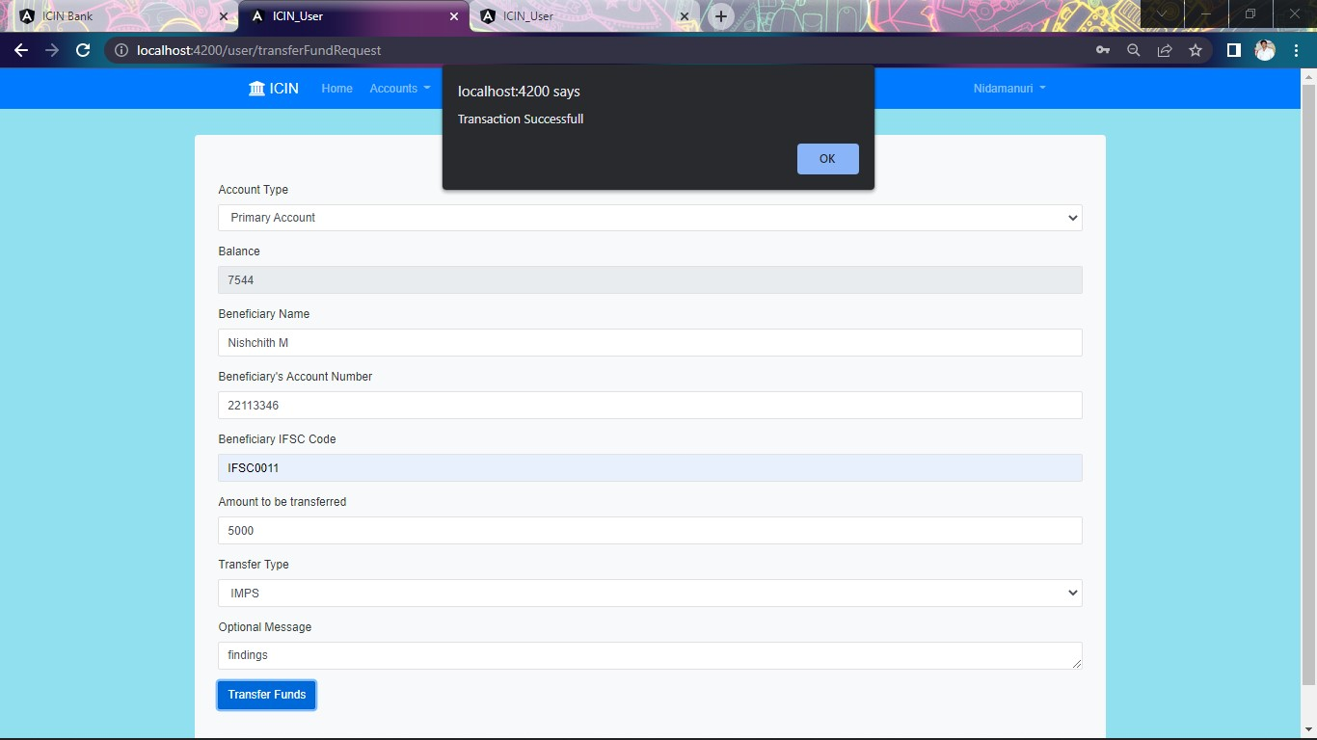
Snapshots:

Slide 33
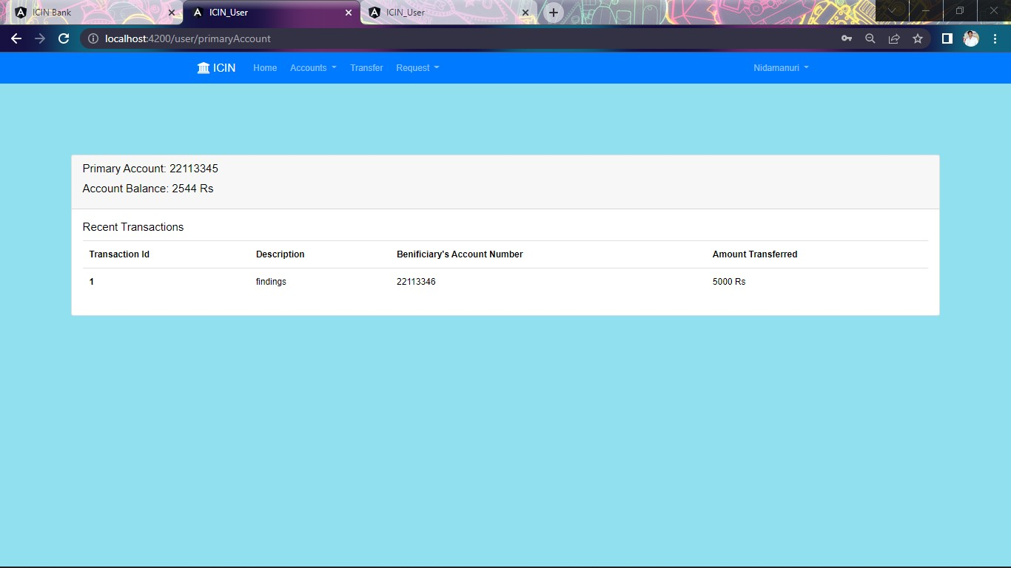
Snapshots:

Slide 34
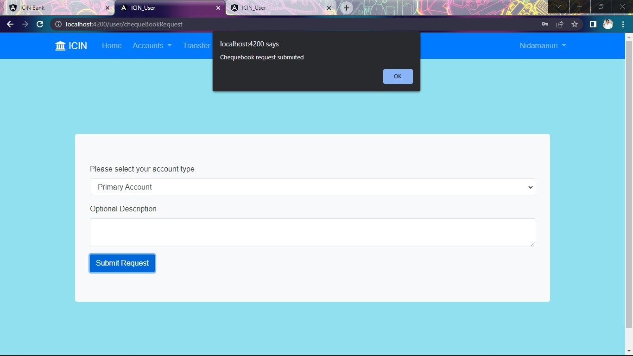
Snapshots:

Slide 35
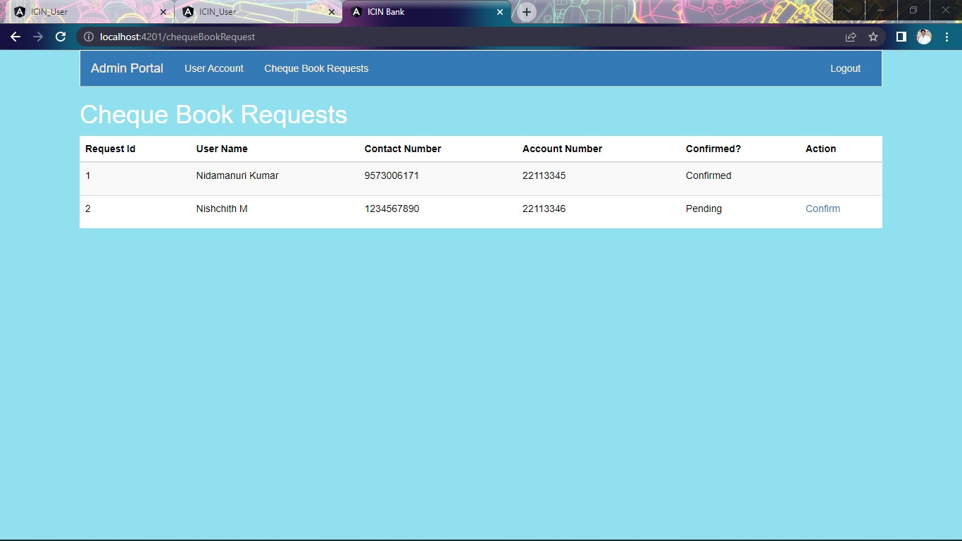
Snapshots:

Slide 36
Bibliography:
www.google.com
www.stackoverflow.com
www.w3school.com

Slide 37
Conclusion:
Online banking offers a higher level of convenience for managing one's finances.
However, it continues to present challenges to financial security and personal privacy.
Many people have had their account details compromised, as a result of online banking.

Slide 38


