Slide 1


KENDRICK.
Avi KC
Ayush Prajapati
Nidan Poudyal

Slide 2

Why chose SDL?
At any given time, the game renders ~10 rectangles, in some cases calculating coordinates individually.
Refresh rate for screen 500 ms
Refresh rate for characters 175 ms
We want our program to effortlessly scale.
“Complex systems fail.”

Slide 3
OOP helps
Programming languages must capture the essence of the program without being unnecessarily verbose
OOP lets users build ‘types’ and implement ‘methods’ to these types
“What I really liked about Simula was, it allowed me to write my own types”
Bjarne Stroustrup

Slide 4
Resource Acquisition Is Initialization
RAII is an object oriented design pattern where creation of class invariant decides the lifetime of an object
Destructor takes responsibility for automatic cleanup
RAII helps with memory leaks
RAII helps to cleanup memory of screen parameters without us having to worry about it

Slide 5
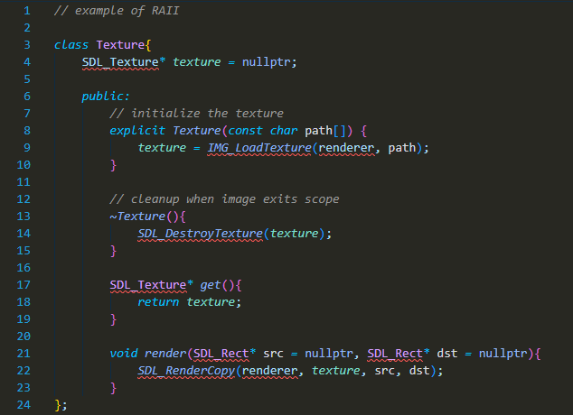
RAII pattern for resource management

Slide 6
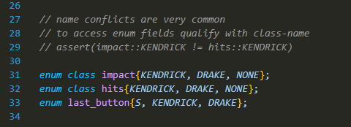
Preferring scoped enums
C++ allows for scoped enums
Scoped enums require explicit qualification
We have a choice? ‘enum’ or ‘enum class’ ?
For character dynamics name conflicts are a common source of errors
Scoped enums resolve this

Slide 7
Game Structure
—> assets
—> src
|---> include
|--- > lib
—> finals.cpp
—> README.md
—> main.exe
—> SDL2_image.dll
—> SDL2_mixer.dll
—> SDL2.dll
~/src/include has header files
~/src/lib has libraries
The executable needs be located in the same directory as the dynamic libraries, ending with
‘.dll’ syntax

Slide 8
Heavy, not Dense
“About 10% of code runs for 90 % of the time, and that is what gave RISC architecture its magic!”
Similar to the above finding, our codebase also shows that most of the code space is spent allocating, deallocating, and checking for conditionals.
Of ~1300 loc, +700 loc simply read filenames and do basic initialization, deallocation with it

Slide 9
Verbosity
“The uncomforting truth of maintaining a large codebase, is that the program loses its spirit”
To maintain the ‘spirit’ of our game, we factorize code into individual functions, that do a small-specific task repeatedly
Isn’t this grammar intuitive?
main -> begin -> init -> load_assets -> begin -> (game logic and conditionals)
-> health_regulator -> end -> clear_screen

Slide 10
Run the Program
To compile, navigate to the root directory
g++ finals.cpp -Isrc/Include -Lsrc/lib -o main -lmingw32 -lSDL2main -lSDL2 -lSDL2_image -lSDL2_mixer
This creates an executable ‘main.exe’ in the root directory itself
./main to run the game

Slide 11
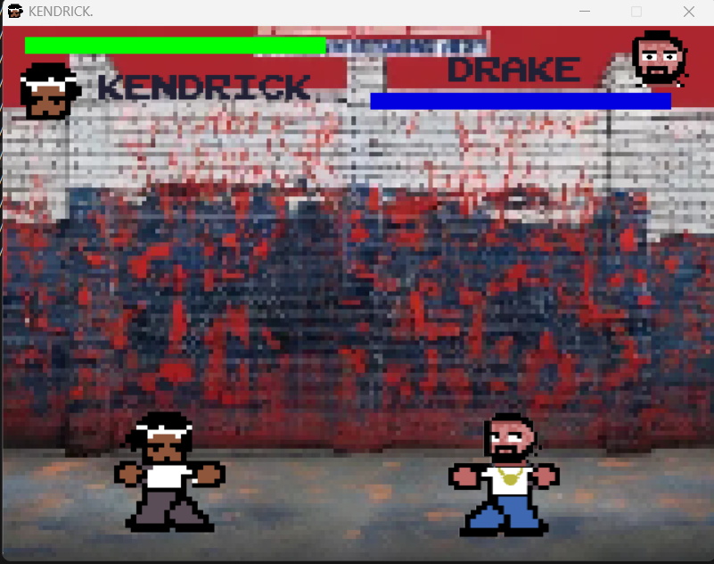
A Look
Control
KENDRICK. uses [WASD] for movement
DRAKE uses [UP,LEFT,DOWN,RIGHT] for movement

Slide 12



Questions?
Any question regarding any part of the process?

Slide 13



Thank you!
Now go, defeat drake.

