Slide 1
TRAVEL MANAGEMENT Mohith Sai(RA2211026010304) Harshavardhan M(RA2211026010309) Nidarshan M V(RA2211026010304)

Slide 2
INTRODUCTION
Travel management involves gathering and analyzing user preferences and requirements to tailor personalized travel experiences. While it doesn't directly handle bookings or accommodations, it plays a pivotal role in curating and optimizing travel plans. By understanding traveler needs, such as destinations, activities, and budget constraints, travel management ensures that each journey aligns with the individual's or organization's objectives. This data-driven approach maximizes the efficiency, enjoyment, and cost-effectiveness of trips, making it an indispensable facet of modern travel, where customization and user-centric experiences are paramount.

Slide 3
PROBLEM STATEMENT
The problem at hand revolves around inefficient and outdated travel management processes, leading to suboptimal travel experiences. Current systems lack the ability to collect, analyze, and utilize user preferences effectively, resulting in generic travel plans that do not align with individual or organizational objectives. This inefficiency can lead to increased costs, missed opportunities, and traveler dissatisfaction. The challenge is to develop a more data-driven and user-centric travel management solution that gathers and leverages user information to curate personalized travel itineraries, ensuring cost-effectiveness, satisfaction, and alignment with specific travel goals, ultimately enhancing the overall travel experience for both individuals and organizations.

Slide 4
APPLICATION OVERVIEW
Java Travel management App: Collecting and Managing User Travel details
User-Friendly Travel management Application
Main Features
User Input Fields:
Name
Date of Trip
Email Id
Mode of Travel

Slide 5
2.Buttons:
Register: Register to get started
Details: Enter all the Required fields
Exit: Close the application
3.Database Integration:
MySQL database for data storage
Prepared statements for secure data manipulation

Slide 6
USER INTERFACE JAVA
NAME FIELD:
Allows users to enter their name.
EMAIL ID:
Collects user's email addresses.
DATE:
Gets Date of Travel From The User
4. REGISTER:
Saves the Information User Entered
5. MODE OF TRANSPORT:
Gets The Transport Details From the User
DISPLAY:
Display the Travel Information Got From The User
7. EXIT

Slide 7
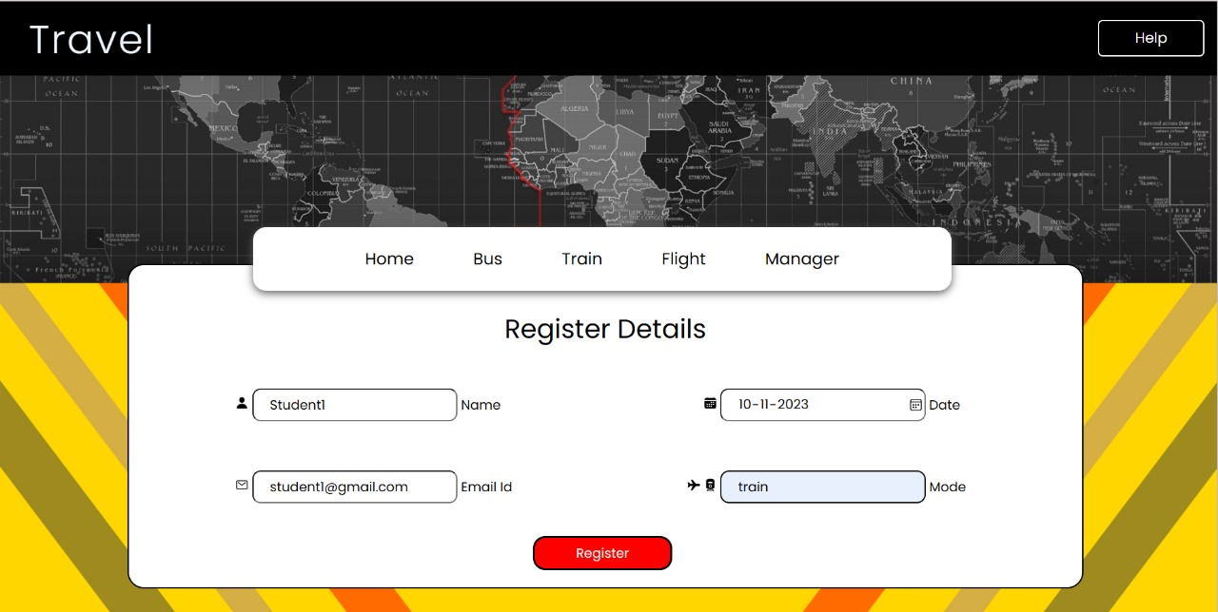

Slide 8
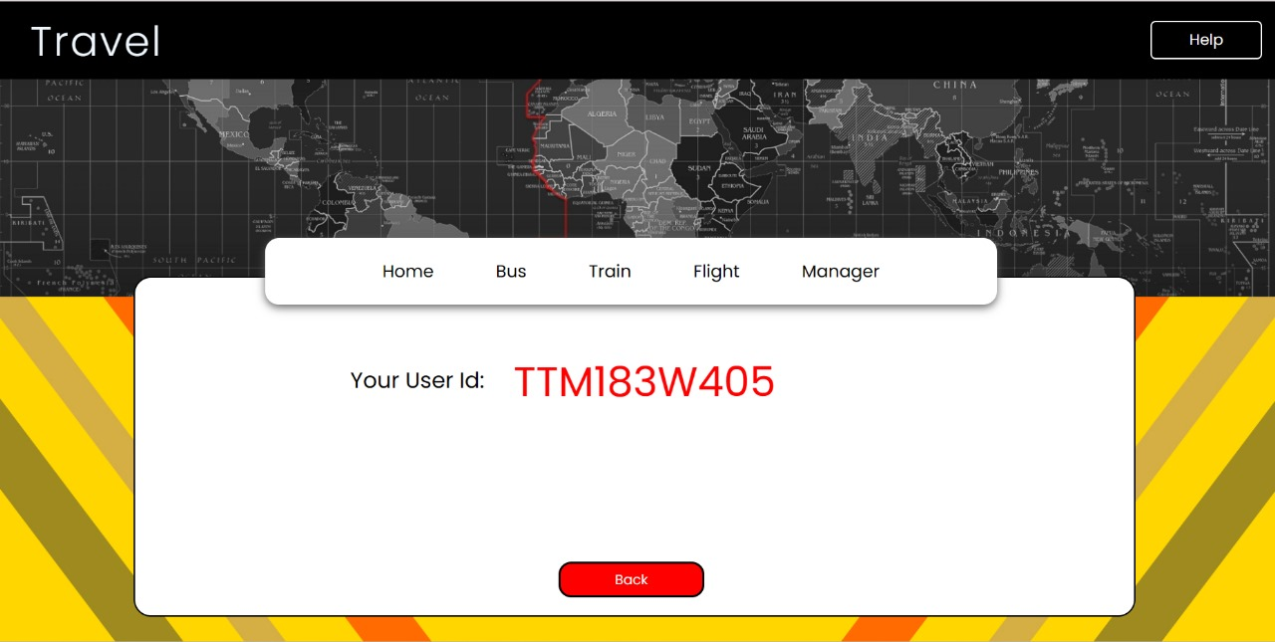

Slide 9
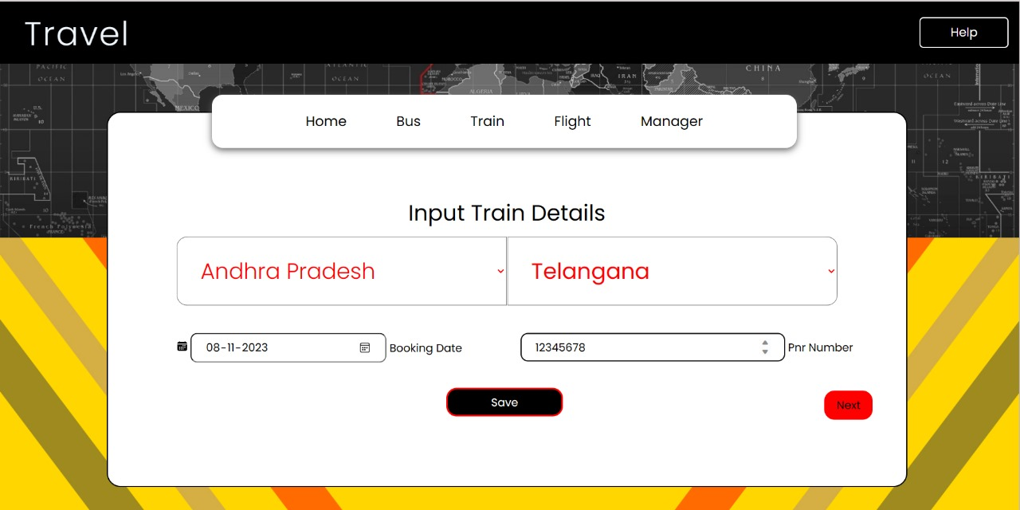

Slide 10
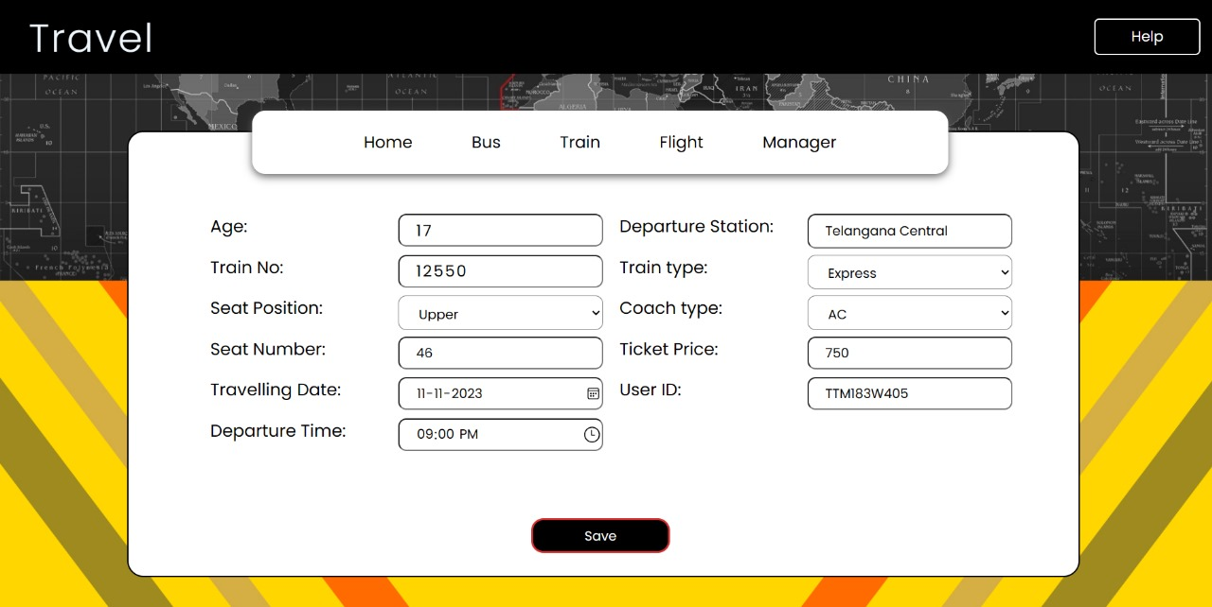

Slide 11
Application overview-python
Python:
Python is the primary programming language used to develop the application. It provides the core logic for the application, including user interface design and database interaction.
Tkinter:
Tkinter is the standard GUI library for Python. It's used to create the graphical user interface of the "Survey App." Tkinter provides tools for creating windows, dialogs, buttons, text fields, labels, and other GUI elements.

Slide 12
3.MySQL Database:
MySQL is an open-source relational database management system used to store and manage user feedback data. The application interacts with the MySQL database to insert, update, and retrieve feedback data.
4.mysql.connector:
The mysql.connector library is used to connect the Python application to the MySQL database. It enables the execution of SQL queries and database operations within the Python code.

Slide 13
USER INTERFACE DESIGN- PYTHON
Application Title:
The application title, “Travel Management," is displayed at the top of the main window, indicating the purpose of the application.
Main Window:
The main window of the application is designed to have a fixed size with dimensions set to 800x500 pixels, providing a consistent and easily readable interface.
Input Fields:
The UI includes input fields for users to enter their feedback:
Name Field: A text entry field allows users to input their name.
Email Field: Another text entry field where users can provide their email.
3. DATE:Gets Date of Travel From The User
. 4. MODE OF TRANSPORT: Gets The Transport Details From the User Through Which They Want To travel
.

Slide 14
4.Labels:
Labels are provided next to each input field to clearly indicate what information should be entered. These labels include "Name," "Email," “Mode of Transport?,"
5.Buttons:
The UI includes several buttons for user actions:
"Submit": When users filled The Labels, they can click the "Submit" button.
“Next": If users Enters their Details, they can click the “next" button.
"Exit": The "Exit" button allows users to close the application.
6.Scrollbars:
The “Details" includes scrollbars, enabling users to navigate through their feedback if it exceeds the visible area

Slide 15
7.Message Boxes:
Message boxes are used to display informative messages to users:
Error Messages: For instance, if users try to submit without filling in all the required fields, an error message will inform them.
Success Messages: When All The Details Entered ,successfully submitted or updated, a success message will confirm the action.
Overall Design:
The UI design is clean and straightforward, making it easy for users to understand and interact with the application.
Fonts and styles are kept simple, maintaining readability.
The UI elements are well-arranged, providing a logical flow from top to bottom, with labels and input fields matching user expectations.

Slide 20
DATABASE CONNECTION
Database Connection Details:
Database Type: MySQL
Database Server: localhost
Port: 3306
Database Name: survey_db
Username: root
Password: [Your database password]

Slide 21
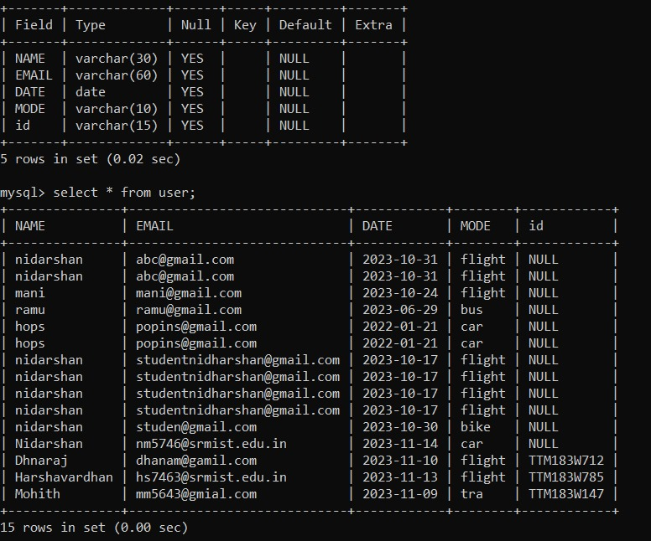
DATABASE SCHEMA

Slide 22
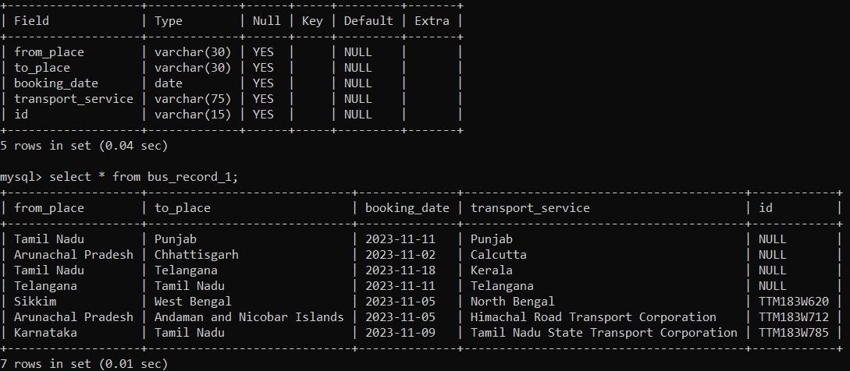

Slide 23
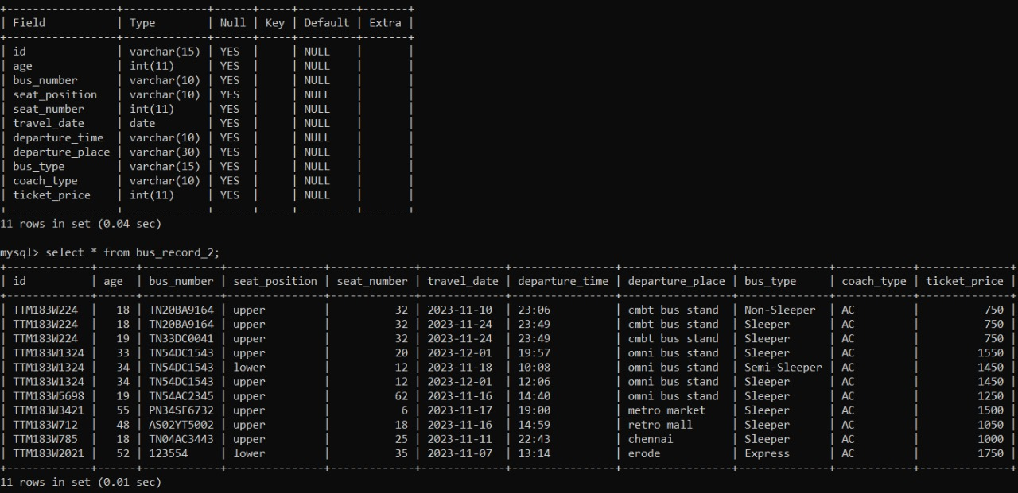

Slide 24
CONCLUSION
Explored user-friendly Travel Management Website.
Emphasized UI, secure database connection.
Improves user experiences, services.
Potential for future enhancements.
Share feedback, stay connected!
This condensed conclusion provides a concise summary of the key points in a single slide, emphasizing the user-friendliness, its impact, future possibilities, and an invitation for Travel and further engagement.

Slide 25
FUTURE ENHANCEMENTS
User Authentication
Multi-platform compatibility
Integration with other systems

