Slide 1
AQUAFLOW
Enterprise Smart Water Billing & Intelligent Leak Management Platform
Multi-Tenant Smart Metering · Dynamic 3-Tier Tariff · Quantile Regression AI · Resident Feedback Active Learning
CORE TECHNOLOGY STACK
Spring Boot 3.2.5 · React 19 & Vite 6 · Python 3.12 & FastAPI · LightGBM AI · MySQL 8 · Docker
Roles: Super Admin · Building Owner · Resident
Live Demo: http://localhost:5173 | Swagger API: http://localhost:8080/api/swagger-ui.html

Slide 2
1 · PROJECT OVERVIEW
What AquaFlow Delivers
A next-generation municipal & residential water intelligence platform
AquaFlow is an enterprise-grade IoT water management platform engineered for residential high-rises, gated communities, and commercial properties. It completely eliminates flat-rate unmetered billing inequities, dynamically adjusts water tariffs based on bulk procurement and tanker costs, and protects properties from devastating water losses using Quantile Regression ML and real-time resident feedback.
3
26+
16
3
USER ROLES
REST ENDPOINTS
JPA ENTITIES
ML REGRESSORS
Super Admin, Building Owner, and Resident with strict hierarchical RBAC
Stateless, JWT-secured endpoints across 5 dedicated domain controllers
Normalized relational database tables hosted on high-performance MySQL 8
LightGBM Quantile models (q10, q50, q95) with in-JVM statistical failover

Slide 3
2 · KEY FEATURES
Core Capabilities & Advanced AI Innovations
Engineered for operational precision, financial transparency, and water conservation
CORE CAPABILITIES
ADVANCED AI & GOVERNANCE
TARGET USE CASES
• Building & Flat Hierarchy Management
• Digital Water Meter Telemetry Pairing
• Bulk Water Procurement & Tanker Logging
• 1-Click Automated Monthly Bulk Billing
• Instant iText PDF Invoice Generation
• Resident Simulated Online Payment Gateway
• Tenant Occupancy Requests & Token Invitations
• Quantile Regression ML (q10, q50, q95 Bounds)
• Dynamic 3-Tier Progressive Tariff Engine
• Household Size Demographic Normalization
• Vacation Away-Period Anomaly Suppression
• Human-Readable Leak Reason Codes
• Super Admin Owner Verification Gatekeeper
• Resident Feedback Active-Learning Loop
• Multi-Tenant Residential High-Rises
• Gated Communities & Villa Townships
• Commercial Tech Parks & Office Complexes
• Private Water Supply & Tanker Operators
• Smart City Municipal Water Distribution
• Mixed-Use Real Estate Developments
• Property Facility Management Firms

Slide 4
3 · PROBLEM & SOLUTION
Overcoming Legacy Water Management Inequities
How AquaFlow replaces outdated manual methods with intelligent automation
DOMAIN CHALLENGE | LEGACY INDUSTRY PROBLEM | AQUAFLOW INTELLIGENT SOLUTION
Billing Inequity | Flat-rate fee divided equally across all flats penalizes conservative users and ignores wastage. | Digital meter per flat; automated billing based strictly on actual delta consumption volume (kL).
Volatile Tanker Costs | Building owners absorb heavy summer tanker costs or impose arbitrary lump-sum surcharges. | Dynamic procurement-based tariff: Average cost + owner markup % with 3 progressive tiers.
Undetected Leaks | Silent toilet leaks and concealed pipe bursts go unnoticed until astronomical water bills arrive. | 24/7 telemetry scoring via Quantile Regression with continuous night-flow anomaly attribution.
False Alarm Fatigue | Simple threshold alerts trigger panic when residents host guests or wash terraces. | Demographic scaling by flat type, vacation away-period scheduling, and resident feedback loop.
Governance & Privacy | Unverified building owners list non-existent buildings and collect payments illegally. | Strict Super Admin approval gatekeeper before building inventory and flats become public.

Slide 5
4 · TECHNOLOGY STACK
Modern Polyglot Enterprise Architecture
Industry-proven tools chosen for type safety, computational speed, and developer velocity
BACKEND ENTERPRISE CORE
FRONTEND PRESENTATION
AI & MACHINE LEARNING
STORAGE & DEVOPS
• Java 17 (LTS)
Modern type-safe object model & pattern matching
• Spring Boot 3.2.5
Dependency injection, auto-configuration & REST API
• Spring Security & JWT
Stateless bearer token authentication & RBAC
• Spring Data JPA / Hibernate
Object-relational mapping with 22 repositories
• iText PDF 5.5
Dynamic water bill invoice PDF document rendering
• Spring Mail (JavaMail)
Asynchronous SMTP notification dispatch via TLS
• React 19 & React DOM
Declarative component-driven user interface
• Vite 6.0
Next-gen lightning fast bundler & dev server
• React Router DOM 7.1
Client-side routing and protected role guards
• Bootstrap 5.3 & Icons
Modern responsive layout & iconography
• Recharts 3.10
Real-time consumption histograms & quantile graphs
• Axios 1.7
HTTP client with automated JWT request interceptors
• Python 3.12 & FastAPI
Asynchronous high-throughput ML scoring microservice
• Uvicorn ASGI
Ultra-fast production ASGI server execution
• LightGBM Quantile Regressors
Gradient boosted models for q10, q50, q95 bounds
• Scikit-Learn & Pandas
Demographic feature engineering & rolling transforms
• Pydantic 2.7
Strict schema validation and type enforcement
• Joblib 1.4
Optimized model serialization & persistent disk caching
• MySQL 8.0 Database
Primary ACID relational store with strict constraints
• HikariCP Pooling
Zero-overhead enterprise database connection pool
• Apache Maven
Automated dependency resolution & multi-phase builds
• Docker & Dockerfile
Containerization readiness for ML microservice
• Springdoc OpenAPI 2.5
Interactive Swagger 3.0 API docs at /swagger-ui.html
• In-JVM Failover Engine
Zero-downtime statistical fallback on service timeout

Slide 6
5 · SYSTEM ARCHITECTURE
Hybrid Distributed Service Topology
Decoupled presentation, enterprise business core, and resilient ML microservice
CLIENT TIER
React 19 SPA (Vite) · Role-Segregated Dashboards (Admin, Owner, Resident) · Recharts Visualizations · Axios JWT Interceptor
SECURITY & ROUTING
Spring Security 6 · CORS Filter · Stateless JwtAuthenticationFilter · Role-Based Access Control (RBAC)
ENTERPRISE BUSINESS BACKEND
Java 17 / Spring Boot 3.2.5 | REST API Controllers (/api) | BulkBillingService | TariffCalculationService
OccupancyService | AlertScheduler Cron | iText PDF Generator | Spring RestClient with In-JVM Statistical Fallback
STORAGE & DATA ACCESS
MySQL 8.0 Relational Database
HikariCP Connection Pool · Hibernate ORM 6.4
16 Normalized Entities with Strict Referential Integrity
PYTHON ML MICROSERVICE
Python 3.12 / FastAPI (Port 8000)
LightGBM Quantile Regressors (q10, q50, q95)
X-API-KEY Verification · Sub-50ms Inference Latency

Slide 7
6 · USER ROLES & MODULES
Multi-Tenant Role-Based Access Control (RBAC)
Strict separation of concerns with hierarchical governance across 3 personas
SUPER ADMIN
ROLE_SUPER_ADMIN
BUILDING OWNER
ROLE_BUILDING_OWNER
RESIDENT
ROLE_RESIDENT
• Platform root administrator & oversight
• Building Owner verification & approval gate
• Platform-wide consumption & revenue analytics
• Prevents unvetted properties from public view
• Owner registration audit logs & status history
• System configuration & health monitoring
• Building & apartment inventory management
• Water meter pairing & telemetry ingestion
• Bulk water tanker & municipal purchase logging
• Dynamic markup % setting & 3-tier tariff control
• 1-Click automated monthly bulk billing calculation
• Resident management & occupancy approval
• Property-wide leak incident monitoring & dispatch
• Self-service onboarding into approved buildings
• Real-time daily & hourly consumption histograms
• Detailed 3-tier water bill review & PDF download
• Simulated 1-click online bill payment gateway
• Household occupant count declaration & updates
• Vacation away-period scheduling (leak suppression)
• Active leak incident feedback (Confirmed / False Alarm)

Slide 8
7 · RESIDENT EXPERIENCE
Resident Dashboard & Self-Service Portal
Empowering residents with transparent billing, telemetry insights, and false-alarm controls
TELEMETRY & USAGE CHARTS
TRANSPARENT BILLS & PAYMENTS
HOUSEHOLD SIZE & AWAY PERIODS
• Hourly & daily consumption telemetry visualized via Recharts
• Comparative usage benchmarks against peer building averages
• Real-time visibility into current cycle cumulative usage (kL)
• Visual alerts when consumption crosses Tier 1 threshold into higher rate slabs
• Itemized breakdown across Tier 1, Tier 2, and Tier 3 brackets
• Full visibility into base rates, multipliers, and previous meter delta readings
• 1-Click simulated instant payment gateway updating bill status to PAID
• Downloadable official iText PDF invoices with embedded receipt metadata
• Self-declaration of flat occupant count (1 to 15 persons)
• Dynamic normalization of expected baseline water consumption per capita
• Scheduling of upcoming travel / vacation away-periods
• Suppresses false-positive leak alarms while home is verified unoccupied

Slide 9
8 · BUILDING OWNER MODULE
Property Portfolio & Tenant Operations
Centralized property, meter, tenant, and bulk billing lifecycle management
PROPERTY & METER CATALOG
TENANT & INVITATION WORKFLOW
BULK BILLING & INVOICING ENGINE
• Multi-building hierarchy with custom flat configurations (1BHK, 2BHK, 3BHK, Penthouse)
• Digital water meter binding per flat with serial number and initial reading
• Vacant flat tracking & dynamic occupancy capacity analytics
• Real-time overview of unassigned meters and active residential occupancies
• Review and approve incoming resident occupancy self-requests
• Generate and email secure tokenized invitation links to prospective tenants
• One-click lease termination and tenant move-out processing with final bill settlement
• Permanent audit log of historical flat tenancies and occupancy dates
• Create monthly billing cycles with automated start and end date calculation
• 1-Click batch bill generation across all occupied apartments in seconds
• Automatic calculation of 3-tier progressive tariffs per flat delta consumption
• Bulk PDF invoice compilation and automated email dispatch to tenants

Slide 10
9 · DYNAMIC TARIFF ENGINE
Procurement-Based 3-Tier Tariff Formula
Fair pricing that adapts dynamically to bulk water purchase costs and tanker pricing
STEP 1: BULK PURCHASES
Log Water Procurements
Owner logs municipal and private water tanker loads with volume (kL) and cost ($)
STEP 2: AVERAGE COST
Compute Weighted Unit Cost
Average Procurement Cost = Total Water Purchase Cost / Total Volume (kL)
STEP 3: OWNER MARKUP %
Apply Property Margin
Base Tariff = Average Procurement Cost * (1 + Owner Markup % / 100)
STEP 4: 3-TIER SLABS
Compute Progressive Tiers
Tier 1: Base * 1.00 | Tier 2: Base * 1.25 | Tier 3: Base * 1.50
THE 3-TIER PROGRESSIVE SLAB BREAKDOWN
• Tier 1: Conserving Baseline (0 - 20 kL) [Multiplier: 1.00x Base Rate]
Standard essential consumption for basic household requirements. Incurred at baseline rate to reward conservation.
• Tier 2: Moderate Consumption (20 - 40 kL) [Multiplier: 1.25x Base Rate]
Above-average domestic consumption. Billed at 25% premium above base tariff to encourage mindful usage.
• Tier 3: Heavy Usage / Penalty (> 40 kL) [Multiplier: 1.50x Base Rate]
Excessive water usage (e.g. garden irrigation, car washing, unreported leakage). 50% surcharge penalty.

Slide 11
10 · BILLING LIFECYCLE
End-to-End Automated Invoicing Flow
From water meter telemetry ingestion to payment reconciliation and PDF generation
1. CYCLE CREATION
Owner defines active billing cycle window (e.g. Oct 1 to Oct 31).
2. WATER INGESTION
Bulk tanker receipts & digital water meter telemetry recorded.
3. TARIFF RECALCULATION
Dynamic base tariff & 3-tier rates automatically updated.
4. BATCH BILL CALCULATION
Delta consumption volume matched against tier thresholds.
5. PDF INVOICE RENDERING
iText PDF engine builds official downloadable tax invoices.
6. PAYMENT RECONCILIATION
Residents pay online; accounts marked PAID with instant receipt.

Slide 12
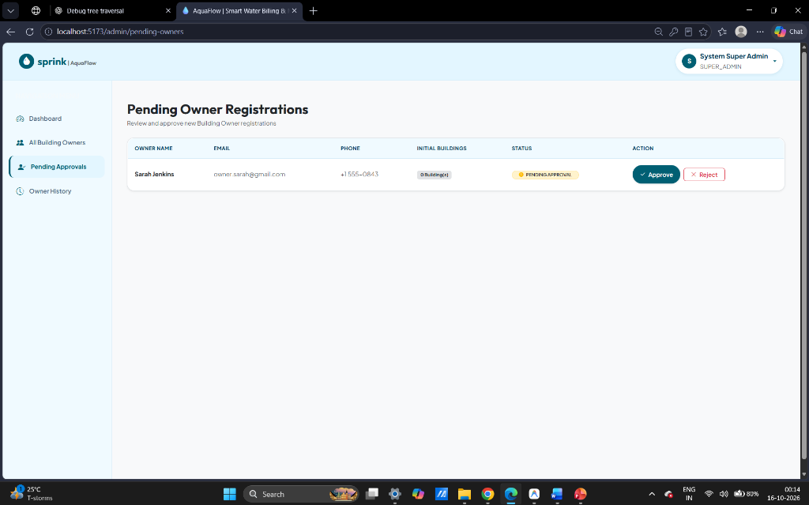
11 · SUPER ADMIN CONSOLE
Platform Oversight & Owner Verification Gatekeeper
Super Admin gatekeeping prevents unapproved property listings and protects residents
SUPER ADMIN GOVERNANCE CONTROLS
• Approval Gatekeeper
Newly registered Building Owners default to PENDING status and cannot publish buildings until vetted.
• Inventory Isolation
Unapproved owners and their apartments are strictly hidden from public registration dropdowns and occupancy requests.
• Platform-Wide Metrics
Global visibility into active building counts, aggregate water consumption, and total bill revenues.
• Audit History Trail
Immutable record of owner approval decisions, rejections, and profile modifications.

Slide 13
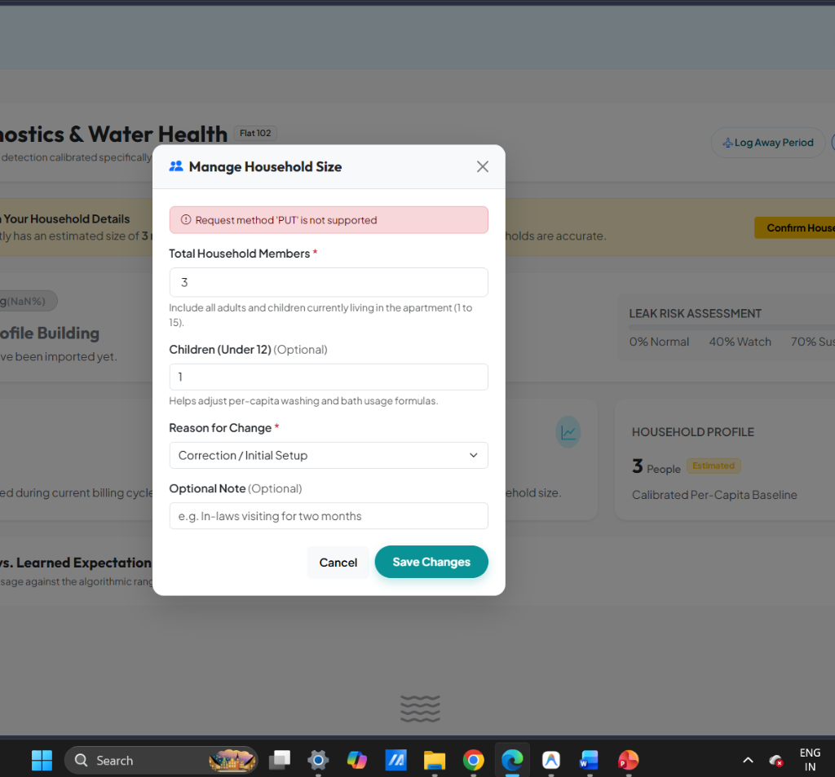
12 · AI LEAK DETECTION
Quantile Regression & Anomaly Scoring
Predicting consumption bounds rather than naive fixed thresholds
LIGHTGBM QUANTILE REGRESSION
• Beyond Static Thresholds
A 500L spike is normal for a 5-person family but indicative of a burst pipe for a single resident.
• Quantile Bounds (q10, q50, q95)
LightGBM models predict expected minimum (q10), median (q50), and 95th percentile upper limit (q95).
• Demographic Scaling
Inputs include rolling 14-day history, day-of-week, household occupant count, and away status.
• Human Reason Attribution
Classifies anomalies as CONTINUOUS_NIGHT_FLOW, ABNORMAL_SPIKE_FOR_HOUSEHOLD_SIZE, or UNEXPLAINED_AWAY_FLOW.

Slide 14
13 · RESILIENCE & FAULT TOLERANCE
Dual-Engine Fail-Safe Architecture
Zero downtime guarantee: In-JVM statistical fallback on ML service interruption
PRIMARY PATH: PYTHON FASTAPI
FAILOVER PATH: IN-JVM STATISTICAL RULE
BUSINESS CONTINUITY ASSURANCE
• Spring RestClient dispatches batch of flat features to Python ML service on port 8000
• Authenticated with X-API-KEY header and configured with 5000ms read/connect timeout
• Returns LightGBM quantile bounds, normalized risk scores (0 to 1.0), and reason codes
• Sub-50ms high-throughput inference across hundreds of apartments in parallel
• Triggered automatically if Python service times out, returns 5xx error, or is offline
• Executes in-memory heuristic calculation: Threshold = Rolling Mean + 2 * StdDev
• Scaled by household occupant count and suppressed for active away periods
• Zero exceptions thrown: Daily alert scheduler completes without interruption
• Prevents single-point-of-failure (SPOF) risks inherent in distributed microservices
• Billing cycles and daily scheduled leak detections are never blocked by network outages
• System logs automated warning and marks incident source as STATISTICAL_FALLBACK
• Seamless self-healing: Remote ML calls automatically resume once microservice recovers

Slide 15
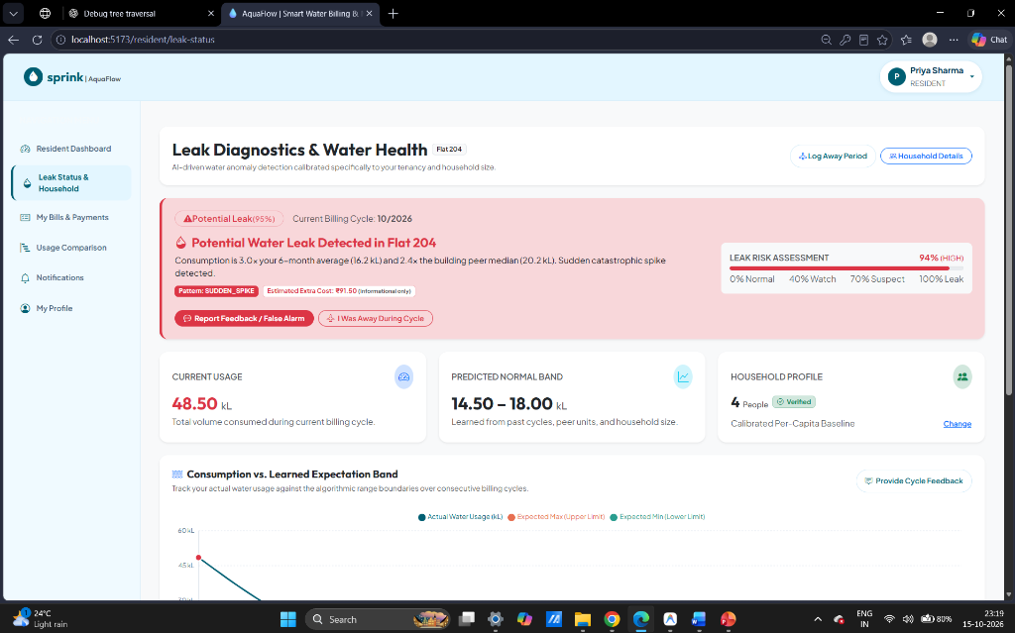
14 · ACTIVE LEARNING
Closing the Loop with Resident Feedback
Turning resident incident feedback into high-value training data to eliminate false alarms
RESIDENT FEEDBACK CYCLE
• Actionable Incident Modal
Residents receive a modal detailing detected leak severity, consumption spike amount, and suspected causes.
• Structured Feedback Options
Residents categorize the event: Confirmed Leak (e.g. toilet flush valve), False Alarm (guests/washing), or Resolved.
• Ground-Truth Collection
Submitted feedback is persisted into leak_feedbacks table with resident notes and timestamps.
• Automated Retraining Script
retrain_from_feedback.py periodically ingests verified feedback to fine-tune quantile boundaries and prevent repeats.

Slide 16
15 · NOTIFICATIONS & ALERTS
Multi-Channel Event-Driven Notification System
Real-time in-app alerts and asynchronous email dispatch powered by Spring Boot
ASYNCHRONOUS EMAIL ENGINE
IN-APP ALERT NOTIFICATIONS
EVENT-DRIVEN DISPATCH TRIGGERS
• Spring JavaMailSender integrated with SMTP over secure TLS (port 587)
• Dedicated background thread pool ensures HTTP request threads are never blocked
• Automatic dispatch of monthly water bill invoices with itemized tier breakdown
• Instant payment receipt confirmation emails with transaction references
• Real-time badge counter and notification dropdown in top navigation bar
• Severity-based visual styling: LOW (Blue), MEDIUM (Amber), HIGH (Orange), CRITICAL (Red)
• One-click deep link to navigate directly to incident feedback or billing review
• Mark as read and historical alert filtering for audit compliance
• CRITICAL_LEAK_DETECTED: Immediate notification to both resident and building owner
• BILL_GENERATED: Monthly bill summary sent to resident email upon cycle finalization
• PAYMENT_CONFIRMED: Instant settlement acknowledgment for online payments
• OWNER_APPROVED: Super Admin sends activation confirmation email to approved owner

Slide 17
16 · DATABASE ARCHITECTURE
Relational Schema & Entity-Relationship Modeling
16 normalized entities in MySQL 8 ensuring strict data integrity and referential safety
IDENTITY & PROPERTY
TENANCY & OCCUPANCY
METERING & BILLING
AI & LEAK INCIDENTS
• users
User credentials, roles (ADMIN/OWNER/RESIDENT), profile
• building_owners
Owner metadata, business contact, approval_status
• buildings
Building name, number, address, total flats count
• apartments
Flat number, floor, unit type (2BHK, 3BHK), status
• apartment_occupancies
Active resident lease mapping with start/end dates
• occupancy_requests
Resident onboarding requests pending owner approval
• resident_invitations
Secure tokenized invitation links sent via email
• household_size_histories
Historical audit log of occupant count changes
• water_meters
Hardware meter serial number, current reading, flat link
• water_usages
Hourly telemetry logs recording flow & consumption
• water_purchases
Tanker & bulk water purchases (volume, cost, vendor)
• tariff_plans
Active 3-tier rates, base tariff, markup % per cycle
• billing_cycles
Monthly billing period boundaries (OPEN / FINALIZED)
• bills
Generated bill records with slab breakdown & payment status
• leak_incidents
Detected leak records, severity, risk score, reasons
• leak_feedbacks
Resident ground-truth classifications & comments
• away_periods
Resident scheduled travel dates for leak suppression

Slide 18
17 · QUALITY ASSURANCE
Comprehensive Multi-Tier Test Suite
Rigorous automated testing spanning Java services, Python ML models, and security rules
BACKEND JUNIT & INTEGRATION TESTS
PYTHON ML SERVICE PYTEST SUITE
API & CODE QUALITY STANDARDS
• 13+ automated JUnit 5 & Mockito test cases executing on every compile
• TariffCalculationService: Verifies weighted tanker average & 3-tier slab math
• LeakDetectionFallbackTest: Validates in-JVM failover when ML service is offline
• HouseholdManagementTest: Tests sanity limits (1-15 persons) and away-period logic
• Spring Security Test: Ensures unauthenticated or wrong-role requests return 401/403
• test_api.py: Validates /v1/leak/score endpoint with API key verification
• test_features.py: Tests rolling 14-day transforms and demographic normalization
• test_predictor.py: Ensures quantile regressors return valid monotonic bounds (q10 <= q50 <= q95)
• test_edge_cases.py: Validates handling of zero-usage, sudden spikes, and active away periods
• Synthetic data generator pipeline tested across 10,000 simulated apartment days
• Springdoc OpenAPI: Automatic Swagger 3.0 documentation & schema verification
• Postman API Collection: Full coverage of all 26+ RESTful endpoints
• ESLint & React 19 Best Practices: Clean frontend components with zero console errors
• Database Migrations: Hibernate DDL validation preventing schema drift

Slide 19
18 · ENGINEERING CHALLENGES
Architectural Obstacles & Implemented Solutions
Key technical trade-offs resolved during enterprise system development
UNAPPROVED PROPERTY EXPOSURE
Challenge: Unvetted building owners could register, create fake apartments, and appear in resident onboarding dropdowns.
Solution: Enforced Super Admin approval gatekeeper across all public endpoints (owners, buildings, available flats).
MICROSERVICE DEPENDENCY RISK
Challenge: If the Python ML microservice crashes or experiences latency spikes, scheduled leak detection would fail.
Solution: Built an in-JVM statistical fallback (mean + 2*SD) with a 5000ms RestClient timeout, ensuring zero downtime.
VOLATILE WATER TANKER PRICING
Challenge: Fixed static water rates caused massive financial losses for building owners during summer tanker shortages.
Solution: Architected dynamic procurement engine computing weighted average purchase costs + owner markup %.
FALSE-POSITIVE ALARM FATIGUE
Challenge: Static thresholds triggered false leak alerts during weekend parties or heavy terrace gardening.
Solution: Combined demographic household scaling, vacation away-period scheduling, and active feedback retraining.

Slide 20
19 · PROJECT OUTCOMES
Measurable Engineering & Business Impact
Delivering a production-ready smart water management platform
3 LIVE PORTALS
Super Admin, Owner, and Resident dashboards fully operational in React 19.
100% AUTOMATED BILLING
From meter telemetry delta ingestion to tiered invoice generation and PDF rendering.
SUB-50MS ML INFERENCE
High-throughput asynchronous leak scoring with zero single-point-of-failure.
100% AUDIT COMPLIANCE
Every bill, occupancy lease, tariff change, and feedback is timestamped.
VERIFIED END-TO-END SYSTEM LIFECYCLE
• Step 1: Super Admin Approvals: Owner Sarah Jenkins registered (Pending) -> Super Admin reviews -> Approves owner into active state.
• Step 2: Property Setup: Owner creates Skyline Luxury Towers -> Configures 24 flats -> Binds digital water meters to each unit.
• Step 3: Resident Onboarding: Resident requests occupancy in Flat 204 -> Owner accepts -> Meter readings begin logging telemetry.
• Step 4: Dynamic Procurement Billing: Owner logs municipal bulk purchase -> Markup set to 20% -> 1-Click bulk billing generates 3-tier bills & PDFs.
• Step 5: ML Leak Detection & Feedback: FastAPI predicts q10/q50/q95 bounds -> Night spike flags HIGH leak -> Resident submits Confirmed Leak feedback.

Slide 21
THANK YOU!
Questions & Live Demonstration
LIVE PLATFORM ACCESS
• Frontend Web Application: http://localhost:5173
• Spring Boot Core REST API: http://localhost:8080/api (Swagger UI: /swagger-ui.html)
• Python FastAPI ML Service: http://localhost:8000/docs

