Slide 1
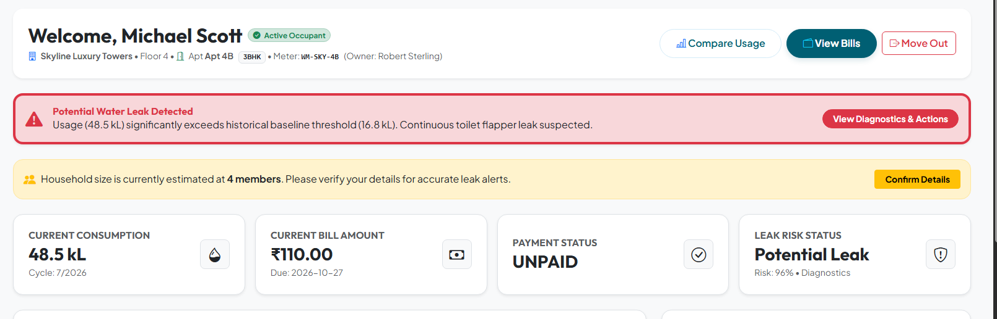
Explainable Alerts: Reason Codes & Severity
SEVERITY LEVELS
LOW
MEDIUM
HIGH
CRITICAL
Residents see why an alert fired, not just that it fired
ABNORMAL_SPIKE_FOR_HOUSEHOLD_SIZE
Usage far above what the declared household size explains (e.g. 48.5 kL vs 16.8 kL upper ceiling threshold for 4 members).
UNEXPLAINED_AWAY_CONSUMPTION
Significant water consumption detected while flat occupancy is marked as vacant or resident logged an active vacation period.
AQATRAC | Web-Based Water Billing & Leak Management
19

Slide 2
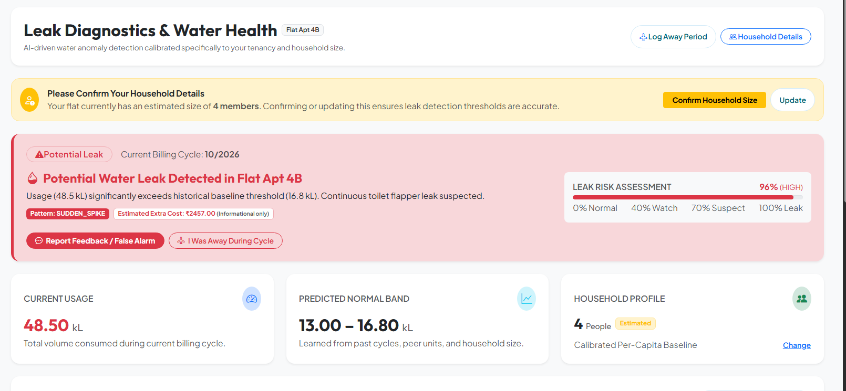
Leak Diagnostics: Risk Assessment & Feedback Actions
Residents inspect calibrated risk bands, estimated extra costs, and log feedback for AI model retraining
AQATRAC | Web-Based Water Billing & Leak Management
20

