Slide 1
Project Presentation — ideal_chatlify
NAMES AND ADM
1 PHINEAS NDUNGU PA106/G/17490/22
2 Bonface mamboleo ondieki PA106/G/15339/21
3 Polycarp Sally PA106/G/17443/22
4 mark njogu PA106/G/17469/22
5 Eric mue. Pa106/g/17479/22
6 Ngahu ALICE PA106/G/17580/22
7 BRADIL MUKHWANA – PA106/G/17716/22

Slide 2
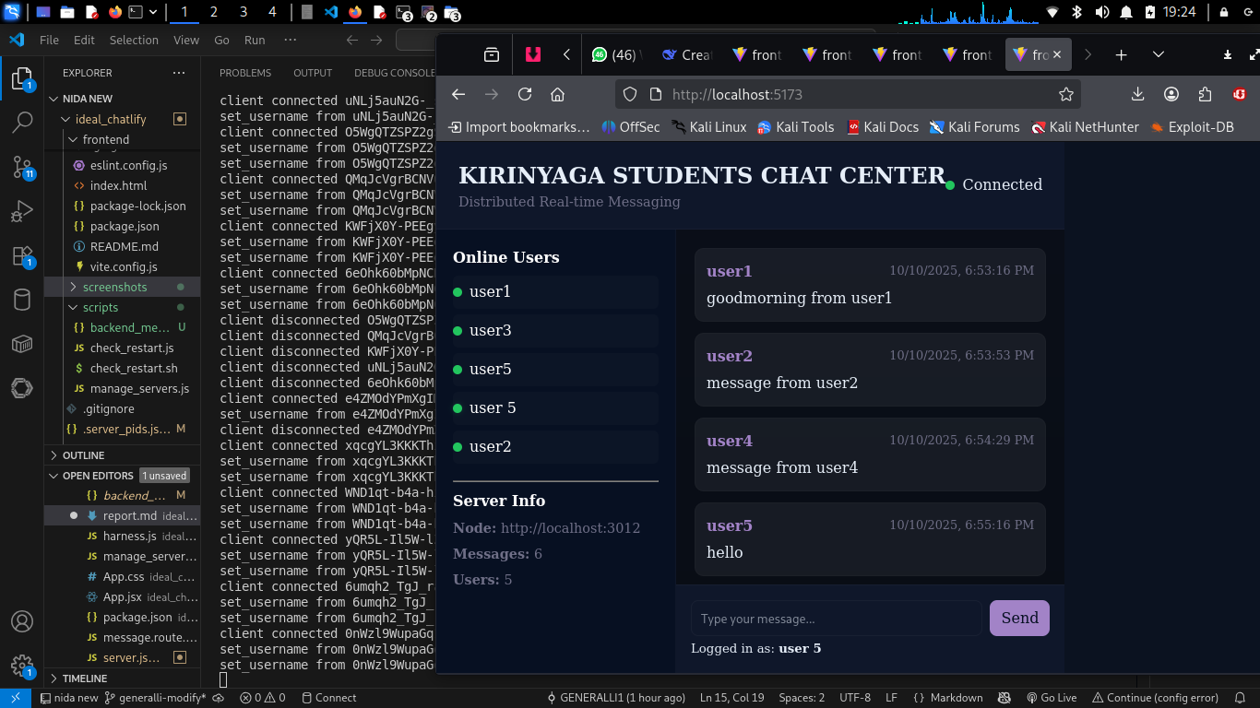
Screenshort

Slide 3
Slide 2 — Motivation & Goals
Demonstrate a simple distributed chat architecture.
Show client failover, message persistence, and multi-node communication.
Keep the design lightweight and educational for a class assignment.

Slide 4
Slide 3 — System overview (architecture)
Three independent backend nodes (Socket.IO servers).
Clients connect to any node; messages are persisted locally and relayed to peers.
Deduplication via message ids on relay; simple REST endpoints for health and users.

Slide 5
Slide 4 — How it works (runtime flow)
Client connects to a randomly-selected node and emits set_username.
Client sends chat_message events that the node persists and broadcasts locally.
Node POSTs message to peers at /internal/relay.
Peers deduplicate by id, persist, and broadcast locally.

Slide 6
Slide 5 — Demo steps (live demo)
Start backend nodes: node scripts/manage_servers.js start.
Start frontend: cd frontend && npm run dev.
Open 2–3 browser windows and join with different names.
Send messages and observe cross-node delivery.
Kill one node: node scripts/manage_servers.js stop (or kill PID) and show reconnect behavior.

Slide 7
Slide 6 — Challenges & Solutions
Message duplication: solved via unique message ids + deduplication.
Process spawning / paths: use process.execPath and resolve script paths relative to the manager script.
Persistence overhead: explained and flagged for improvement.

Slide 8
Slide 7 — Performance & Observations
Local latency: sub-100ms for local dev machine.
Relay overhead proportional to peers; file I/O can be the bottleneck.

Slide 9
Slide 8 — Future improvements
Centralized datastore or message broker (Redis / PostgreSQL).
Stronger ordering guarantees and authentication.
Metrics and monitoring.

Slide 10
Slide 9 — How to reproduce (quick)
Clone repo, install, start manager, run frontend, open browser.
show backend/test/harness.js for simulated clients.

Slide 11
Slide 10 — Questions
Invite feedback and questions from the students

