Slide 1
Descriptive Statistics
The farthest most people ever get

Slide 2
Descriptive Statistics
Descriptive Statistics are Used by Researchers to Report on Populations and Samples
In Sociology:
Summary descriptions of measurements (variables) taken about a group of people
By Summarizing Information, Descriptive Statistics Speed Up and Simplify Comprehension of a Group’s Characteristics

Slide 3
Sample vs. Population
Population
Sample

Slide 4
Descriptive Statistics
An Illustration:
Which Group is Smarter?
Class A--IQs of 13 Students
102 115
128 109
131 89
98 106
140 119
93 97
110
Class B--IQs of 13 Students
127 162
131 103
96 111
80 109
93 87
120 105
109
Each individual may be different. If you try to understand a group by remembering the qualities of each member, you become overwhelmed and fail to understand the group.

Slide 5
Descriptive Statistics
Which group is smarter now?
Class A--Average IQ Class B--Average IQ
110.54 110.23
They’re roughly the same!
With a summary descriptive statistic, it is much easier to answer our question.

Slide 6
Descriptive Statistics
Types of descriptive statistics:
Organize Data
  Tables
  Graphs
Summarize Data
  Central Tendency
  Variation

Slide 7
Descriptive Statistics
Types of descriptive statistics:
Organize Data
  Tables
    Frequency Distributions
    Relative Frequency Distributions
  Graphs
    Bar Chart or Histogram
    Stem and Leaf Plot
    Frequency Polygon

Slide 8
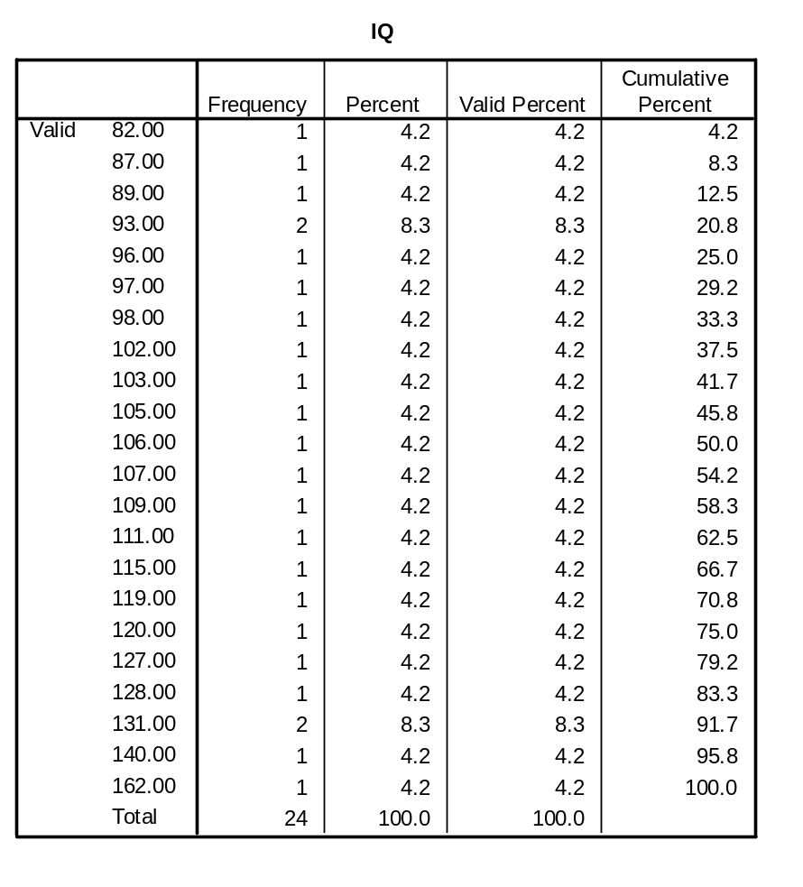
SPSS Output for
Frequency Distribution

Slide 9
Frequency Distribution
Frequency Distribution of IQ for Two Classes
IQ Frequency
82.00 1
87.00 1
89.00 1
93.00 2
96.00 1
97.00 1
98.00 1
102.00 1
103.00 1
105.00 1
106.00 1
107.00 1
109.00 1
111.00 1
115.00 1
119.00 1
120.00 1
127.00 1
128.00 1
131.00 2
140.00 1
162.00 1
Total 24

Slide 10
Relative Frequency Distribution
Relative Frequency Distribution of IQ for Two Classes
IQ Frequency Percent Valid Percent Cumulative Percent
82.00 1 4.2 4.2 4.2
87.00 1 4.2 4.2 8.3
89.00 1 4.2 4.2 12.5
93.00 2 8.3 8.3 20.8
96.00 1 4.2 4.2 25.0
97.00 1 4.2 4.2 29.2
98.00 1 4.2 4.2 33.3
102.00 1 4.2 4.2 37.5
103.00 1 4.2 4.2 41.7
105.00 1 4.2 4.2 45.8
106.00 1 4.2 4.2 50.0
107.00 1 4.2 4.2 54.2
109.00 1 4.2 4.2 58.3
111.00 1 4.2 4.2 62.5
115.00 1 4.2 4.2 66.7
119.00 1 4.2 4.2 70.8
120.00 1 4.2 4.2 75.0
127.00 1 4.2 4.2 79.2
128.00 1 4.2 4.2 83.3
131.00 2 8.3 8.3 91.7
140.00 1 4.2 4.2 95.8
162.00 1 4.2 4.2 100.0
Total 24 100.0 100.0

Slide 11
Grouped Relative Frequency Distribution
Relative Frequency Distribution of IQ for Two Classes
IQ Frequency Percent Cumulative Percent
80 – 89 3 12.5 12.5
90 – 99 5 20.8 33.3
100 – 109 6 25.0 58.3
110 – 119 3 12.5 70.8
120 – 129 3 12.5 83.3
130 – 139 2 8.3 91.6
140 – 149 1 4.2 95.8
150 and over 1 4.2 100.0
Total 24 100.0 100.0

Slide 12
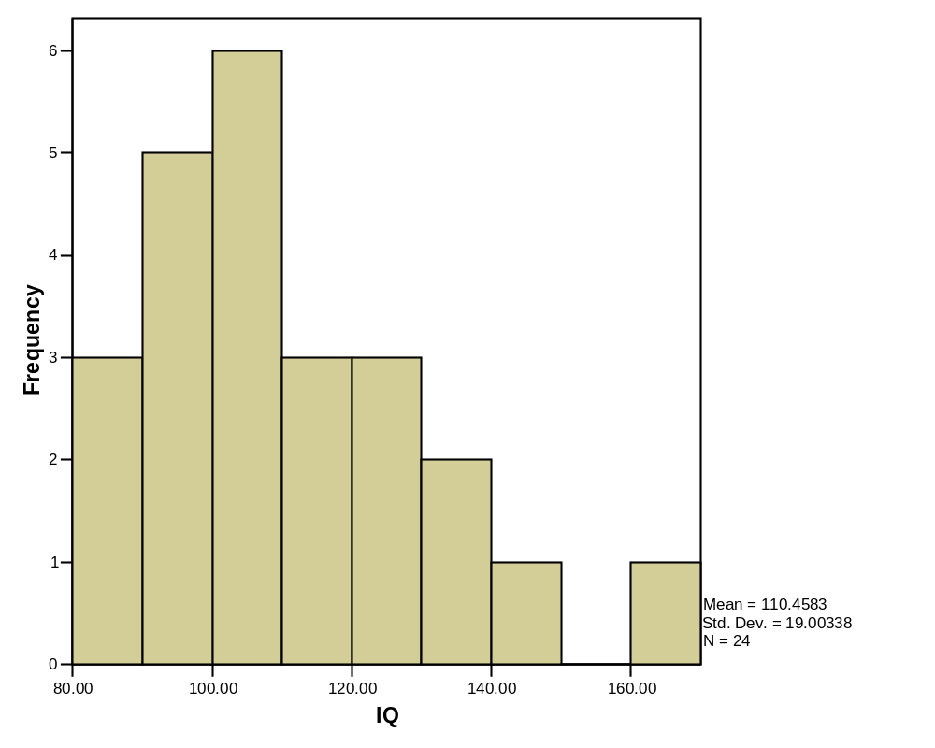
SPSS Output for Histogram

Slide 13
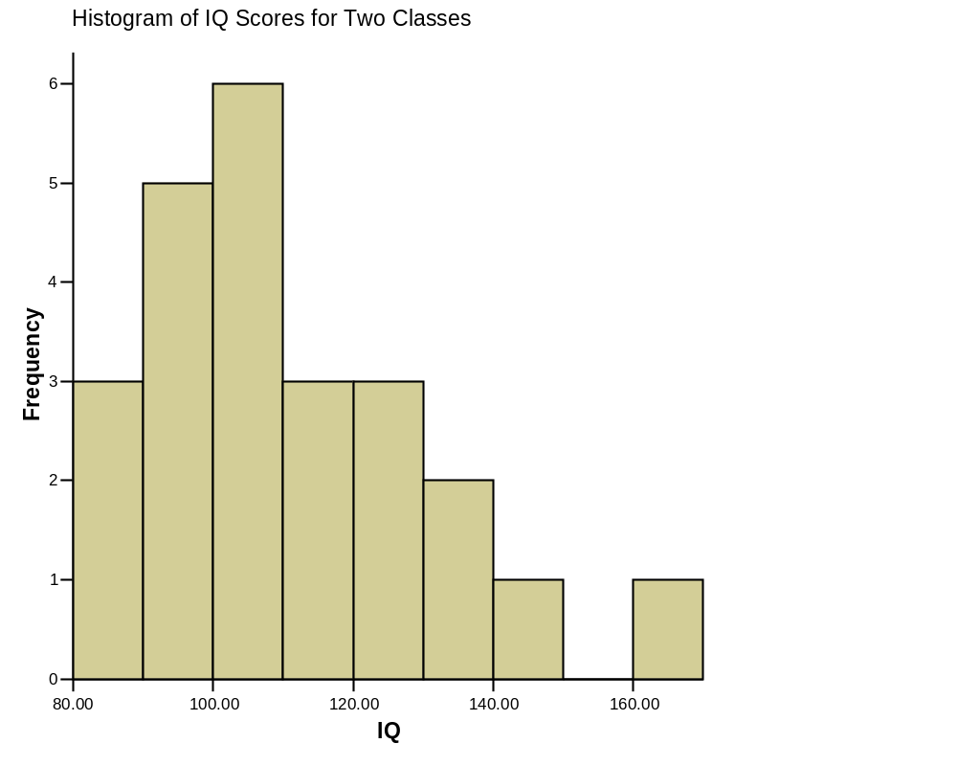
Histogram

Slide 14
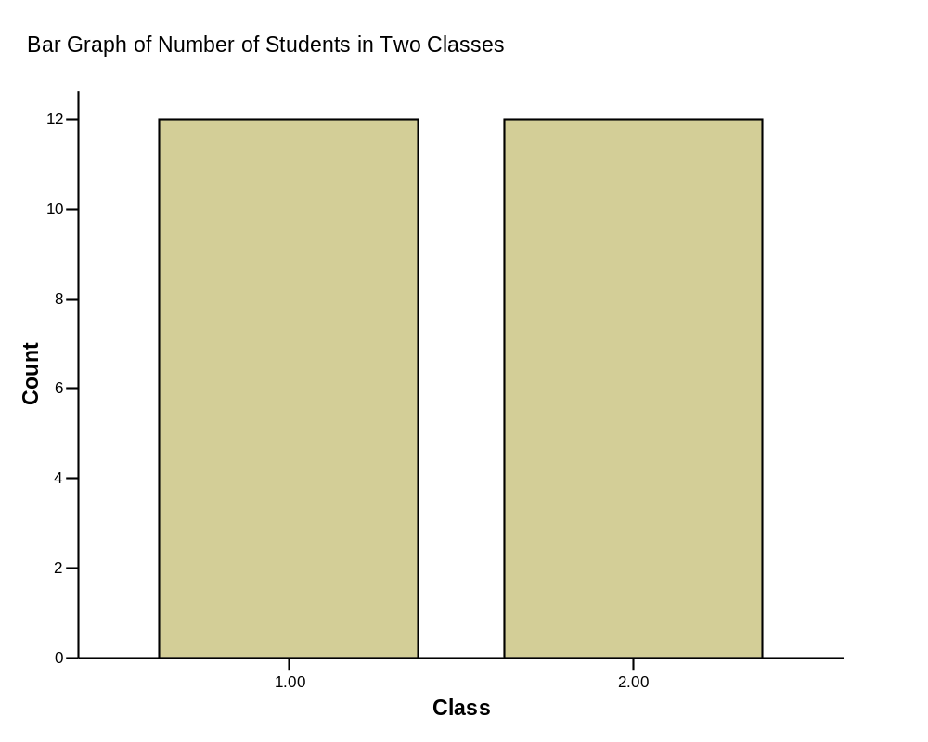
Bar Graph

Slide 15
Stem and Leaf Plot
Stem and Leaf Plot of IQ for Two Classes
Stem Leaf
8 2 7 9
9 3 6 7 8
10 2 3 5 6 7 9
11 1 5 9
12 0 7 8
13 1
14 0
15
16 2
Note: SPSS does not do a good job of producing these.

Slide 16
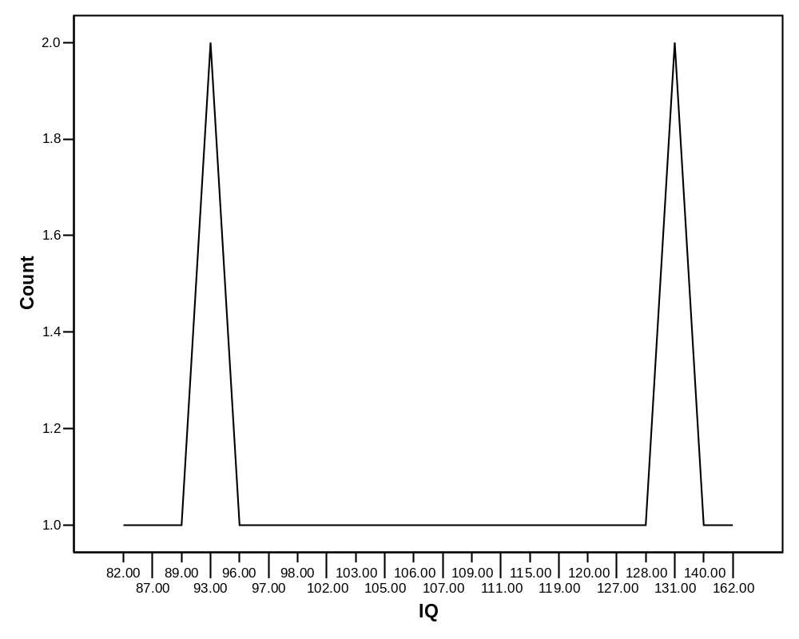
SPSS Output of a Frequency Polygon

Slide 17
Descriptive Statistics
Summarizing Data:
  Central Tendency (or Groups’ “Middle Values”)
    Mean
    Median
    Mode
  Variation (or Summary of Differences Within Groups)
    Range
    Interquartile Range
    Variance
    Standard Deviation

Slide 18
Mean
Most commonly called the “average.”
Add up the values for each case and divide by the total number of cases.
Y-bar = (Y1 + Y2 + . . . + Yn)
n
Y-bar = Σ Yi
n

Slide 19
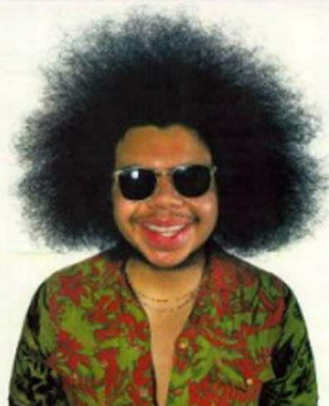
Mean
What’s up with all those symbols, man?
Y-bar = (Y1 + Y2 + . . . + Yn)
n
Y-bar = Σ Yi
n
Some Symbolic Conventions in this Class:
Y = your variable (could be X or Q or ☺ or even “Glitter”)
“-bar” or line over symbol of your variable = mean of that variable
Y1 = first case’s value on variable Y
“. . .” = ellipsis = continue sequentially
Yn = last case’s value on variable Y
n = number of cases in your sample
Σ = Greek letter “sigma” = sum or add up what follows
i = a typical case or each case in the sample (1 through n)

Slide 20
Mean
Class A--IQs of 13 Students
102 115
128 109
131 89
98 106
140 119
93 97
110
Class B--IQs of 13 Students
127 162
131 103
96 111
80 109
93 87
120 105
109
Σ Yi = 1437 Σ Yi = 1433
Y-bar_{A} = Σ Yi = 1437 = 110.54 Y-bar_{B} = Σ Yi = 1433 = 110.23
n 13 n 13

Slide 21
Mean
The mean is the “balance point.”
Each person’s score is like 1 pound placed at the score’s position on a see-saw. Below, on a 200 cm see-saw, the mean equals 110, the place on the see-saw where a fulcrum finds balance:
1 lb at 93 cm
1 lb at 106 cm
1 lb at 131 cm
110 cm
17 units below
21 units above
4 units below
0 units
The scale is balanced because…
17 + 4 on the left = 21 on the right

Slide 22
Mean
Means can be badly affected by outliers (data points with extreme values unlike the rest)
Outliers can make the mean a bad measure of central tendency or common experience
Income in the U.S.
Bill Gates
All of Us
Mean
Outlier

Slide 23
Median
The middle value when a variable’s values are ranked in order; the point that divides a distribution into two equal halves.
When data are listed in order, the median is the point at which 50% of the cases are above and 50% below it.
The 50th percentile.

Slide 24
Median
Class A--IQs of 13 Students
89
93
97
98
102
106
109
110
115
119
128
131 140
Median = 109
(six cases above, six below)

Slide 25
Median
If the first student were to drop out of Class A, there would be a new median:
89
93
97
98
102
106
109
110
115
119
128
131
140
Median = 109.5
109 + 110 = 219/2 = 109.5
(six cases above, six below)

Slide 26
Median
The median is unaffected by outliers, making it a better measure of central tendency, better describing the “typical person” than the mean when data are skewed.
All of Us
Bill Gates
outlier

Slide 27
Median
If the recorded values for a variable form a symmetric distribution, the median and mean are identical.
In skewed data, the mean lies further toward the skew than the median.
Symmetric
Skewed
Mean
Mean
Median
Median

Slide 28
Median
The middle score or measurement in a set of ranked scores or measurements; the point that divides a distribution into two equal halves.
Data are listed in order—the median is the point at which 50% of the cases are above and 50% below.
The 50th percentile.

Slide 29
Mode
The most common data point is called the mode.
The combined IQ scores for Classes A & B:
80 87 89 93 93 96 97 98 102 103 105 106 109 109 109 110 111 115 119 120
127 128 131 131 140 162
BTW, It is possible to have more than one mode!
A la mode!!

Slide 30
Mode
It may mot be at the center of a distribution.
Data distribution on the right is “bimodal” (even statistics can be open-minded)

Slide 31
Mode
It may give you the most likely experience rather than the “typical” or “central” experience.
In symmetric distributions, the mean, median, and mode are the same.
In skewed data, the mean and median lie further toward the skew than the mode.
Symmetric
Skewed
Mean
Median
Mode
Mode
Median
Mean

Slide 32
Descriptive Statistics
Summarizing Data:
  Central Tendency (or Groups’ “Middle Values”)
    Mean
    Median
    Mode
  Variation (or Summary of Differences Within Groups)
    Range
    Interquartile Range
    Variance
    Standard Deviation

Slide 33
Range
The spread, or the distance, between the lowest and highest values of a variable.
To get the range for a variable, you subtract its lowest value from its highest value.
Class A--IQs of 13 Students
102 115
128 109
131 89
98 106
140 119
93 97
110
Class A Range = 140 - 89 = 51
Class B--IQs of 13 Students
127 162
131 103
96 111
80 109
93 87
120 105
109
Class B Range = 162 - 80 = 82

Slide 34
Interquartile Range
A quartile is the value that marks one of the divisions that breaks a series of values into four equal parts.
The median is a quartile and divides the cases in half.
25th percentile is a quartile that divides the first ¼ of cases from the latter ¾.
75th percentile is a quartile that divides the first ¾ of cases from the latter ¼.
The interquartile range is the distance or range between the 25th percentile and the 75th percentile. Below, what is the interquartile range?
25%
25%
25% of cases
25% of cases
0 250 500 750 1000

Slide 35
Variance
A measure of the spread of the recorded values on a variable. A measure of dispersion.
The larger the variance, the further the individual cases are from the mean.
The smaller the variance, the closer the individual scores are to the mean.
Mean
Mean

Slide 36
Variance
Variance is a number that at first seems complex to calculate.
Calculating variance starts with a “deviation.”
A deviation is the distance away from the mean of a case’s score.
Yi – Y-bar
If the average person’s car costs $20,000, my deviation from the mean is - $14,000!
6K - 20K = -14K

Slide 37
Variance
The deviation of 102 from 110.54 is? Deviation of 115?
Class A--IQs of 13 Students
102 115
128 109
131 89
98 106
140 119
93 97
110
Y-bar_{A} = 110.54

Slide 38
Variance
The deviation of 102 from 110.54 is? Deviation of 115?
102 - 110.54 = -8.54 115 - 110.54 = 4.46
Class A--IQs of 13 Students
102 115
128 109
131 89
98 106
140 119
93 97
110
Y-bar_{A} = 110.54

Slide 39
Variance
We want to add these to get total deviations, but if we were to do that, we would get zero every time. Why?
We need a way to eliminate negative signs.
Squaring the deviations will eliminate negative signs...
A Deviation Squared: (Yi – Y-bar)²
Back to the IQ example,
A deviation squared for 102 is: of 115:
(102 - 110.54)² = (-8.54)² ⁼ 72.93 (115 - 110.54)² = (4.46)² = 19.89

Slide 40
Variance
If you were to add all the squared deviations together, you’d get what we call the
“Sum of Squares.”
Sum of Squares (SS) = Σ (Yi – Y-bar)²
SS = (Y1 – Y-bar)² + (Y2 – Y-bar)² + . . . + (Yn – Y-bar)²

Slide 41
Variance
Class A, sum of squares:
(102 – 110.54)² + (115 – 110.54)² +
(126 – 110.54)² + (109 – 110.54)² +
(131 – 110.54)² + (89 – 110.54)² +
(98 – 110.54)² + (106 – 110.54)² +
(140 – 110.54)² + (119 – 110.54)² +
(93 – 110.54)² + (97 – 110.54)² +
(110 – 110.54) = SS = 2825.39
Class A--IQs of 13 Students
102 115
128 109
131 89
98 106
140 119
93 97
110
Y-bar = 110.54

Slide 42
Variance
The last step…
The approximate average sum of squares is the variance.
SS/N = Variance for a population.
SS/n-1 = Variance for a sample.
Variance = Σ(Yi – Y-bar)² / n – 1

Slide 43

Variance
For Class A, Variance = 2825.39 / n - 1
= 2825.39 / 12 = 235.45
How helpful is that???

Slide 44
Standard Deviation
To convert variance into something of meaning, let’s create standard deviation.
The square root of the variance reveals the average deviation of the observations from the mean.
s.d. = Σ(Yi – Y-bar)²
n - 1

Slide 45
Standard Deviation
For Class A, the standard deviation is:
235.45 = 15.34
The average of persons’ deviation from the mean IQ of 110.54 is 15.34 IQ points.
Review:
1. Deviation
2. Deviation squared
3. Sum of squares
4. Variance
5. Standard deviation

Slide 46
Standard Deviation
Larger s.d. = greater amounts of variation around the mean.
For example:
19 25 31 13 25 37
Y = 25 Y = 25
s.d. = 3 s.d. = 6
s.d. = 0 only when all values are the same (only when you have a constant and not a “variable”)
If you were to “rescale” a variable, the s.d. would change by the same magnitude—if we changed units above so the mean equaled 250, the s.d. on the left would be 30, and on the right, 60
Like the mean, the s.d. will be inflated by an outlier case value.

Slide 47
Standard Deviation
Note about computational formulas:
  Your book provides a useful short-cut formula for computing the variance and standard deviation.
  This is intended to make hand calculations as quick as possible.
  They obscure the conceptual understanding of our statistics.
  SPSS and the computer are “computational formulas” now.

Slide 48
Practical Application for Understanding
Variance and Standard Deviation
Even though we live in a world where we pay real dollars for goods and services (not percentages of income), most American employers issue raises based on percent of salary.
Why do supervisors think the most fair raise is a percentage raise?
Answer: 1) Because higher paid persons win the most money.
2) The easiest thing to do is raise everyone’s salary by a fixed percent.
If your budget went up by 5%, salaries can go up by 5%.
The problem is that the flat percent raise gives unequal increased rewards. . .

Slide 49
Practical Application for Understanding
Variance and Standard Deviation
Acme Toilet Cleaning Services
Salary Pool: $200,000
Incomes:
President: $100K; Manager: 50K; Secretary: 40K; and Toilet Cleaner: 10K
Mean: $50K
Range: $90K
Variance: $1,050,000,000 These can be considered “measures of inequality”
Standard Deviation: $32.4K
Now, let’s apply a 5% raise.

Slide 50
Practical Application for Understanding
Variance and Standard Deviation
After a 5% raise, the pool of money increases by $10K to $210,000
Incomes:
President: $105K; Manager: 52.5K; Secretary: 42K; and Toilet Cleaner: 10.5K
Mean: $52.5K – went up by 5%
Range: $94.5K – went up by 5%
Variance: $1,157,625,000 Measures of Inequality
Standard Deviation: $34K –went up by 5%
The flat percentage raise increased inequality. The top earner got 50% of the new money. The bottom earner got 5% of the new money. Measures of inequality went up by 5%.
Last year’s statistics:
Acme Toilet Cleaning Services annual payroll of $200K
Incomes:
$100K, 50K, 40K, and 10K
Mean: $50K
Range: $90K; Variance: $1,050,000,000; Standard Deviation: $32.4K

Slide 51
Practical Application for Understanding
Variance and Standard Deviation
The flat percentage raise increased inequality. The top earner got 50% of the new money. The bottom earner got 5% of the new money. Inequality increased by 5%.
Since we pay for goods and services in real dollars, not in percentages, there are substantially more new things the top earners can purchase compared with the bottom earner for the rest of their employment years.
Acme Toilet Cleaning Services is giving the earners $5,000, $2,500, $2,000, and $500 more respectively each and every year forever.
What does this mean in terms of compounding raises?
Acme is essentially saying: “Each year we’ll buy you a new TV, in addition to everything else you buy, here’s what you’ll get:”

Slide 52

Practical Application for Understanding
Variance and Standard Deviation
Toilet Cleaner Secretary Manager President
The gap between the rich and poor expands.
This is why some progressive organizations give a percentage raise with a flat increase for lowest wage earners. For example, 5% or $1,000, whichever is greater.

Slide 53
Descriptive Statistics
Summarizing Data:
  Central Tendency (or Groups’ “Middle Values”)
    Mean
    Median
    Mode
  Variation (or Summary of Differences Within Groups)
    Range
    Interquartile Range
    Variance
    Standard Deviation
  …Wait! There’s more

Slide 54
Box-Plots
A way to graphically portray almost all the descriptive statistics at once is the box-plot.
A box-plot shows: Upper and lower quartiles
Mean
Median
Range
Outliers (1.5 IQR)

Slide 55
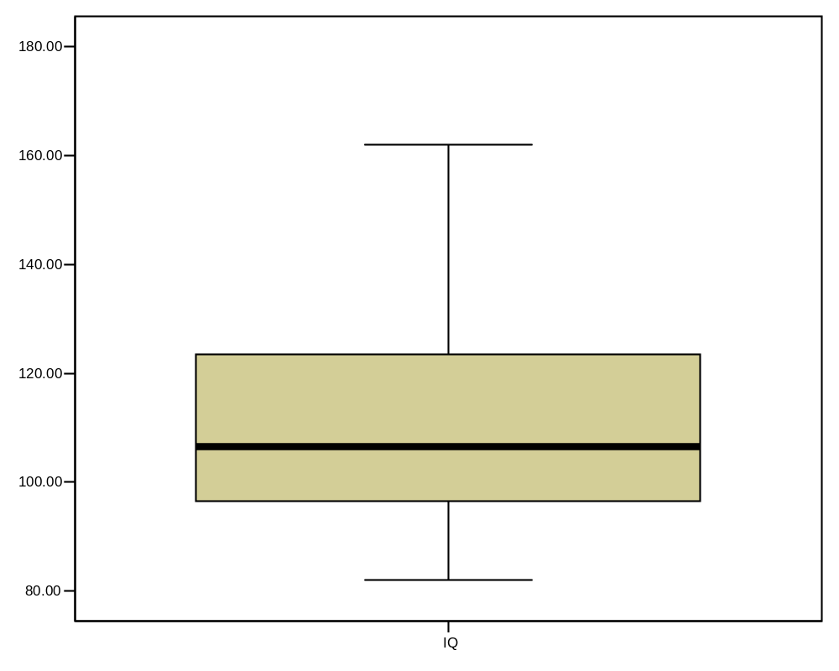
Box-Plots
IQR = 27; There is no outlier.
162
123.5
M=110.5
106.5
96.5
82

Slide 56
IQV—Index of Qualitative Variation
For nominal variables
Statistic for determining the dispersion of cases across categories of a variable.
Ranges from 0 (no dispersion or variety) to 1 (maximum dispersion or variety)
1 refers to even numbers of cases in all categories, NOT that cases are distributed like population proportions
IQV is affected by the number of categories

Slide 57
IQV—Index of Qualitative Variation
To calculate:
K(100² – Σ cat.%²)
IQV = 100²(K – 1)
K=# of categories
Cat.% = percentage in each category

Slide 58
IQV—Index of Qualitative Variation
Problem: Is SJSU more diverse than UC Berkeley?
Solution: Calculate IQV for each campus to determine which is higher.
SJSU: UC Berkeley:
Percent Category Percent Category
00.6 Native American 00.6 Native American
06.1 Black 03.9 Black
39.3 Asian/PI 47.0 Asian/PI
19.5 Latino 13.0 Latino
34.5 White 35.5 White
What can we say before calculating? Which campus is more evenly distributed?
K (100² – Σ cat.%²)
IQV = 100²(K – 1)

Slide 59
IQV—Index of Qualitative Variation
Problem: Is SJSU more diverse than UC Berkeley? YES
Solution: Calculate IQV for each campus to determine which is higher.
SJSU: UC Berkeley:
Percent Category %² Percent Category %²
00.6 Native American 0.36 00.6 Native American 0.36
06.1 Black 37.21 03.9 Black 15.21
39.3 Asian/PI 1544.49 47.0 Asian/PI 2209.00
19.5 Latino 380.25 13.0 Latino 169.00
34.5 White 1190.25 35.5 White 1260.25
K = 5 Σ cat.%² = 3152.56 k = 5 Σ cat.%² = 3653.82
100² = 10000
K (100² – Σ cat.%²)
IQV = 100²(K – 1)
5(10000 – 3152.56) = 34237.2 5(10000 – 3653.82) = 31730.9
10000(5 – 1) = 40000 SJSU IQV = .856 10000(5 – 1) = 40000 UCB IQV =.793

Slide 60

Descriptive Statistics
Now you are qualified use descriptive statistics!
Questions?

