Slide 1
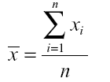
1.Descriptive statistics
A) Measures of central location of ungrouped data
Arithmetic Mean
Calculate the mean weight of the following
set of data:
5 2 3 2 4 2

Slide 2

Ctd
Geometric mean
What is the geometric mean of 4,8,3,9,17

Slide 3

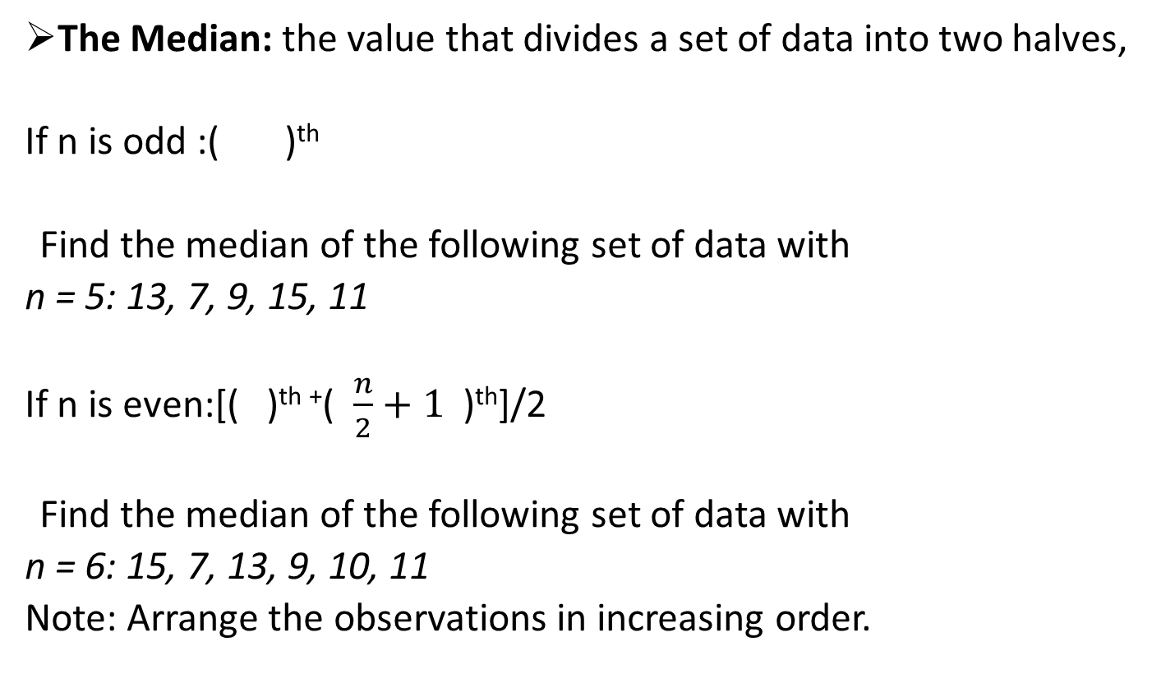
Ctd
The Median: the value that divides a set of data into two halves,
If n is odd :( )^{th}
Find the median of the following set of data with
n = 5: 13, 7, 9, 15, 11
If n is even:[( )^{th +}( $\frac{n}{2}+1$ )^{th}]/2
Find the median of the following set of data with
n = 6: 15, 7, 13, 9, 10, 11
Note: Arrange the observations in increasing order.

Slide 4
Ctd
The Mode
The mode is the value that occurs most often in a set of data.
Find the mode of the following set of data: 29, 31, 24, 29, 30, and 25 days

Slide 5
B) Measures of Dispersion of ungrouped data
The range : the difference between its largest (maximum) and smallest (minimum) values.
Find the minimum value, maximum value, and range of the following data: 29, 31, 24, 29, 30, 25

Slide 6
Ctd
Percentiles: Percentiles divide the data in a distribution into 100 equal parts.
percentile of integer
P=[(np/100)th+(np/100+1)th /2 if np/100] is an integer
Percentile of not an interger
P= (k+1)th if np/100 is not an integer
(where k is the largest integer less than np/100)
Find 80th percentile of the following data
13.3,12.1,5.4, 3.3,7.0,11.9,27.4,16.2,6.1,8.2
Find 65th percentile of the following data
13.3,12.1,5.4, 3.3,7.0,11.9,27.4,16.2,6.1,8.2
N.B : First sort the data in increasing order

Slide 7
Ctd
Quartiles :group data into four equal parts, or quartiles.
Identify the position of the 1st and 3rd quartiles.
position of 1st Quartiles:(n+1)/4
Position of 3 ^{nd} quartiles:3(n+1)/4=3xQ1

Slide 8
Ctd
Identify the value of the 1st and 3rd quartiles.
a. If a quartile lies on an observation , the value of the quartile is the value of that observation.

Slide 9
Ctd
b. - If a quartile lies between observations, the value of the quartile is the value of the lower observation plus the specified fraction of the difference between the observations.
- For example, if the position of a quartile is 20¼, it lies between the 20th and 21st observations, and its value is the value of the 20th observation, plus ¼ the difference between the value of the 20th and 21st observations.

Slide 10
Ctd
Find Q1,Q2,Q3 of the following set of data:
10, 12, 11,3, 49, 12, 5, 18, 16, 8, 9, 18, 9, 22, 13, 10, 27, 10,, 12, 5, 2, 7, 14, 10, 9, 6, 19, 10, 0, 4

Slide 11
Ctd
0, 2, 3, 4, 5, 5, 6, 7, 8, 9, 9, 9, 10, 10, 10, 10, 10, 11, 12, 12, 12, 13, 14, 16, 18, 18, 19, 22, 27, 49
Position of Q1= (n + 1) / 4 =(30 + 1) / 4 = 7.75
Position of Q3=3(n +1)/4 =3(30 + 1)/4 = 23.25
Value of the 7th observation: 6
Value of the 8th observation: 7
Q1 = 6 + ¾(7 − 6) = 6 + ¾(1) = 6.75
Value of the 23rd observation: 14
Value of the 24th observation: 16
Q3 =14 + ¼(16 −14) =14 + ¼(2) =14 + 2/4) = 14.5

Slide 12
ctd
Interquartile range:
It represents the central portion of the distribution, from the 25th percentile to the 75th percentile.

Slide 13
Ctd
IQR Rule for Outliers
Q1-(1.5IQR) ; Q3+(1.5IQR) Anything outside this range is an outlier.

Slide 14
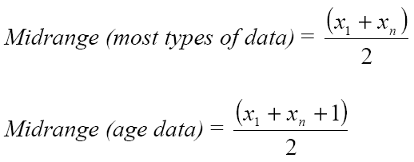
Midrange
X1= Minimum
Xn =Maximum

Slide 15
Ctd
Find the midrange of the five non-age of the following set of data:
0, 4, 4, 4, 5, 5, 5, 6, 6, 6, 10
Find the midrange of the age group 15–24 years.

Slide 16


Ctd
Variance and standard deviation
The variance and standard deviation are measures of the deviation or dispersion of observations around the mean of a distribution.

Slide 17
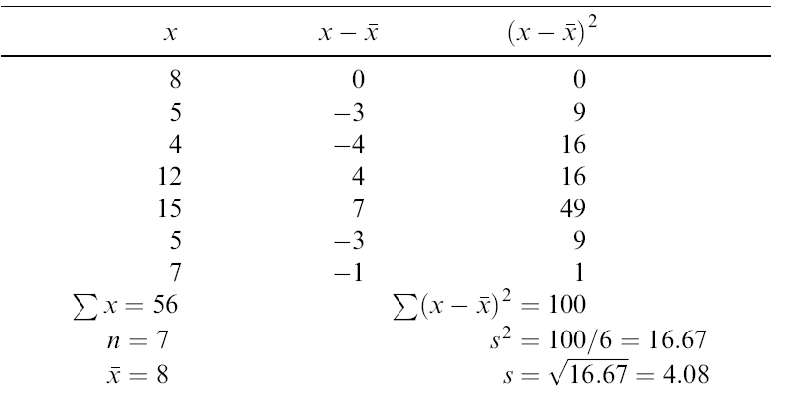

Slide 18
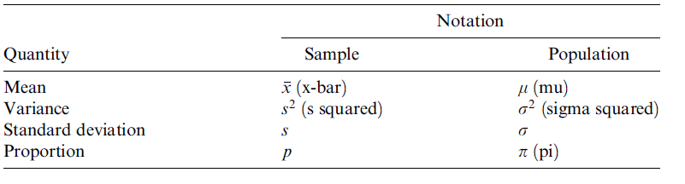
Ctd

Slide 19

The Coefficient of Variation
comparing the variability of several different samples
Age of first sexe
Male Female
12 11 22 33 16 21 16 19 33 19

Slide 20
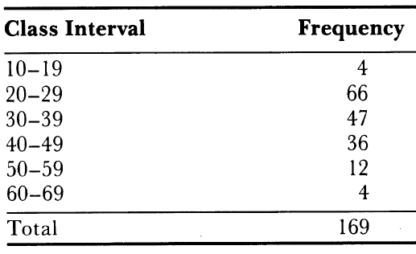
C. Measures of central tendency & variability of grouped data
Mode
Calculate the mode of following set of grouped data

Slide 21
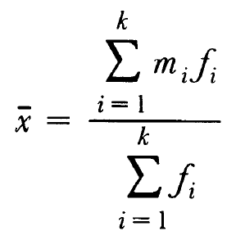
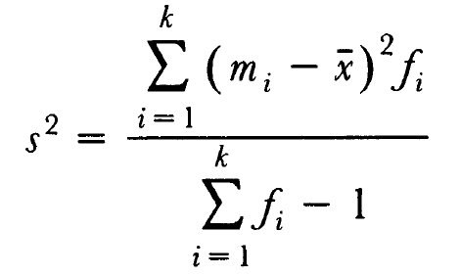

Mean and standard deviation of grouped data

Slide 22
Ctd
Calculate the mean of the following set of grouped data:
Class interval frequency Class midpoint fm
20-30 6 25 150
30-40 18 35 630
40-50 11 45 495
50-60 11 55 605
60-70 3 65 195
70-80 1 75 75
f=50 2150

Slide 23

Class interval f m fm m- (m- )² f (m- )²
20-30 6 25 150 -18 324 1944
30-40 18 35 630 - 8 64 1152
40-50 11 45 495 2 4 44
50-60 11 55 605 12 144 1584
60-70 3 65 195 22 484 1452
70-80 1 75 75 32 1024 1024
7200

Slide 24
Ctd
D. Grouping and representation of statistical data
Tabulation presentation of data
Graphical presentation of data a)charts displaying frequencies (bar, pie, and Pareto charts, b) charts displaying trends (run and control charts), c) charts displaying distributions histograms), and d) charts displaying associations scatter diagrams).

Slide 25
Ctd
Tabulation presentation of data

Slide 26
N^{O} | VARIABLES | Absolute frequency | Cumulated absolute frequency | relative frequency (%) | Cumulated relative frequency (%)
1. | Solving time | 320 | 320 | 37,9 | 37,9
2. | Information provided | 210 | 530 | 24,9 | 62,8
3. | Received treatment | 92 | 622 | 10,9 | 73,7
4. | Too many formatives | 75 | 697 | 8.9 | 82,6
5. | Time table | 60 | 757 | 7,1 | 89,7
6. | Waiting line time | 53 | 810 | 6,3 | 96
7. | Personnel skill | 18 | 828 | 2,1 | 98,1
8. | Forms missing | 13 | 841 | 1,5 | 99,6
9. | other | 4 | 845 | 0,4 | 100

Slide 27
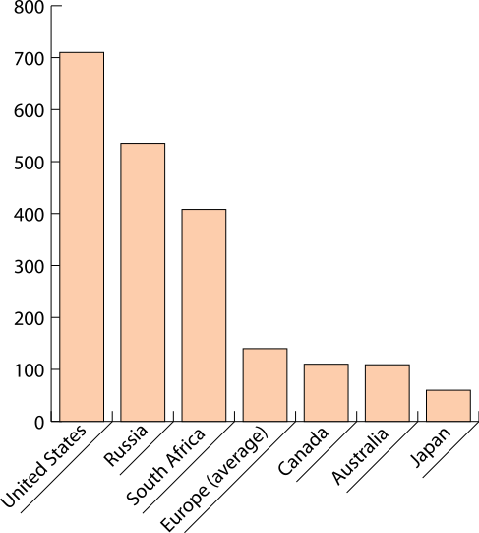
Graphical presentation of data
Bar Chart

Slide 28
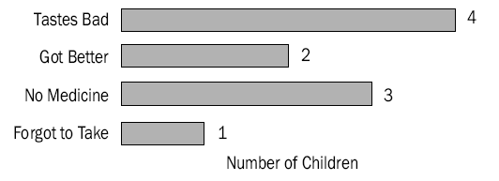
Reason why children did not take madicatinon

Slide 29
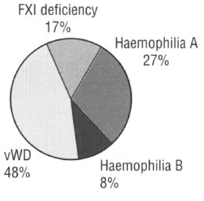
Pie chart

Slide 30
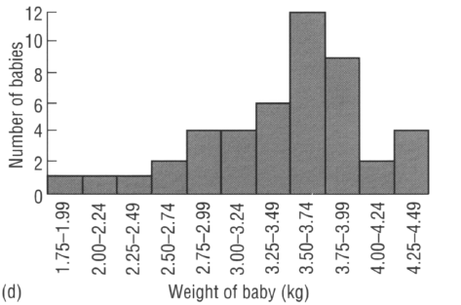
Histograms

Slide 31
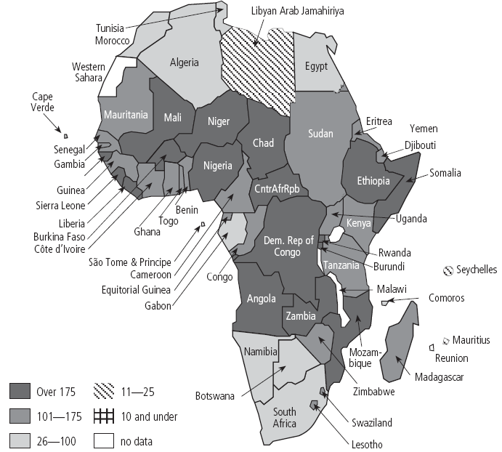
Maps
Under-five mortality per 1000 in africa,2000

Slide 32
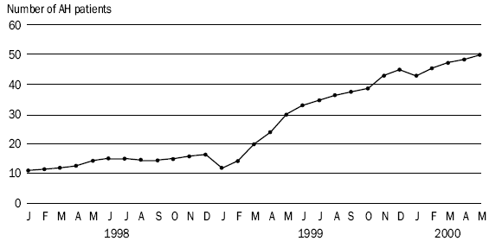
line chart

Slide 33
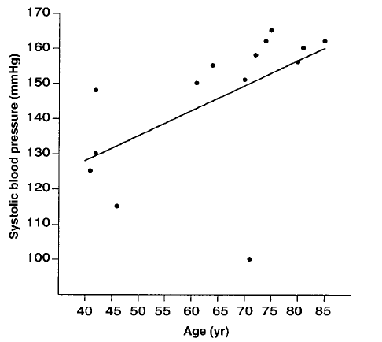
scatter diagram

Slide 34
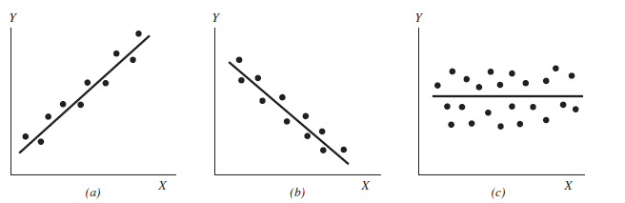

Slide 35
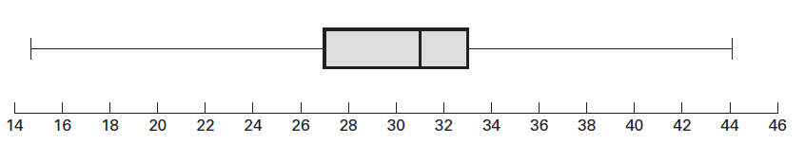
Box-and-whisker plot

Slide 36
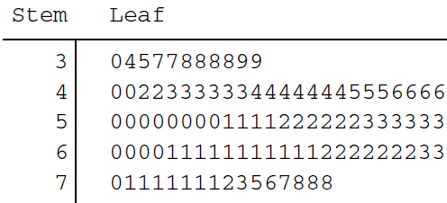

Slide 37
E. Normality
Look at mean and median
Histogram/eyeballing:

Slide 38
Look at the mean and median
variable 1 variable 2
mean 100 130
median 101 100
sd 20 25
Variable 1 normally distributed: mean = median
Variable 2 not normally distributed: mean not equal to median

Slide 40
Properties
It is bell shaped
It has symmetry around the mean
The mean, median and mode are equal
68%(two-thirds ) fall within 1SD of the mean
95% are found within 2 SD of the mean
98% are found within 3 SD of the mean

Slide 41
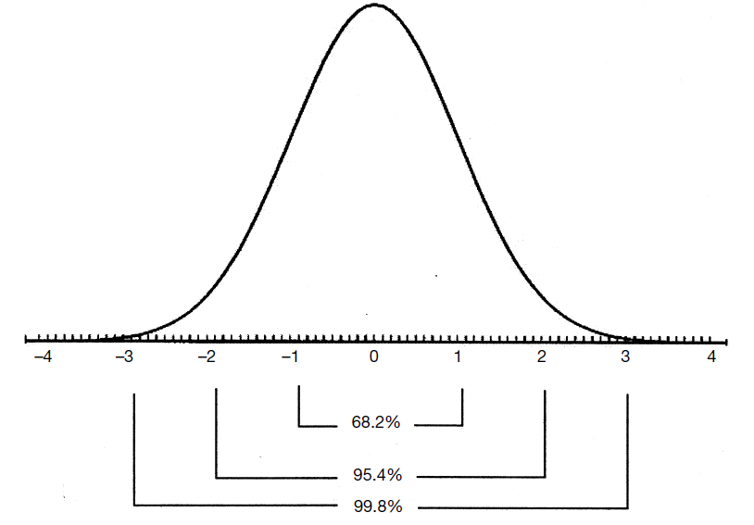

Slide 42
In a study at the university, the mean systolic blood pressure of 250 students was 116 mm Hg, with a standard deviation of 4mm Hg.
From the data,99% of the students will have the systolic blood pressure (mm Hg) in the range of
a)110-130
b)104-128
c)112-120
d)116-124
e)118-122

Slide 43
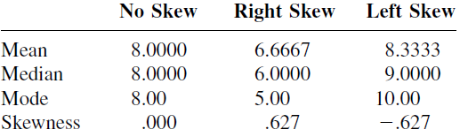

Slide 44
