Slide 1
Recitation 2
Data Analytics (18-787)
Friday 3 February, 2023

Slide 2
Note on recitation slides
Recitation slides are intended to be a guide on how to approach the assignment and not a prescription of exactly what to do
There could be many approaches to any problem
Seek to understand the problem and solve it instead of just trying to reproduce the steps listed in the slides
To avoid overdependence on the slides, start your assignment early!
If you have to choose between a “creative” approach, or following assignment instructions in the PDF, choose to follow PDF instructions always.

Slide 3
Assignment Objectives
Explore and visualize time series data
Investigate variability in time series data over different timescales
Perform statistical measures: mean reversion, stationarity
Evaluate model performance based on benchmarking
Fit ARIMA model

Slide 4
Question 1
Download the WindGeneration.csv file
Generate dates/timestamps
Plot wind generation against the timestamps
Is there any evidence of intra-annual seasonality?
Daily
Weekly
Monthly
Quarterly

Slide 5
Question 2
Calculate the change in wind generation over time as a percentage of the maximum generation.
Plot it against the timestamps
Is there any evidence of seasonality?

Slide 6
Question 3
Ramp function defined as
r(t,d) =100 * [x (t + d) - x(t) ] / max(x)
Calculate the ramps where d=1 for an hourly sampling period
Separate them into positive and negative ramps
Use their absolute values and sort the resulting dataframe
Plot the ramps using a semilogy plot (vertical logarithmic axis)
Plot a normal distribution CDF on the same graph

Slide 7
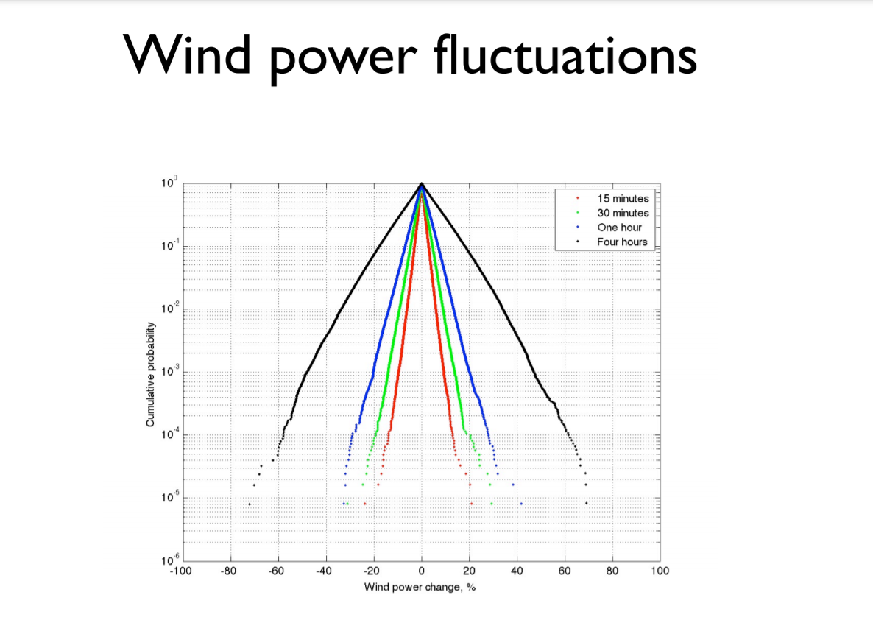

Slide 8
Question 4
Investigate the variability in wind generation over different timescales
Timescales: 1h, 2h, 3h, …., 24h
Use the percentile analysis on the ramps
r(t,d) =100 * [x (t + d) - x(t) ] / max(x)
Iterate over the d param using d=1...24
Compute the percentiles (1%, 5%, 95%, and 99%) for each d
Plot the results
What did you learn?
Python: numpy.percentile() MATLAB: prctile()

Slide 9
Question 5
Calculate the autocorrelation of the wind generation (actual) for 10 days lags
10 days lags = 1hr * 24hr * 10 = 240
Comment on the autocorrelation plot

Slide 10
Question 6
Calculate the autocorrelation of change in wind generation for lags over 10 days
Calculate the change in wind generation
Calculate the autocorrelation with lags of 10 days (240 hours)
Plot the resulting data

Slide 11
Question 6 cont’d
Plot horizontal lines to detect statistically significance values (p<0.05)
Corresponding value can be calculated from the normal distribution
Plot it for every value
Is there any evidence of diurnal seasonality?
Might it be more appropriate to model the change in wind generation than the actual wind generation?

Slide 12
Question 7
The variance ratio test will be used to investigate the structure of the wind generation time series.
MATLAB: vratiotest Python: Arch library, Adfuller from statsmodels
Using the result from the functions above, can the null hypothesis of a random walk be rejected?
Test mean reversion
Is there evidence of either mean-reversion or mean aversion?

Slide 13
Question 8
Test window size using n = [1: 24]
For each n, calculate the simple moving average (SMA)
MATLAB: tsmovavg or equivalent Python: df.rolling()
Calculate the mean absolute error (MAE) between the SMA and the actual wind power.
For which n, do you obtain the minimum MAE?
Is there a simple benchmark that improves on the persistence benchmark?

Slide 14
Question 9
For each forecast horizon n = [1 : 24]
Calculate the persistence of n X_predicted(t) = X(t-n)
Handle missing or NaN values
Calculate the mean absolute error (MAE) between the predicted wind power and the actual wind power
Plot MAE as a percentage of the maximum generation for the persistence benchmark. Hint (X = timescale, Y = max MAE percentage wind generation)

Slide 15
Question 10
Understand an AutoRegressive Integrated Moving Average (ARIMA) model
Find parameters it takes (p, d, q)
Loop through a range of parameters (p and q = [1:4]) to find the optimal parameters
Pass the parameters to the arima model
Fit and return the model estimates
calculate the AIC and BIC from the estimation

Slide 16
Question 10 cont’d
Determine if there is some improvement in the model’s performance (small AIC and BIC are better)
What are the optimal ARIMA model parameters?
Notes:
Bayesian information criterion (BIC) is a criterion for model selection among a finite set of models. It is based, in part, on the likelihood function.
When fitting models, it is possible to increase the likelihood by adding parameters, but doing so may result in overfitting.

Slide 17
Submission Instructions
Submission Instructions
Single Python/MATLAB code file(.ipynb or .m) [Do not Submit checkpoints for .ipynb]
Assignment report(.pdf) - remember to name the file as instructed
Indicate the libraries you have used in your code at the beginning of the report (After the title page)
Data files (as given)
Submission process:
Put code file and data files in a single folder
Name of the folder should be the same as your andrew ID
Zip this folder and attach the zipped file on assignment submission page (CANVAS)
After attaching zipped file, click on "Add Another File" from assignment submission page and attach your report
Submit your assignment

