Slide 1



USER ACCOUNT MANAGEMENT SOLUTION
Node.js, ExpressJS, Postgres, NextJS
NIYOMWUNGERI PARMENIDE ISHIMWE
NIDEDROGBA@GMAIL.COM
07 JUNE 2023
Notes:
REQUIREMENTS: Easy onboarding, performance, scalability, and security.
4 FEATURES: User auth mgt, security features, user profile, account verification
● Ease the onboarding process of new users. ● Highly available and performant application to handle thousands of requests simultaneously. ● Store and manage user data at orders of magnitude of scale. ● Implement best-in-class security features.

Slide 2
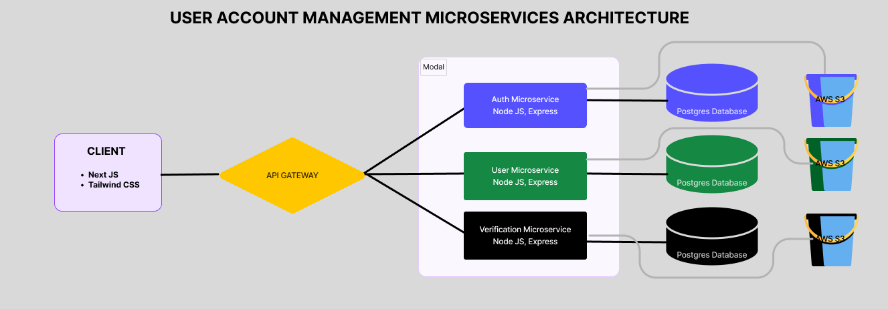
THE ARCHITECTURE
Notes:
Microservices architecture is an approach to building software applications where the application is divided into small, independent services that work together to form the overall system.
In simple terms, it's like breaking down a large application into smaller building blocks.
Each service in an MS architecture is focused on a specific function.
This allows the system to handle increased load and traffic; because each MS can be scaled independently.
Load balancing, caching, using the API gateway

Slide 3

DESIGN PRINCIPLES
Microservices architecture.
JavaScript language.
Relational database.
Cloud-based file storage.
Notes:
MICROSERVICE:
Scalability – each microservice can be scaled horizontally depending on the requirement
Modularity and Flexibility: Breaking down the app into smaller services simplifies scalability, agility, faster development
Fault and fail isolation; Technology diversity: can use different tech for each.
JAVASCRIPT
Versatility: Can now be used on both front and backend via NodeJS.
Client-Side Interactive Uis; Wide Browser Support, Easy to Learn and Use.
Large community: can seek help easily.
Asynchronous Programming: executing tasks concurrently without blocking the main thread.
RELATIONAL DB:
Structured: ensuring data consistency and integrity, specific data types, relationships, and constraints, which can help maintain data quality and prevent data inconsistencies.
ACID (Atomicity, Consistency, Isolation, Durability); Complex Queries and Joins.
CLOUD-BASED STORAGE:
Accessibility from anywhere, security, data backup, cost-effective: pay for what you use.

Slide 4

FRONTEND
Next JS
Tailwind CSS
Axios to interact with the gateway
Notes:
Almost similar to REACT, Fast, of course, I need to learn new concepts
Automatic code splitting: Next.js automatically splits your JavaScript code into smaller chunks, allowing for faster page loads.
Routing: Next.js provides a simple routing system.
Server-side rendering (SSR): (Need for dynamic content) - Next.js allows you to render pages on the server before sending them to the client – Faster loads.
Static site generation (SSG): (For static content) - Next.js supports generating static HTML pages at build time. –Pre-generated and stored on disk or browser.
TAILWIND:
Allows rapid styling; Easily customizable, reusability and responsive UI dev; Easy-to-lean and easy-to-navigate documentation.
AXIOS: HTTP Client for interacting with HTTP server.
Cross-site request forgery (CSRF) protection; Built-in error handling; Simplicity and ease of use.

Slide 5

API GATEWAY
Node JS
Express, …
Routes client requests to the corresponding microservice.
Notes:
API Gateway acts as an entry point for client requests and provides access to backend services or microservices.
Simplified Client Communication;
Load Balancing and Request Routing;
Caching and Performance Optimization;
Security
Logging, Monitoring, and Analytics,
TECHNOLOGIES USED:
Node JS is a Javascript runtime environment that allows running JS on servers:
It is Fast and Lightweight; Rich Package Ecosystem; Community and Support; Asynchronous and Non-blocking I/O
Express Easily handles HTTP requests & methods compared to nodejs. – easy to build and handle RESTful APIs.
Wide Adoption and Active Community; Performance; Minimalistic and Lightweight:
Routing and Middleware: Express.js offers a powerful routing system that allows developers to define routes for different URL endpoints and HTTP methods.
RESTful API Development: Express.js is often used for building RESTful APIs. It provides a simple and intuitive way to define API endpoints, handle request methods (GET, POST, PUT, DELETE, etc.), and perform data validation and manipulation.

Slide 6

AUTH MICROSERVICE
Node JS
Express JS
Sequelize
NodeMailer
JWT authentication
Endpoints for user login, logout, password reset and change, 2FA, ...
Notes:
Auth Microservice:
Decentralized and Independent; Service Reusability; Scalability and Performance; Enhanced Security,
Sequelize: Object-Relational Mapping (ORM) library for Node.js that provides a convenient way to interact with databases.
Object-Oriented Approach: Sequelize maps database tables to JavaScript objects; helps in SQL Query Building and Execution
Migration and Schema Management: manage changes to the DB.
NodeMailer: email-sending library for Node.js applications
Why? Error Handling and Retry Mechanisms; Simplicity and Ease of Use; Multiple Transport Options
JWT authentication: a method for implementing authentication and authorization in web applications.
JWT authentication is stateless, meaning the server does not need to store session information or maintain server-side sessions.
Enhanced Security: JWT tokens are digitally signed using a secret key or public/private key pair, ensuring their integrity and authenticity.

Slide 7

USER MICROSERVICE
Node JS
Express JS
Sequelize
AWS S3
NodeMailer
Multer
Endpoints for user creation, profile management...
Notes:
User Microservice:
Modularity and Separation of Concerns
Decentralized and Independent; Service Reusability; Scalability and Performance; Enhanced Security,
AWS S3: cloud-based object storage service for files.
Scalability; Durability and Reliability; Availability; Security; Cost-Effectiveness; Performance
Multer: middleware for handling file uploads in Node.js applications.
- Easy Integration with NodeJS; Compatibility with Cloud Storage Services; Handling of Form Data and so on.

Slide 8

VERIFICATION MICROSERVICE
Node JS
Express JS
Sequelize
AWS S3
NodeMailer
Multer
Endpoints for user account documents verification, …
Notes:
Verification Microservice:
Decentralized and Independent; Service Reusability; Scalability and Performance; Enhanced Security,

Slide 9

DATA & FILES
Postgres Database
AWS S3 Buckets
Notes:
Postgres: powerful open-source relational database management system (RDBMS)
Performance and Optimization; Reliability and Stability;
Community and Ecosystem
Advanced Features: supports complex queries, joins, subqueries, and advanced indexing mechanisms.
AWS S3: cloud-based object storage service for files.
Scalability; Durability and Reliability; Availability; Security; Cost-Effectiveness; Performance

Slide 10

SECURITY
Password and form validation
Token-based authentication(JWT)
Role-based access
Protected routes
HTTPs usage (SSL/TLS encryption)
Password hashing (bcrypt)
Notes:
Password and form validation: Usage of REGEX(a powerful tool for pattern matching and manipulation of text) - Efficient String Manipulation
Token-based authentication: It’s stateless, meaning the server does not need to store session information or maintain server-side sessions.
Enhanced Security: JWT tokens are digitally signed using a secret key or public/private key pair, ensuring their integrity and authenticity.
Role-based access simplifies access control by organizing permissions based on roles;
Reducing the administrative overhead of managing access rights;
Separation of Duties
Protected routes: Enhanced Security: only authenticated and authorized users can access sensitive or restricted content within an application

Slide 11

TESTING
Testing ensures the quality and reliability of the solution.
Browser Dev tools: UI
Console.log
Postman: Backend APIs
Running the application.
Future: Jest and Mocha for testing individual microservices, the gateway, and the front end.
Notes:
TESTING ensures functionality, identifies bugs and improves quality.
MANUAL TESTING: due to time shortage
Console.log: placed in code to output data to confirm the expected values.
Postman: API dev testing tool, sends requests to backend endpoints to verify responses.
Browser dev tools: inspect network requests; view response payloads; console to quickly see and resolve bugs
Run the app: see visual changes in the UI; simulate user scenarios (right and wrong inputs) to evaluate flaws.
I recognize the importance of automated testing, and I intend to continuously improve in the future, to learn and write tests.

Slide 12

DEMO

Slide 13

END
Q&A

