Slide 1
USER ACCOUNT MANAGEMENT SOLUTION
Node.js, ExpressJS, Postgres, NextJS
Niyomwungeri Parmenide ISHIMWE
nidedrogba@gmail.com
25 May 2023

Slide 2
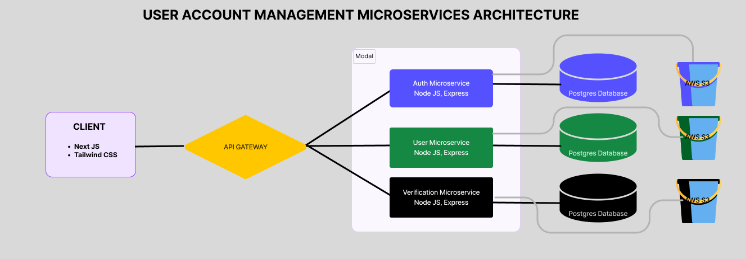
THE ARCHITECTURE

Slide 3

API GATEWAY
Node JS
Express

Slide 4

SECURITY
Password and form validation
Token-based authentication
Role-based access
Protected routes

Slide 5

AUTH MICROSERVICE
Node JS
Express
Sequelize
NodeMailer
Endpoints for user login, logout, and password reset.

Slide 6

USER MICROSERVICE
Node JS
Express
Sequelize
AWS S3
NodeMailer
Endpoints for user creation, profile management...

Slide 7

VERIFICATION MICROSERVICE
Node JS
Express
Sequelize
AWS S3
NodeMailer
Endpoints for user documents verification, …

Slide 8

DATA
POSTGRES DATABASE
AWS S3 BUCKETS

Slide 9

FRONTEND
NextJS
Tailwind css

Slide 10

DESIGN PRINCIPLES
Microservices architecture
Database choice: Postgres
Cloud-based storage: AWS S3

Slide 11

TESTING
Testing ensures the quality and reliability of the solution.
Browser dev tools: UI
Postman: Backend
Future: Jest and Mocha for backend tests.

Slide 12

END
Q&A

