Slide 1


ParkTwin AI
Self-Learning Congestion-Aware Parking Intelligence Digital Twin
12
5
6
Modules Implemented
Novel Innovations
Pipeline Layers
"Which violations matter most, how do they propagate,
where will they strike next — and what should we do about it?"
Notes:
Open with the paradigm: we're not building a detector, we're building a decision intelligence engine. Pause on the tagline.

Slide 2




THE PROBLEM
Poor Visibility on Parking-Induced Congestion
Reactive patrolling
The Question
Officers respond to complaints, not to data-ranked risk.
How can AI-driven parking intelligence detect illegal parking hotspots and quantify their impact on traffic flow to enable targeted enforcement?
No heatmap linkage
Violation logs exist but nothing ties them to actual delay caused.
From counting violations
to measuring their cost
No zone priority
With finite patrols, there is no way to rank 'clear this first.'
Notes:
Emphasize that today's tools count violations. They don't know which violations actually caused congestion. That gap is what ParkTwin AI closes.

Slide 3
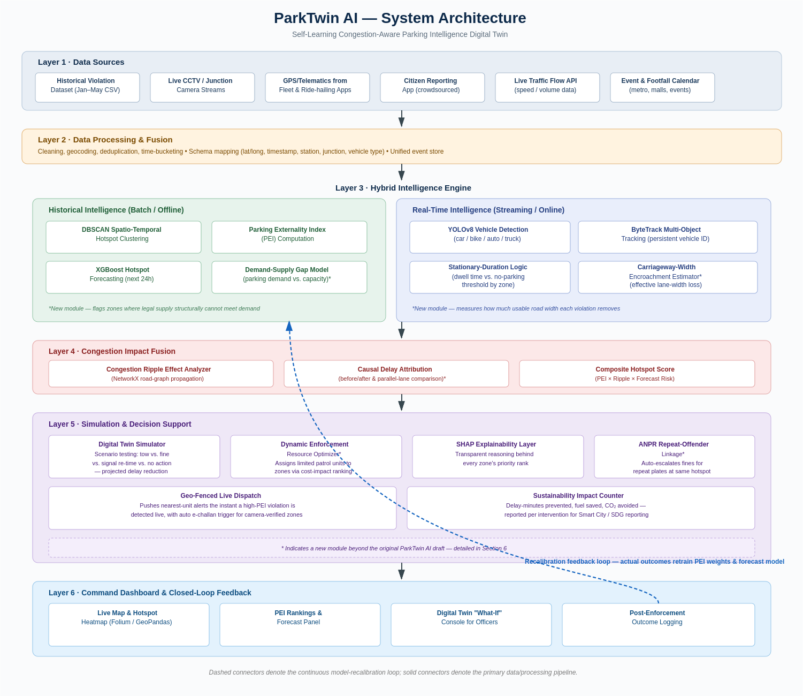
SYSTEM ARCHITECTURE
6-Layer End-to-End Intelligence Pipeline
Notes:
Walk through each layer: Data → Processing → Hybrid Intelligence (historical + real-time in parallel) → Congestion Fusion → Simulation/Decision → Dashboard with feedback loop.

Slide 4


BLUEPRINT vs IMPLEMENTATION
Every designed module is production-implemented
Blueprint Module
Implemented File
Status
Historical Hotspot Intelligence
services/hotspot_service.py
Done
Parking Externality Index (PEI)
services/pei_service.py
Done
Predictive Hotspot Forecasting
services/forecast_service.py
Done
Congestion Ripple Effect Analyzer
services/delay_service.py
Done
Digital Twin Simulator
services/simulation_service.py
Done
SHAP Explainability Layer
services/explainability_service.py
Done
YOLOv8 + ByteTrack Detection
services/detection_service.py
Done
Traffic Memory Engine ★
services/traffic_memory_service.py
Done
Traffic Immunity Score (TIS) ★
services/immunity_service.py
Done
★ Indicates a new innovation beyond the original blueprint — detailed on the next slides
Notes:
Every module that was designed was fully implemented. Highlight the two starred items — Traffic Memory and TIS — as going beyond the original concept.

Slide 5







CORE MODULES
8 Production Modules — Detection → Impact → Prediction → Decision
M1
M2
M3
M4
Historical Hotspot
Intelligence
Real-Time CV
Detection
Parking Externality
Index (PEI)
Predictive Hotspot
Forecasting
DBSCAN spatial clustering
by time-of-day band
YOLOv8 + ByteTrack
stationary-duration logic
5-factor weighted score
normalized 0–100
XGBoost 24-hour risk
timeline forecasting
M5
M6
M7
M8
Congestion Ripple
Analyzer
Digital Twin
Simulator
SHAP Explainability
Layer
Sustainability
Counter
NetworkX 1st & 2nd hop
propagation modeling
Patrol/Tow/Barricade/Fine
what-if scenarios
Tree SHAP waterfall plots
global feature importance
Delay, fuel, CO₂ metrics
per intervention
Notes:
Quick pass over each module. Emphasize that M3 (PEI) and M5 (Ripple) are the core novel contributions from the blueprint.

Slide 6

NOVEL INNOVATIONS
2 New Capabilities Beyond the Blueprint — Exclusive to Implementation
Traffic Memory Engine
Traffic Immunity Score (TIS)
services/traffic_memory_service.py
services/immunity_service.py
• Builds institutional memory from historical interventions
TIS = 0.30×Recovery Speed + 0.25×Intervention
Effectiveness + 0.20×Spillover Resistance
+ 0.15×Recurrence Resistance + 0.10×Sustainability
• Tracks per-junction success rates for Tow / Patrol / Fine / Barricade
• Computes recurrence ratios & average blockage durations
Fragile (0–40)
Prone to immediate gridlocks
• Advises dispatcher: which intervention cleared fastest, historically
Adaptive (41–70)
Sensitive to high-severity events
• Outcome-aware: learns from every resolved violation
Resilient (71–100)
Absorbs disruptions rapidly
Notes:
Traffic Memory and TIS are the two capabilities that went beyond the blueprint. Memory makes it learn from outcomes. TIS quantifies resilience — a research-grade metric no other team will have.

Slide 7
10-STEP SMART CITY DEMO
Autoplay Story Mode — Judge-Ready Walkthrough
1
2
3
4
5
Live CV Detection
DBSCAN Hotspot Map
PEI Severity Scoring
XGBoost Risk Forecast
AI Commander Rec.
6
7
8
9
10
Traffic Memory Profile
Digital Twin Simulation
Traffic Immunity (TIS)
Sustainability Analytics
Executive PDF Briefing
Notes:
This 10-step autoplay is the judge demo. Walk them through it in under 2 minutes — each step lights up as you proceed. The finale is an auto-generated executive PDF briefing.

Slide 8
TECH STACK & BACKEND
Production-Grade Pipeline — Tested with 10 Pytest Cases
Vision
YOLOv8 • ByteTrack • OpenCV
REST API Endpoints
Analytics
XGBoost • DBSCAN • SHAP
GET
/api/hotspots
Spatial clusters
Network
NetworkX (ripple propagation)
GET
/api/leaderboard
PEI ranking leaderboard
Backend
FastAPI • SQLite / PostGIS
POST
/api/forecast
XGBoost risk probability
Dashboard
Streamlit • Plotly • Folium
POST
/api/simulate
What-if intervention matrix
Maps/GIS
GeoPandas • Haversine DBSCAN
POST
/api/detect
Live CV tracking output
10 automated Pytest cases validate all models, pipelines, services, and REST APIs
Notes:
The full system has a FastAPI backend, Streamlit frontend, and is covered by 10 Pytest cases. Mention the test suite — it signals production-grade quality to judges.

Slide 9
SCORING MODELS
Parking Externality Index (PEI) × Traffic Immunity Score (TIS)
0 – 40
41 – 70
71 – 100
0 – 40
41 – 70
71 – 100
Moderate
High
Critical
Fragile
Adaptive
Resilient
Notes:
Both metrics share an identical 5-factor structure — which is intentional. PEI measures the burden a violation places on the network. TIS measures how well a node can absorb that burden. Together they define which junctions need intervention and which can self-recover.

Slide 10

COMPETITIVE EDGE
Why ParkTwin AI Wins
Most Other Teams
ParkTwin AI
Detect illegal parking ✓
Detection → impact → prediction
Count violations by area ✓
Novel PEI — 5-factor burden score
Show a heatmap ✓
Causal delay attribution
No causal impact measurement
NetworkX congestion propagation
No network propagation
XGBoost 24-hr forecasting
No institutional memory
Digital Twin what-if simulation
No resilience quantification
Traffic Memory (institutional learning)
No resource optimizer
Traffic Immunity Score (resilience)
Notes:
Close strong: the progression from detection → causal impact → prediction → simulation → institutional memory → resilience scoring is what separates a counting tool from a command intelligence platform.

Slide 11

ParkTwin AI
Transforms illegal parking enforcement from reactive patrolling into
proactive congestion intelligence — combining real-time CV, novel PEI scoring,
causal impact attribution, XGBoost forecasting, digital twin simulation,
and institutional Traffic Memory to prevent congestion before it happens.
12 Modules
6 Pipeline Layers
10 Pytest Cases
FastAPI Backend
10-Step Demo
Notes:
End here. Let the pitch sit. Offer to run the 10-step autoplay demo immediately.

