Slide 1
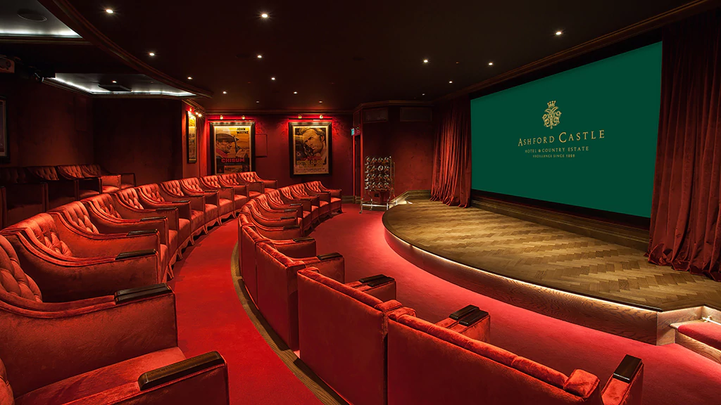

CINECLICK
AN ONLINE MOVIE BOOKING SYSTEM
NIDHEESH PANCHAL
2016UCP1008
VANDITA GOYAL
2016UCP1004
AKSHITA AGRAWAL
2016UCP10023

Slide 2
REQUIREMENTS
Based on a survey of 70 students of MNIT of different years, it was found that 75% of those surveyed depend on online applications for booking movies. 62% felt that the existing applications could be improved or new features added. According to the survey, a majority expect that an online movie booking system should have the following features:
Registration for new users and secure login for existing users.
Various search parameters such as movie name, city, cinema hall, date, time etc.
Seat selection
Secure online payment
Cancellation of a booking
Notifications regarding registration, booking, refund etc.

Slide 3
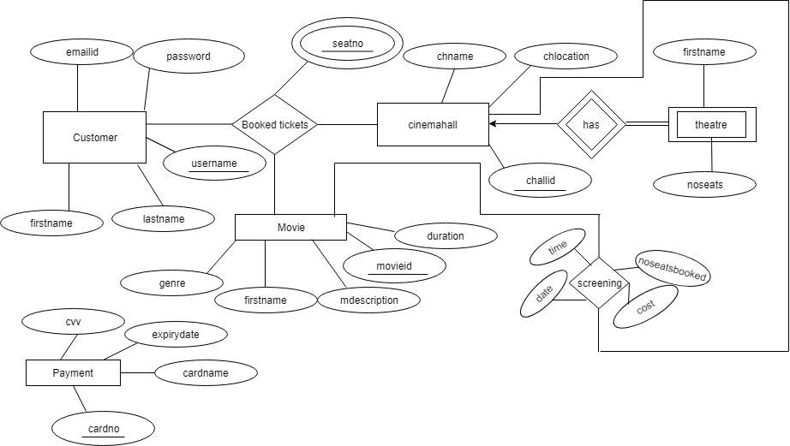
ENTITY RELATIONSHIP DIAGRAM

Slide 4
SCHEMAS
1. Customer (username,password,emailid,firstname,lastname)
Primary key: username
Super keys: username,emailid
Since, all values are atomic, this relation is in 1NF
Since there are no partial functional dependency, this relation is in 2NF
Since there are no transitive functional dependency, this relation is in 3NF
2. Cinemahall (challid,chname,chlocation)
Primary key: challid
Super keys: challid
Since, all values are atomic, this relation is in 1NF
Since there are no partial functional dependency, this relation is in 2NF
Since there are no transitive functional dependency, this relation is in 3NF

Slide 5
3. Theatre (theatreid,challid,noseats)
Primary key: (theatreid,challid)
Super keys: (theatreid,challid)
Since, all values are atomic, this relation is in 1NF
Since there are no partial functional dependency, this relation is in 2NF
Since there are no transitive functional dependency, this relation is in 3NF
4. Movie (movieid,mname,mdescription,genre,duration)
Primary key: movieid
Super keys: movieid, mname
Since, all values are atomic, this relation is in 1NF
Since there are no partial functional dependency, this relation is in 2NF
Since there are no transitive functional dependency, this relation is in 3NF

Slide 6
5. Screening (movieid, theatreid,challid,time,date,noseatbooked,cost)
Primary key: (theatreid,challid,time,date)
Super keys: (theatreid,challid,time,date),((theatreid,challid,time,date,movieid)...
Since, all values are atomic, this relation is in 1NF
Since there are no partial functional dependency, this relation is in 2NF
Since there are no transitive functional dependency, this relation is in 3NF
6. Ticket (username, theatreid,challid,time,date,seatno)
Primary key: (theatreid, challid, time, date, seatno)
Super keys: (theatreid, challid, time, date, seatno),(theatreid, challid, time, date, username)...
Since, all values are atomic, this relation is in 1NF
Since there are no partial functional dependency, this relation is in 2NF
Since there are no transitive functional dependency, this relation is in 3NF
7. Payment (cardno, cvv, cardname, expirydate)
Primary key: cardno
Super keys: cardno
Since, all values are atomic, this relation is in 1NF
Since there are no partial functional dependency, this relation is in 2NF
Since there are no transitive functional dependency, this relation is in 3NF

Slide 7
FEATURES IMPLEMENTED
CineClick provides a fast and easy method to search for and book the latest movies across a network of cities in India. Catch Bollywood and Hollywood blockbusters as well as the finest of local cinema without waiting in lines! Booking on CineClick also gets you the seat of your choice so that you can fully enjoy all the onscreen action. CineClick provides the following features:
Password protected accounts for users(with forgot password option)
Main page featuring currently running movies with genre and description.
Quick and user friendly booking(multiple bookings are allowed)
Previous and upcoming bookings for a user
Easy cancellation up to 3 hours before a movie starts
Easy seat selection and secure payment(using dummy database)
A unique alert feature that informs the user if there is a clash in his/her movie bookings.
Email notifications regarding booking confirmation, refund status, clash in movie bookings etc.

Slide 8
SOFTWARE USED FOR DEVELOPMENT
Database Server: MySQL
Development End: Java GUI
Tool for Databse: SQL Workbench
Tool for Java GUI: NetBeans IDE 8.2
SCOPE OF THE SYSTEM
CineClick relies on a user friendly and simple interface that users can adapt to easily. As a result, anyone with an Internet Connection, an email address and low level of experience with technology can use this system. As of now, CineClick is available only in certain cities and urban centers. Users should also hold a verified debit or credit card to make bookings.

Slide 9
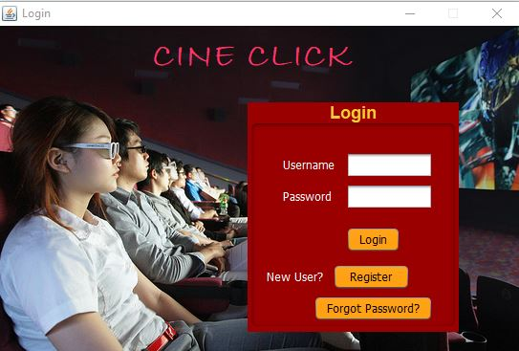
LOGIN PAGE

Slide 10
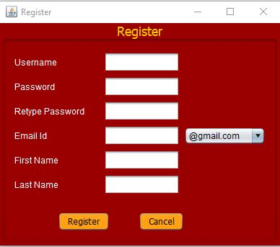
REGISTRATION

Slide 11
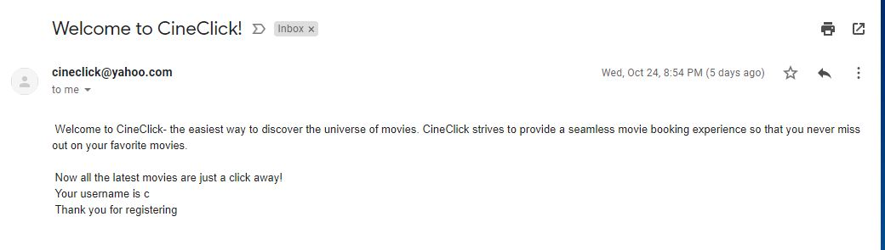
EMAIL NOTIFICATION FOR REGISTRATION

Slide 12
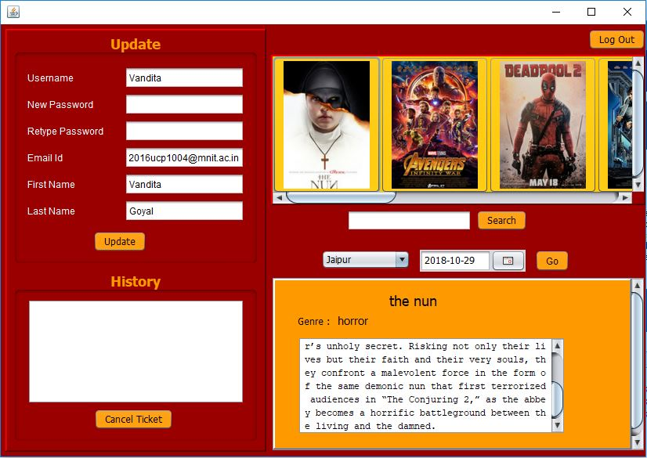
MAIN PAGE

Slide 13
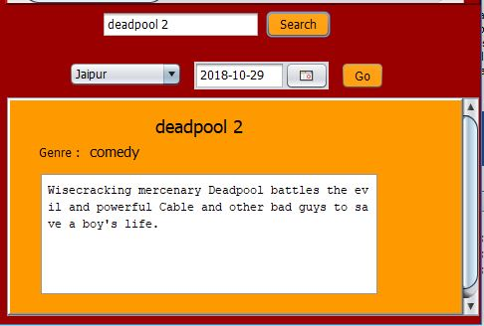
SEARCH FEATURE (BY MOVIE NAME,LOCATION,DATE OR TIME)

Slide 14
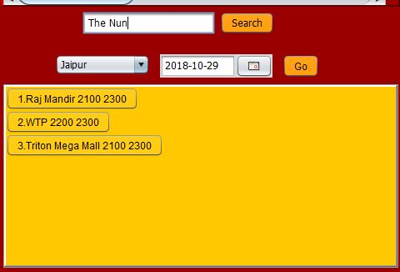
DIFFERENT SCREENINGS FOR A MOVIE

Slide 15
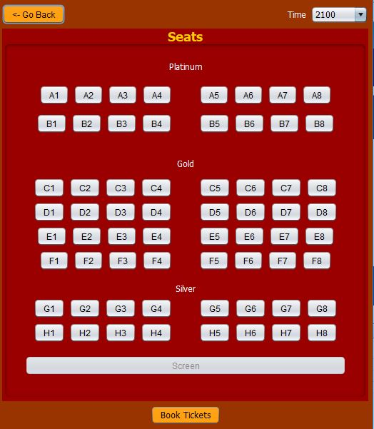
SEAT PANEL AND SELECTION

Slide 16
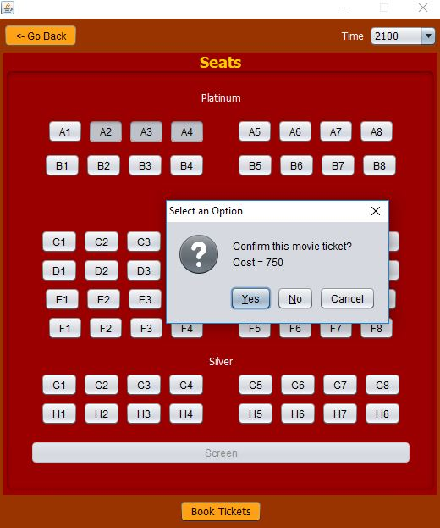

Slide 17
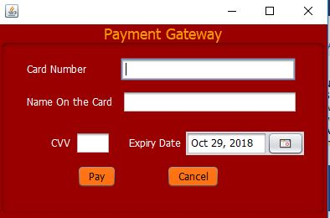
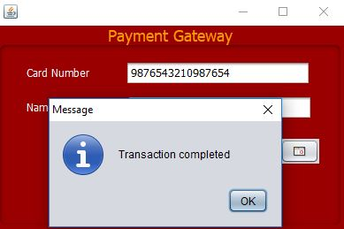
PAYMENT

Slide 18
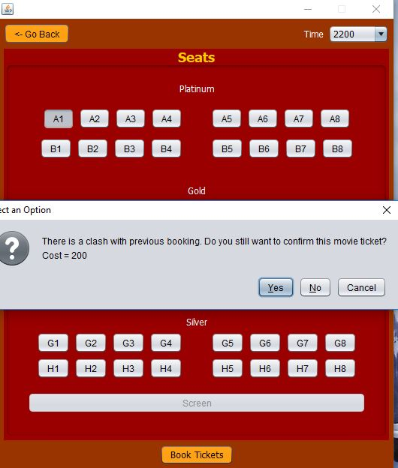
CLASH IN MOVIE BOOKINGS

Slide 19
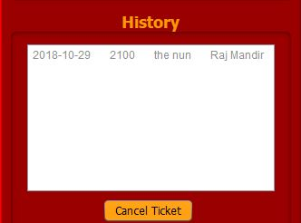
USER HISTORY

Slide 20
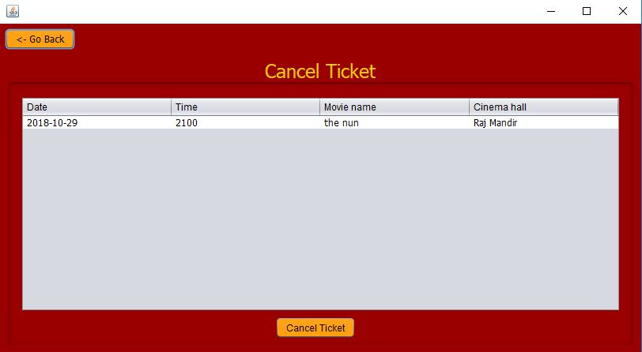
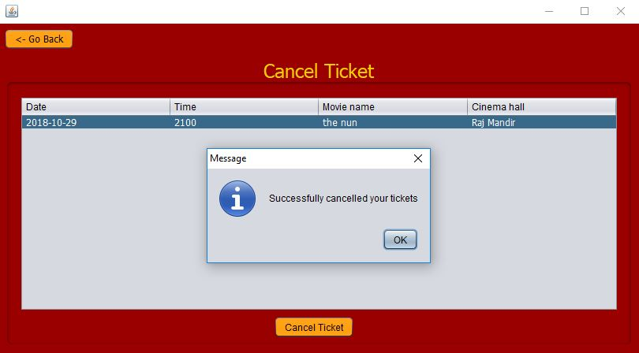
CANCEL TICKET

Slide 21
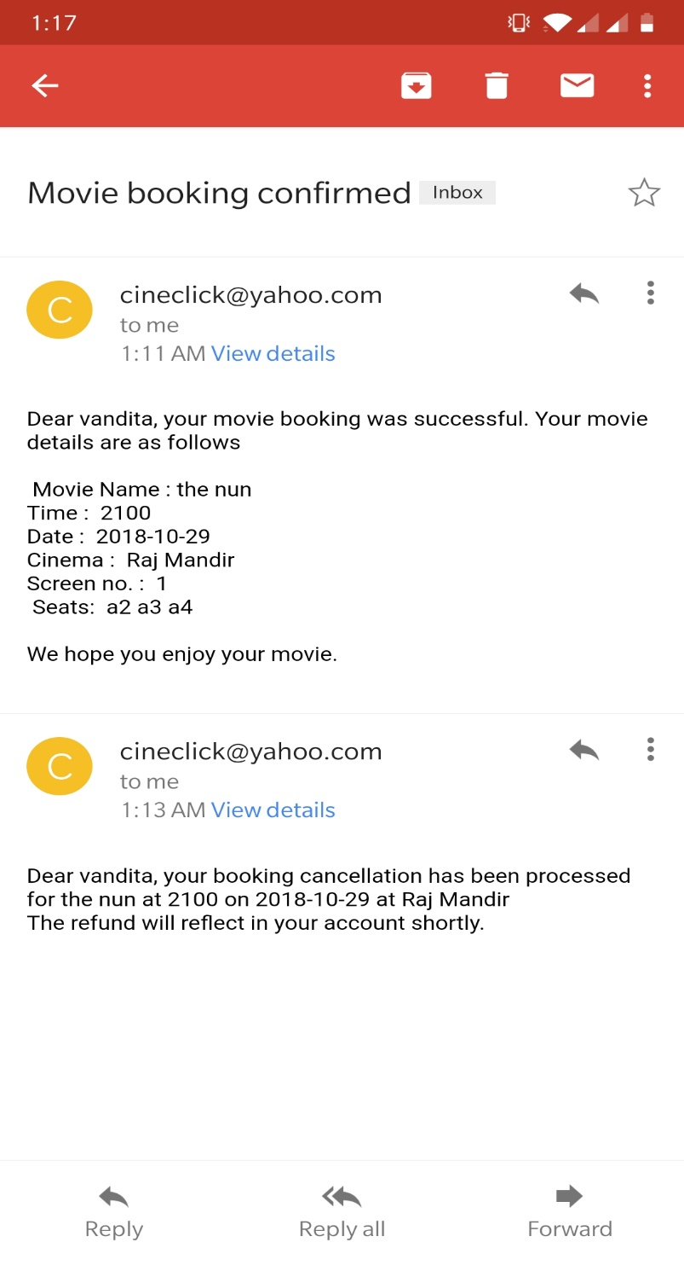
EMAIL NOTIFICATIONS

Slide 22
THE WAY AHEAD IDEAS FOR FUTURE DEVELOPMENT
Integrate a food ordering system for with classic movie snacks as well as local favorites, depending on location selected so that customers can skip long queues at the cinema.
Curate a team of movie critics to rate movies on different parameters and customers can view these reviews before they make a booking.
A special loyalty program that gives members booking discounts as well as other exclusive benefits such as movie premiere screenings.

