Slide 1
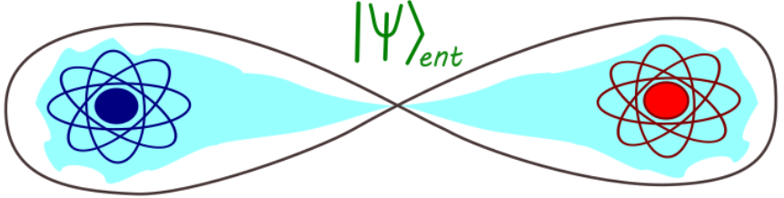
Entanglement and the Speed of Quantum Evolution
Notes:
This paper is the study of connection between entanglement and the speed of quantum evolution under a local Hamiltonian.
Evolution of pure states, mixed states and bosonic and fermionic composite system to a state which could be orthogonal or not orthogonal to the initial state
Entanglement
It’s a very important aspect
A state of a composite quantum system is called “entangled” if it cannot be represented as a mixture of factorizable pure states.
Seperable
Here how entanglement speeds up quantum evolution of states is looked into

Slide 2

Quantum System
Bipartite system where the subsystems are equal and distinguishable.
Two qubits (A,B) which are in 4-D Hilbert space and are evolving under a local Hamiltonian.
Haar Measure is used to generate random quantum states which could be pure or mixed.
Notes:
For numerically simulating quantum states, we consider a bipartite quantum system – It consists of two subsystems which are equal but distinguishable.
So this could a pair of qubits which are entangled and as each qubit is in 2-D space each the entire system is in 4-D Hilbert space and it evolves under a local Hamiltonian of the form.
If the states of the quantum system are uniformly distributed in the space what can we understand from it
Here comes the concept of measure which provides a description for how things are distributed in mathematical space.
One such measure is haar measure which describes how NxN unitary matrices are distributed mathematically in a N dimensional space.
Here the Haar Measure is used to generate random quantum states which could be pure or mixed.
Let us consider pure states and study how the quantum speed limit.
Now the initial state of 2 qubit system can be given as in the computational basis of 0 and 1.

Slide 3





Quantum speed limit for pure states
Entanglement measure quantifies how entangled a quantum states is.
For pure state – Reduced von Neumann entanglement entropy
For mixed state – Concurrence
Both measures are invariant under time evolution.
For pure states an initial state can be given as -
Notes:
Entanglement of all systems are not the same
How do you quantify how entangled the states are – so entanglement measure comes into picture
For pure states the most common entanglement measure is entanglement entropy
for mixed states this measure is not used.
One of the measure used for mixed states is concurrence
So both these measures are invariant under the time evolution determined by the local Hamiltonian
Consider an initial pure state at time t = 0
Now under time evolution the pure state evolves into a state at time = t

Slide 4



Quantum speed limit for pure states
Fidelity measures the closeness of the quantum states.
For pure states the expression becomes –
Now the pure states which were considered to evolve for particular time.
The time required for a state to evolve from F=1 to a state with fidelity F has a lower bound. It depends on the expectation value of energy of the state and its fluctuation.
Notes:
Fidelity determines how two close two quantum states are
The fidelity between two states given by (rho) and (sigma) is given by the expression
For pure states the formula becomes
Thus at the initial state F=1. the value of fidelity is bound between 0 and 1
after time evolution for some time t the fidelity measured with the initial state will have an value of F.

Slide 5
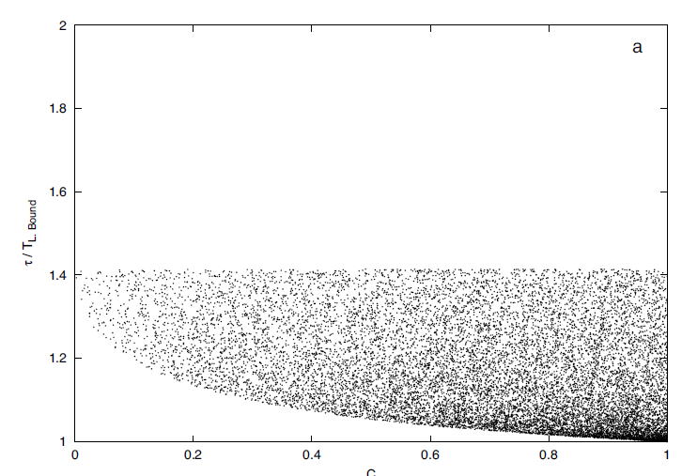
Quantum speed limit for pure states
Information on the speed of evolution is obtained by studying the time evolution of fidelity. And its plotted with the concurrence values of the state as it remains invariant under time evolution.
Pure states evolving from F=1 to an orthogonal states where F = 0

Slide 6
Algorithm
Randomly generate pure states which evolve under the local Hamiltonian.
Obtain its concurrence values which remain invariant under the time evolution.
Then obtain the time τ required for the initial pure states to evolve to an orthogonal state.
Under this process obtain the expectation value of energy for each state and also its fluctuation to calculate the lower bound for the time evolution.
Plot a graph between Concurrence (C) and τ/TL.B

Slide 7


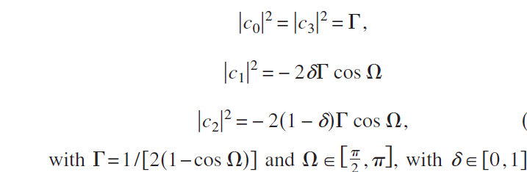
Algorithm
The initial state undergoes time evolution under the local Hamiltonian.
The time interval is measured in the units h/ε
The parametrization considered for the pure states evolving into orthogonal states are -

Slide 8
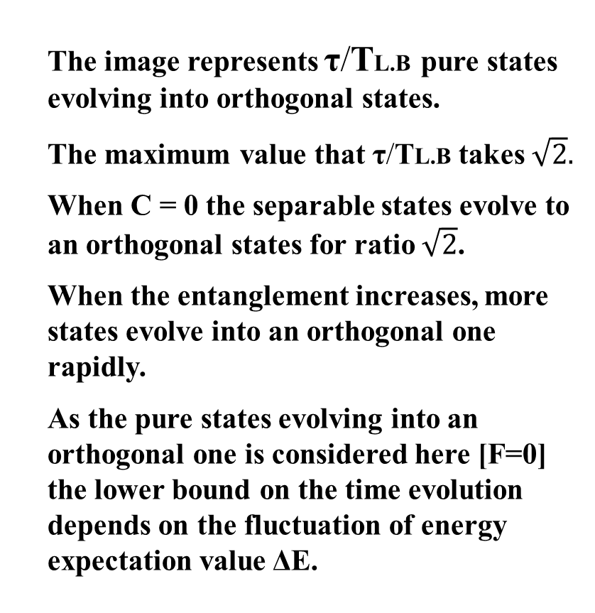
Result
The image represents τ/TL.B pure states evolving into orthogonal states.
The maximum value that τ/TL.B takes $\sqrt{2}.$
When C = 0 the separable states evolve to an orthogonal states for ratio $\sqrt{2}$.
When the entanglement increases, more states evolve into an orthogonal one rapidly.
As the pure states evolving into an orthogonal one is considered here [F=0] the lower bound on the time evolution depends on the fluctuation of energy expectation value ΔE.

Slide 9
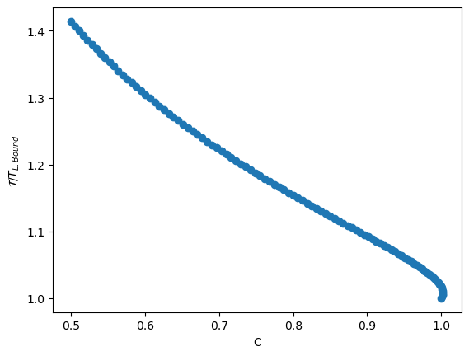
Result

Slide 10
Result
The speed of quantum evolution depends on the value of τ/TL.B.
Thus less the value of τ/TL.B higher the speed of evolution.
Thus more the entanglement higher the speed.

Slide 11
References
A. Borras, M. Casas, A. R. Plastino, and A. Plastino, Phys. Rev.A 74, 022326 (2006).
J. Batle, M. Casas, A. Plastino, and A. R. Plastino, Phys. Rev. A 72, 032337 (2005); 73, 049904(E) (2006).
https://pennylane.ai/qml/demos/tutorial_haar_measure/

