Slide 1
Basic Details of the Team and Problem Statement
PSID: KVH-012
Problem Statement Title: FUND TRAIL ANALYSIS
Team Name: KAVACH CUSTODIANS
Team Leader Name: NIDHI SINHA
Institute Code (AISHE):
Institute Name: DON BOSCO INSTITUTE OF TECHNOLOGY

Slide 2
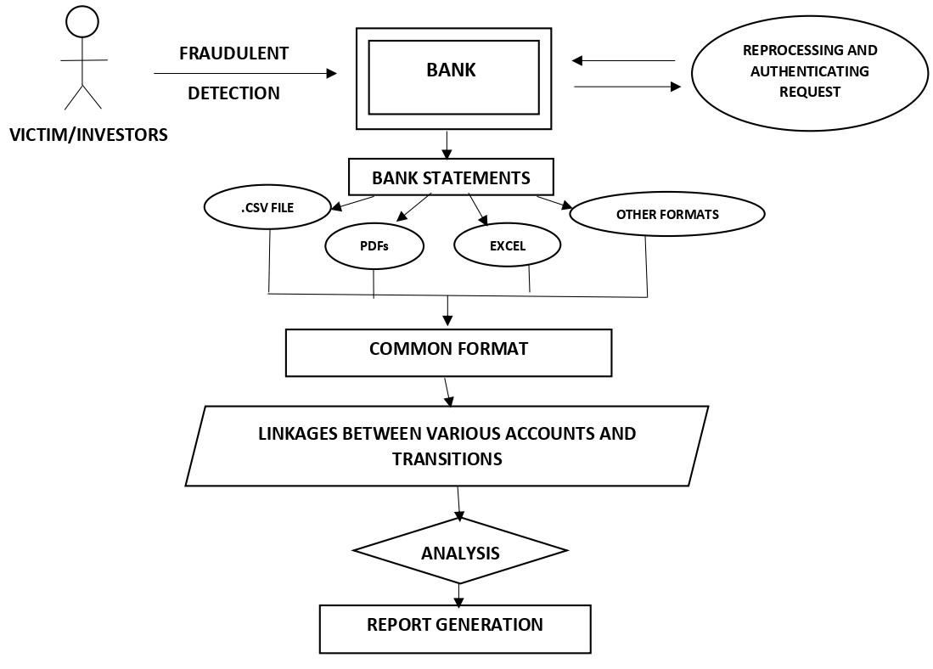
Idea/Approach Details
Describe your idea/Solution/Prototype here:
Our project aims to develop a platform for fund trailing analysis that can detect various forms of illicit financial activities, including money laundering, fraud, terrorist financing, and compliance monitoring. We have developed a model that has been trained on extensive data to enable it to identify patterns and anomalies that may indicate suspicious financial activity.
1. Data collection: To collect financial data, a range of financial records are employed, including bank statements, transaction logs, and other financial records.
2. Data organisation: The data is set up such that trends and connections between transactions are easily observable.
3. Data analysis: The structured data is investigated using a number of methodologies, including data mining and statistical analysis, to uncover patterns and linkages.
4. Pattern recognition: Data analysis reveals trends and connections between transactions that may be used to identify potential fraud or questionable activity.
5. Investigation: After suspicious transactions are found, extra investigation is done to find out where the money came from and what kind of transaction it was.
Describe your Technology stack here:
Web Development(Developing Platform)
App Development(Developing Platform)
Block chain Technology(for high level security)
Database management systems: MySQL,oracle & MongoDB
Data mining & analytics tools: Python
Visualization tools: Tableau & power BI

Slide 3
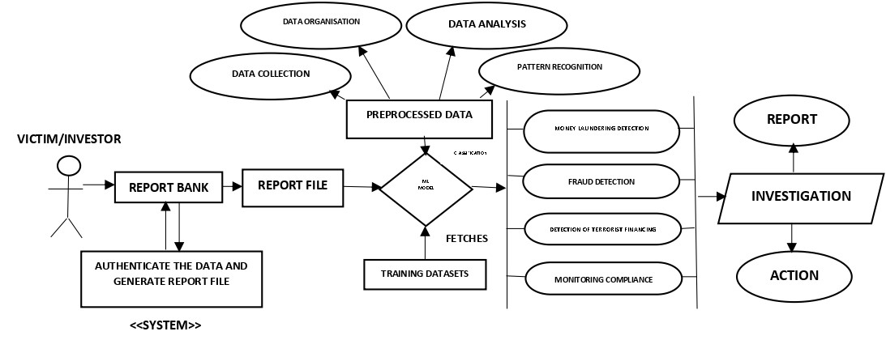
Idea/Approach Details
Describe your Use Cases here
Describe your Dependencies / Show stopper here
Data availability
Data quality
Data processing
Data storage
Compliance regulations
Expertise
Collaboration
Show stopper : our model doesn’t only investigate and seize the malicious detected bank account though it even detects the corresponding resembling accounts and furthermore freeze them till other processions.
BUSSINESS POTENTIAL : It can be implemented with central banking system or national economy controlling system to majorly overdeal with corruption and can abrupt the fund trail to greater extent. Moreover, further it can be scaled to work with high potential security and block chain.
By providing this platform, we hope to help financial institutions and regulatory bodies to better track and identify these illicit activities, reducing the risk of financial crime and enhancing compliance. Our approach could also help to improve the overall transparency and integrity of financial systems, contributing to a more secure and stable economic environment.

Slide 4
Team Member Details
Sr. No. | Name of Team Member | Branch (Btech/Mtech/PhD etc): | Stream (ECE, CSE etc): | Year | Position in team (Team Leader, Front end Developer, Back end Developer, Full Stack, Data base management etc.)
1 | NIDHI SINHA | B.Tech | AI&ML | 3 | Team Leader
2 | SHREYA DAMODAR | B.Tech | AI&ML | 3 | Database management
3 | ESHAN KUSHWAH | B.Tech | CSE | 3 | Back end Developer
4 | HARSH KUMAR TIWARY | B.Tech | AI&ML | 3 | Full Stack
5 | SPARSH BISEN | B.Tech | CSE | 2 | Front end Developer
6 | DYLAN Z FERNANDES | B.Tech | AI&ML | 2 | Full Stack
Team Mentor/s Details
Sr. No. | Name of Mentor | Category (Academic/Industry): | Expertise (AI/ML/Blockchain etc): | Domain Experience (in Years )
1 | DR. ANASUYA NJ | Academic | AI&ML/BLOCK CHAIN | 15
2 | DR. MANU K S | Academic | AI&ML/BLOCK CHAIN | 11

